Slide 1
Correlation Between Infection Rate and Unemployment Rate in Denver, Colorado
Summer Ai

Slide 2
Research Question
How the unemployment rate was impacted by the pandemic in Denver, Colorado
Details to consider:
Is unemployment rate and infection rate correlated?
What is the trend of unemployment rate after months of the outbreak?

Slide 3
Data
COVID-19 data from John Hopkins University: https://www.kaggle.com/antgoldbloom/covid19-data-from-john-hopkins-university?select=RAW_us_confirmed_cases.csv
Mask Mandates data from CDC: https://data.cdc.gov/Policy-Surveillance/U-S-State-and-Territorial-Public-Mask-Mandates-Fro/62d6-pm5i
Unemployment Rate data from U.S. Bureau of Labor Statistics: https://beta.bls.gov/dataViewer/view/timeseries/LAUCN080310000000003

Slide 4
Data Cleaning
Daily case count is smoothed by using 7-day moving average
Daily Infection Rate = Number of Confirmed Cases/Population at Risk, where Population at Risk is defined as Total Population – cumulative confirmed cases

Slide 5
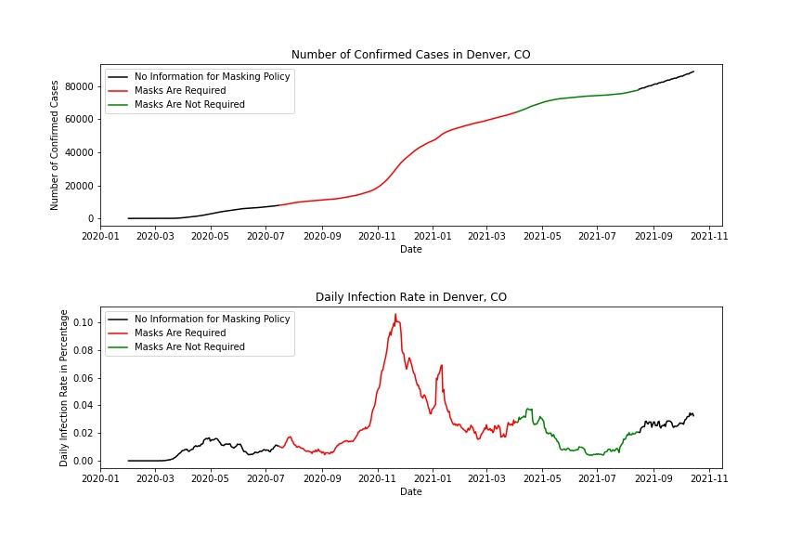
Confirmed Cases & Infection Rate in Denver, CO

Slide 6
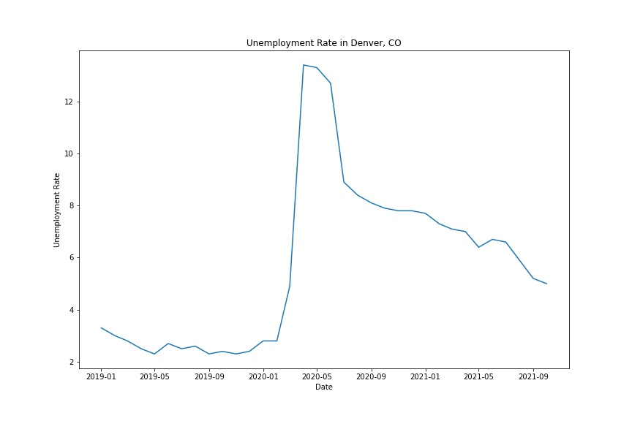
Unemployment Rate in Denver, CO

Slide 7
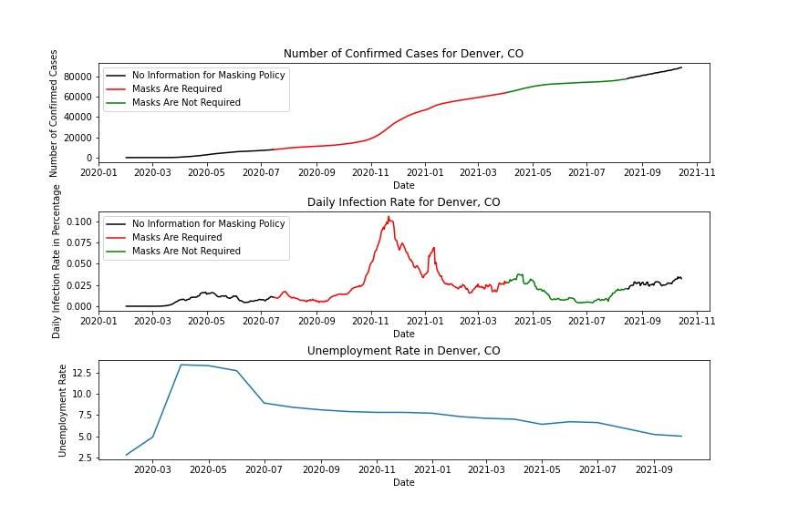
Contrast

Slide 8
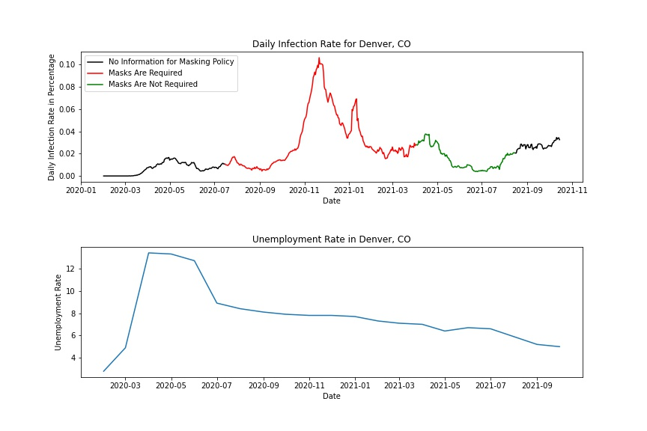
Correlation Between Infection Rate and Unemployment Rate
Pearson r: a number between -1 and 1 that measures how two continuous signals co-vary linearly over time
Provides insights about global synchrony rather than dynamics signals
Pearson r = -0.0354, p-value = 0.3773

Slide 9
Time Lagged Cross Correlation
Provide insights about dynamic signals
Repetitively calculate correlation between two time series, with one time series constantly shifting
Determine if two time series synchronize over time by creating time offsets

Slide 10
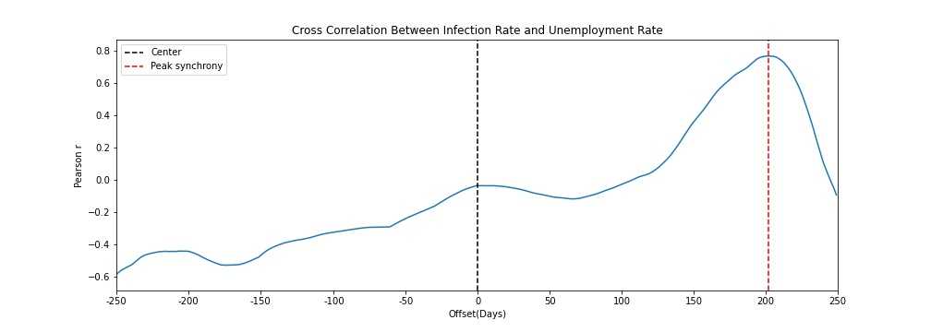
Cross Correlation Visualization

Slide 11
Contrast
Peak synchrony: 203 days
No evidence support a strong correlation

Slide 12
Conclusion
There is no evidence to suggest a strong correlation between infection rate and unemployment rate in Denver, Colorado
The spike in unemployment rate in the beginning of the pandemic can be related to other factors
Despite the unemployment rate keeps declining in recent months, it still doesn’t return to pre-pandemic level yet

