Slide 1
Database HD Assignment
Bank of China Database
AI XINXIN 13064050

Slide 2


Bank of China Australia
Head Branch of Melbourne
1. Sydney Branch
2. Haymarket Branch
3. Parramatta Branch
4. Hurstville Branch
5. Chatswood Branch
6. Burwood Branch
Head Branch
of Sydney
New South Wales
1. Melbourne Branch
2. Boxhill Branch
3. Melbourne Chinatown Branch
Victoria
Queensland
Brisbane Branch
Western Australia
Perth Branch
South Australia
Adelaide Branch
http://www.bankofchina.com/au/

Slide 3
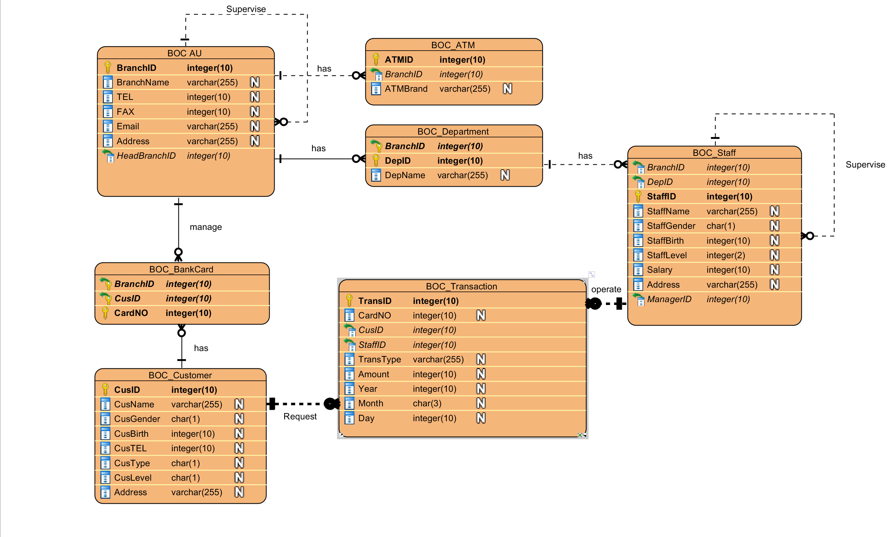
Entity Relationship Diagram

Slide 4
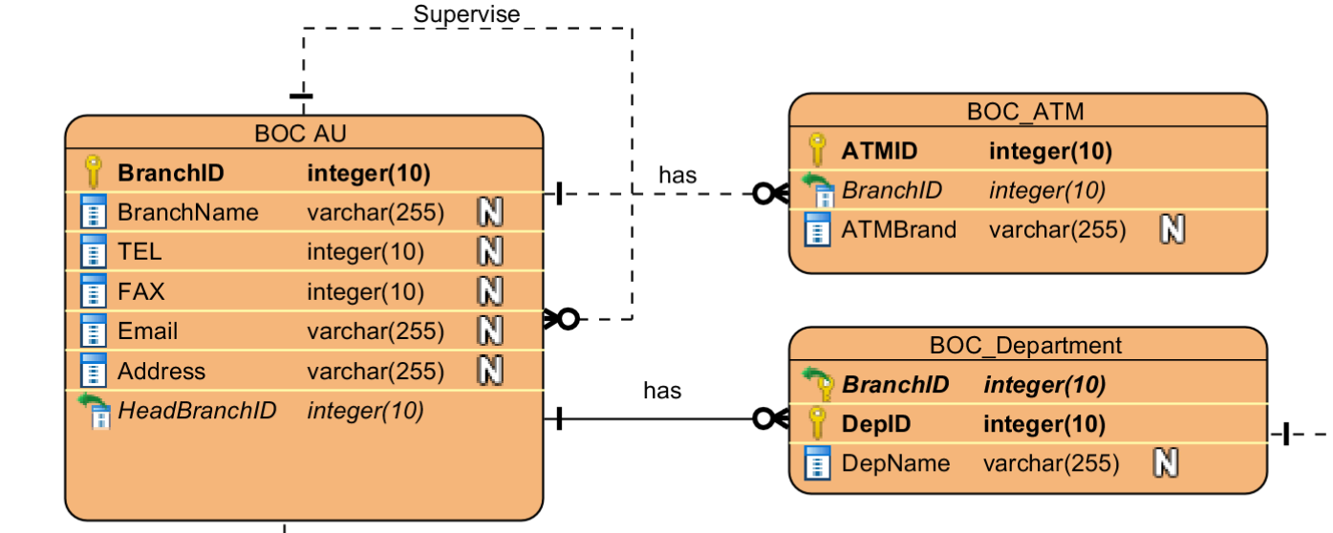
One To Many Relationship

Slide 5
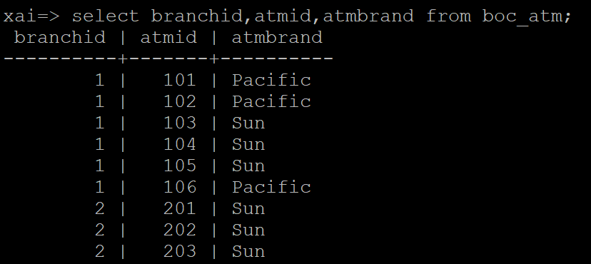
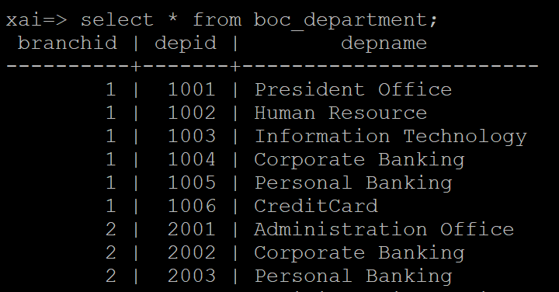
One To Many Relationship

Slide 6
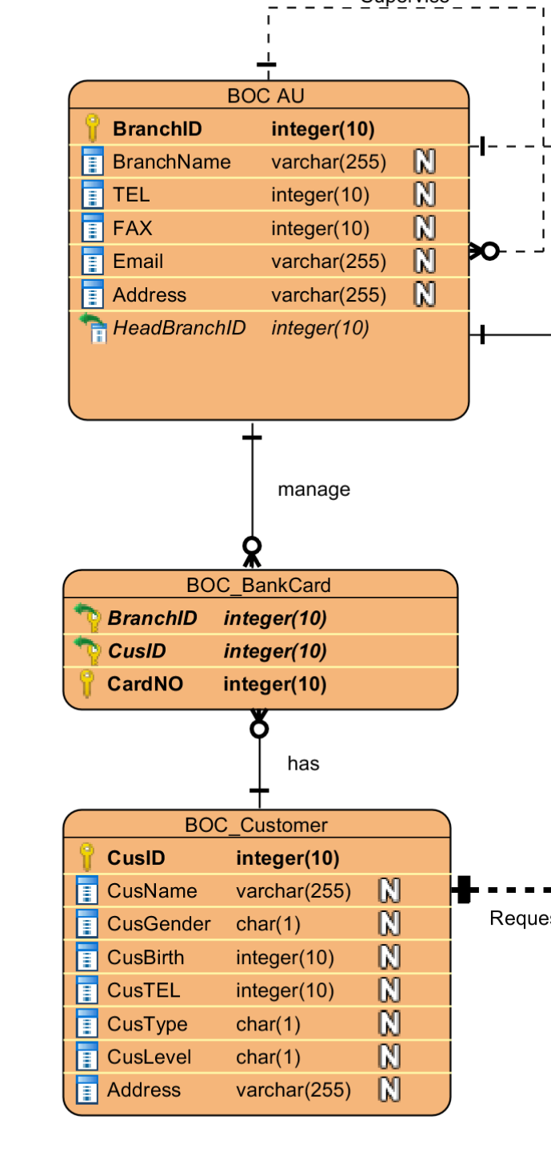
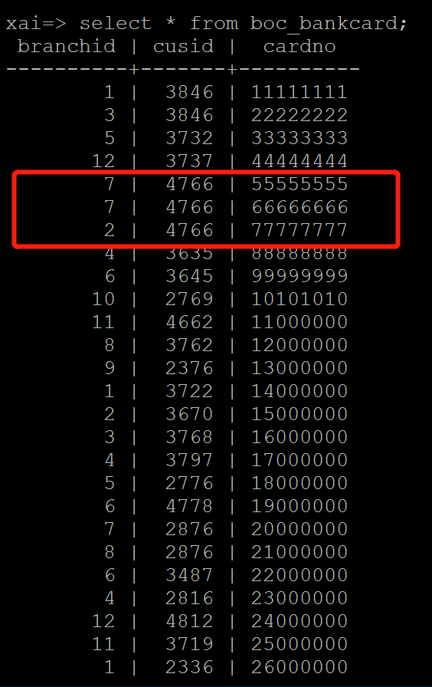
Many To Many Relationship

Slide 7
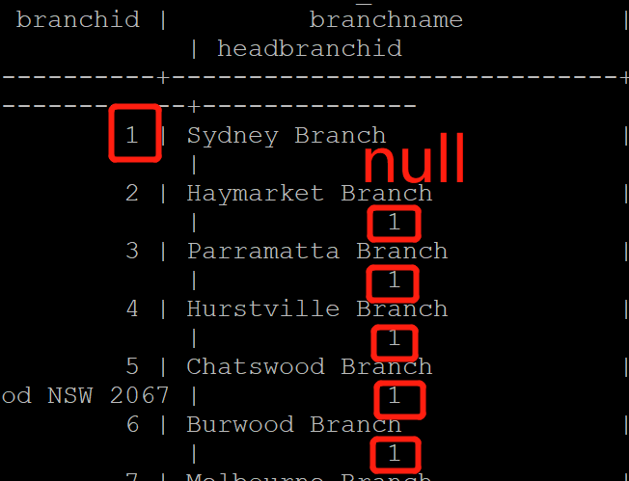
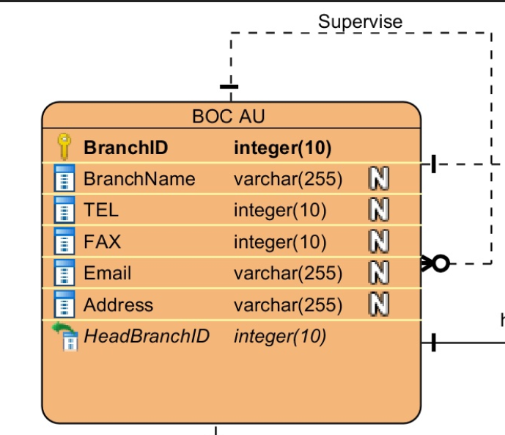
Self-join Relationship

Slide 8
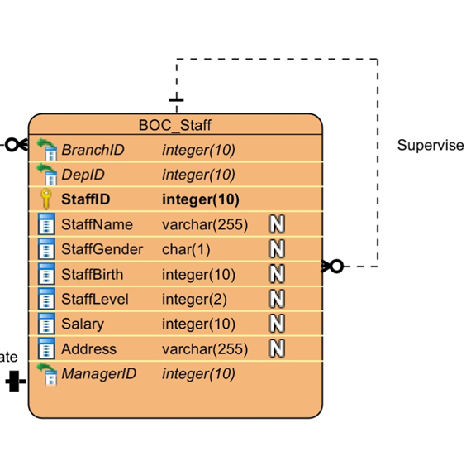
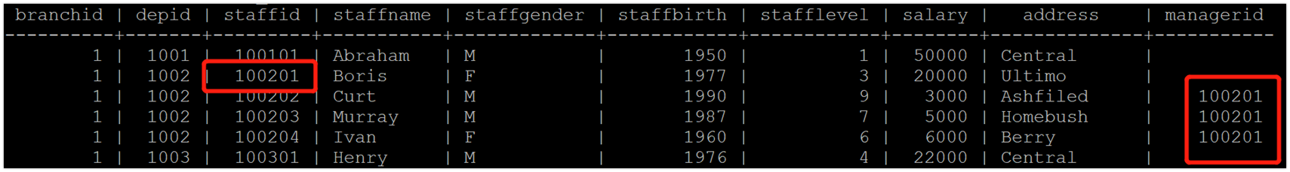
Self-join Relationship

Slide 9
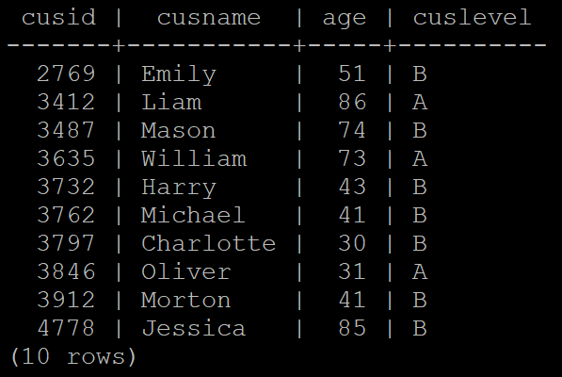
A simple query of a single table.
Find out personal customers’ ID, name, age and level from BOC_Customer whose level is ‘A’ or ‘B’ order by customer ID.
select cusid,cusname,(2018-cusbirth) as age, cuslevel from boc_customer where custype = 'P' and (cuslevel = 'A' or cuslevel = 'B') order by cusid;

Slide 10
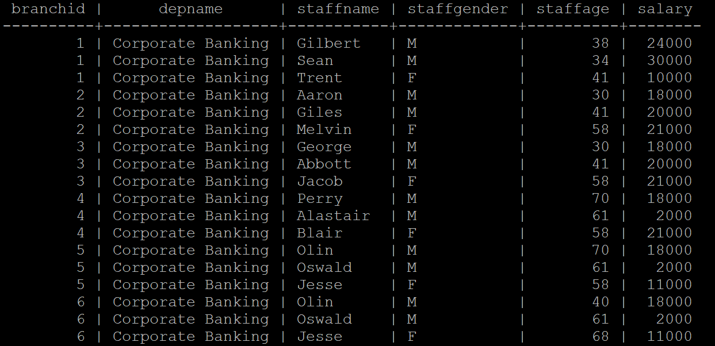
A query which uses the words "natural join"
Select all the staff who work in the corporate department
select branchid, depname, staffname, staffgender, (2018-staffbirth)
as staffage, salary
from boc_department natural join boc_staff
where depname = 'Corporate Banking' order by branchid, depname;

Slide 11
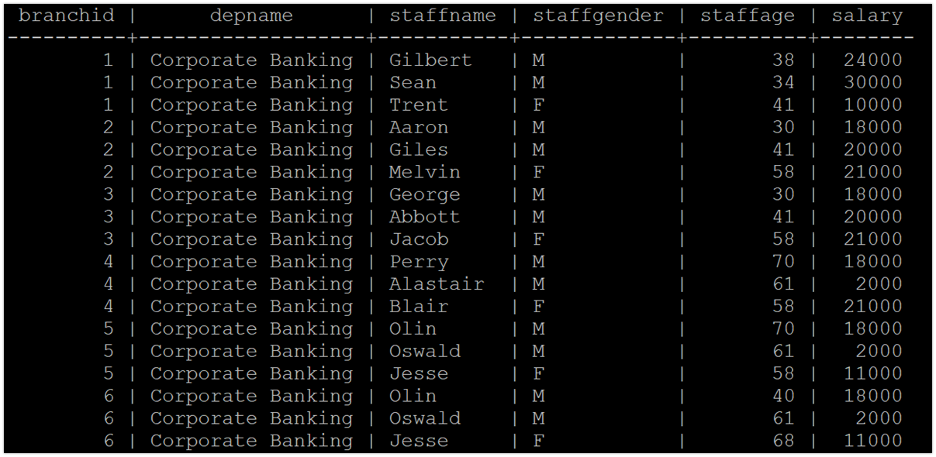
The cross product equivalent to the "natural join" query
select d.branchid, d.depname, s.staffname, s.staffgender, (2018-s.staffbirth) as staffage, s.salary
from boc_department d, boc_staff s
where d.branchid = s.branchid and d.depid = s.depid and d.depname = 'Corporate Banking' order by d.branchid;

Slide 12
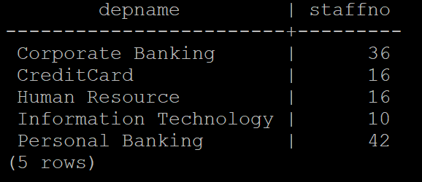
A query involving a “Group By…Having”
Find out the total number of staff in each department and display the department having more than 10 staff.
select depname, count(staffid) as staffno
from boc_department natural join boc_staff
group by depname
having count(staffid) >= 10 order by depname;

Slide 13
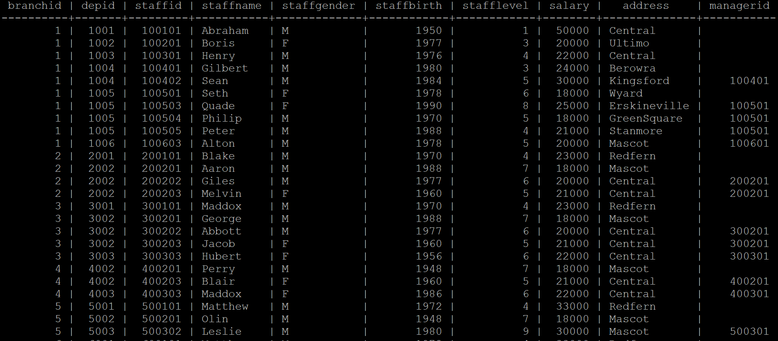
A query which uses a sub query
Find out the information of staff whose salary is higher than the average level
select * from boc_staff where salary >= (select avg(salary) from boc_staff);

Slide 14
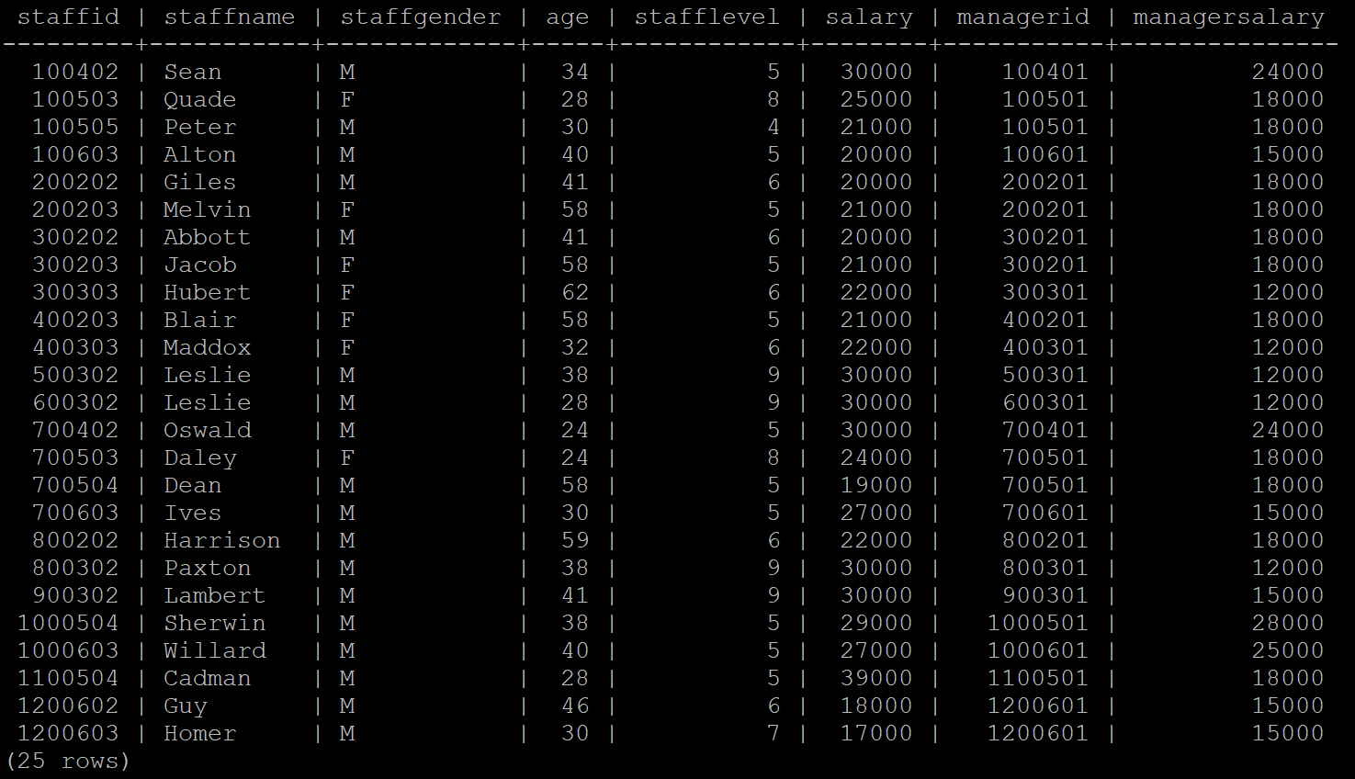
A cross product which cannot be implemented using the words “natural join”
Find out the information of staff whose salary is more than their manager’s
select a.staffid, a.staffname, a.staffgender, (2018-a.staffbirth) as age, a.stafflevel, a.salary, a.managerid, b.salary as managersalary
from boc_staff a, boc_staff b
where a.managerid = b.staffid and a.salary > b.salary;

Slide 15
Check statements
BOC_ATM:
CONSTRAINT di_table_BOC_ATM_ATMBrand CHECK (ATMBrand IN ('Pacific','Sun’)
BOC_Staff:
CONSTRAINT di_table_BOC_Staff_StaffGender CHECK(StaffGender IN ('M','F')),
CONSTRAINT di_table_BOC_Staff_StaffBirth CHECK(StaffBirth >= 1900 AND StaffBirth <= 2000),
CONSTRAINT di_table_BOC_Staff_StaffLevel CHECK(StaffLevel >=1 and StaffLevel < 10)

Slide 16
Check Statements
BOC_Customer:
CONSTRAINT di_table_BOC_Customer_CusGender CHECK (CusGender IN ('M', --male
'F')), --female
CONSTRAINT di_table_BOC_Customer_CusType CHECK (CusType IN ('P', --private
'C')), --company
CONSTRAINT di_table_BOC_Customer_CusLevel CHECK (CusLevel IN ('A','B','C','N’)),
CONSTRAINT di_table_BOC_Customer_CusBirth CHECK (CusBirth >= 1900 AND CusBirth <= 2000)

Slide 17
Check Statements
BOC_Transaction:
CONSTRAINT di_table_BOC_Transaction_TransType CHECK
(TransType IN ('O', --open account
'W', --withdraw money
'D', --deposit money
'E', --exchange money
'C')),--company transcations
CONSTRAINT di_table_BOC_Transaction_Year CHECK (Year >= 1990 AND Year <= 2018),
CONSTRAINT di_table_BOC_Transaction_Month CHECK
(Month IN('Jan','Feb','Mar','Apr','May','Jun','Jul','Aug','Sep','Oct','Nov','Dec')),
CONSTRAINT di_table_BOC_Transaction_Day CHECK (Day >= 1 AND Day <= 31)

Slide 18
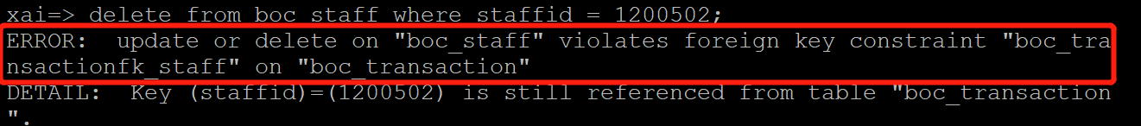
ON DELETE RISTRICT
BOC_Transaction:
CONSTRAINT BOC_TransactionFK_Staff FOREIGN KEY(StaffID) REFERENCES BOC_Staff ON DELETE RESTRICT,
CONSTRAINT BOC_TransactionFK_Customer FOREIGN KEY(CusID) REFERENCES BOC_Customer ON DELETE CASCADE,

Slide 19
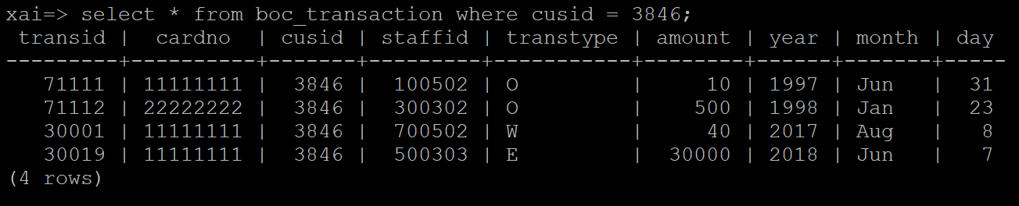
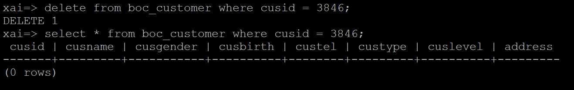
ON DELETE CASCADE
Before
After

Slide 20
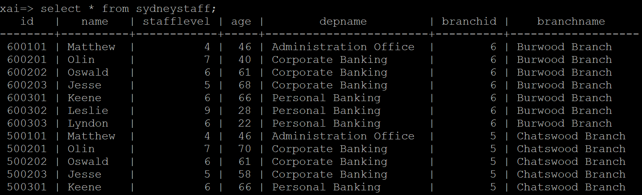
View
This view(SydneyStaff) shows all information of staff working in Sydney.
CREATE VIEW SydneyStaff As
select s.staffid as id, s.staffname as name, s.stafflevel, (2018-s.staffbirth) as age, d.depname, a.branchid, a.branchname
from boc_au a, boc_staff s,boc_department d where( a.branchid = 1 or a.headbranchid = 1)
and a.branchid = s.branchid and a.branchid = d.branchid and s.branchid = d.branchid
and d.depid = s.depid order by a.branchname;

Slide 21
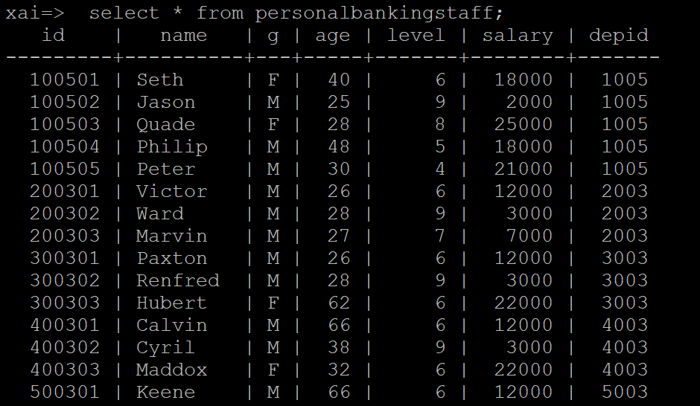
View
This view(PersonalBankingStaff) shows all the staff of Personal Banking department.
CREATE VIEW PersonalBankingStaff As
select staffid as ID, staffname as name, staffgender as G, (2018 -staffbirth) as Age, stafflevel as level, salary, depid
from boc_staff natural join boc_department
where depname = 'Personal Banking' order by staffid;

