Slide 1
Test PPT
Test test test test

Slide 2
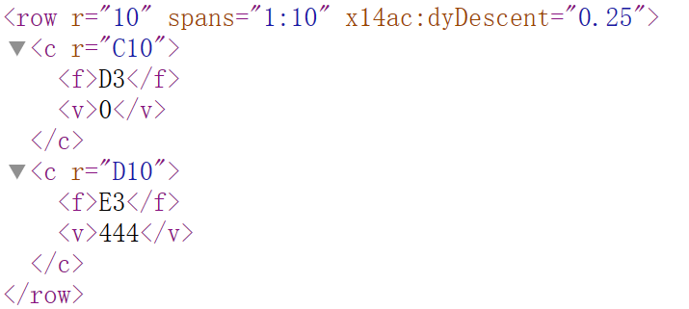
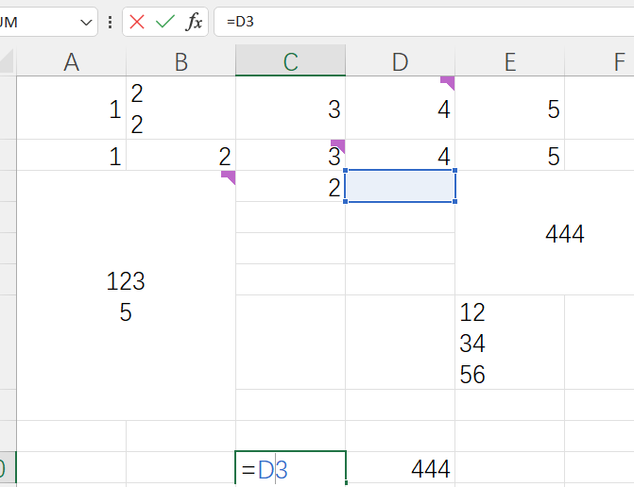
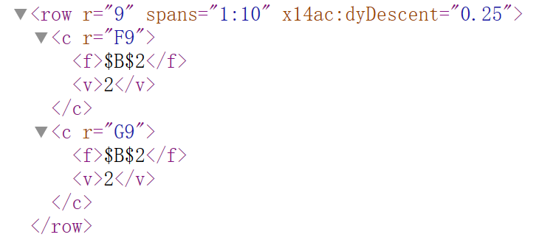
Spreadsheet
Relative address:
Absolute address:

Slide 3
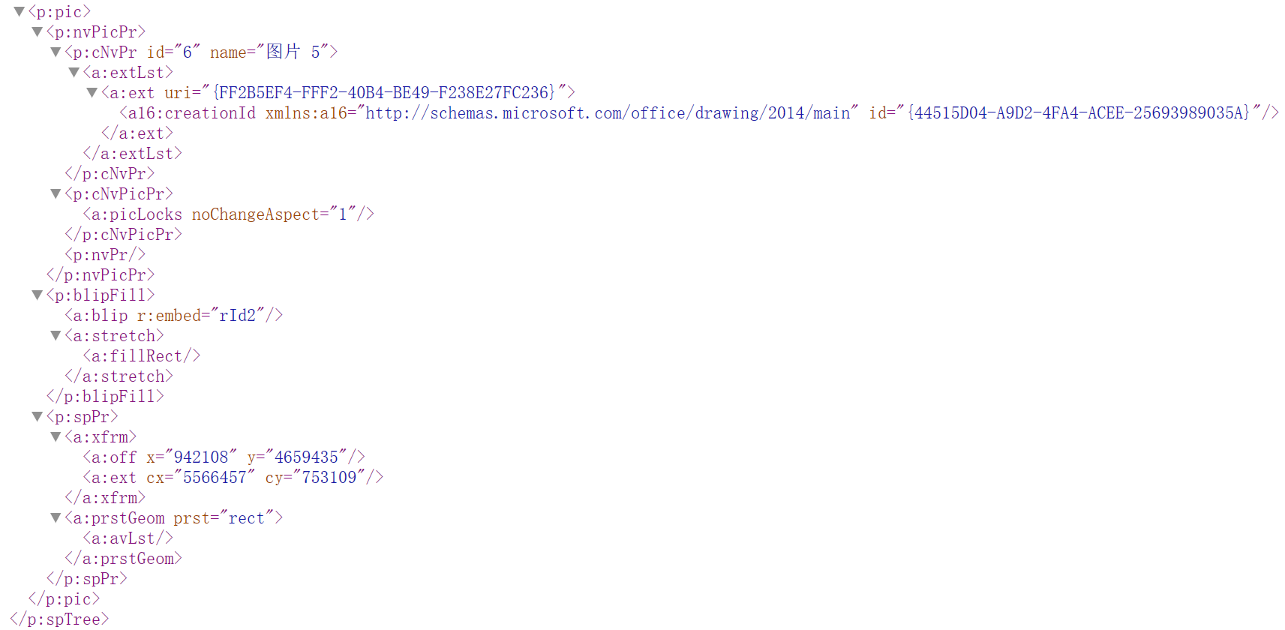
Presentation

Slide 4
Thank you！

