Slide 1







Welcome to my
Digital portfolio
1

Slide 2
NAME: AIYSHA SIDDIQUA M A
REGISTER NO:31224U18001
NM ID: 961AEF5EBF5B27A9DEA4CE3553216909
DEPARTMENT: B.SC COMPUTER SCIENCE
COLLEGE NAME: ISLAMIAH WOMEN'S ART'S AND
WOMEN'S ARTS AND SCIENCE COLLEGE
UNIVERSITY: THIRUVALLUVAR
2

Slide 3



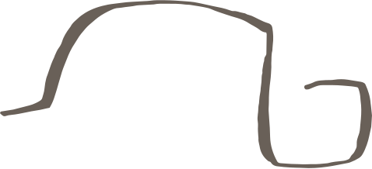
EDUCATION BACKGROUND
B.Sc. Computer Science - Islamiah Women's
Arts And Science College﻿ (present)
Higher secondary - 2021-2023
Schooling - completed in 2021
My Background and Interests
PERSONAL INTERESTS
As a Computer Science student, I am passionate about coding, web design, and exploring new technologies. I enjoy solving logical problems, learning innovative tools, and staying updated with the latest trends in technology. Beyond academics, I like reading, creativity, and engaging in activities that enhance my knowledge and skills.
3

Slide 4



Problem Statement
Overview of the project
End Users
Tools and Technologies
portfolio design and layout
Features and Functionality
Results and Screenshot
conclusion
Agenda
4

Slide 5


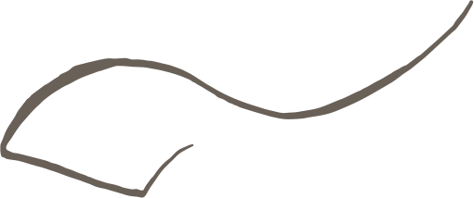
Problem Statement
❌ Not interactive – Hard to showcase multimedia projects, videos, or coding work.
🕒 Difficult to update – Every time a new project or certificate is added, students must recreate or print again.
📉 Limited visibility – Paper resumes and files cannot reach a wide audience.
💼 Less professional appeal – Recruiters, teachers, and institutions prefer digital presence.
🔎 Hard to access – Carrying physical documents everywhere is impractical.
5

Slide 6



Project Overview
💻 A digital portfolio is an online platform to present academic and personal achievements.
📁 It contains projects, skills, certificates, and creative works in digital form.
👩‍💼 Acts as a professional profile for students and job seekers.
🎨 Encourages creativity, innovation, and digital literacy.
🎓 Supports self-assessment, career growth, and higher education opportunities.
6

Slide 7



👩‍💼 Recruiters / Employers – Evaluate skills, projects, and suitability for jobs.
👥 Peers / Classmates – Share ideas, collaborate, and get inspiration.
📚 Students / Learners – Reference projects and gain knowledge.
📝 Professional Network / LinkedIn Connections – Build connections and personal branding.
End Users
7

Slide 8

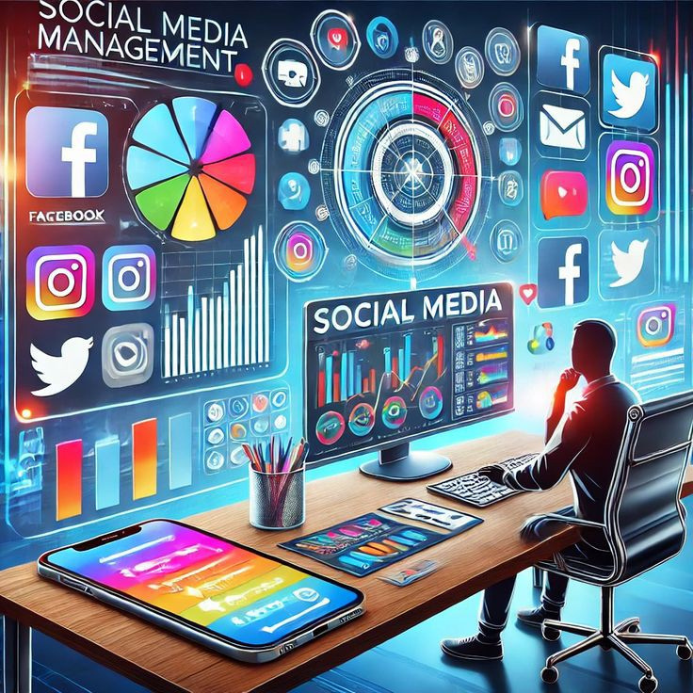


Tools and Technologies
🎨 Canva / Figma – Design slides, layouts, and graphics.
🌐 HTML, CSS, JavaScript – Build web-based portfolios.
🖼 Photoshop / Canva – Image and graphic editing.
📝 Microsoft Office / Google Workspace – Documents and certificates
📄 PDF Tools – Convert reports and certificates
8

Slide 9

💡 Projects: images, descriptions, tools/technologies used.
🛠️ Skills: progress bars, charts, or icons.
🏆 Achievements & Certificates: gallery or carousel display.
📬 Contact: email, social media, LinkedIn, GitHub.
🎨 Consistent colors, fonts, and spacing.
Design and layout
9

Slide 10

Features and Functionality
🔗 Hyperlinks & Attachments – Easy linking to external sources, GitHub, LinkedIn, or project demos.
🎯Career Oriented – Serves as a resume alternative for job applications, internships, and higher studies.
🖼️ Multimedia Support – Allows bainclusion of text, images, videos, audio, and interactive elements.
.
10

Slide 11

Project Results
11

Slide 12
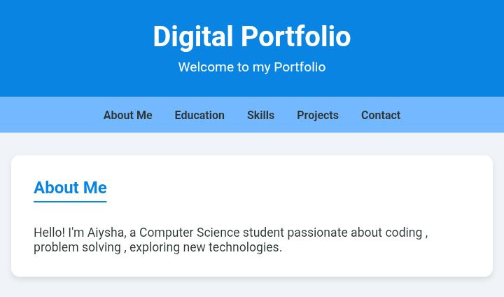
DIGITAL PORTFOLIO
12

Slide 13
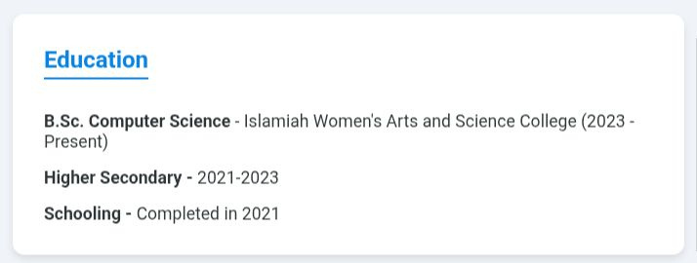
13

Slide 14
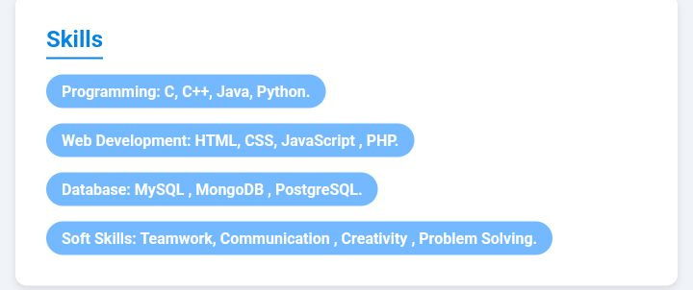
14

Slide 15
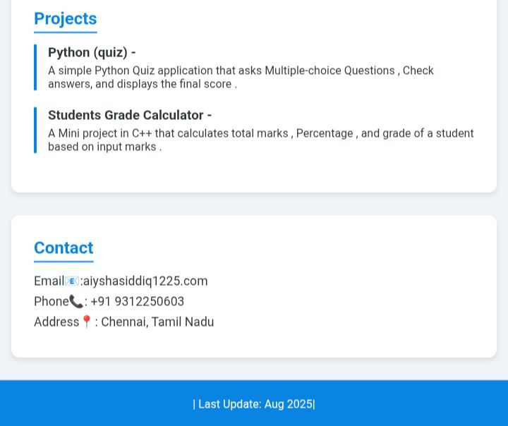
15

Slide 16

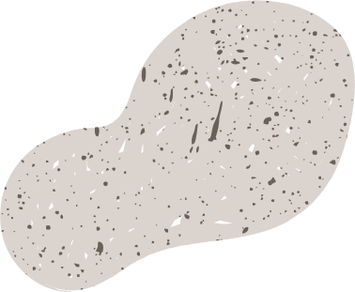
Conclusion,
Digital portfolio is a modern way to showcase your skills, projects, and achievements in organized place. It makes your work easy to access, visually appealing, and leaves a strong impression on teachers, recruiters, and peers. It helps in personal branding and opens opportunities for learning and growth.
16

Slide 17



Thank You!
17

