Slide 1


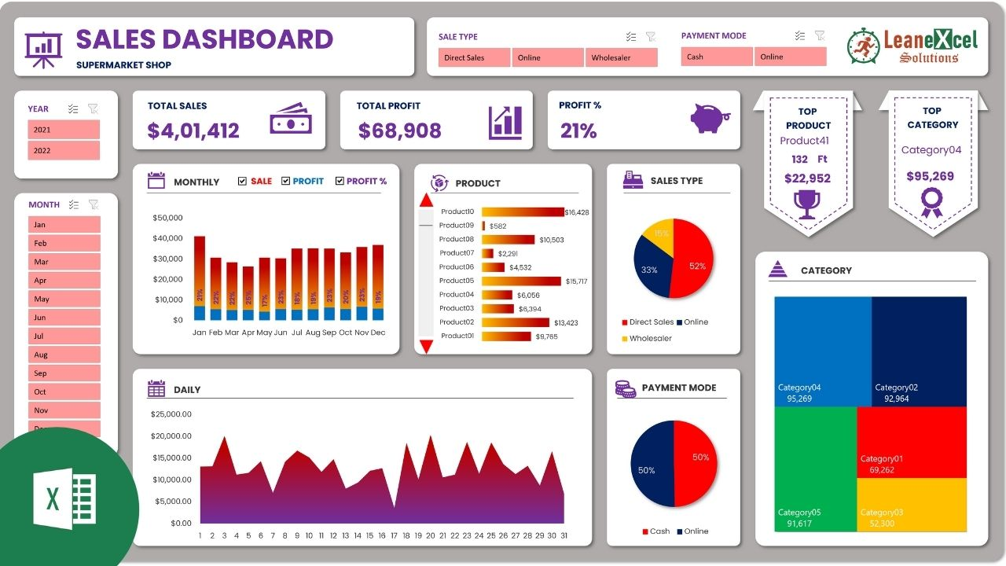
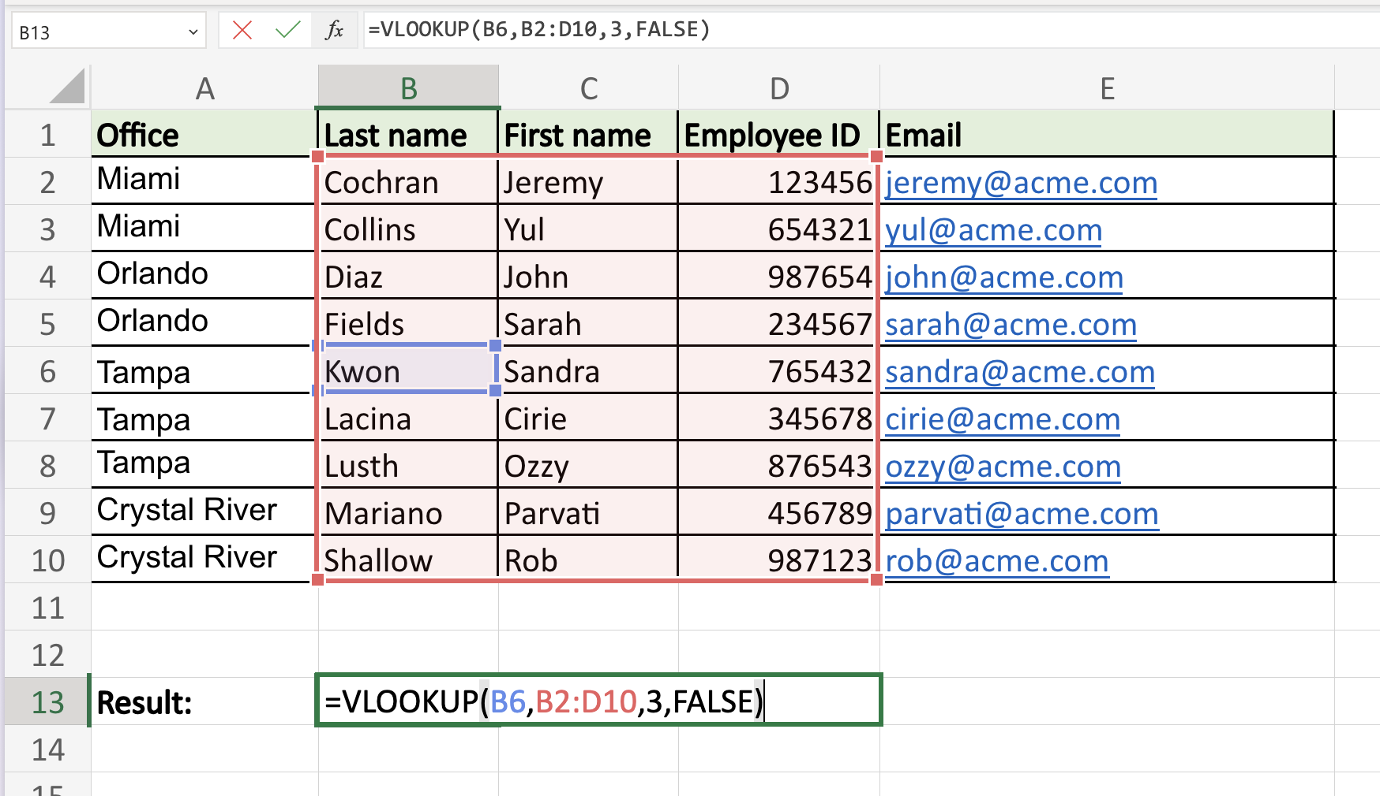
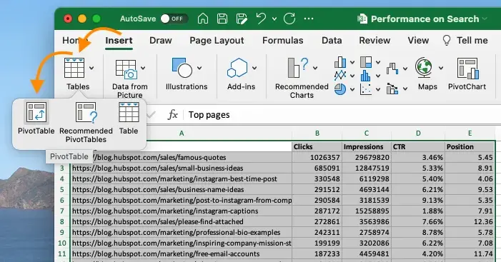
Mudahnya Belajar Excel
Bersama Dr Aizat
Whatsapp : 010 231 4951
Video Tutorial Excel (Single)
Video Tutorial Excel (Combo)
Asas
Vlookup
Pivot Table
Analisis Data
Formula
Power Query
Finance
Power Pivot
Power BI
Macro & VBA
Chart & Graph
Dashboard

