Slide 1
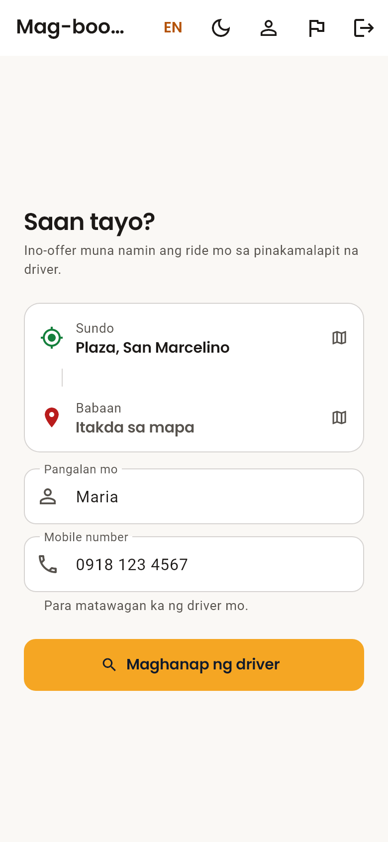
THESIS PROPOSAL DEFENSE
TrikeKoTo
A Tricycle Ride-Hailing and Dispatch System
for TODA Chapters
Jelo Jian Sabroso
President Ramon Magsaysay State University – San Marcelino
September 2026
Notes:
Good day, panel. I am Jelo Jian Sabroso, and this is my proposal: TrikeKoTo, a tricycle ride-hailing and dispatch system built for TODA chapters.
In one sentence: a commuter books the nearest available TODA tricycle from a phone, while the chapter stays in control of who drives, what the fare is, and who can use the system.

Slide 2
BACKGROUND
The problem
1
2
3
Commuters wait
Drivers roam empty
No trust, no record
Passengers walk to a terminal or wait by the road without knowing whether a tricycle is coming — worst at night and in the rain.
Drivers circle for passengers or queue at the terminal, spending fuel and hours without a fare.
Bookings by text or call leave no record of who rode with whom, and nothing a TODA chapter can check.
The gap: general ride-hailing apps either leave TODA tricycles out, or go around the chapter that already decides who drives and what they charge.
Notes:
Three sides of one problem. Commuters wait blind. Drivers waste fuel looking for passengers. And informal bookings leave no record, which matters for safety and for the chapter.
Close with the gap: existing apps do not serve TODA tricycles, or they bypass the TODA structure that already governs who may drive and what they may charge.

Slide 3
PROPOSED SOLUTION
Built with the TODA, not around it
General ride-hailing apps
TrikeKoTo
Who drives
Anyone who signs up
TODA members approved by their chapter
Fare
Set by the app
The posted TODA tariff, paid in cash
Chapter control
None
Officers approve, suspend, and can stop all bookings at once
Identity
Varies by app
Every driver and commuter ID-verified by the chapter
Notes:
This is the question the panel will ask first: why not Grab or Move It?
The answer is the right column. The chapter decides who drives. The fare is the ordinance tariff, so the app shows no price that could disagree with the posted one. Officers can approve, suspend, and stop bookings instantly. And every account is verified by the chapter.

Slide 4
OBJECTIVES
What this study will do
1
Book and dispatch
GENERAL OBJECTIVE
Let commuters book a ride that is offered automatically to the nearest available driver, with live tracking.
To design and develop TrikeKoTo, a mobile and web ride-hailing system that connects commuters with the nearest available TODA tricycle while keeping dispatch, driver verification and records under the chapter's control.
2
Verify and administer
Let the TODA chapter approve drivers, verify government IDs, and monitor rides and feedback.
3
Protect personal data
Secure personal information in line with the Data Privacy Act of 2012 (RA 10173).
4
Evaluate
Assess usability and acceptance with TODA drivers and commuters, using task testing and the System Usability Scale.
Notes:
Match these to the exact wording in your manuscript before presenting — edit this slide if your chapter 1 phrases them differently.
Specific objectives: one, booking and automatic nearest-driver dispatch; two, chapter administration and ID verification; three, data privacy under RA 10173; four, evaluation with real drivers and commuters.

Slide 5
SCOPE AND LIMITATIONS
What is in, and what is not
Scope
Limitations
Commuter: mobile-number sign-in, booking, live tracking, cancelling, rating, feedback
Driver: registration, online/offline, ride offers, trip controls, navigation
TODA officer: driver approval, ID review, ride figures, feedback, dispatch settings
Android app and web version, in Filipino and English
One TODA chapter in San Marcelino, Zambales
Booking needs mobile data or Wi-Fi
Rides go only to online drivers within the search radius
No in-app payment — the posted fare is paid in cash
A new user can book or drive only after an officer approves their ID
Maps and routing use free public OpenStreetMap services
Notes:
Say the limitations before the panel does — it reads as understanding, not weakness.
The biggest practical limit: it only works where drivers are online, so adoption by the chapter is what makes it useful.

Slide 6
SYSTEM ARCHITECTURE
One app, one secure backend
Commuter
Firebase (Google Cloud)
Android · Web
TrikeKoTo app
Authentication
Cloud Firestore
Flutter · Dart
Phone and email sign-in
Rides, drivers, security rules
Driver
One codebase for Android and the web
Cloud Functions
Cloud Storage
Android
Dispatch, ratings, ID retention
ID photos, profile photos
TODA officer
Cloud Messaging
App Check
Android · Web
Ride offer notifications
Only the genuine app gets in
Maps: OpenStreetMap tiles · OSRM road routing · Nominatim place search
Notes:
Three users, one Flutter codebase, and Firebase as the backend.
Key design point: the phone is never trusted. Every read and write is checked by server-side security rules, and the nearest-driver search runs in Cloud Functions, so no commuter app can see where every driver is.

Slide 7
HOW A BOOKING WORKS
Nearest available driver, one at a time
1
2
3
4
5
Commuter books
Server searches
Offer to nearest
Next if no answer
Ride accepted
Pickup and drop-off set on the map
Approved drivers within 5 km, ranked by road distance
That driver has 15 seconds to accept
Up to 10 drivers, for up to 5 minutes
Live tracking to the drop-off, then a rating
5 km
15 s
1 winner
Search radius, set by the chapter
For each driver to answer an offer
If two drivers tap Accept at once, a database transaction lets exactly one claim the ride
Notes:
This is a greedy nearest-first search. Straight-line distance shortlists drivers inside the radius, then road distance picks the nearest. One driver is offered the ride at a time; if they decline or do not answer in 15 seconds, the next is asked.
If the commuter closes the app, a scheduled server job keeps the search going every minute.
Double booking is prevented by a transaction plus a security rule — tested with simultaneous accepts.

Slide 8
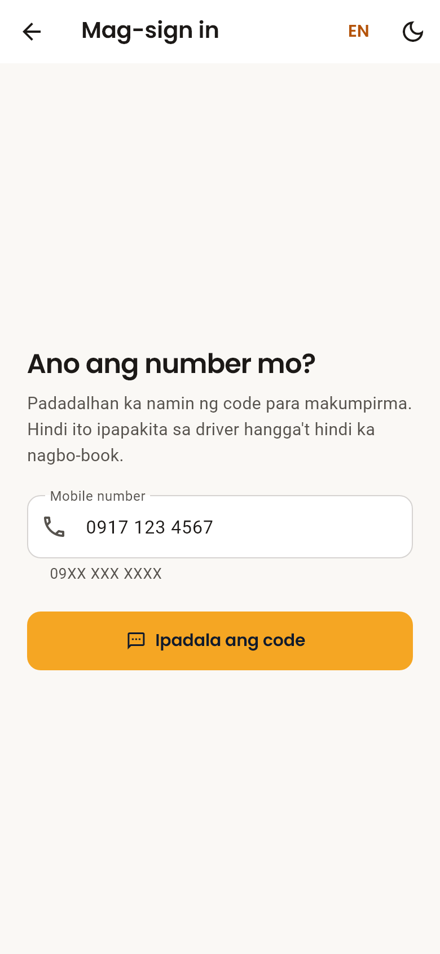
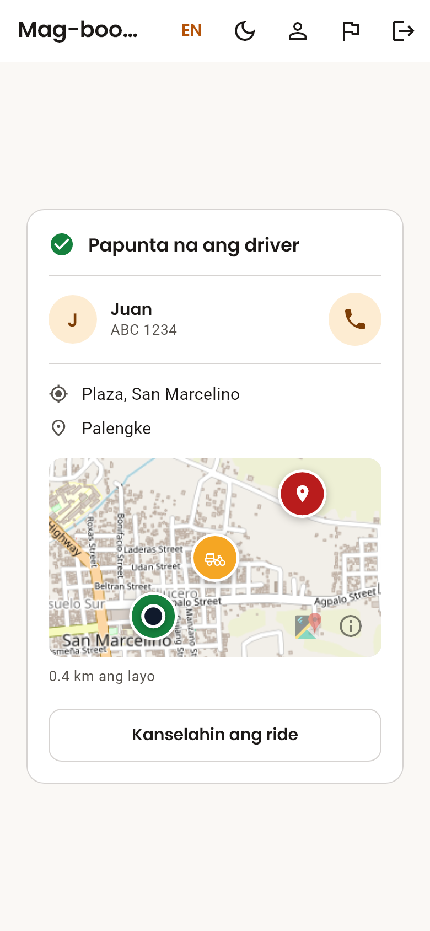
PROTOTYPE
The commuter experience
1. Sign in with a mobile number
2. Set pickup and drop-off
3. Track the tricycle live
Notes:
These are the actual screens of the working prototype, in Filipino, which is the app's default language; English is one tap away.
Sign in with an SMS code, set pickup and drop-off — pickup fills in from GPS — then follow the tricycle on the map with the driver's name, plate and a call button.
If you do a live demo, do it here, and keep it to two minutes.

Slide 9
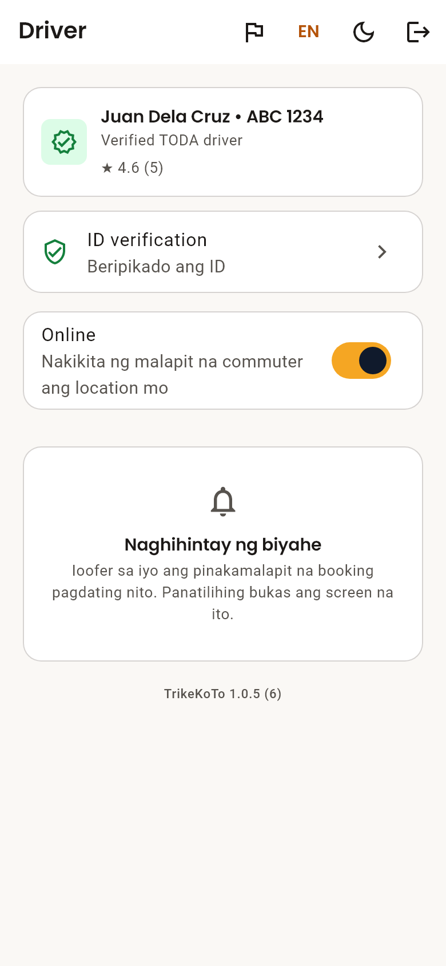
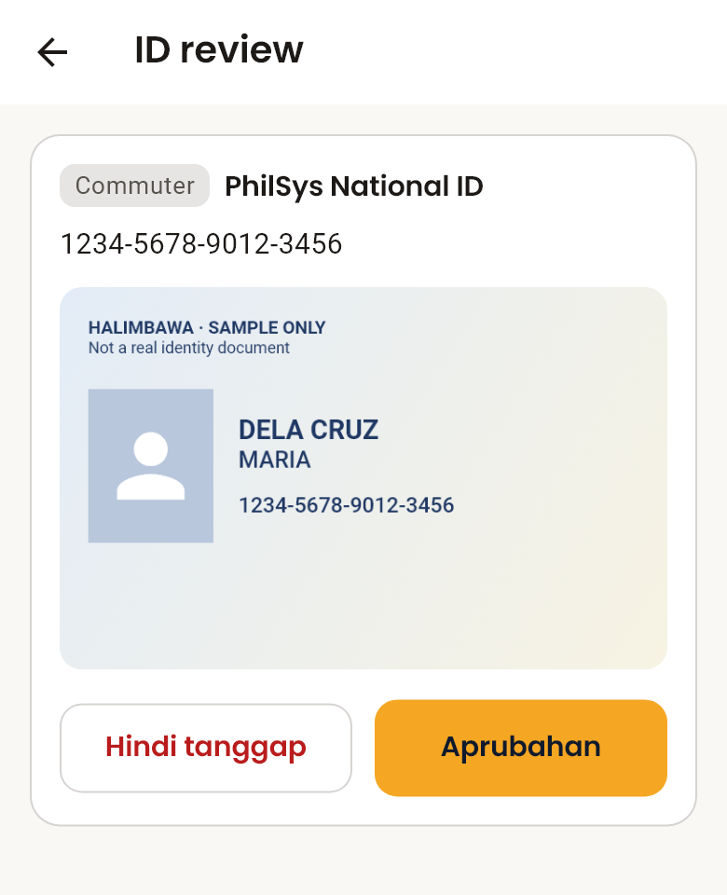
PROTOTYPE
Tools for drivers and the chapter
A
Drivers
Go online with one switch, get offers by notification, and run each trip: start, complete, call, navigate.
B
Chapter officers
Approve or suspend drivers, review IDs — the photo must be opened before Approve works — and see daily ride figures.
C
Stop switch
ID review by an officer
One switch halts new bookings on every phone within seconds, with no app update. Rides in progress still finish.
Driver screen
Notes:
Drivers need very little: one switch to go online, and big buttons for each step of the trip.
The chapter officer is the control point. They approve drivers and IDs, and the Approve button stays off until the ID photo has actually been opened — approval has to mean somebody looked.
The stop switch is the rollback for a pilot: it stops new bookings everywhere without reinstalling anything.

Slide 10
SECURITY AND DATA PRIVACY
Designed for RA 10173 from the start
216
1
Chapter-only access
Only TODA officers can see a submitted ID. Other passengers and drivers never can.
automated security-rule tests, including attack scenarios
2
Consent on record
Users read how their ID is used and tick consent; the time is stored with it.
90 days
3
Right to withdraw
after sending, ID photos and numbers are deleted automatically
Commuters can delete their ID and their account from inside the app.
0
4
Genuine app only
App Check refuses scripts and modified apps at the database and at dispatch.
open findings after the September 2026 security review
An ethics and data-privacy review will be completed before any real ID is collected.
Notes:
Government IDs are sensitive personal information under RA 10173, so this was designed in, not added later.
Access is limited to chapter officers, consent is recorded, retention is enforced by a scheduled job at 90 days, and users can withdraw.
Say the last line yourself: real IDs will not be collected until the university ethics review is done. The panel will respect that you raised it.

Slide 11
METHODOLOGY
How it is built and how it will be evaluated
Development — iterative, in phases
Evaluation — user acceptance testing
1
Requirements and design
Participants: 5 TODA drivers and 5 commuters, on their own phones, in Filipino
Tasks: sign up, send an ID, book, track, cancel, rate; drivers go online and complete a trip
Measures: task completion, time on task, errors, and the System Usability Scale (SUS)
Debrief: would drivers use it for real work?
Then a small pilot with the chapter, with daily monitoring and stop thresholds
2
Backend and security rules
3
Commuter, driver and admin features
4
Maps and notifications
5
Testing and security review
6
Deployment: Android app and web
Notes:
Use the development model name your manuscript uses (for example Agile or Rapid Application Development) — these six phases map onto either.
Evaluation: five and five is the usability-testing norm for finding most problems; SUS gives a standard score, reported with n = 10 so it is not overclaimed. The debrief question for drivers is the real acceptance test.

Slide 12
CURRENT STATUS
A working prototype, ready for testing
Done
Next
89 / 93
Android app and web version, deployed
Nearest-driver dispatch on the server
ID verification with automatic deletion
216 security tests and a security review
User manual and testing kit
User acceptance testing with the chapter
Native Filipino language review
Ethics and data-privacy clearance
Pilot rollout with the chapter
build steps complete
The four remaining steps depend on others: testing with the chapter, a language review, the pilot, and moving old records from the earlier web app.
Notes:
Be exact about status. The prototype is built, deployed and tested; it is not yet cleared for real users.
What remains all needs people: the chapter for testing, a native speaker for the Filipino, the ethics committee, and then the pilot.

Slide 13
Salamat po.
Questions and live demo
TrikeKoTo — a tricycle ride-hailing and dispatch system for TODA
Jelo Jian Sabroso · PRMSU – San Marcelino
Notes:
Thank the panel and invite questions.
If a question has no ready answer: "Thank you, I will include that in the revision." Do not guess.
Demo only if the signal in the room is good; otherwise use the screenshots on slides 8 and 9.

