Slide 1
Classification of Wheat Varieties Using KNN and MLP
Presented by Aizaz Ahmad and Abhijot Kaler

Slide 2
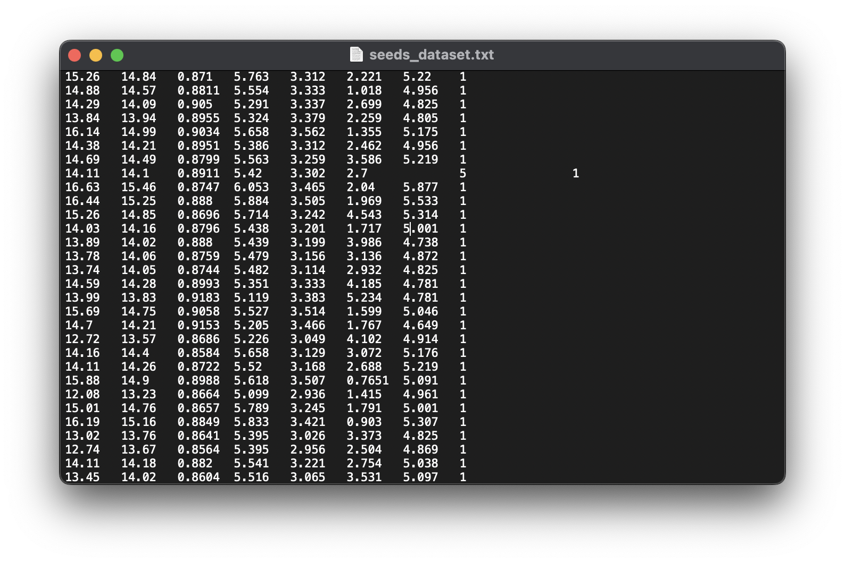
Dataset
Dataset contains 3 different types of Kernels of wheat
Kama - 70 instances
Rosa - 70 instances
Canadian - 70 instances
Each data point has 7 attributes like length, width, height, etc.
Attributes values are measured via X-ray technique
Has no missing values

Slide 3
Methodology
Cross-validation Strategy: Stratified 10-fold cross-validation.
KNN: Experimented with values of K (1, 3, 5).
MLP: Adjusted learning rate, momentum, and hidden layers.
Performance Metrics: Accuracy, Confusion Matrix, Error Percentages.
Pre-processing the data: Standardized (0 mean)

Slide 4
KNN Algorithm Analysis
Summary
Observations
Insights
Best Configuration: K=1.
Best Accuracy: 94.29%.
Strong performance for Canadian wheat.
Kama wheat had the most misclassifications.
Normalization and standardization had no significant impact.
K=1 provided the highest accuracy but error metrics were a bit high.
Larger K values led to worse accuracies

Slide 5
MLP Algorithm Analysis
Summary
Observations
Insights
Best Configuration:
Learning Rate: 0.5
Momentum: 0.2
Hidden Layers: 6
Accuracy: 97.1429%.
Rosa wheat: Perfect classification, indicating strong feature separation.
Fewer misclassifications compared to KNN.
Lower error percentages across all metrics.
Tweaking hidden layers significantly improved accuracy (up to 97.14%).
Slight increase in accuracy when we reduced the learning rate from 0.3 -> 0.2
95.23% -> 95.71%

Slide 6
Performance Comparison
KNN
MLP
Key Metrics
Best Accuracy: 94.29%
Fast computation (~0 seconds).
Best Accuracy: 97.14%
Higher build time (0.17 seconds). More consistent and accurate predictions.
Mean Absolute Error: MLP (0.0286) vs KNN (0.0581).
Root Relative Squared Error: MLP (25.51%) vs KNN (41.11%).
These metrics underline MLP's superiority over KNN

Slide 7
Conclusion
Conclusion:
MLP outperformed KNN in accuracy and error rates.
KNN is faster and computationally efficient.

Slide 8
Recommendations
Recommendations:
Use MLP for highest accuracy.
Use KNN for faster results.
Both algorithms achieved >94% accuracy.
Future Work:
Explore KNN with different Distance calculating algorithms
Explore with other preprocessing techniques (other than standardizing or normalizing)
Explore other machine learning algorithms like SVM

Slide 9
Thank you
max growth
Any Questions?

