Slide 1
Quasi-Random Techniques
Don P. Mitchell

Slide 2
MC Integration for Rendering
Ray tracing yields point samples f(x_{i})
Discontinuous f thwarts efficient methods
High dimensionality of distributed RT

Slide 3
Truly Random x_{i}
Useful mostly in cryptography
Tricky to get uniform distribution
Hardware is available
  Intel firmware hub RNG (840 chip set)
  Clock sampling trick
Too expensive for Monte Carlo really

Slide 4
Sample CPU With Clock Interrupts
#include <windows.h>
unsigned
PentiumNoise()
{
LARGE_INTEGER nCounter1, nCounter2;
QueryPerformanceCounter(&nCounter1);
Sleep(1L);
QueryPerformanceCounter(&nCounter2);
return nCounter1.LowPart ^ nCounter2.LowPart;
}

Slide 5
Pseudo-random x_{i}
Generated deterministically and efficiently
Mimic random distribution
Multiply With Carry (MWC)
Hard to test, notoriously buggy
  BSD’s linear shift register was bugged
  A widely used MWC source is bugged

Slide 6
A Well-Tested MWC Generator
inline unsigned
RandomUnsigned()
{
_asm
{
mov eax, g_nX
mov ecx, g_nC
mov ebx, 1965537969
mul ebx
add eax, ecx
mov dword ptr [g_nX], eax
adc edx, 0
mov dword ptr [g_nC], edx
}
return g_nX;
}

Slide 7
Quasi-Random x_{i}
Must have measure-preserving distribution
Structured, less-irregular distributions
  Stratified sampling
  Blue-noise samling
Classic QR means low-discrepancy

Slide 8
Discrepancy in 1 Dimension
Consider subset of unit interval, [0, x]
Of N samples, n are in the subset
Local discrepancy, | x – n/N |
Maximum discrepancy: worst-case x
A measure of quality for sampling pattern
Random samples yields O(N^{-1/2}) error
Uniform x_{i} = i/N yields O(N⁻¹) error

Slide 9
Discrepancy in 2 Dimensions
Subset of unit square, [0,x] × [0, y]
| xy – n/N | for worst case (x, y)
Uniform pattern yields O(N^{-1/2})
Theoretical bound: Θ(N⁻¹ log^{1/2}N)
This is better than uniform or random!
But there is a catch…axis alignment

Slide 10
Hammersley Points
Radical Inverse φ_{p}(I) for prime p
Reflect digits (base p) about decimal point
φ₂ : 111010₂ → 0.010111
For N samples, a Hammersley point
  ( i/N, φ₂(i) )
Discrepancy O(N⁻¹ log N) in 2D

Slide 11
2D Experiments
Zone plate, sin(x² + y²)
Integrate over pixel areas (box filter)
Random sampling: σ_{mean} = σ_{f} N^{-1/2}
Look at error divided by standard deviation

Slide 12
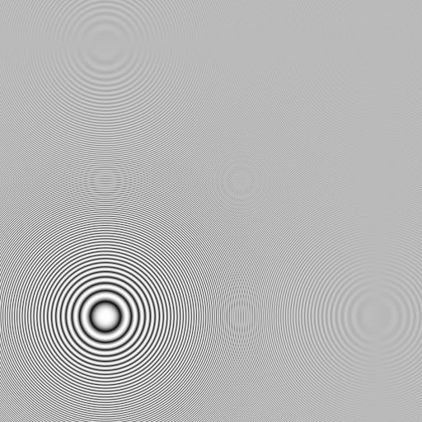
Zone Plate Test Image

Slide 13
Uniform Random Sample Pattern

Slide 14
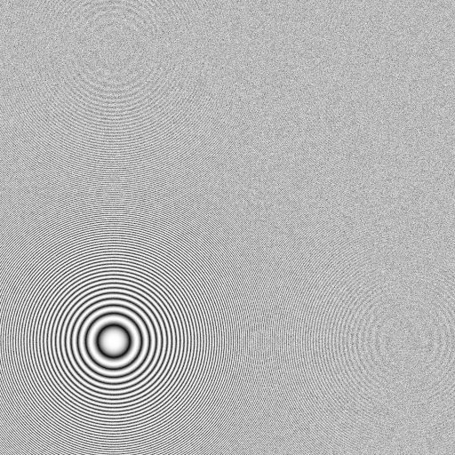
16 Random Samples Per Pixel

Slide 15
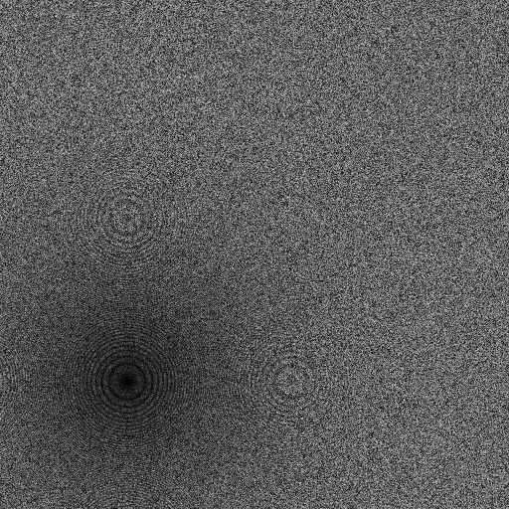
Error Image

Slide 16
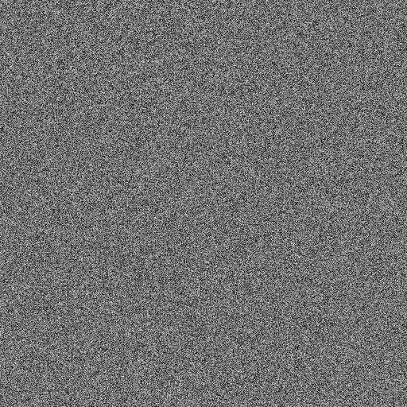
Error / σ

Slide 17
Jittered Distribution

Slide 18
Special Case of Stratified Design

Slide 19
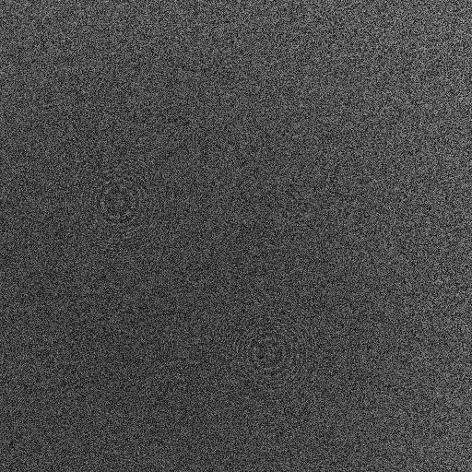
Jittered Sampling Error/σ

Slide 20
Poisson-Disk Sampling Pattern

Slide 21
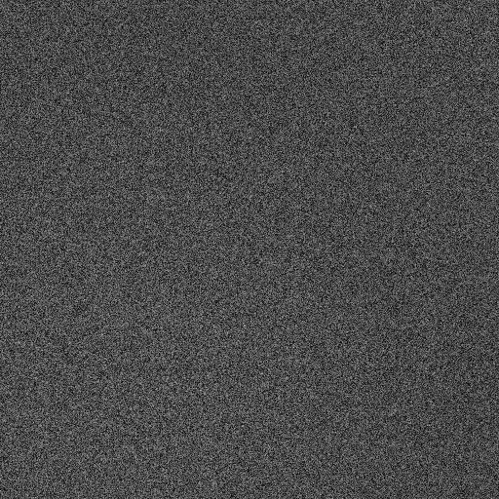
Poisson-Disk Error/σ

Slide 22
Hammersley Distribution

Slide 23
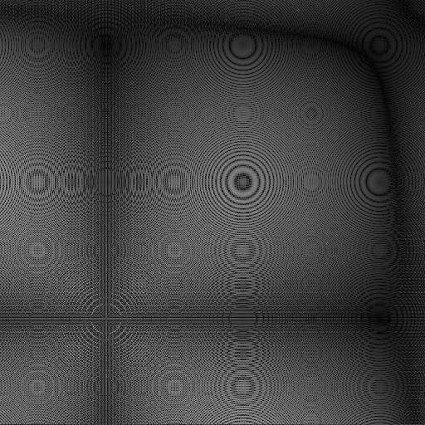
Hammersley Error/σ

Slide 24
Qualitative Observations
Random sampling insensitive to nature of f
Jittered sampling better in smooth region
Poisson-Disk, insensitive to nature of f ?
Hammersley works best with axis-aligned features!

Slide 25
Error in 16-Sample Experiments
Sampling Pattern | RMS Error
Random | 0.153
Jittered | 0.064
Poisson-Disk | 0.061
Hammersley | 0.045

Slide 26
Arbitrary-Edge Discrepancy
Consider arbitrary edge through square
Max | Area Under Edge – n/N |
Theoretical bounds
  Ω(N^{-3/4})
  O(N^{-3/4} log^{1/2} N)
Unlike axis-aligned discrepancy, error approaches O(N^{-1/2}) as dimension increases

Slide 27
Computing Discrepancy
Dobkin & Mitchell (GI ’93)
Consider N sampling points and the 4 points of the square’s corners
Worst-case edge thru pair of points
O(N³) Algorithm – try every pair
O(N² log N) – for each point, sort the rest by angle

Slide 28
Optimized Sampling Patterns
Dobkin & Mitchell (EG Rendering, ’92)
Discrepancy 2N dimensional scalar function
Minimize discrepancy with downhill simplex method

Slide 29
Optimized Pattern (4 samples)

Slide 30
Optimized Pattern (8 samples)

Slide 31
Optimized Pattern (16 samples)

Slide 32
Optimized Pattern (64 samples)

Slide 33
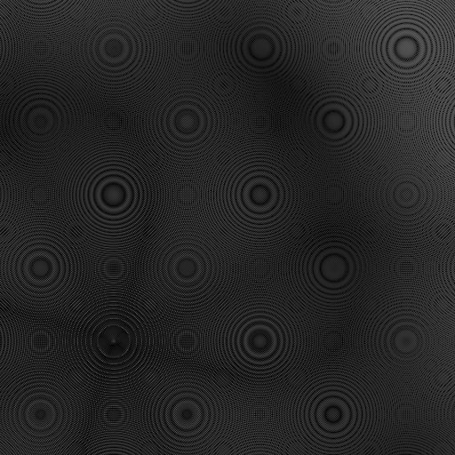
Optimized Error/σ

Slide 34
Sampling Error
Sampling Pattern | RMS Error
Random | 0.153
Jittered | 0.064
Poisson-Disk | 0.061
Hammersley | 0.045
Optimized | 0.017

Slide 35
Distributed Ray Tracing
Integrate over additional dimensions
  Pixel area
  Time
  Lens area
  Light-source area
  BRDF
Hammersley: ( i/N, φ₂(i), φ₃(i), ...φ_{p}(i) )

Slide 36
Quasi-Spectral Sampling
Use a good sampling pattern for pixel area
Additional dimensions project high-frequency, uncorrelated (SIGGRAPH ’91)
( x_{i}, y_{i}, φ₂(i), φ₃(i), ...φ_{p}(i) )
Must have correlated: i → ( x_{i}, y_{i} )
The spatial-indexing problem

Slide 37
Motion-Blur Experiment
Spinning fan test image
Jittered sampling ( x_{i}, y_{i} ) in grid ( j, k )
Spatial indexing mappings: i → ( j, k )
  Hilbert curve
  Interleave j, k
  Interleaved gray code
  Interleaved j, j ⊕ k

Slide 38
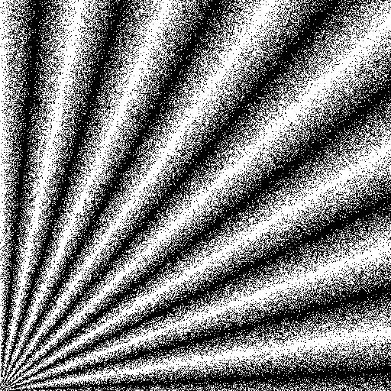
Spinning-Fan Test Image

Slide 39
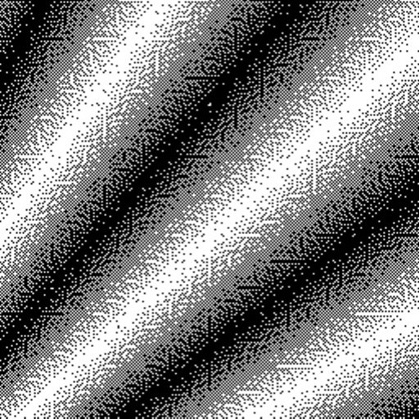
Hilbert-Curve Order

Slide 40

Interleaved j, j ⊕ k

Slide 41
Error in 16-Sample Experiments
Sample Pattern | RMS Err. | Max Err.
Random Time | 0.102 | 0.530
Hammersley | 0.0409 | 0.247
QS Hilbert | 0.0277 | 0.267
QS InterXor | 0.0277 | 0.191

Slide 42
References
Chazelle Bernard, The Discrepancy Method
Dobkin, Epstein, Mitchell, "Computing the Discrepancy with Applications to Supersampling Patterns", TOG Oct. 1996
Keller, Alexander, Quasi-Monte Carlo Methods for Photorealistic Image Synthesis

