Slide 1
Filtering Prompt Tuning to Avoid Further Training
Student: Anna Chen
Mentor: Dr. Cheng Han
6/23/2025
Week 5

Slide 2
Problem statement, current hypothesis and research question
Problem Statement: How can we change prompt tuning to improve accuracy?
Current Hypothesis:
By creating a gate that builds off prompt tuning, we can improve the accuracy of models without further fine-tuning.
Current Research Questions:
Can we find some differentiation between success and failure cases during prompt tuning to predict failures before they occur?
Can we create some sort of post-hoc calibration that will allow the model to learn from its mistakes during training?

Slide 3

Prompt tuning and Cybersecurity
Bias and misinformation
Threat detection and malware analysis

Slide 4
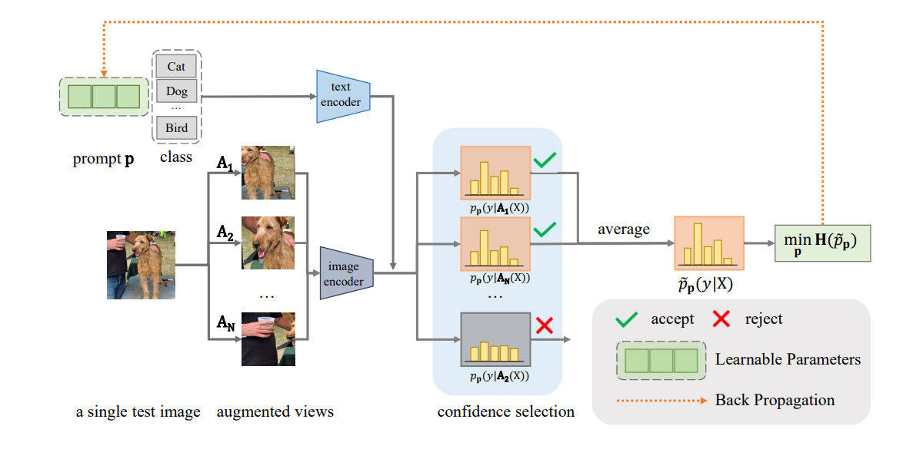
Test-Time prompt tuning for
Zero-Shot generalization in Vision-Language models:
They are able to make prompt tuning more accurate by discarding views that are less confident, reducing noise from the views and making the results less chaotic.
Unsupervised learning
Prompt tuning, Vision-Language model
Shu, M., Nie, W., Huang, D., Yu, Z., Goldstein, T., Anandkumar, A., & Xiao, C. (2022, September 15). Test-Time prompt tuning for Zero-Shot generalization in Vision-Language models. arXiv.org. https://arxiv.org/abs/2209.07511

Slide 5
AI methods used
Traditional supervised learning model
Prompt tuning
Possible use of post-hoc calibration
Possible use of test time learning/adaptation
Possible use of gating method

Slide 6
Initial results
Recreated two scripts last week:
BERT + COPA: 71.0, comparable to their 73.0
BERT + BoolQ: 73.73, comparable to their 75.8
New results:
WSC + Bert: 65.38 (their results - 68.3)
RTE + Bert: 76.53 (their results - 80.1)
WiC + Bert: 72.88 (their results: 75.1)
CoNLL04 + Bert: 82.21 (their results: 84.5)

Slide 7
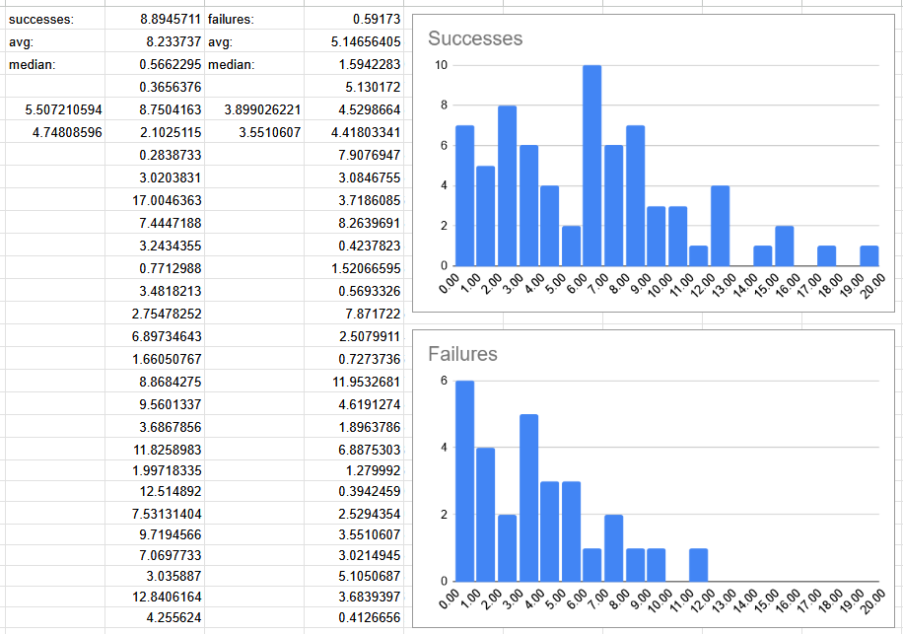
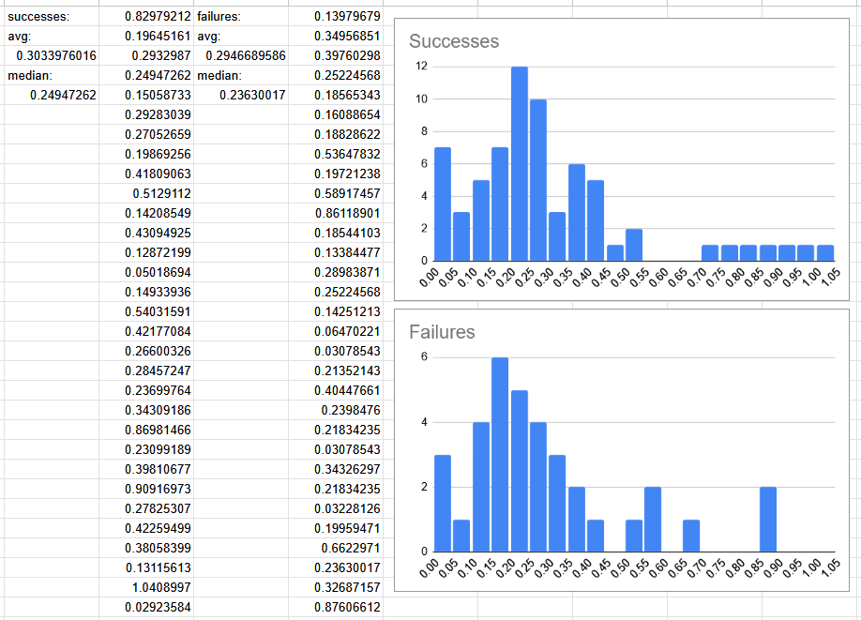
Initial results
(WSC + BERT)
(Copa + BERT)

Slide 8
Next Steps + Current Challenges
By week 6: Flesh out more testing analysis and find a statistical equation to model confidence
Challenges:
Testing and graphing more data
Finding differences/similarities between different datasets
Finding a statistical equation that can represent this relationship

Slide 9
References
Hu, J., Zhang, Z., Chen, G., Wen, X., Shuai, C., Luo, W., Xiao, B., Li, Y., & Tan, M. (2025, May 27). Test-Time learning for large language models. arXiv.org. https://arxiv.org/abs/2505.20633
Liu, X., Ji, K., Fu, Y., Tam, W. L., Du, Z., Yang, Z., & Tang, J. (2021, October 14). P-Tuning v2: Prompt Tuning Can Be Comparable to Fine-tuning Universally Across Scales and Tasks. arXiv.org. https://arxiv.org/abs/2110.07602
Xiao, G., Tian, Y., Chen, B., Han, S., & Lewis, M. (2023, September 29). Efficient Streaming Language Models with Attention Sinks. arXiv.org. https://arxiv.org/abs/2309.17453/

