Slide 1
Filtering Prompt Tuning to Avoid Further Training
Student: Anna Chen
Mentor: Dr. Han
6/15/2025
Week 3

Slide 2
Current hypothesis and research question
Possible Hypothesis:
Can we create a gate that builds off prompt tuning that improves the accuracy of models without further fine-tuning?
Possible Research Questions:
Can we create a self-learning gate that can predict whether the outcome of a prompt is accurate or not?
Can we find a statistical relationship between the perplexity of a sample and the outcome of that sample?

Slide 3
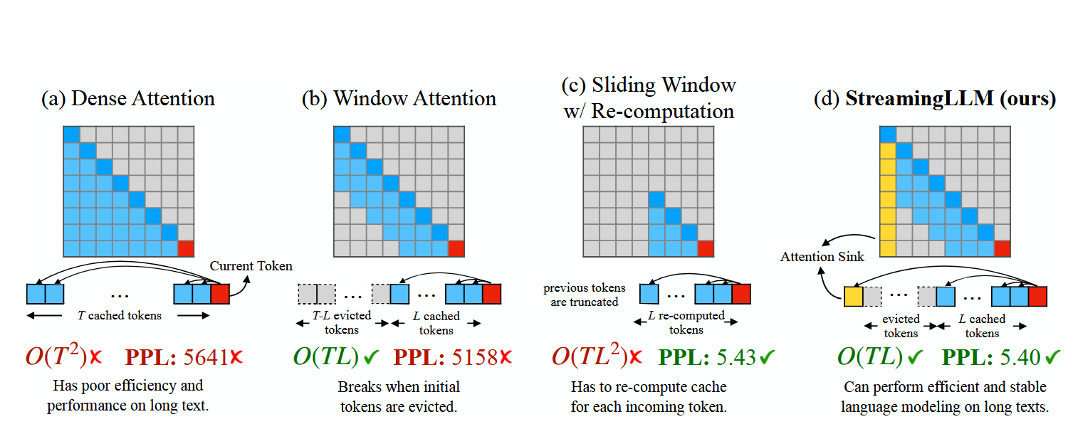
Attention Sink
StreamingLLM - for long inputs, keeps the initial tokens (attention sink), evicts tokens between the attention sink and the recent tokens, and keeps the recent tokens
Combines the sliding window technique of storing key value pairs with the attention sink of the first four key value pairs
x22.2 speedup compared to sliding window
Xiao, G., Tian, Y., Chen, B., Han, S., & Lewis, M. (2023, September 29). Efficient Streaming Language Models with Attention Sinks. arXiv.org. https://arxiv.org/abs/2309.17453/

Slide 4
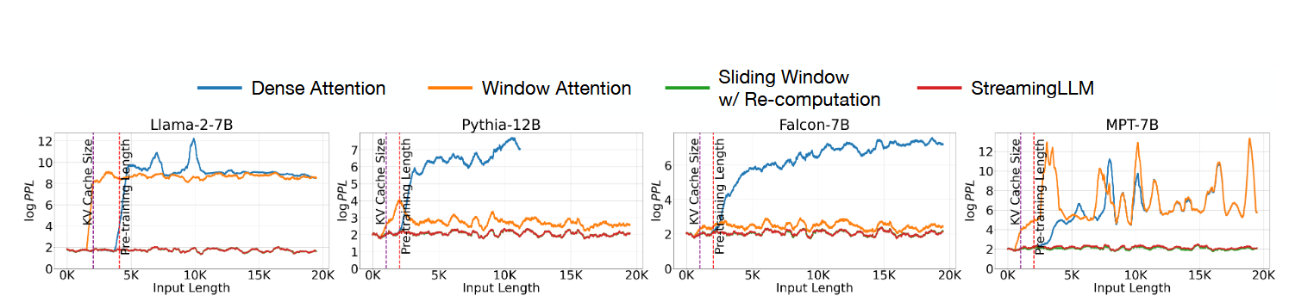
StreamingLLM is able to extend to an infinite length using this technique
The initial tokens are visible to all subsequent tokens, so it makes sense that they will take up more attention
Extra learnable token at the beginning can become a designated attention sink

Slide 5
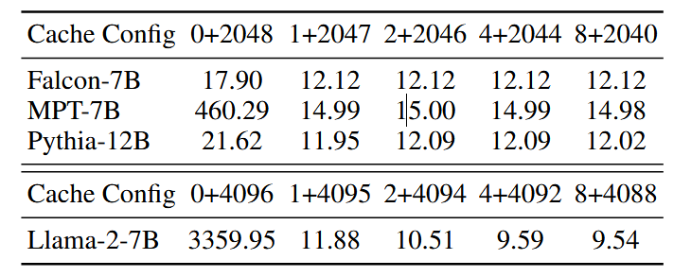
Diminishing returns after adding more than 4 learnable tokens

Slide 6
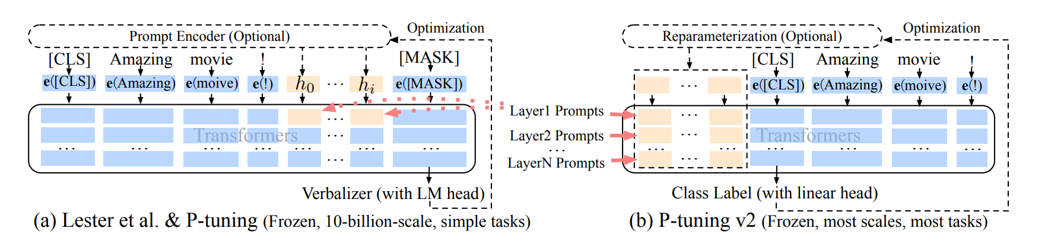
Related Work
P-Tuning v2: Prompt Tuning Can Be Comparable to Fine-tuning Universally Across Scales and Tasks.
- Properly optimized prompt tuning can be universally effective across a wide range of model scales and NLU tasks. They can match the performance of fine-tuning, while only having to use 0.1%-3% tuned parameters.

Slide 7
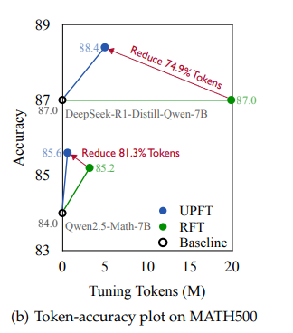
Related Work pt.2
The First Few Tokens Are All You Need for Fine-Tuning Reasoning Models
Just by using prefix substrings for guidance, they were able to outperform full-token fine-tuning approaches. By taking this approach, the training time and inference time is greatly reduced. Because this approach uses unsupervised fine-tuning, most methods will not be applicable to the supervised fine-tuning that we plan to conduct for our research question. However, the prefix-based fine-tuning used in this paper will provide important insights to how we can improve fine tuning in our approach.

Slide 8
AI methods used
Traditional supervised learning model
Prompt tuning
Using a gate during prompt tuning to filter through predicted positive and negative cases
Use of initial tokens due to attention sink
No use of fine tuning or further training after prompt tuning

Slide 9
Initial setup + Next Steps
Use of CB, COPA LLMs for testing
Use of glue and superglue datasets for testing
Use P-tuning v2 t-5 models as listed in their paper:
Focusing on changing the prompt and how that affects attention sink
Making a connection between attention sink and overall performance
Designing a possible gate or filter after finding patterns in performance
By week 4: Find a pattern between attention sink and performance, and start creating iterations of a possible gate.

Slide 10
Current Challenges
Finding a connection between attention sink and performance
Creating a gate that can predict positive and negative prompt cases
Creating a secondary method that can be used on the filtered negative prompt cases to result in better accuracy

