Slide 1
Filtering Prompt Tuning to Avoid Further Training
Student: Anna Chen
Mentor: Dr. Cheng Han
6/23/2025
Week 4

Slide 2
Problem statement, current hypothesis and research question
Problem Statement: How can we change prompt tuning to improve accuracy?
Current Hypothesis:
By creating a gate that builds off prompt tuning, we can improve the accuracy of models without further fine-tuning.
Current Research Questions:
Is there a relationship between sample perplexity and sample success/failure?
Can we find a statistical representation of this relationship to improve the accuracy of prompt tuning?

Slide 3
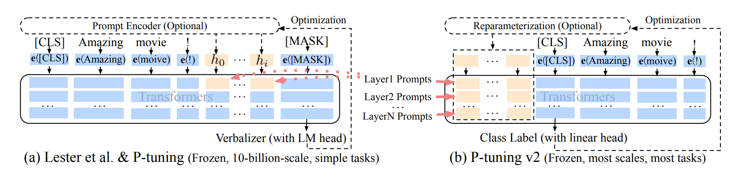
Related Work
P-Tuning v2: Prompt Tuning Can Be Comparable to Fine-tuning Universally Across Scales and Tasks.
- Properly optimized prompt tuning can be universally effective across a wide range of model scales and NLU tasks. They can match the performance of fine-tuning, while only having to use 0.1%-3% tuned parameters.
Liu, X., Ji, K., Fu, Y., Tam, W. L., Du, Z., Yang, Z., & Tang, J. (2021, October 14). P-Tuning v2: Prompt Tuning Can Be Comparable to Fine-tuning Universally Across Scales and Tasks. arXiv.org. https://arxiv.org/abs/2110.07602

Slide 4
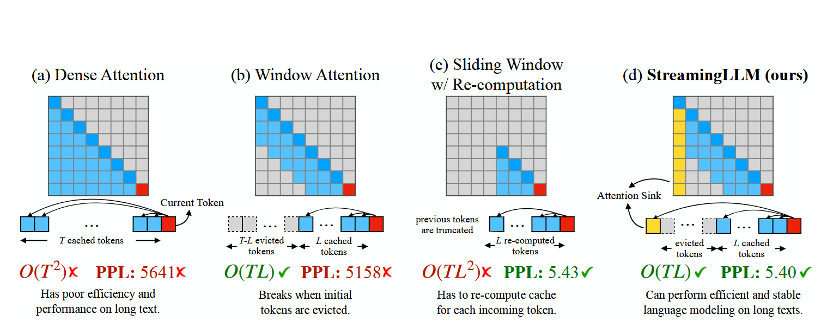
Attention Sink
Attention sink with sliding
window method
StreamingLLM - for long inputs, keeps the initial tokens (attention sink), evicts tokens between the attention sink and the recent tokens, and keeps the recent tokens
Combines the sliding window technique of storing key value pairs with the attention sink of the first four key value pairs
x22.2 speedup compared to sliding window
Xiao, G., Tian, Y., Chen, B., Han, S., & Lewis, M. (2023, September 29). Efficient Streaming Language Models with Attention Sinks. arXiv.org. https://arxiv.org/abs/2309.17453/

Slide 5
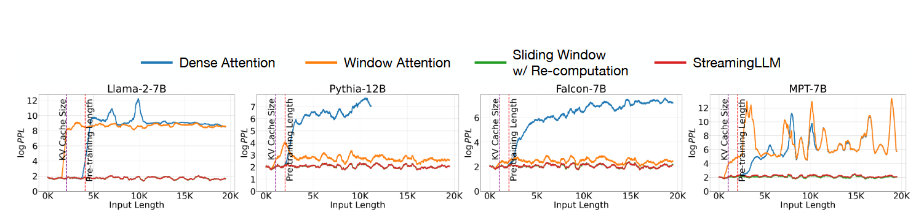
StreamingLLM is able to extend to an infinite length using this technique
The initial tokens are visible to all subsequent tokens, so it makes sense that they will take up more attention
Extra learnable token at the beginning can become a designated attention sink
Diminishing returns after adding more than 4 learnable tokens

Slide 6
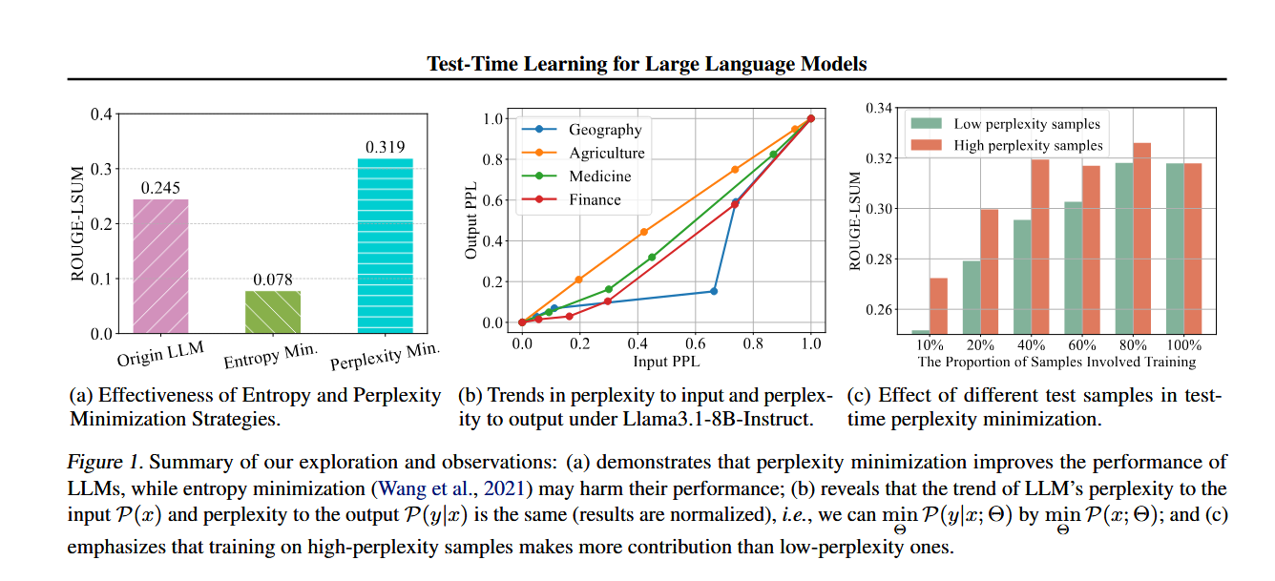
TLM
LoRA model
They've observed that high-perplexity samples are more informative for model optimization
They create the Sample Efficient Learning Strategy which uses those high-perplexity samples for test-time updates
Found that TLM improves the performance of original LLM's by at least 20% on domain knowledge adaptation.
Hu, J., Zhang, Z., Chen, G., Wen, X., Shuai, C., Luo, W., Xiao, B., Li, Y., & Tan, M. (2025, May 27). Test-Time learning for large language models. arXiv.org. https://arxiv.org/abs/2505.20633

Slide 7
AI methods used
Traditional supervised learning model
Prompt tuning
Using a gate during prompt tuning to filter through predicted positive and negative cases
Use of initial tokens due to attention sink
No use of fine tuning or further training after prompt tuning

Slide 8
Initial results
Currently, I have recreated two scripts:
BERT + COPA: 71.0, comparable to their 73.0
BERT + BoolQ: 73.73, comparable to their 75.8

Slide 9
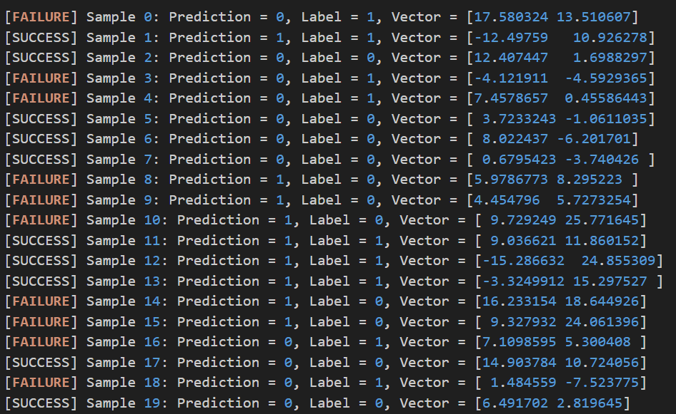
Initial results
BERT + COPA:
(epoch 79)

Slide 10
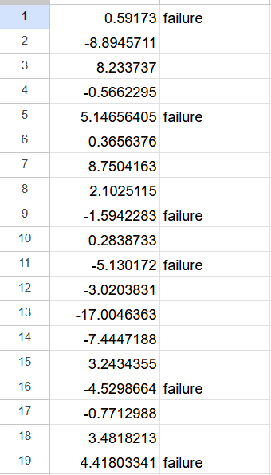
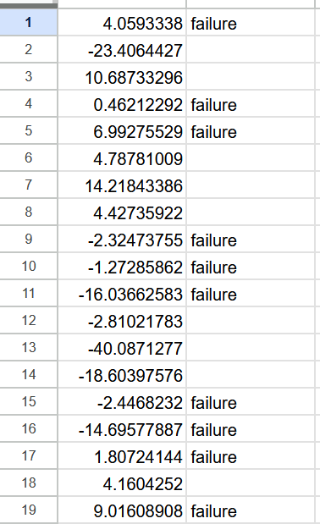
Initial results
(epoch 24) (epoch 79)

Slide 11
Next Steps + Current Challenges
By week 5: Flesh out more testing analysis and find a statistical equation between perplexity and performance
Challenges:
Testing and graphing much more data
Finding differences/similarities between different datasets
Finding a statistical equation that can represent this relationship

Slide 12
References
Hu, J., Zhang, Z., Chen, G., Wen, X., Shuai, C., Luo, W., Xiao, B., Li, Y., & Tan, M. (2025, May 27). Test-Time learning for large language models. arXiv.org. https://arxiv.org/abs/2505.20633
Liu, X., Ji, K., Fu, Y., Tam, W. L., Du, Z., Yang, Z., & Tang, J. (2021, October 14). P-Tuning v2: Prompt Tuning Can Be Comparable to Fine-tuning Universally Across Scales and Tasks. arXiv.org. https://arxiv.org/abs/2110.07602
Xiao, G., Tian, Y., Chen, B., Han, S., & Lewis, M. (2023, September 29). Efficient Streaming Language Models with Attention Sinks. arXiv.org. https://arxiv.org/abs/2309.17453/

