Slide 1

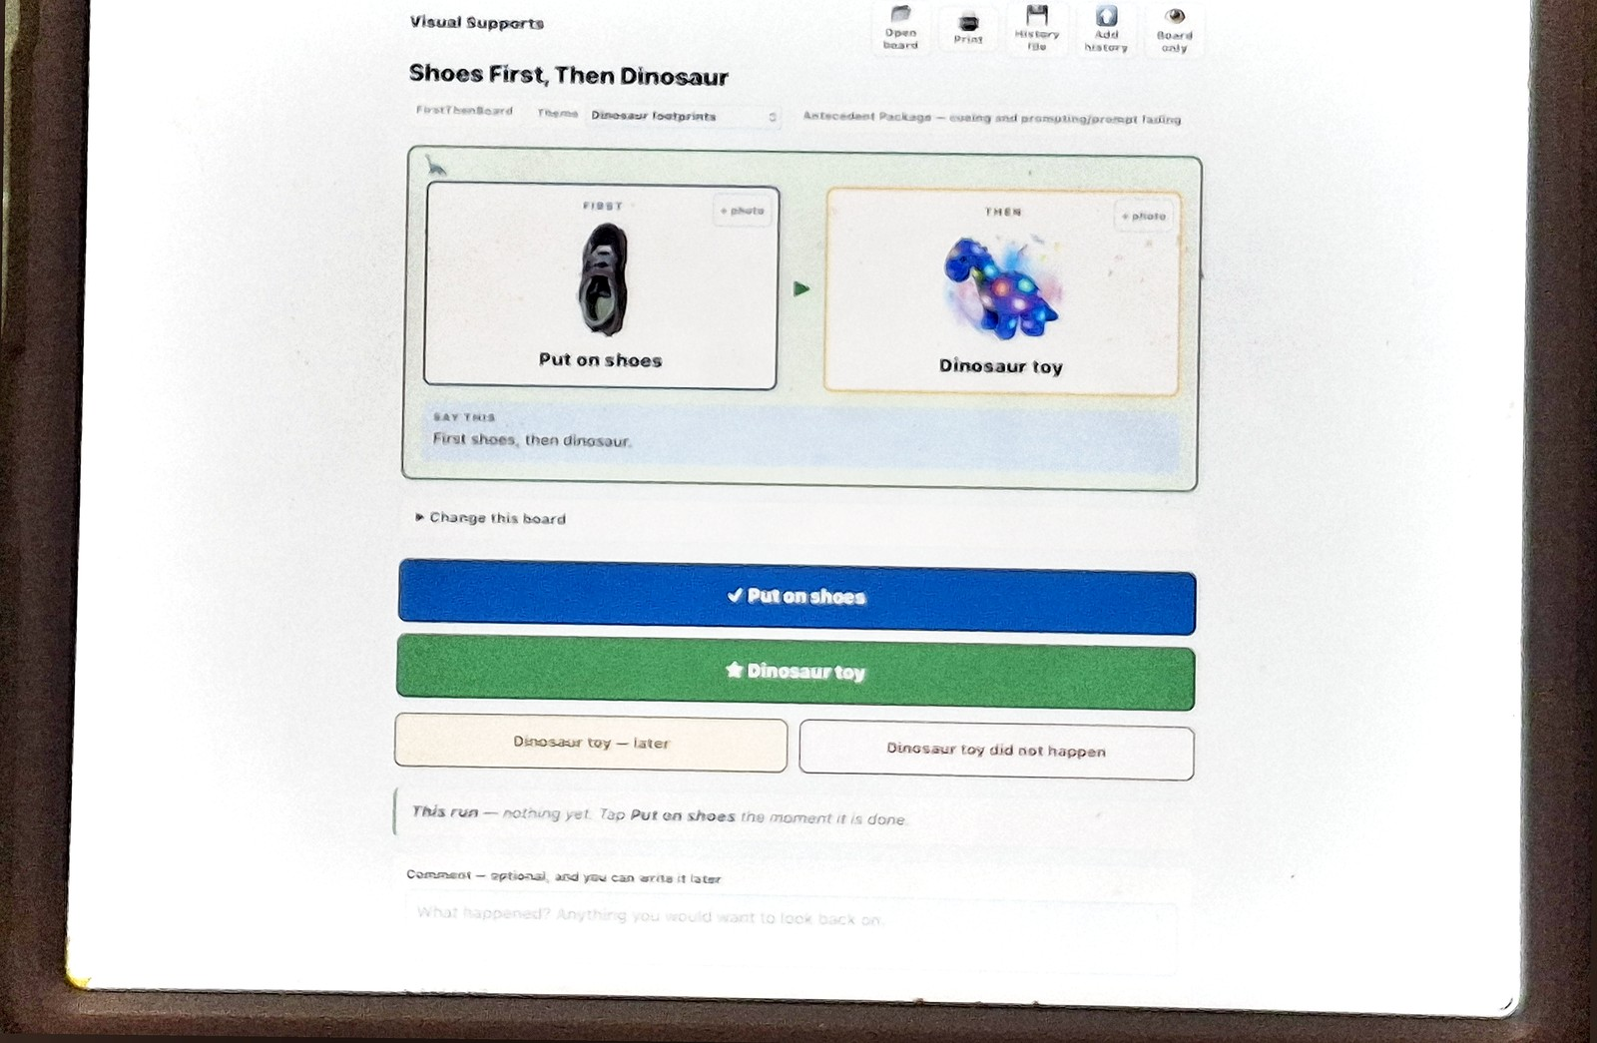
What this is, and the one claim it rests on
An agent composes a First-Then board from what a parent types, and cites the practice it used.
Every number in this video is in a file you can open.
1 / 11 · [0:00]
Notes:
This is an agentic app in OutSystems Developer Cloud. One agent drafts a visual support board from a parent's own words, grounded in two uploaded documents, and every board names the evidence-based practice it used.
That last clause is the whole project. So the interesting engineering is not the drafting. It is everything that stops the model from writing a confident board out of training data and citing a toolkit it never read.

Slide 2

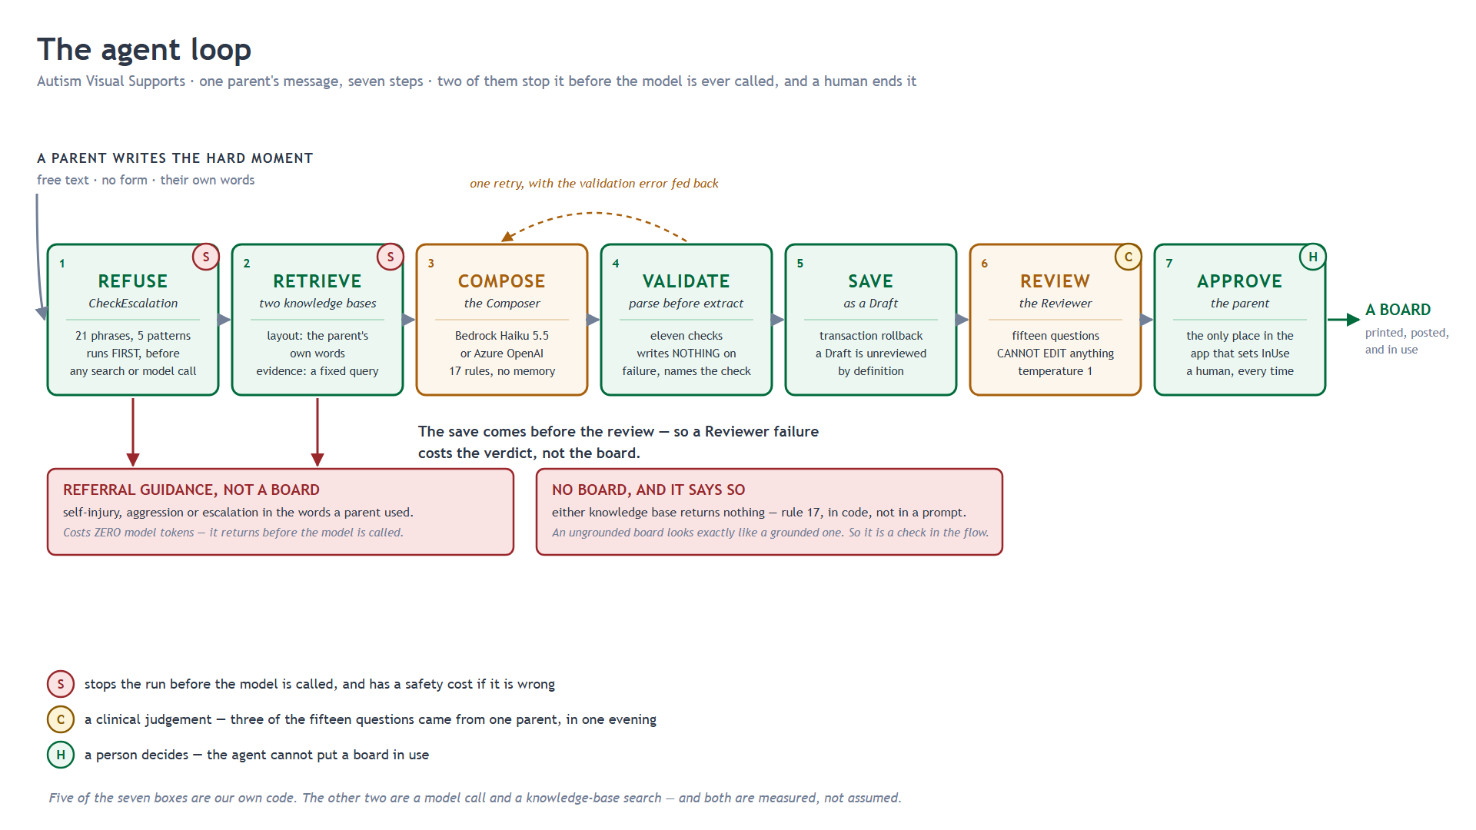
The flow, in order, because the order is the design
Safety check first. Retrieval. Grounding check. Compose. Parse. Save. Review.
The save comes before the review — a draft is unreviewed by definition.
2 / 11 · [0:40]
Notes:
Seven stages. Two of them stop the run before the model is ever called, and a human ends it.
`CheckEscalation` is first, on purpose. It reads the parent's text against twenty-one substrings and five regular expressions. On a hit it returns referral guidance and ends — it searches nothing, calls no agent, writes no board and logs no tokens.
It fired in production at half past four. "He hits himself when the toothbrush comes out." What matched is a verb-plus-reflexive regular expression, because the first version was substrings alone and the phrase a parent actually writes is "he bangs his head on the floor". Harm is a verb plus a target.
The same list is a Python module in the repo with seventy-four test rows across twenty-one tests. I compared the ODC patterns against it string by string. They are identical — and the translation is what found the bug: `elope` was a substring, so it matched `developed`. All twenty-one tests passed while that was true, because nothing had ever probed the substrings.

Slide 3

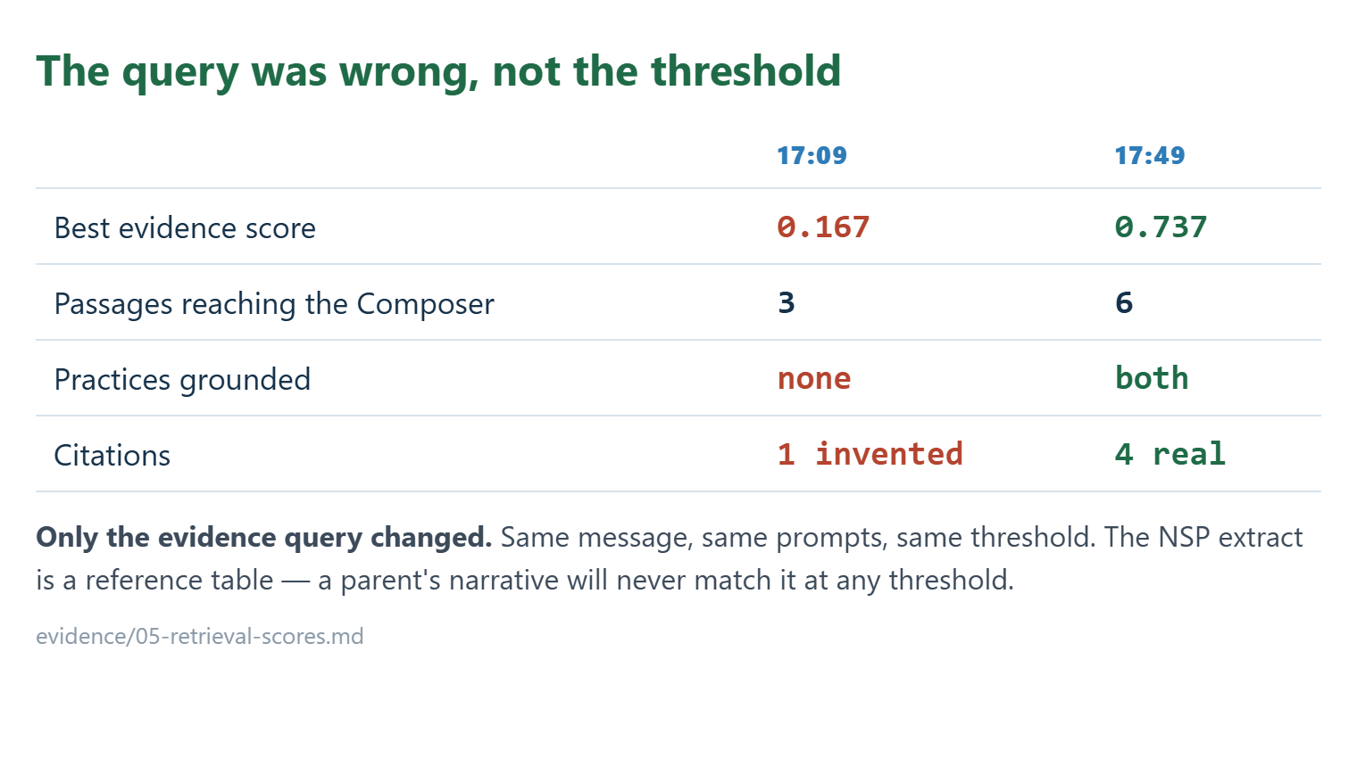
Retrieval, and the mistake worth showing
3 / 11 · [1:40]
Notes:
Two knowledge bases. The TRIAD toolkit for how a support is laid out; the National Standards extract for which practice it is. Both are queried on every call, before the prompt is built. The agent never retrieves — it is handed passages.
The first version queried both with the parent's paragraph. Evidence scored 0.167 and was rejected, so the board named three practices with no passage behind them.
I did not fix that by lowering the threshold. The National Standards extract is a reference table of treatment names; a narrative will never match it. The query was wrong, not the threshold. The evidence base is now queried with the practice vocabulary itself.
Evidence went from 0.167 to 0.737. The layout base is situational; the evidence base is reference. And the minimum score ships at 0.25 — set from scores observed, not chosen.
And these documents may be in a knowledge base at all because the TRIAD toolkit's own credits permit distribution as an electronic file, at no cost. Licensed, not assumed.

Slide 4

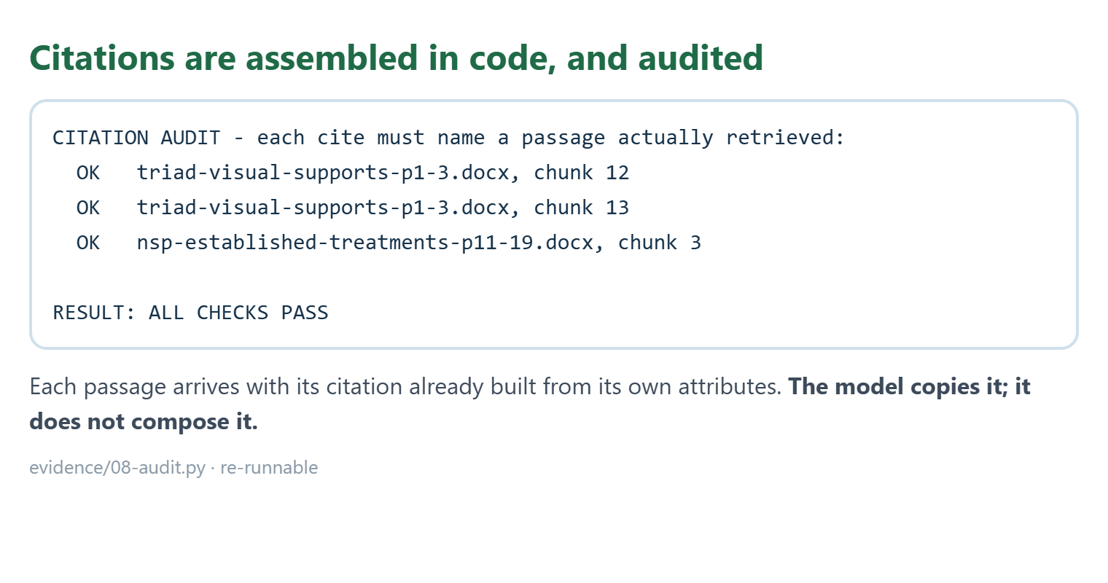
Citations built by code, not by the model
4 / 11 · [3:05]
Notes:
The first real board invented its citation — a section name that exists nowhere in the retrieval metadata.
A chunk position, a document id, a knowledge base id. The page number is zero on every result, which is a trap: a model told "pageNumber = 0" will cite page zero.
The fix was not to rewrite a nineteen-thousand-character prompt. Each passage now arrives with its citation already built from its own attributes — "cite this exactly as: filename, chunk twelve" — and the model copies it.
This script checks every citation in a board against the passages the model was given. Zero fabrication. It cited four of six and omitted the two it did not use.

Slide 5

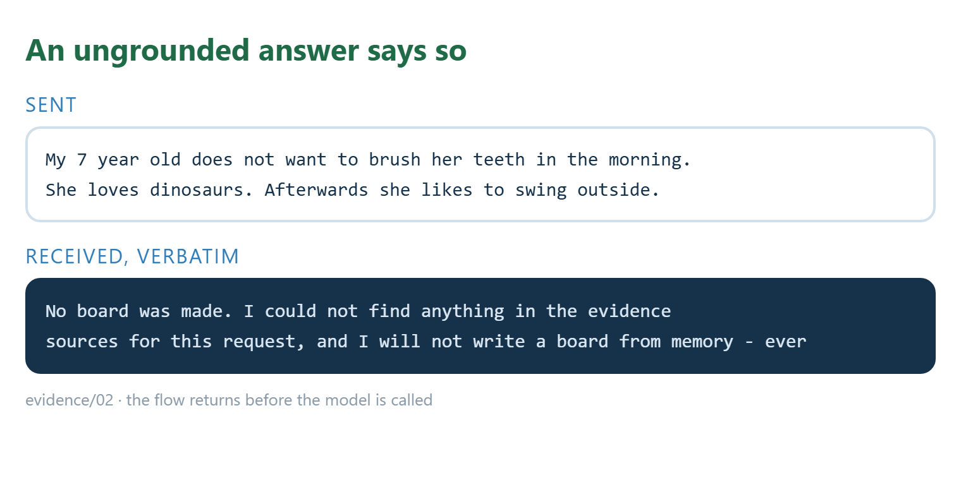
Refusing before extracting
5 / 11 · [3:55]
Notes:
Rule seventeen of the prompt says: if nothing was retrieved, do not compose from memory. That is now a step in the flow, not a line in a prompt. Zero passages from either base and it returns before the model is called.
And parsing begins by refusing. Thirty-eight checks — invalid JSON, a missing required field, the wrong card count, a practice outside the six citable values, a label over three words, a plan field longer than its column. Any of those and it writes nothing and names the check that failed, and the first failure wins, so a parent gets one message and not a list. It then retries once, with the validation message fed back to the model. A failure during saving rolls the transaction back.
A missing board is recoverable. A half-saved one is not. Thirty-one boards are saved.

Slide 6
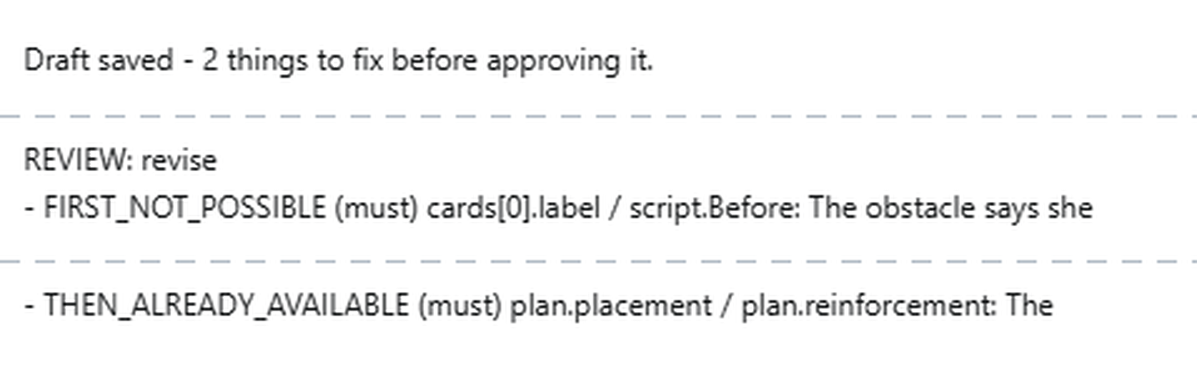
The second agent
6 / 11 · [5:05]
Notes:
The Reviewer has no tools and cannot edit anything. Fifteen questions a validator cannot answer. It runs after the save — a draft is unreviewed by definition, so a Reviewer failure costs the verdict and not the board — and its verdict gates only the approve step.
Three of those fifteen came from one conversation with the first test user, who is my wife, on the last build night. Ninety minutes later question thirteen fired at `must` on her own case, and its fix was her rule almost word for word.
Sixteen evaluation cases and seventy-four test rows did not find that. One conversation with a parent did.
One caveat: it runs at temperature 1, and that is forced — Bedrock Haiku 5.5 rejects 0.2. So a single pass proves nothing. Question thirteen has now fired three times.

Slide 7

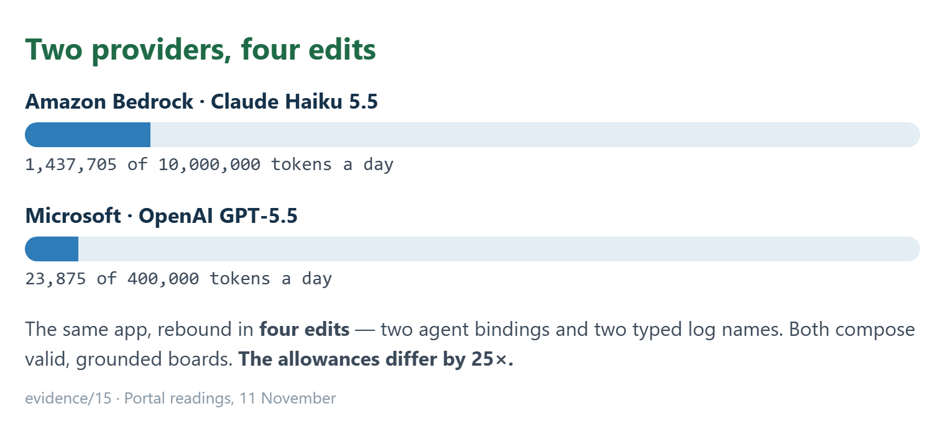
The platform parts, honestly
7 / 11 · [6:20]
Notes:
The model is Claude Haiku 5.5 through Amazon Bedrock — and at midnight I rebound a clone to Microsoft's GPT-5.5 through Azure OpenAI in four edits: two agent bindings and two typed log names. Both providers compose valid grounded boards and both return Reviewer verdicts.
Each provider rejects a different parameter and neither rejection is visible in the designer: Bedrock refuses a temperature of 0.2, Azure OpenAI refuses `max_tokens` and wants `max_completion_tokens`. So every binding needs a runtime call before you believe it.
Two things I would tell the next person. An ODC agent's model binding cannot be driven by a Setting, so switching providers is four edits, not one field.
Nothing in this app pauses; a service action runs to the end. What is true is that nothing becomes an in-use board without a separate approve call, and no other path sets that status.

Slide 8
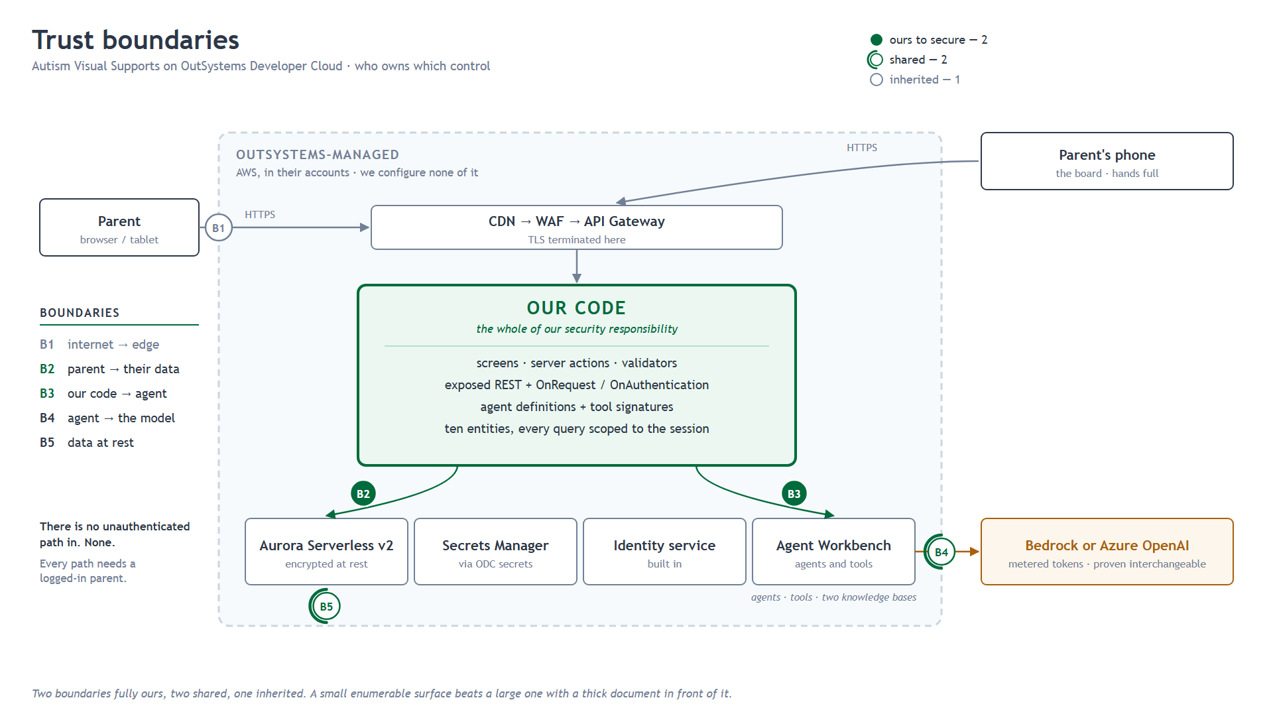
The data layer, and the criterion this does not meet
This application does not use DataFabric. There was nothing to federate.
Every entity is private; the only way in is a service action.
8 / 11 · [7:15]
Notes:
Enterprise connectivity, and I will be straight about it. This application does not use DataFabric. It holds its own data in ODC. There was no second system to unify, so there was nothing to federate and I did not invent a reason to.
What I did do is close the surface. Every entity is private. The only way in is a service action, because an action can validate and an entity cannot.
And one thing worth knowing, because it surprised me: in this version every service action is public by nature — making one private raises a validation error. So "expose only service actions" does not give you a private surface. The accurate sentence is that the entities are private, and every entry point is a service action that enforces its own rules.

Slide 9

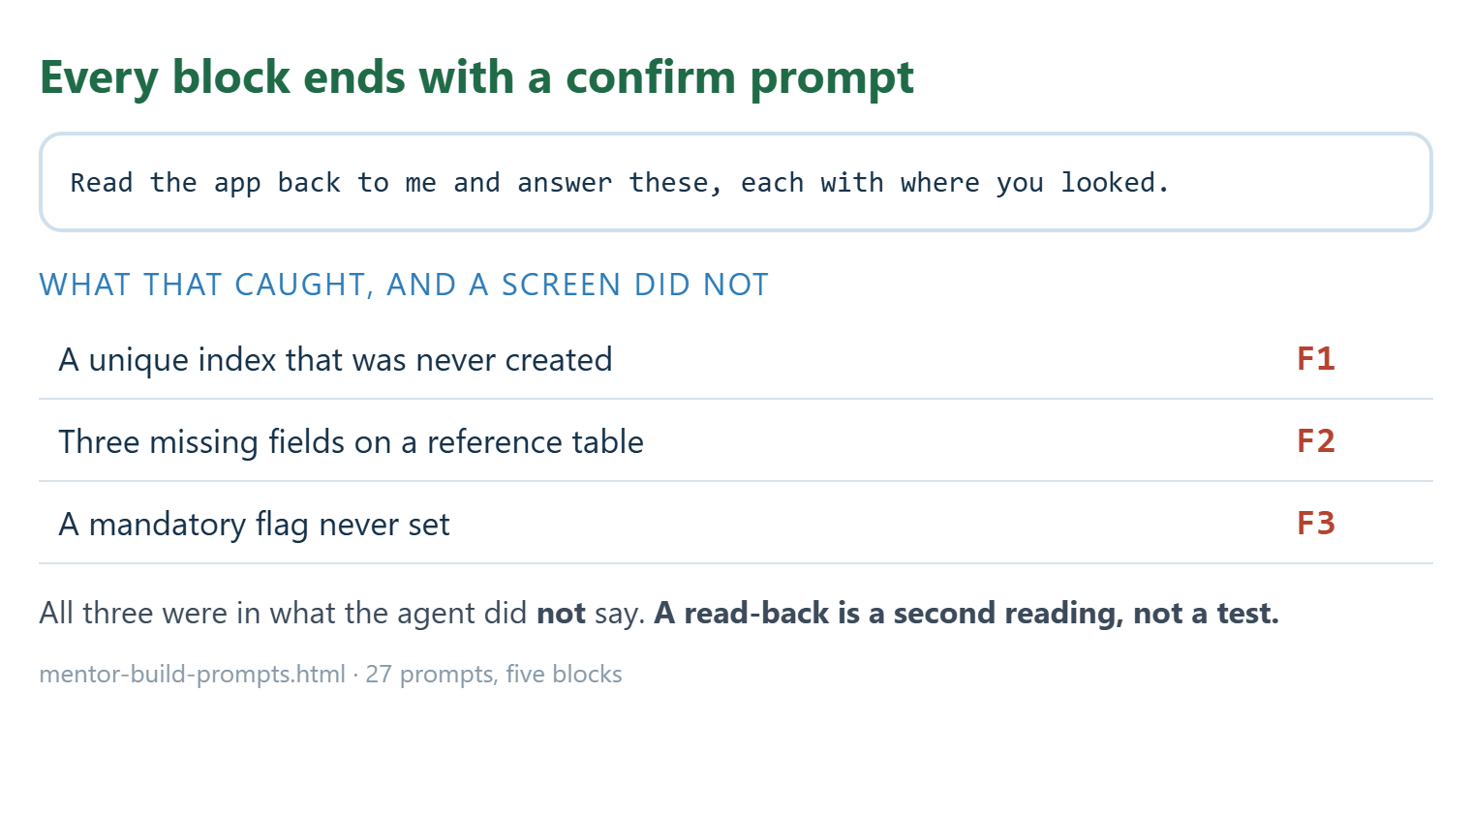
An agent built this, and the rule that made it safe
9 / 11 · [8:10]
Notes:
I did not hand-write this application. I wrote prompts and an agent built it — twenty-seven of them, in five blocks, and every block ends the same way: a confirm prompt that asks the agent to read the app back and say where it looked.
That is the part worth copying. Mentor is fast and usually right. What it is not is a witness. Three defects came out of those confirm blocks, and none of them came from looking at a screen. They were in what the agent did not say.
It also told me twice that the app had four settings. It has sixteen. It was counting its own and not the libraries'. And an unused agent sat in the app for a day, because validation does not warn about one.
Twice it told me something was impossible in OutSystems and was wrong. So "that cannot be done" is worth exactly one challenge.
And the rule I would put on the wall: a read-back is a second reading, not a test. It described an expression to me, I reproduced it, and my own importer rejected the result. The app was fine; the description had been shortened. Nothing is verified until something runs.

Slide 10

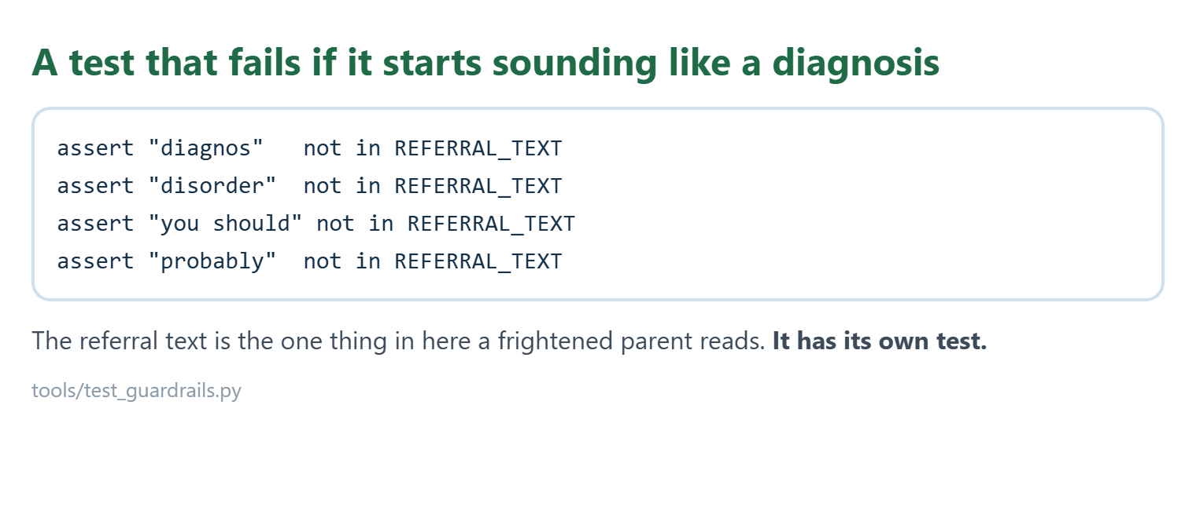
Wording as a constraint, not a flourish
10 / 11 · [9:55]
Notes:
A last technical note, because this is enforced rather than hoped for.
The non-affirming language rule is twelve phrases mapped to replacements, in code, checked before a board is saved — not prompt wording.
There is no gender field in the `Child` entity — the theme cannot be keyed on a child's sex, because the data model does not permit it. A schema guarantee, not a policy.
And the referral text — the one thing in here a frightened parent reads — has its own test. It asserts the text contains no "diagnos", no "disorder", no "you should", no "probably". A unit test that fails if the software starts sounding like a diagnosis.
Kindness is checkable. That is the only reason it survives a deadline.

Slide 11

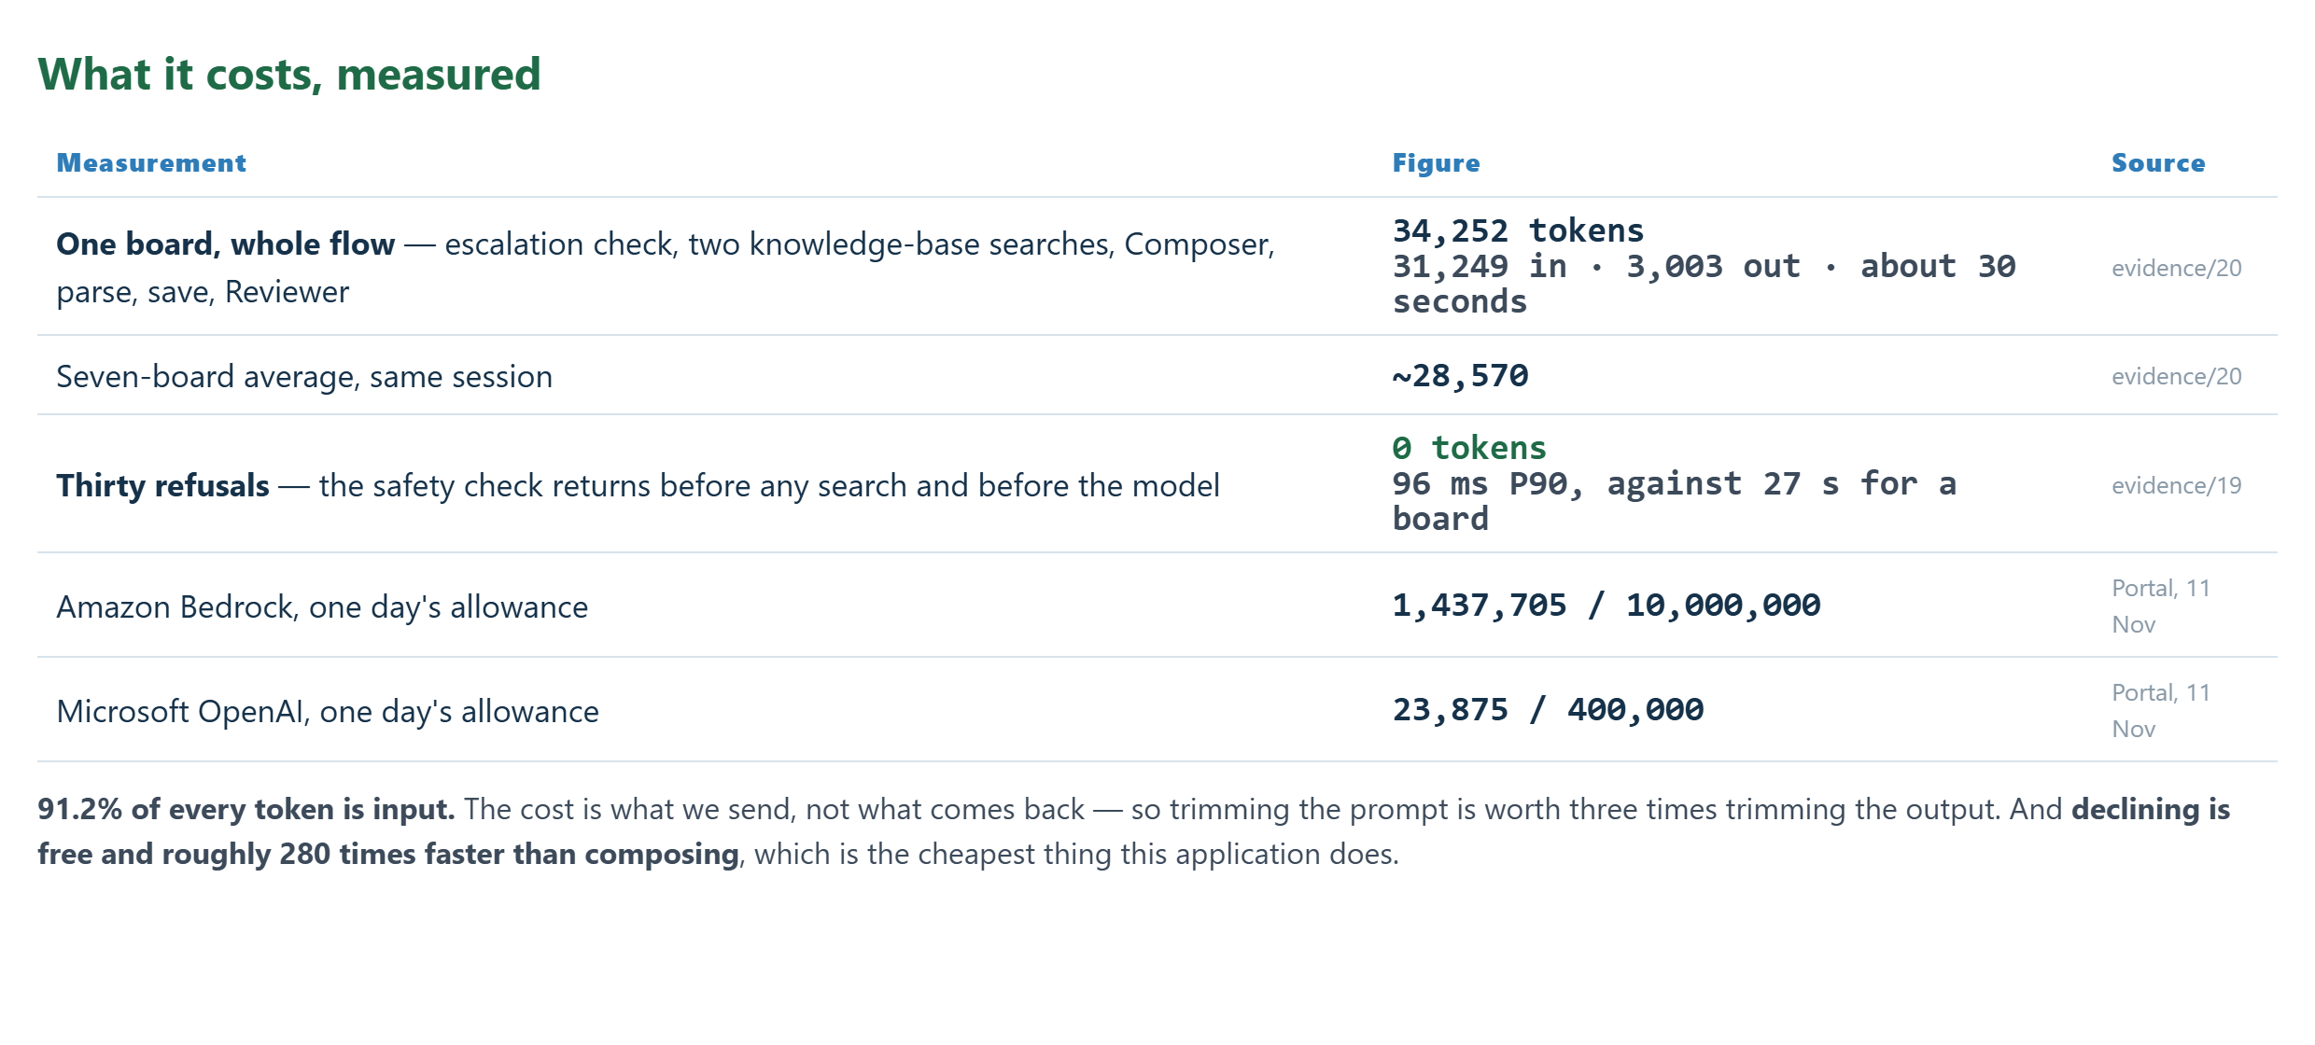
Appendix — what it costs
11 / 11 · [appendix]
Notes:
NOT SPOKEN. Hold this frame under the closing line rather than cutting away.
Every figure is traceable: one board 34,252 tokens (31,249 in, 3,003 out) and about thirty seconds, evidence/20. Seven-board average ~28,570, same session. Thirty refusals, zero tokens, 96 ms P90 against 27 s for a board, evidence/19. Portal readings of 11 November: Bedrock 1,437,705 of 10,000,000 a day, Microsoft 23,875 of 400,000 — the allowances are 25 times apart.
The two sentences worth noticing: 91.2% of every token is input, so the cost is what is sent rather than what comes back; and declining is free and about 280 times faster than composing.

