Slide 1
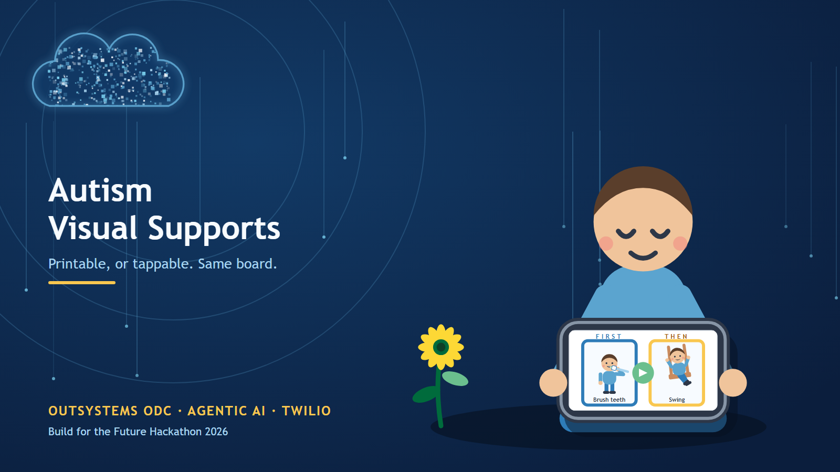
A.J. Aronoff
Notes:
Solo entry. The nonprofit partner is Autism Speaks, whose Autism Treatment Network published the toolkit this is built on. My daughter is autistic; my wife is the first test user.

Slide 2
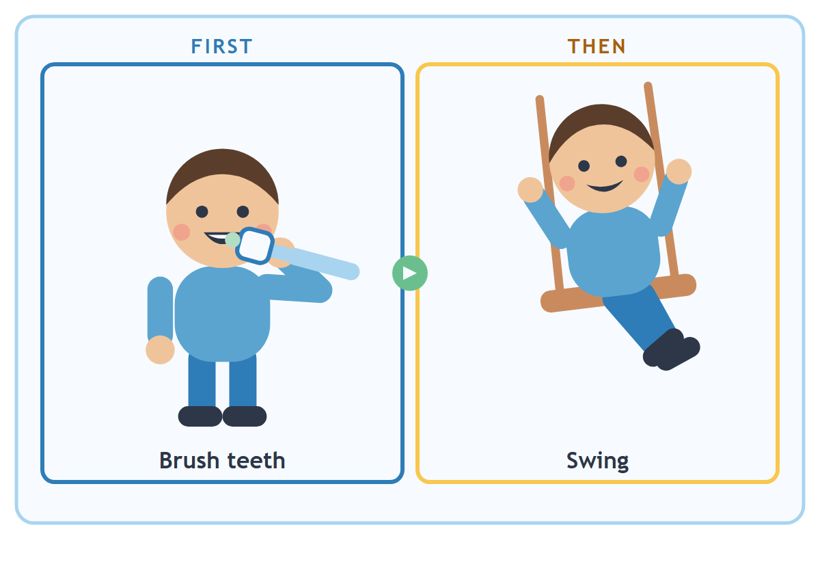
Four minutes to get out the door
A child is on the floor with a toy. In four minutes they need shoes on with their go-bag and they need to be in the car.
“We have to go now” does not work. Saying it louder works less.
What works is a picture.
First shoes. Then swing.
Two cards, in order, where the child can see them.
Notes:
Open with the scene, not the technology. Every parent in the room has lived this morning.

Slide 3
The method works. The making does not
What the research says
So why do most parents make two or three boards, ever?
First–Then boards, visual schedules and parameter cards are documented practice in the Vanderbilt TRIAD toolkit, published through the Autism Speaks Autism Treatment Network.
Find pictures the child recognises
Cut them to size
Keep every label to three words or fewer
Laminate, then add Velcro
And in the standards
The National Autism Center lists Schedules, Antecedent Packages and Story-based Intervention among the interventions with compelling scientific evidence.
40 minutes
and the morning you needed it
was this morning
Notes:
This is the gap the app closes. The craft project is the barrier, not the method.

Slide 4
“You must give them the reinforcing activity or item after they complete the ‘first’ task. Otherwise, your child may not trust the board the next time you use it.”
Vanderbilt Kennedy Center TRIAD / Autism Speaks ATN — Visual Supports and Autism (2011)
A board the child has stopped trusting is worse than no board. The next one starts from suspicion.
Notes:
This quote is the thesis of the whole product. Everything in the build serves it.

Slide 5
Three questions in. Three things out
The child’s profile — age, reading level, photos or icons, special interests, sensory triggers — is filled in once and reused forever. Every later board is three questions: which routine, what is hard about it, what the child actually wants afterwards.
1
The cards
Three words maximum. Phrased positively — “Walk in hallway”, never “Don’t run”. Printable with cut lines for lamination, or full-screen on a tablet.
2
The caregiver script
The one or two low-demand phrases to say out loud. “First shoes, then swing.” Then “All done shoes. Now swing!” Most tools stop at the picture. The words are what parents fumble.
3
The implementation plan
Where to put the board, the prompt hierarchy from least to most intrusive, and what to do when it goes wrong.
Notes:
The three-part package is lifted straight from the prompts I had already written; all three converged on it.

Slide 6
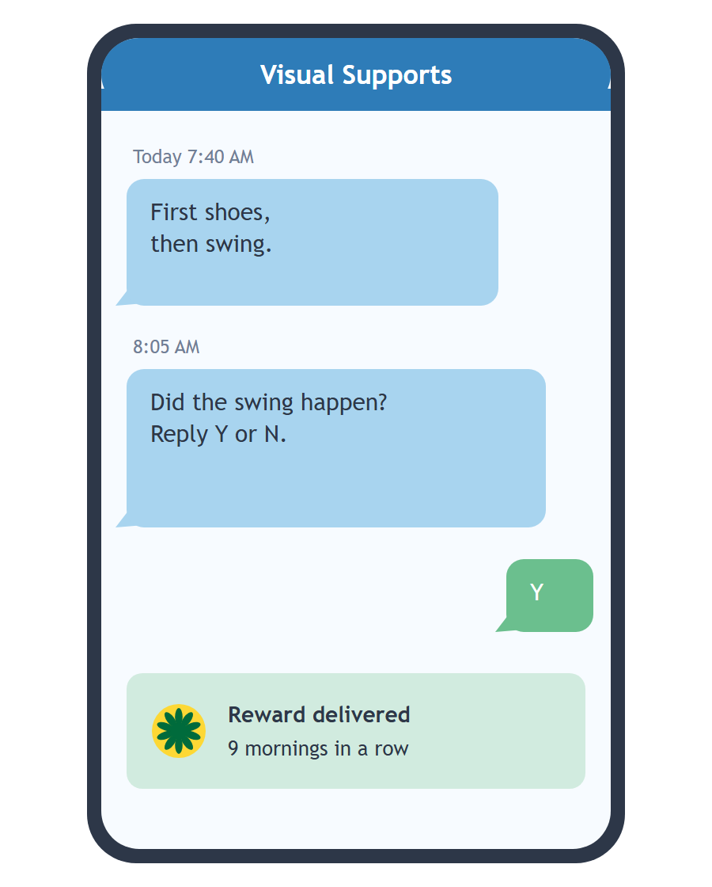
The loop nobody else closes
At the moment the routine runs, the parent is at the front door holding a pair of shoes. They are not holding a tablet.
Twilio carries the script
The caregiver phrase arrives by SMS when the routine is due — the only channel that reaches a parent mid-morning.
And asks one question after
“Did the swing happen? Reply Y or N.” One character writes the field the whole method depends on.
The home screen shows how reliably the promise has been kept — not how many boards you have made.
Notes:
This is the answer to 'why not just use a chatbot'. The chatbot makes the artifact. The app owns the follow-through.

Slide 7
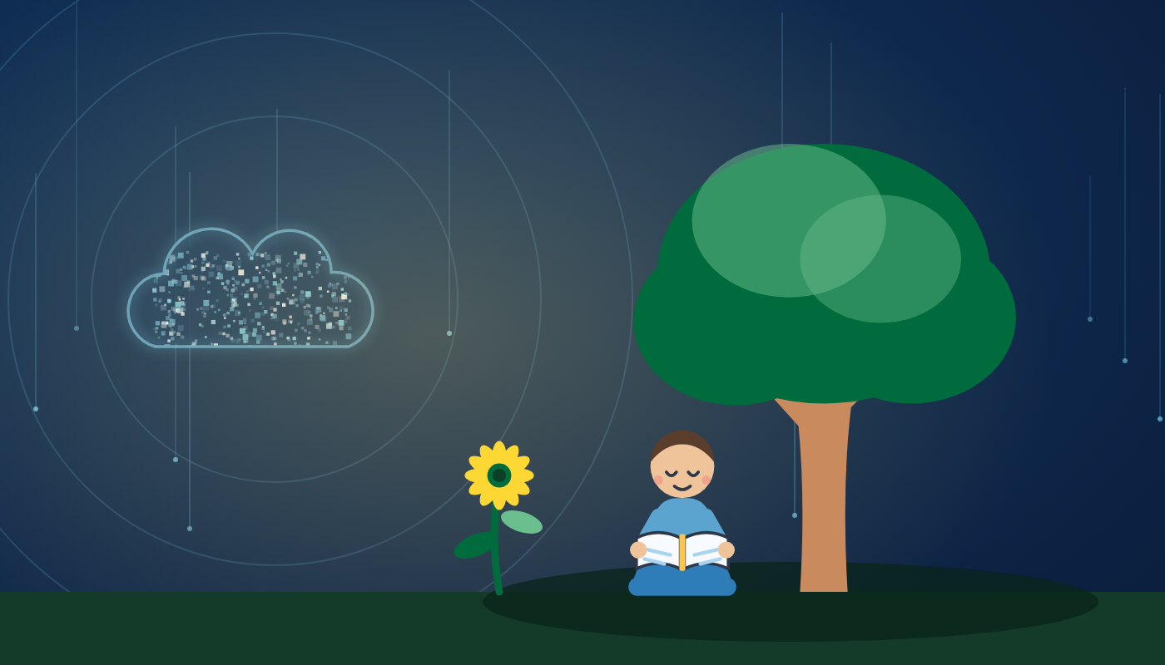
Next: social stories
Not in the seven-day build — but it is the next support type, and it costs one branch rather than a second app. A First–Then board handles the transition happening now; a social narrative handles what has not happened yet: the dentist, the fire drill, the new classroom.
Same three-part output
Pictures, the words to say, and the plan — written in the first person, delivered before the event rather than during it.
Same evidence base
Read in the shade, by the light of the cloud that wrote it.
Story-based Intervention: who, what, when, where and why, answered ahead of time.
Notes:
Roadmap, not demo scope. Say so out loud: it is the next support type through the same pipeline, which is why it costs one branch rather than a second app.

Slide 8
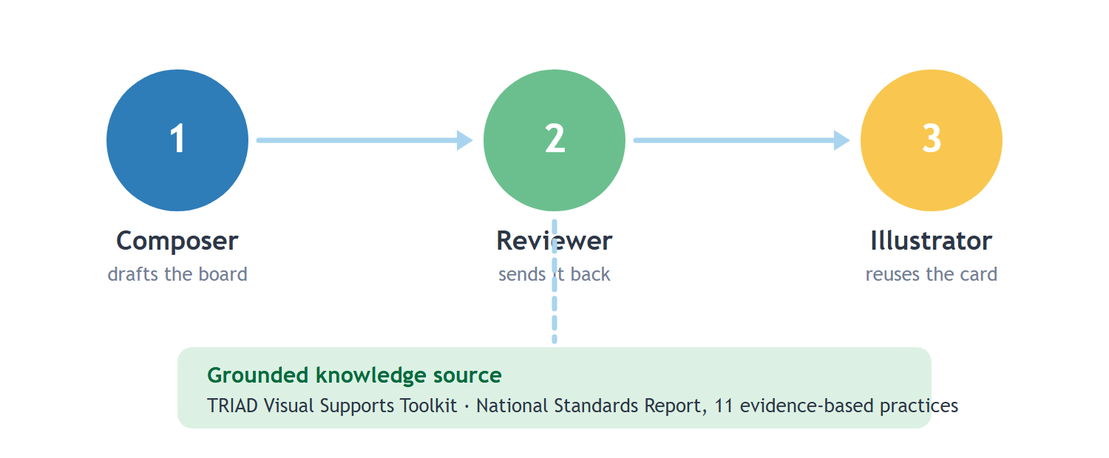
Agentic AI, not a single prompt
Each agent has a job small enough to inspect, and Agent Workbench exposes the reasoning path — which makes it demonstrable in five minutes.
Notes:
Composer drafts against the grounded toolkit. Reviewer bounces it when labels run over three words or the Then card is missing. Illustrator searches the child's card library before generating, so 'brush teeth' keeps the same picture forever.

Slide 9
Guardrails live in the app, not the prompt
Three words maximum
Positive phrasing only
Rejected and regenerated. The toolkit’s limit, not a style preference.
“Don’t run” is refused in favour of “Walk”.
No Then card, no save
No diagnosis, no clinical advice
A First–Then board cannot exist without its reward.
Self-injury or escalation in the text surfaces referral guidance instead of a board.
The child’s name never leaves
Open source
Image prompts say “a child”. Profiles are never training input.
Per the hackathon rules, so any family or nonprofit can run it.
Notes:
Validations in server actions, so a model that drifts cannot ship a bad board.

Slide 10
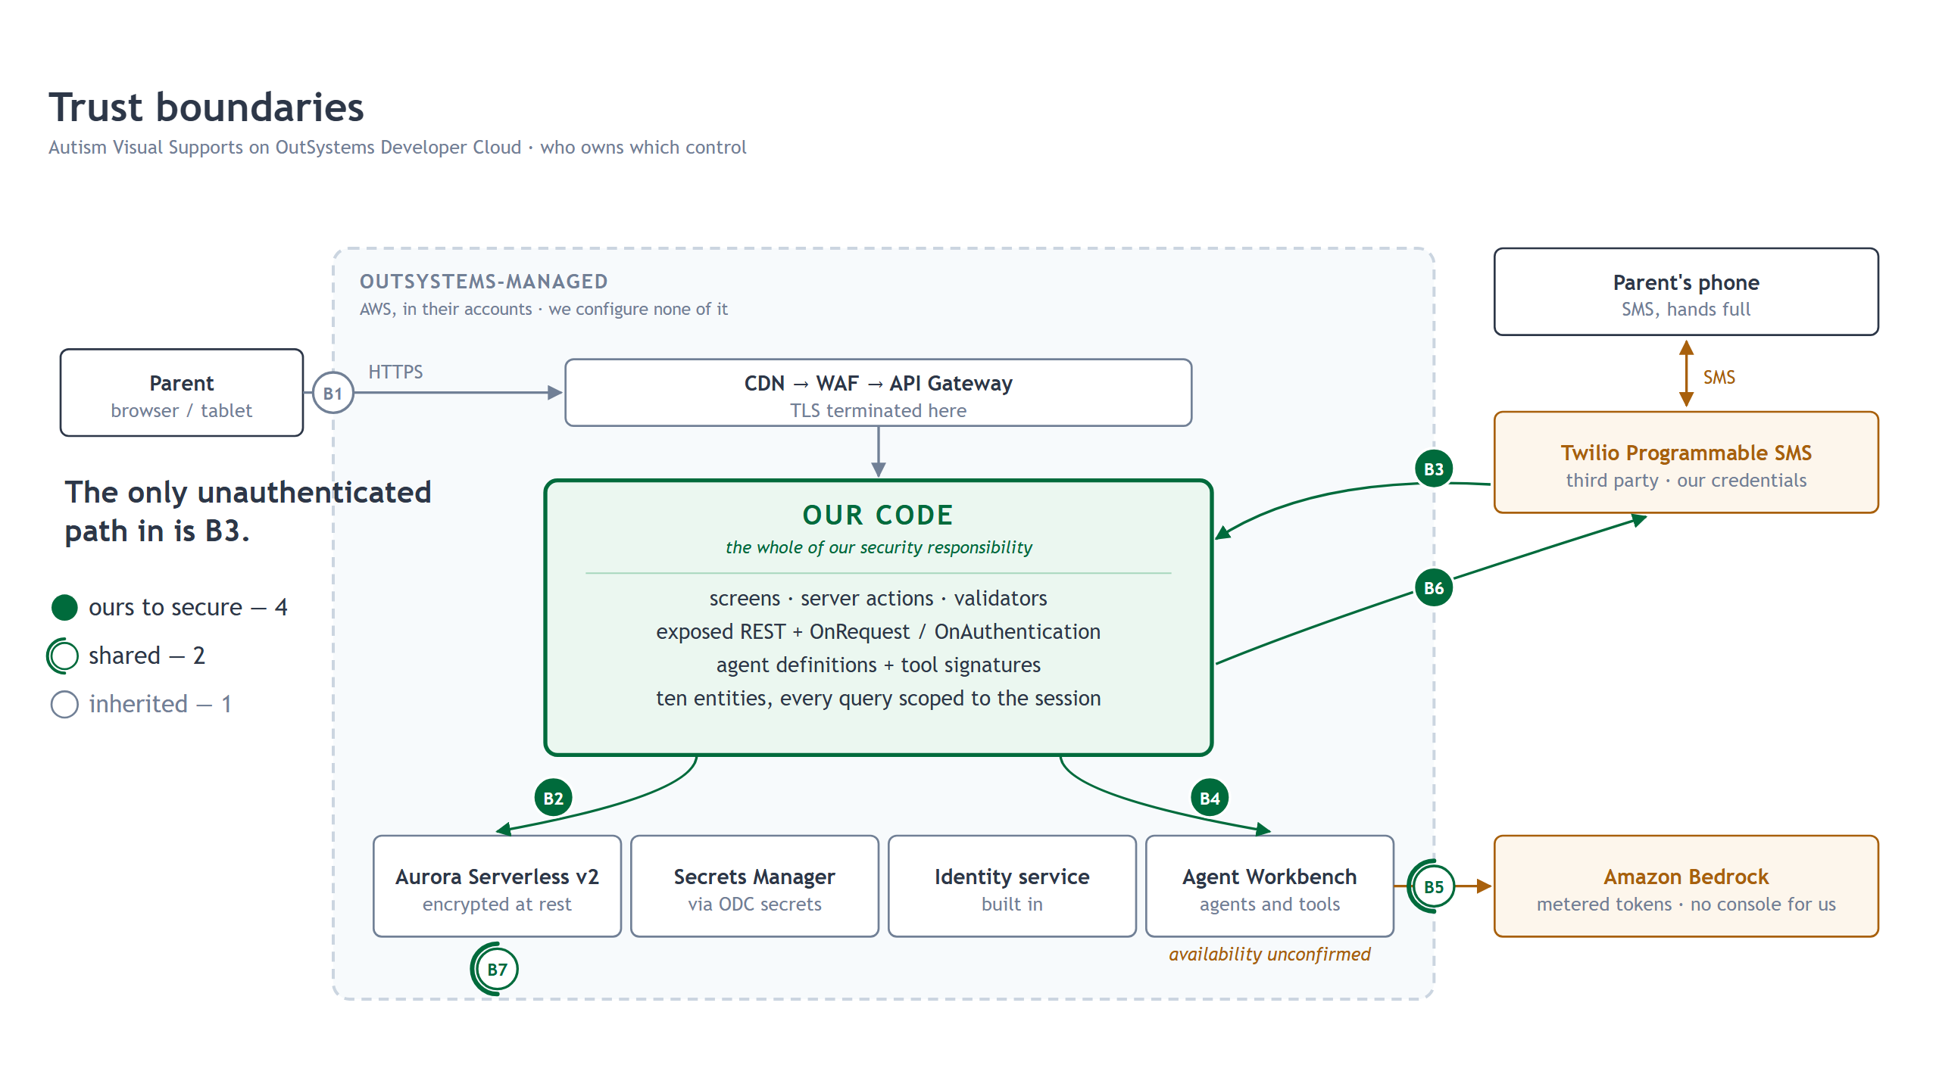

Slide 11
Seven days, demo path first
2 Nov
Kickoff
Re-plan against the ODC features and scoring announced there.
3–4 Nov
Model + agents
Entities, child profile, Composer and Reviewer on the First–Then branch.
4 Nov
Mid submission
Problem, use case, AI services and integrations.
5–7 Nov
The demo path
Wizard, editor, card library, print sheet, tablet mode, Twilio loop.
8 Nov
UX pass
Every screen the video touches. Nothing new built.
9 Nov
Submit
Five-minute walkthrough the judges can replicate. 11:59 PM CET.
ODC access opens only after registration closes on 28 October — so nothing can be built before the 2 November kickoff.
Notes:
Build the demo path first and leave nothing on it stubbed, because the judges re-run the app after the video.

Slide 12
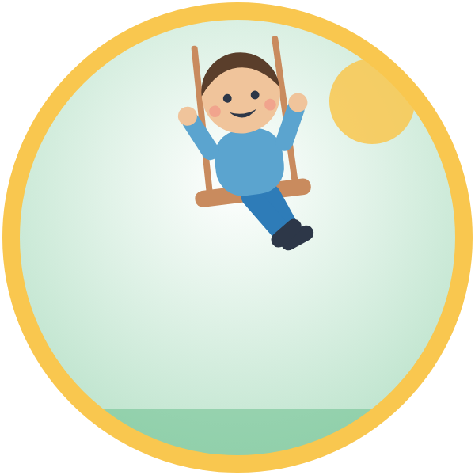
Why this team
My daughter is autistic. My wife will be the first test user.
I have been making these boards by hand for years, and I know exactly which forty minutes this app gives back.
Nonprofit partner: Autism Speaks — whose Autism Treatment Network published the toolkit this is built on.
Notes:
Also pursuing TRIAD at Vanderbilt and local Autism Society chapters, where a 12-month ODC license would go furthest.

