Slide 1
Calm Skies Travel
Safe travels, calm skies.
✈
☁
☁
Helping autistic children travel with more joy and less fear — one calm sky at a time.
calmskiestravel.com
🤖 IBM Bobathon
Notes:
Cover slide. Calm Skies Travel pitch deck for the IBM Bobathon event. Tagline: Safe travels, calm skies.

Slide 2
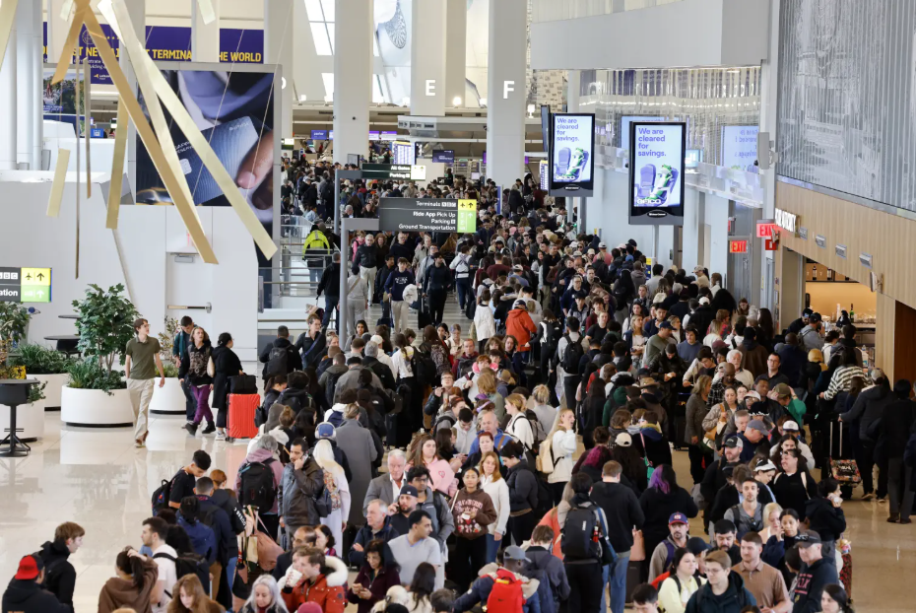
Why I started this
My family was flying to Florida to visit my mom. My daughter, who is autistic, generally likes to travel. We always pack a go bag with her must-have items: fidgets, snacks, chewelry, noise-canceling headphones and preloaded music.
But that day, LaGuardia was packed. We had left plenty of time, yet the security line was a nightmare.
The staff at LaGuardia were incredibly helpful. They knew some of the signs to look for. Still, the day would have gone much better if I had known how to travel calmly through the skies.
This website is for anyone in a similar situation.
Safe travels, calm skies, and best wishes.
A.J. Aronoff
LaGuardia Airport · Photo: Kevin C. Downs
Notes:
Slide 2: Why I started this. LaGuardia photo on left. A.J.'s personal backstory on the right. Keep tone warm and personal.

Slide 3


One Guide, Two Voices
Every step of the trip has a plan for the parent and a story for the child.
For the Parent
For the Child
Tips for each travel stage
Step-by-step checklists
Meltdown plan: before, during, after
Simple "I" stories, read together
What helps me feel calm
My own travel story — just for me
Always from MY point of view
Notes:
Slide 3: One Guide, Two Voices. Light blue background. Large green title. Two white boxes — Parent left with Parent.png icon, Child right with Child.png icon. No Bob badge until final slide.

Slide 4
The Journey — Step by Step
Always from the child's point of view.
🏠
I get ready
at home
✈
I go to the
airport
🛫
I get on
my plane
🌟
I arrive and
see my family
🏡
I go home
again
→
→
→
→
Pack the Calm 🎒
Go bag ready
Social story read
Schedule visible
Airport Time 🛂
TSA Cares
Sunflower Lanyard
Pre-boarding
On the Plane 🎧
Headphones on
Fidgets ready
My calm playlist
I Arrive! 💚
Familiar faces
Familiar snacks
I did it!
🤖 IBM Bobathon
Notes:
Slide 4: The Journey Step by Step. 5 steps with emoji icons and connecting arrows. Below each step is a detail card. All from the child's point of view.

Slide 5
Customizable Social Stories
The heart of Calm Skies Travel. A story built around YOUR child — their name, their destination, their feelings.
📖 Going to Visit
"I am [name]. I am going to visit [grandma / friend]. I will fly on a plane. I will see [person] when I land. I am excited about [detail]."
✈️ On the Plane
"I am on the plane. My seat is [seat]. I have my headphones. I have my [comfort item]. If I feel worried, I can [breathe / squeeze my fidget / tell my parent]."
🌟 Land & See Family
"The plane has landed. I did it! I will see [person] soon. They are happy I am here. We will [hug / eat / rest]. I am safe."
How the Story Builder works:
Enter child's name, destination, who they'll see and what helps them feel calm.
The site generates a warm, first-person story — ready to read together, print or laminate.
Every sentence can be edited by the parent.
Stories travel in a QR code — no account, no login, no data on any server.
🤖 IBM Bobathon
Notes:
Slide 5: Social Stories. Three story cards side by side. Below: how the Story Builder works. Emphasize: no login, QR code, parent editable.

Slide 6
Helpful Hints — Easy to Miss, Life Changing
Most of these must be set up BEFORE the flight.
🌻 Sunflower Lanyard
The Hidden Disabilities Sunflower quietly tells airport and airline staff: this traveler may need extra time, patience or help.
Available at most major airports.
📋 DPNA Code
Ask the airline to add the Disabled Passenger — No Advance Warning code to your booking.
This ensures staff are briefed and pre-boarding may be offered.
📞 TSA Cares
Call TSA Cares 72 hours before your flight.
A TSA officer can meet you at the checkpoint to guide your family through security — calmly and kindly.
⭐ More Hidden Help:
✓ Wings for Autism — airport rehearsal days for families
✓ Airport Sensory Rooms — quiet, calm spaces airside
✓ TSA PreCheck — shorter, calmer security lanes
✓ Pre-boarding — ask the gate agent early
✓ Autism Assistance Cards — wallet card for staff
🤖 IBM Bobathon
Notes:
Slide 6: Helpful Hints. Three primary cards: Sunflower Lanyard, DPNA Code, TSA Cares. Bottom strip: Wings for Autism, Sensory Rooms, TSA PreCheck, pre-boarding, autism cards.

Slide 7
Pack the Calm. Ship the Rest.
🎒 The Go Bag — Carry This With You
📦 Ship Ahead — Let the Familiar Arrive First
✓ Noise-canceling headphones
✓ Preloaded music or audiobook
✓ Fidget toys
✓ Chewelry
✓ Favorite snacks
✓ Comfort item (small blanket / stuffed animal)
✓ Printed social story
✓ Autism assistance card
✓ Reusable water bottle
Consider shipping to the hotel or relative's home before you travel:
✓ Favorite foods and snacks
✓ Familiar bath products (same shampoo smell = calm)
✓ Preferred pillow or blanket
✓ Extra comfort items
✓ Activity supplies
💡 When familiar things are already there, the new place feels like home faster.
💡 Tip: Amazon ships to hotels. Ship 2 days before you fly. Familiar things waiting = a calmer arrival.
🤖 IBM Bobathon
Notes:
Slide 7: Pack the Calm, Ship the Rest. Left column: go bag checklist (meadow green). Right column: ship ahead guide (sky blue). Bottom tip strip.

Slide 8
Staying Calm — Before, During and After
Travel breaks routines. These strategies help protect the calm — for child and parent alike.
🌅 BEFORE
• Read the social story together
• Make the schedule visible
• Spot the triggers early
• Pack the go bag the night before
• Set up TSA Cares, DPNA, Sunflower Lanyard in advance
• Build in extra time — always
• Plan for delays with a 'what if' card
✈️ DURING
• Headphones on early
• Fidgets in hand
• Keep the child safe first
• Reduce noise and light
• Use fewer words — calm voice
• Find the quiet spot
• Deep breaths together
• 'We are safe. We are almost there.'
🌿 AFTER
• Comfort item immediately
• Water (reusable bottle)
• No blame. No shame. Ever.
• Rest first — celebrate later
• Note the trigger for next time
• Record what worked in the Trip Review
• Next trip starts smarter than this one
🤖 IBM Bobathon
Notes:
Slide 8: Staying Calm — Before, During, After. Three equal columns. Warm and supportive tone throughout. No clinical language.

Slide 9
Thank You
❤
☁
☁
Safe Travels, Calm Skies.
calmskiestravel.com
🤖 IBM Bobathon
Notes:
Slide 9: Thank You. Large heart, calm sky colors, tagline, website URL. Simple, warm, memorable close.

