Slide 1
MQ AI Agent
Ticket Pipeline
QMS1 · ACME.APPDATA.QUEUE
850 messages waiting · 0 applications reading
From a silent queue to an actionable diagnosis
A.J. Aronoff · IBM AngelHack · October 2026
Notes:
Hi, I'm A.J. This is the MQ AI Agent Ticket Pipeline. Eight hundred and fifty messages on a real queue manager, and nothing reading them. Three minutes on how we find that automatically, and get it answered.

Slide 2
Overview: What we are building
An automated pipeline that records status, notices problems, writes the ticket, enhances the ticket for the MQ AI Agent and asks the agent what is wrong.
DETECT
TICKET
ENHANCE
DIAGNOSE
Sweep every queue. Depth with nothing reading it is the state that always needs a person.
Each stuck queue becomes one ticket, carrying the MQ facts that prove it.
One line is added — the line that turns a record of a problem into a question an agent can answer.
The IBM MQ AI Agent reads it, inspects the live queue manager, and names the cause and the command.
CURDEPTH > 0
IPPROCS = 0
INC-0042 QMS1
850 deep, 0 readers
Diagnose Q <queue>
on Q Manager <qmgr>
GET(DISABLED)
found in 20 seconds
Nobody has to notice first (automated: detection, ticketing, enhancement)
Detect, ticket and enhance are ours, and they run unattended. Diagnose is IBM's MQ AI Agent, live. The fix stays a human decision.
Notes:
Here is the whole idea. A queue manager already knows when a queue is stuck. What it does not do is tell anybody. So we built a pipeline. It detects that state — messages waiting, nothing reading. It raises a ticket carrying the MQ facts. It adds the one line that makes the ticket answerable. And the IBM MQ AI Agent diagnoses it. Detect, ticket and enhance are ours, and they run unattended. The diagnosis is IBM's. The fix stays a human decision.

Slide 3
A queue can be 85% full with no one reading from it
850 / 1000
3600 / 4000
NONE
ACME.APPDATA.QUEUE
ACME.COMMERCE.QUEUE
Connected user applications
85% full and climbing
last put: a week ago
nothing is draining either queue
IBM MQ already knew all of this.
Every number on this slide came off the QMS1 dashboard. The gap is not visibility — it is that nothing turns what MQ already reports into something a person is handed.
Source: IBM MQ Console, queue manager QMS1, 9 October 2026, 12:30 AM
Notes:
Two queues on one queue manager. One is eighty-five percent full. The other has not been read in a week. MQ reports all of it on its own dashboard — but only if somebody goes and looks. Nobody was looking.

Slide 4
One sweep, every queue
SCANNER OUTPUT · QMS1
echo "DISPLAY QSTATUS(*) TYPE(QUEUE) \
CURDEPTH IPPROCS OPPROCS" \
| runmqsc QMS1
QUEUE
DEPTH
IPPROCS
ACME.APPDATA.QUEUE
850
0
TICKET
ACME.COMMERCE.QUEUE
3600
0
TICKET
THE RULE
CURDEPTH > 0 AND IPPROCS = 0
SYSTEM.DEFAULT.LOCAL.QUEUE
0
0
ok
Work is waiting, and no application has the queue open for input. Nothing can drain it.
Two tickets, not one. The sweep found a queue we had not broken on purpose — stuck since last week.
WHERE IT RUNS
One MQSC call per queue manager, on a schedule. The MQ Agent covers up to twenty queue managers; the sweep covers the same estate in one pass.
Depths are live from QMS1. No connected user applications — IBM MQ Console, Overview.
Notes:
One MQSC command covers every queue on the estate. The rule is two fields. Depth above zero: work is waiting. IPPROCS zero: nothing has the queue open to read it. Either one alone is completely normal. Together, they are always a problem. On QMS1 it fires twice — the queue we broke, and a commerce queue stuck for a week that nobody had noticed.

Slide 5
The enhancement is one line
TICKET AS RAISED
AFTER THE ENHANCER
ID INC-0042
SOURCE qstatus sweep
QMGR QMS1
QUEUE ACME.APPDATA.QUEUE
CURDEPTH 850
IPPROCS 0
SEVERITY High
ID INC-0042
QMGR QMS1
QUEUE ACME.APPDATA.QUEUE
CURDEPTH 850
INSTRUCTION
Diagnose Q ACME.APPDATA.QUEUE
on Q Manager QMS1
Accurate, and useless to an agent.
Two field substitutions. That is the whole enhancer.
Template: Diagnose Q <queue from ticket> on Q Manager <queue manager from ticket>
Notes:
On the left, the ticket our scanner raises. Accurate, and useless to an AI agent. On the right, the same ticket with one line added: Diagnose Q ACME.APPDATA.QUEUE on Q Manager QMS1. Two field substitutions. That is the whole enhancer — and now it is a question the agent can answer.

Slide 6
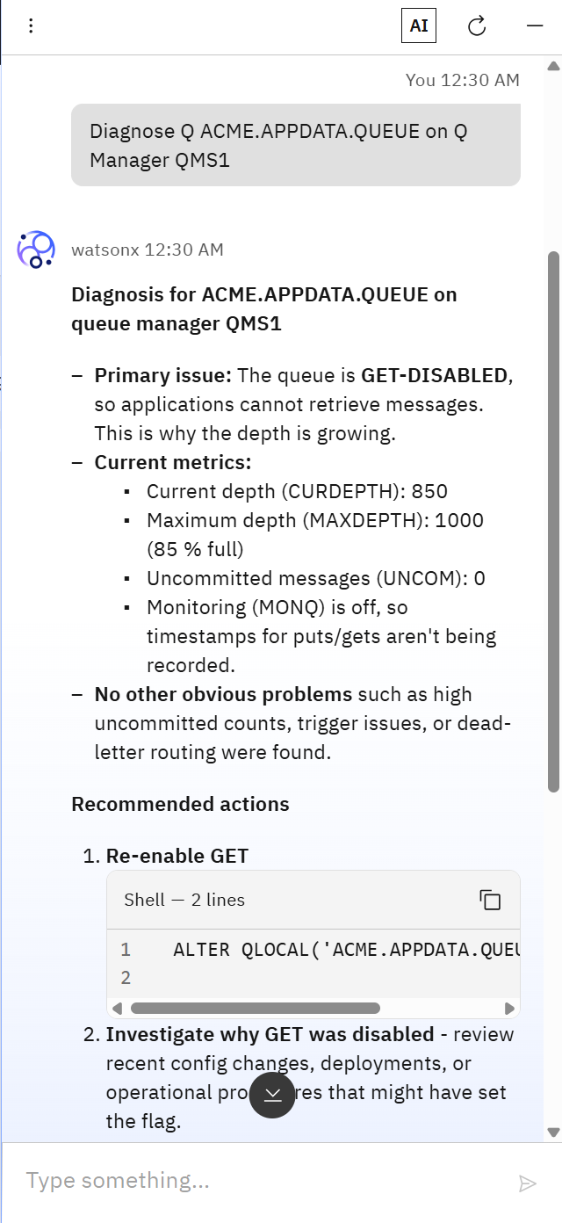
The answer
SEVERITY HIGH
PRIMARY ISSUE
AI
The queue is GET-DISABLED, so applications cannot retrieve messages. This is why the depth is growing.
20 seconds
CURRENT METRICS
from the enhanced ticket to a named root cause and the exact command that fixes it.
CURDEPTH 850 / MAXDEPTH 1000 85% full
UNCOM 0 no in-flight transactions MONQ off no put/get timestamps
Ruled out: high uncommitted counts, trigger issues, dead-letter routing
Three other causes ruled out without being asked.
RECOMMENDED ACTIONS
ALTER QLOCAL('ACME.APPDATA.QUEUE') GET(ENABLED)
Nobody ran a single MQSC command.
Then: investigate why GET was disabled — recent config changes, deployments, or operational procedures.
as it appeared
Decomposed from the live reply. The unedited transcript is in the appendix.
Notes:
This is the live reply, from an IBM sandbox, this week. Not a mock. Primary issue, named: the queue is GET-disabled. The metrics that prove it. Three other causes ruled out without being asked. And the one command that fixes it. Twenty seconds, from a ticket that used to say nothing but a queue name. Nobody ran a single MQSC command to get there.

Slide 7
The agent recommends, people still decide
BEFORE
NOW
NEXT
Someone notices
The ticket arrives explaining itself
The agent takes the ticket directly
A consumer team complains, or a depth alert fires. An administrator opens the console, finds the queue, reads QSTATUS, then goes looking through recent changes for why GET is off.
The sweep finds every stuck queue, raises a ticket per queue, and the enhancer adds one instruction. The agent answers with the cause and the command.
This version makes the ticket easy to enhance. The next version of the agent can consume that enhanced ticket itself, with remediation behind an approval step.
The fix was always one command.
ALTER QLOCAL('ACME.APPDATA.QUEUE') GET(ENABLED)
Everything we built exists to get a person to it faster.
Notes:
Here is the honest boundary. The agent found it. A person still runs the fix. That is IBM's design — the agent diagnoses, it does not change anything. And it matters: the agent recommended MONQ(ENABLED), which is not valid MQSC. Right intent, wrong syntax. A pipeline that applied agent output automatically would have failed right there.

Slide 8
Thank you
QMS1 · ACME.APPDATA.QUEUE · DIAGNOSED
WHAT IS NEXT
Depth-trend detection, to catch the slow consumer
The agent consumes the enhanced ticket directly
Questions?
During questions, I’ll run a recreation of the Qs
And re-ask the MQ AI agent for a diagnosis
Remediation behind an approval step
GET(ENABLED) · depth 0
A.J. Aronoff · IBM AngelHack · October 2026
Notes:
That is the pipeline. Thank you — happy to break the queue manager again, live, if anyone wants to see it.

