Slide 1
MQ AI Agent
Ticket Pipeline
QMS1 · ACME.APPDATA.QUEUE
850 messages waiting · 0 applications reading
From a silent queue to an actionable diagnosis
A.J. Aronoff · IBM AngelHack · October 2026
Notes:
Hi, I'm A.J. This is the MQ AI Agent Ticket Pipeline. Every square up there is ten messages sitting on a real queue manager, with nothing reading them. In five minutes I'll show you how we find that automatically and turn it into a ticket the IBM MQ Agent can answer.

Slide 2
Overview: What we are building
An automated pipeline that records status, notices problems, writes the ticket, enhances the ticket for the MQ AI Agent and asks the agent what is wrong.
DETECT
TICKET
ENHANCE
DIAGNOSE
Sweep every queue. Depth with nothing reading it is the state that always needs a person.
Each stuck queue becomes one ticket, carrying the MQ facts that prove it.
One line is added — the line that turns a record of a problem into a question an agent can answer.
The IBM MQ AI Agent reads it, inspects the live queue manager, and names the cause and the command.
CURDEPTH > 0
IPPROCS = 0
INC-0042 QMS1
850 deep, 0 readers
Diagnose Q <queue>
on Q Manager <qmgr>
GET(DISABLED)
found in 20 seconds
Nobody has to notice first (automated: detection, ticketing, enhancement)
Detect, ticket and enhance are ours, and they run unattended. Diagnose is IBM's MQ AI Agent, live. The fix stays a human decision.
Notes:
Here is the whole idea on one slide. A queue manager already knows when a queue is stuck — messages piling up with nothing reading them. What it does not do is tell anybody. So we built a pipeline. It sweeps every queue and detects that state, raises a ticket with the MQ facts, adds the one instruction that makes the ticket answerable, and hands it to the IBM MQ AI Agent, which comes back with the cause and the exact command. Detection, the ticket and the instruction are ours. The diagnosis is IBM's. The fix is still a person's call.

Slide 3
A queue can be 85% full with no one reading from it
850 / 1000
3600 / 4000
NONE
ACME.APPDATA.QUEUE
ACME.COMMERCE.QUEUE
Connected user applications
85% full and climbing
last put: a week ago
nothing is draining either queue
IBM MQ already knew all of this.
Every number on this slide came off the QMS1 dashboard. The gap is not visibility — it is that nothing turns what MQ already reports into something a person is handed.
Source: IBM MQ Console, queue manager QMS1, 9 October 2026, 12:30 AM
Notes:
Two queues on one queue manager. One is 85 percent full, the other hasn't been read in a week. MQ reports all of it on its own dashboard — but only if somebody goes and looks.

Slide 4
Five stages, one instruction
01
lab
02
ours
03
ours
04
ours
05
IBM
Break
Detect
Ticket
Enhance
Diagnose
Create QMS1, load the queue, set GET(DISABLED)
Sweep every queue for depth with no reader
One ticket per stuck queue, with its MQ facts
Add the instruction that makes it answerable
IBM MQ Agent reads it and replies
AI
Stages 2 to 4 are ours. Stage 5 is the IBM MQ Agent, running live in an IBM-provided sandbox — not a mock, not a recording.
Notes:
Five stages. We built the middle three. The last one is IBM's product, and we ran it live on a sandbox IBM gave us this week.

Slide 5
Building a queue that nobody can drain
Load first, disable second
crtmqm QMS1 && strmqm QMS1
runmqsc QMS1 <<EOF
DEFINE QLOCAL('ACME.APPDATA.QUEUE') +
MAXDEPTH(1000)
EOF
# load the backlog with IBM's own utility
dmpmqmsg -m QMS1 -f appdata.msgs +
-o ACME.APPDATA.QUEUE
# now break it
runmqsc QMS1 <<EOF
ALTER QLOCAL('ACME.APPDATA.QUEUE') +
GET(DISABLED)
EOF
GET(DISABLED) blocks consumers, not producers — so the order is not strictly required. We do it anyway, because it mirrors how the fault really happens.
dmpmqmsg is IBM's own tool
The queue load and unload utility, formerly qload, shipped with MQ since version 8.0. Reading a file onto a queue is a plain PUT.
No consumer is ever started
That is the whole point. IPPROCS stays at zero, and the depth has nowhere to go.
Notes:
A one-script lab. Create the queue manager, define a thousand-deep queue, load it with dmpmqmsg — IBM's own utility — and then disable GET. No consumer is ever started.

Slide 6
One sweep, every queue
SCANNER OUTPUT · QMS1
echo "DISPLAY QSTATUS(*) TYPE(QUEUE) \
CURDEPTH IPPROCS OPPROCS" \
| runmqsc QMS1
QUEUE
DEPTH
IPPROCS
ACME.APPDATA.QUEUE
850
0
TICKET
ACME.COMMERCE.QUEUE
3600
0
TICKET
THE RULE
CURDEPTH > 0 AND IPPROCS = 0
SYSTEM.DEFAULT.LOCAL.QUEUE
0
0
ok
Work is waiting, and no application has the queue open for input. Nothing can drain it.
Two tickets, not one. The sweep found a queue we had not broken on purpose — stuck since last week.
WHERE IT RUNS
One MQSC call per queue manager, on a schedule. The MQ Agent covers up to twenty queue managers; the sweep covers the same estate in one pass.
Depths are live from QMS1. No connected user applications — IBM MQ Console, Overview.
Notes:
One MQSC command, every queue on the estate. The rule is two fields: depth above zero, and no process reading. On QMS1 it fires twice — including on a commerce queue that had been stuck for a week and nobody had noticed.

Slide 7
The enhancement is one line
TICKET AS RAISED
AFTER THE ENHANCER
ID INC-0042
SOURCE qstatus sweep
QMGR QMS1
QUEUE ACME.APPDATA.QUEUE
CURDEPTH 850
IPPROCS 0
SEVERITY High
ID INC-0042
QMGR QMS1
QUEUE ACME.APPDATA.QUEUE
CURDEPTH 850
INSTRUCTION
Diagnose Q ACME.APPDATA.QUEUE
on Q Manager QMS1
Accurate, and useless to an agent.
Two field substitutions. That is the whole enhancer.
Template: Diagnose Q <queue from ticket> on Q Manager <queue manager from ticket>
Notes:
On the left, the ticket our scanner raises. Accurate, and completely useless to an AI agent. On the right, the same ticket with one line added. Two field substitutions, and now it is a question the MQ Agent can answer.

Slide 8
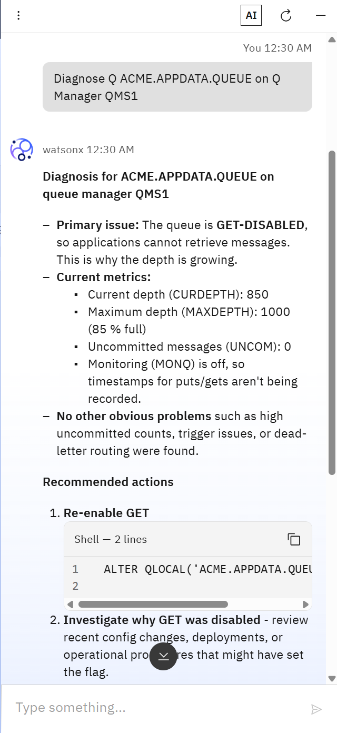
The answer
SEVERITY HIGH
PRIMARY ISSUE
AI
The queue is GET-DISABLED, so applications cannot retrieve messages. This is why the depth is growing.
20 seconds
CURRENT METRICS
from the enhanced ticket to a named root cause and the exact command that fixes it.
CURDEPTH 850 / MAXDEPTH 1000 85% full
UNCOM 0 no in-flight transactions MONQ off no put/get timestamps
Ruled out: high uncommitted counts, trigger issues, dead-letter routing
Three other causes ruled out without being asked.
RECOMMENDED ACTIONS
ALTER QLOCAL('ACME.APPDATA.QUEUE') GET(ENABLED)
Nobody ran a single MQSC command.
Then: investigate why GET was disabled — recent config changes, deployments, or operational procedures.
as it appeared
Decomposed from the live reply. The unedited transcript is in the appendix.
Notes:
This is the live reply. Primary issue named: GET-DISABLED. The metrics that prove it. Three other causes explicitly ruled out. And the one command that fixes it. Twenty seconds, from a ticket that previously said nothing but a queue name.

Slide 9
QMS1, as the agent found it
QUEUE MANAGER
QMS1
running
ACME.APPDATA.QUEUE
GET(DISABLED)
Producer
Consumer
X
MQPUT ok
each square = 10 messages · 85 of 100 squares filled
none
CURDEPTH 850 / MAXDEPTH 1000
85% full
ACME.COMMERCE.QUEUE
Last put: a week ago
CURDEPTH 3600 / MAXDEPTH 4000
90% full
No connected user applications — IBM MQ Console, Overview
Notes:
This is QMS1 as the agent found it. Messages go in on the left. On the right, nothing is reading — the console's own words are no connected user applications. And GET is disabled, so even if a consumer turned up it could not take a message.

Slide 10
What answers the ticket
MCP server
Agent runtime
Up to 20 queue managers
Hosts a suite of tools for gathering information from your IBM MQ queue managers.
What you talk to. Uses AI models, and the tools hosted by the MCP server.
The agent Infers Intent, Analyzes Queries, Resolves Ambiguities
Which can be running anywhere in your estate.
The three components of the IBM MQ Agent, in IBM's words
REQUIRES
AI
Run live, not mocked
MQ Advanced or Cloud Pak for Integration · Red Hat OpenShift · MQ Console 9.4.5 or later
IBM-provided sandbox, 9 Oct 2026
The agent cannot run MQSC commands to make changes. It reads your estate and tells you what is wrong.
Changing anything is still a decision somebody makes.
Notes:
The MQ Agent is three things: an MCP server that gathers facts from your queue managers, a runtime that uses AI models over those tools, and a configuration covering up to twenty queue managers. One limit matters for us: IBM is explicit that it cannot run MQSC. It diagnoses. It does not change anything.

Slide 11
The agent recommends, people still decide
BEFORE
NOW
NEXT
Someone notices
The ticket arrives explaining itself
The agent takes the ticket directly
A consumer team complains, or a depth alert fires. An administrator opens the console, finds the queue, reads QSTATUS, then goes looking through recent changes for why GET is off.
The sweep finds every stuck queue, raises a ticket per queue, and the enhancer adds one instruction. The agent answers with the cause and the command.
This version makes the ticket easy to enhance. The next version of the agent can consume that enhanced ticket itself, with remediation behind an approval step.
The fix was always one command.
ALTER QLOCAL('ACME.APPDATA.QUEUE') GET(ENABLED)
Everything we built exists to get a person to it faster.
Notes:
Here is the honest boundary. The agent found it; a person still runs the fix. That is not a limitation we are hiding — it is IBM's design, and for most operations teams it is the version they would actually deploy. Our contribution is making the ticket good enough to ask.

Slide 12
Thank you
QMS1 · ACME.APPDATA.QUEUE · DIAGNOSED
WHAT IS NEXT
Depth-trend detection, to catch the slow consumer
The agent consumes the enhanced ticket directly
Questions?
During questions, I’ll run a recreation of the Qs
And re-ask the MQ AI agent for a diagnosis
Remediation behind an approval step
GET(ENABLED) · depth 0
A.J. Aronoff · IBM AngelHack · October 2026
Notes:
Thank you. Happy to break the queue manager again live if anyone wants to see it.

Slide 13
Why CURDEPTH and IPPROCS
What this rule does not catch
CURDEPTH > 0
A slow consumer
There is work waiting on the queue. On its own this is normal — a healthy queue has depth all the time.
IPPROCS is above zero but depth still climbs. Needs a depth trend over time, not a single reading.
IPPROCS = 0
A queue that is meant to be deep
Some queues are buffers by design. Needs an allow-list, or a per-queue threshold.
No application has the queue open for input. On its own this is also normal — an idle queue has no readers.
Why MONQ matters
Both together
With monitoring off there are no put and get timestamps, so the agent could tell us what was wrong but not how long it had been wrong.
Messages are arriving and nothing can take them. This is the state that always needs a human, and it is cheap to detect across an entire estate.
Notes:
Two fields, and neither means anything on its own. Depth is normal. No readers is normal. Together they are always a problem. Here is what the rule misses, and it is on the roadmap.

Slide 14
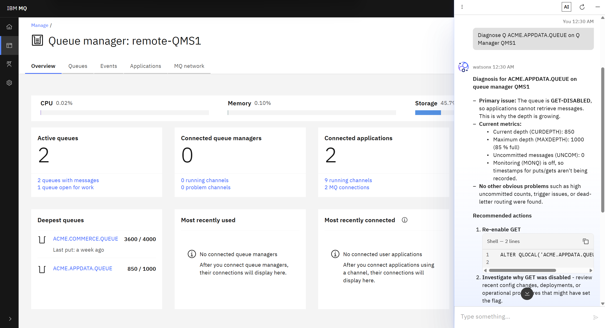
Evidence: QMS1, live
remote-QMS1
The console's name for the remote connection. The agent answers on queue manager QMS1.
850 / 1000
ACME.APPDATA.QUEUE, the queue in the ticket. ACME.COMMERCE.QUEUE sits above it at 3600 / 4000.
No connected user applications
The console's own words for IPPROCS = 0.
The AI button
Opens the agent panel. The reply is watsonx-branded.
Screenshot cropped to the application window. 9 October 2026, 12:33 AM.
Notes:
The unretouched console, cropped to the application window. Everything on the earlier slides traces back to something visible here.

Slide 15
The agent's reply, unedited
You 12:30 AM
Diagnose Q ACME.APPDATA.QUEUE on Q
Manager QMS1
watsonx 12:30 AM
Diagnosis for ACME.APPDATA.QUEUE on
queue manager QMS1
- Primary issue: The queue is
GET-DISABLED, so applications cannot
retrieve messages. This is why the
depth is growing.
- Current metrics:
- Current depth (CURDEPTH): 850
- Maximum depth (MAXDEPTH): 1000
(85 % full)
- Uncommitted messages (UNCOM): 0
- Monitoring (MONQ) is off, so
timestamps for puts/gets aren't
being recorded.
- No other obvious problems such as
high uncommitted counts, trigger
issues, or dead-letter routing were
found.
Recommended actions
1. Re-enable GET
ALTER QLOCAL('ACME.APPDATA.QUEUE')
GET(ENABLED)
2. Investigate why GET was disabled
- review recent config changes,
deployments, or operational
procedures that might have set
the flag.
3. Optionally enable monitoring
ALTER QLOCAL('ACME.APPDATA.QUEUE')
MONQ(ENABLED)
4. After enabling GET, monitor the
depth trend and verify consuming
applications are running correctly.
If the issue persists: check the
consumer applications, trigger
definitions, and any dead-letter or
expiry handling affecting the queue.
Left column transcribed from the screenshot. Right column continues below the visible scroll, from the saved conversation.
Notes:
The whole reply, unedited. The left column is what is visible in the screenshot; the right continues past the scroll.

