Slide 1
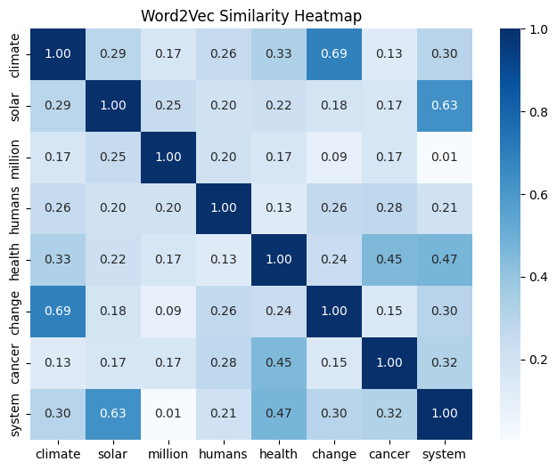
Word2Vec Cosine Similarity between word pairs

Slide 2
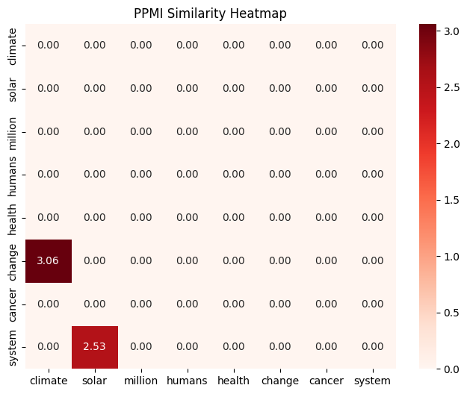
PPMI Pair Similarities between word Pairs

Slide 3
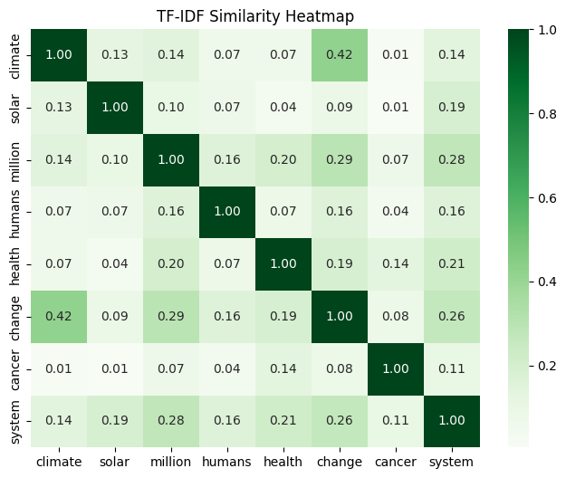
TF-IDF Cosine Similarity between word pairs

