Slide 1

Deep Learning for Mental Health Classification
Analyzing the "Sentiment Analysis for Mental Health" Dataset
Group ID - sp25_DsoDusKan
Kyle Dsouza
Vinay Dussa
Ajay Kanumala
Click here for video of this presentation

Slide 2
Introduction to the Dataset
Dataset: "Sentiment Analysis for Mental Health" (Kaggle)
Categories: Normal, Depression, Suicidal, Anxiety, Bipolar, Stress, Personality Disorder
Objective: Predict mental health status from textual statements

Slide 3
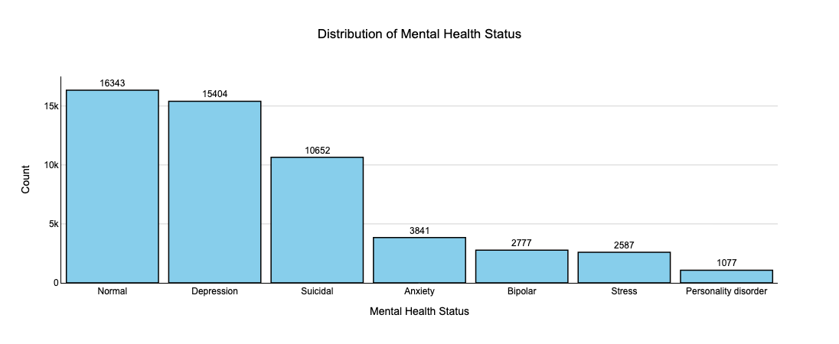
Dataset Distribution (Before Balancing)
Initial Class Distribution:
Normal: 16,343
Depression: 15,404
Suicidal: 10,652
Anxiety: 3,841
Bipolar: 2,777
Stress: 2,587
Personality Disorder: 1,077

Slide 4
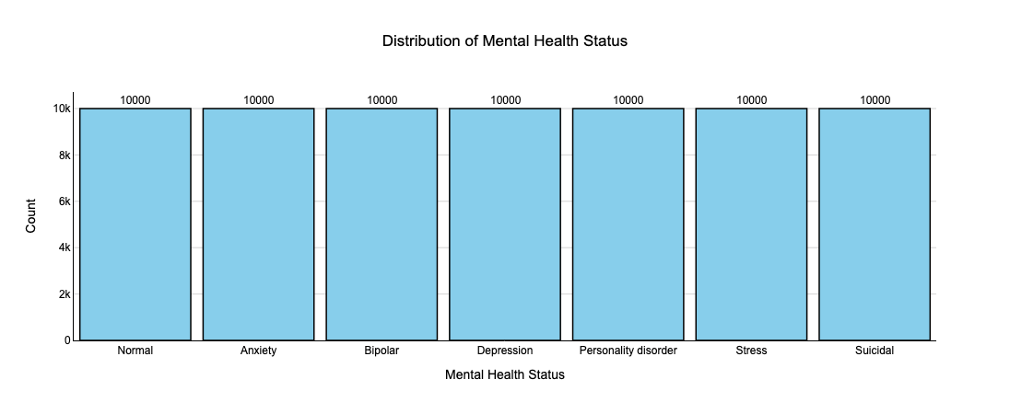
Dataset Distribution (After Balancing)
Resampling: Under-sample the majority class and Over-sample the minority classes.
Balanced Class Distribution:
All classes: 10,000 samples each.

Slide 5

Data Preprocessing
- Found and dropped 362 rows with null values.
- Label Encoding: Encode the status column with numerical values.

Slide 6
Convert Dataset into Tensor Format
Workflow:
Load Pre‑trained Tokenizer
– Maps raw sentences into BERT’s subword vocabulary.
Custom Dataset Class
– Wraps text & label lists
– On access:
• Converts sentence → token IDs + attention mask
• Pads or truncates to fixed length
• Returns tensors for model input
Instantiate Dataset
– Feed DataFrame’s “statement” and “status” columns into the custom class
Create DataLoader
– Batches examples (size 32)
– Shuffles each epoch for robust training
Batch Inspection
– Pull one mini‑batch to confirm:
• input_ids, attention_mask, labels all as tensors

Slide 7
Splitting Data & Preparing DataLoaders
Objective: Divide the tokenized dataset into training and testing subsets and create batched loaders for model training and evaluation.
Redefine Dataset Class
- Ensures encapsulation of text, labels, and tokenization logic.
Set Random Seed
- Guarantees reproducible splits and shuffling.
Compute Split Sizes
- 80% of examples allocated to training, 20% to testing.
Perform Train/Test Split
- Uses PyTorch’s random_split to partition the dataset.
Instantiate DataLoaders
- Training loader: batch size 32, shuffled each epoch
- Test loader: batch size 32, no shuffling

Slide 8
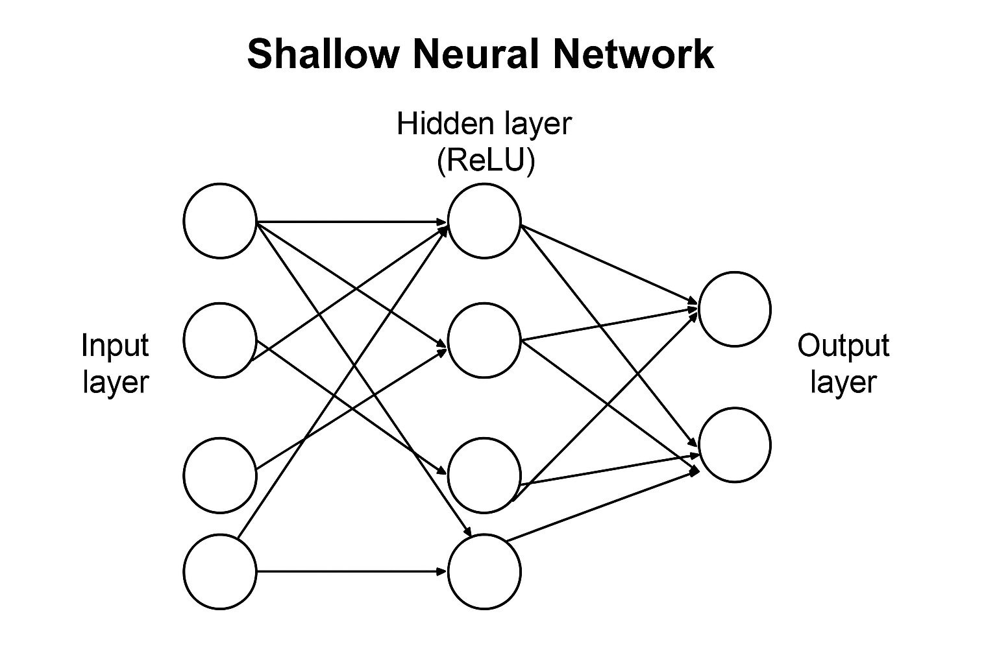
Shallow Neural Network
Architecture:
Input → Linear(128→hidden_dim) → ReLU → Linear(hidden_dim→7)
Initial test with hidden_dim = 16 confirmed output shape [1, 7] ​
Training and Evaluation
Optimizer: SGD (lr 0.05), Loss: CrossEntropy
10 epochs on train_loader: loss decreased from ~1.81→1.60
Test set: Loss ≈ 1.61, Accuracy ≈ 37%
Confusion matrix revealed class‑dependent performance ​

Slide 9
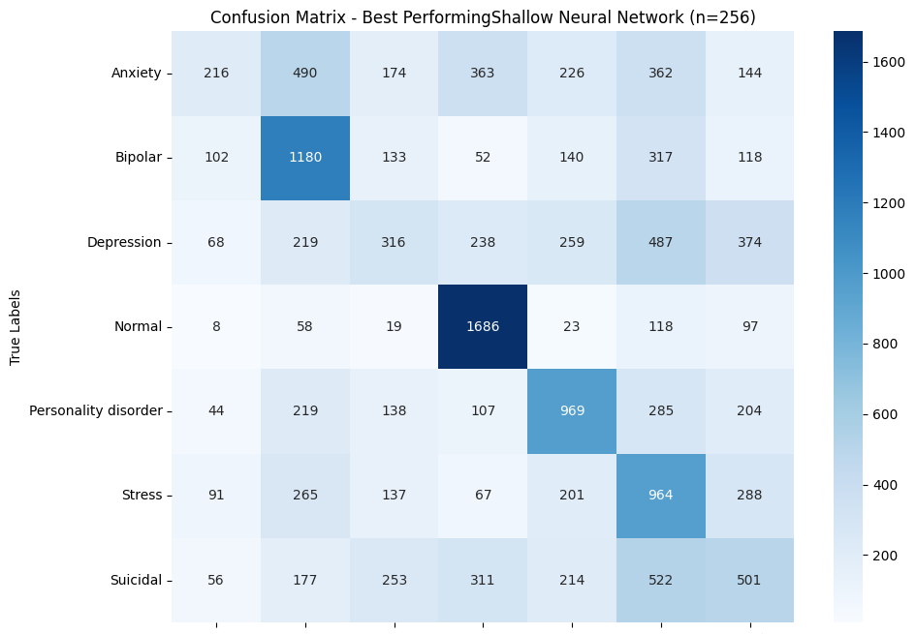
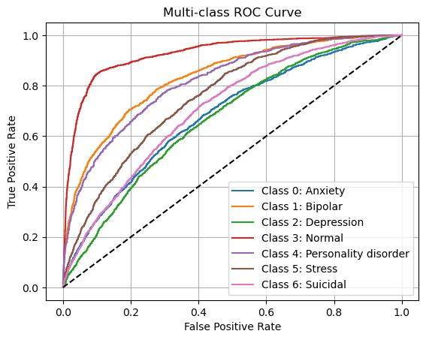
Hyperparameter Sweep (Shallow NN)
Hidden_dim ∈ {2,4,8,16,32,64,128,256}
Recorded test_loss & test_accuracy for each
Best shallow configuration: hidden_dim = 256 → test_loss - 1.538, accuracy - 41.1%

Slide 10
Deep Neural Network Design
Architecture:
Configurable depth (num_layers d) and width (hidden_dim p)
Layers: Input→ReLU→…×(d‑1) hidden layers→Output
Verified sample architectures for (d=2, p=16) ​
Training and Evaluation with Hyperparameter Tuning:
Same training regime (SGD lr 0.05, 10 epochs)
Evaluated metrics: test_loss, accuracy, weighted F1, precision, recall, AUC‑ROC, confusion matrix
Best depth config (d=3, p=128) achieved test_loss ≈ 1.385, accuracy ≈ 47%, AUC ≈ 0.82
Depth | Width | Train Accuracy | Test Loss | Test Accuracy | F1 Score | Precision | Recall | AUC
1 | 16 | 0.349521 | 1.611716 | 0.373500 | 0.351742 | 0.351896 | 0.3735 | 0.739025
1 | 32 | 0.354420 | 1.599197 | 0.377143 | 0.351472 | 0.355835 | 0.3771 | 0.744226
1 | 64 | 0.356984 | 1.585793 | 0.384643 | 0.359323 | 0.360091 | 0.3846 | 0.749974
1 | 128 | 0.362486 | 1.569651 | 0.389786 | 0.364083 | 0.368958 | 0.3898 | 0.757209
2 | 16 | 0.345988 | 1.590924 | 0.379571 | 0.353245 | 0.358187 | 0.3796 | 0.749283
2 | 32 | 0.352195 | 1.557872 | 0.395929 | 0.374493 | 0.372991 | 0.3959 | 0.761711
2 | 64 | 0.364838 | 1.486735 | 0.430143 | 0.408263 | 0.412074 | 0.4301 | 0.788304
2 | 128 | 0.378454 | 1.439733 | 0.443357 | 0.412511 | 0.435914 | 0.4434 | 0.809781
3 | 16 | 0.325725 | 1.629493 | 0.359786 | 0.311045 | 0.317667 | 0.3598 | 0.737624
3 | 32 | 0.323629 | 1.600035 | 0.365786 | 0.319238 | 0.328905 | 0.3658 | 0.746066
3 | 64 | 0.350120 | 1.475127 | 0.432643 | 0.421036 | 0.424490 | 0.4326 | 0.788873
3 | 128 | 0.370586 | 1.384953 | 0.470429 | 0.429236 | 0.443751 | 0.4704 | 0.817389
4 | 16 | 0.284652 | 1.645626 | 0.333643 | 0.284449 | 0.271101 | 0.3336 | 0.719085
4 | 32 | 0.309262 | 1.622106 | 0.355357 | 0.331326 | 0.329526 | 0.3554 | 0.730978
4 | 64 | 0.326971 | 1.574592 | 0.385857 | 0.342211 | 0.349761 | 0.3859 | 0.756101
4 | 128 | 0.347734 | 1.445615 | 0.457143 | 0.429707 | 0.435239 | 0.4571 | 0.795600

Slide 11
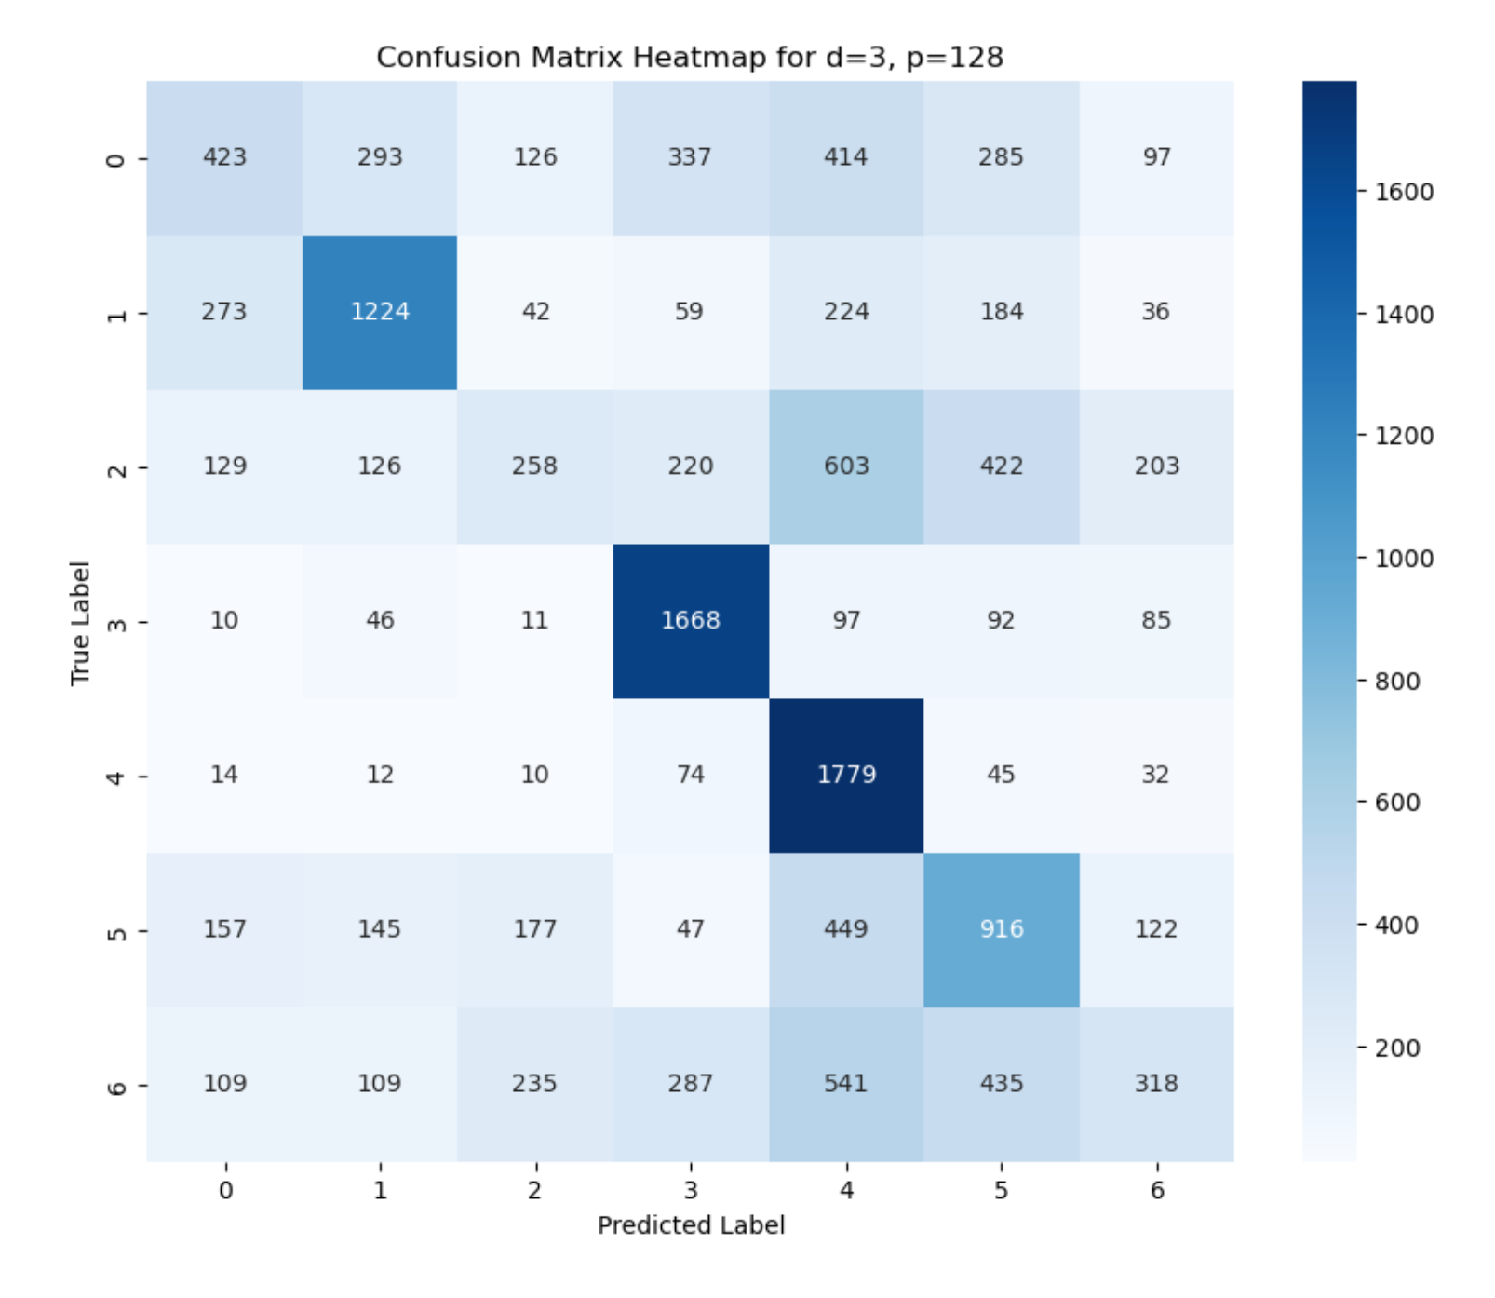
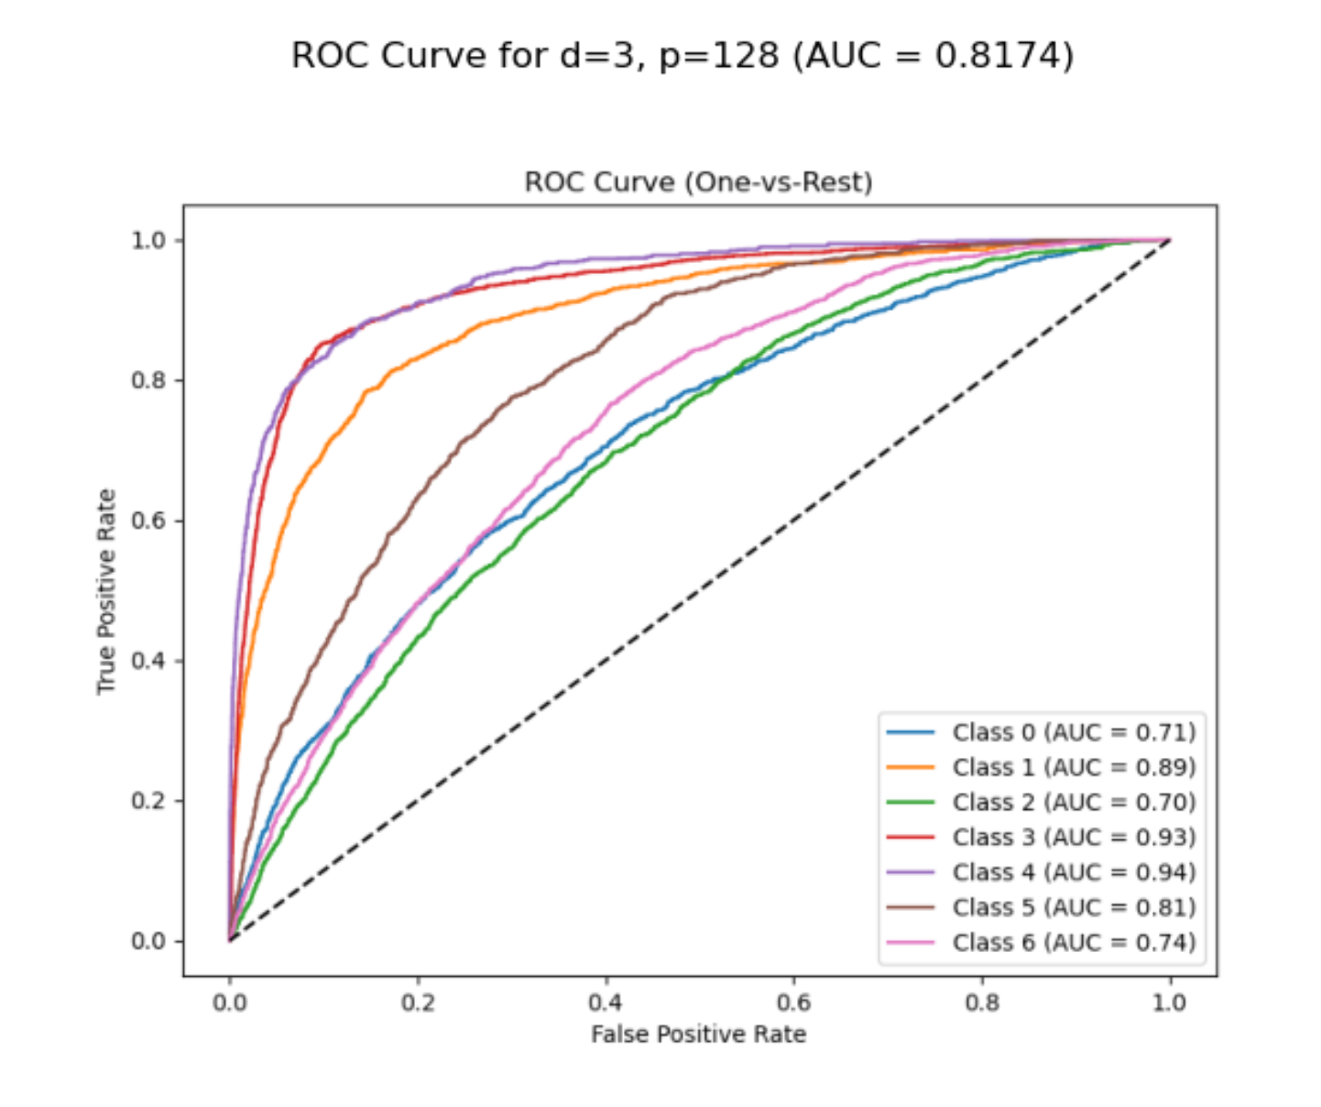
Deep Neural Network Design
Plotted one‑vs‑rest ROC curves for all 7 classes
Confusion heatmap highlighted per‑class precision/recall trade‑offs
Noted strongest performance on “Normal” class, weakest on “Suicidal”

Slide 12
Optimization Techniques Explored
Gradient Descent (Full Batch)
Batch Size: 56 000 (entire training set)
Optimizer: SGD (no momentum), LR = 0.05, 10 epochs
Observations:
  Training loss barely decreased (from 1.9469 → 1.9463)
  Test accuracy only 11.75%
  Very long training time (624 s) ​
Conclusion: Inefficient for large datasets; poor convergence and generalization
Stochastic Gradient Descent (SGD)
Batch Sizes Tested: 56,000; 28,000; 14,000; 7,000; 3,500
Common Settings: SGD (no momentum), LR = 0.05, 10 epochs
Key Trends:
  Smaller batches → faster training (592 s → 441 s)
  Test loss steadily decreased (1.9579 → 1.9437)
  Accuracy stable (~14%) until batch = 3 500, then jumped to 20.31% ​
Insight: Mini‑batch updates improve both speed and generalization

Slide 13
Optimization Techniques (cont.)
SGD + Momentum
Batch Sizes: 56000; 28000; 14000; 7000; 3500
Optimizer: SGD with momentum = 0.9, LR = 0.05, 10 epochs
Results:
  Significant accuracy boost, especially at small batches
  Best (batch = 3500): accuracy 30.49%, loss 1.7198, time 439 s
  Convergence much faster; model escapes flat minima ​
Takeaway: Momentum accelerates learning and enhances generalization
Comparison
Method | Best Batch | Accuracy | Loss | Time (s)
Full‑batch GD | 56000 | 11.75% | 1.9470 | 624.04
SGD (no momentum) | 3500 | 20.31% | 1.9437 | 440.87
SGD + Momentum | 3500 | 30.49% | 1.7198 | 439.00
Key Takeaways:
Gradient Descent: slow, low accuracy
Mini‑Batch SGD: faster, moderate gains
Momentum + Mini‑Batch: best efficiency & generalization

Slide 14
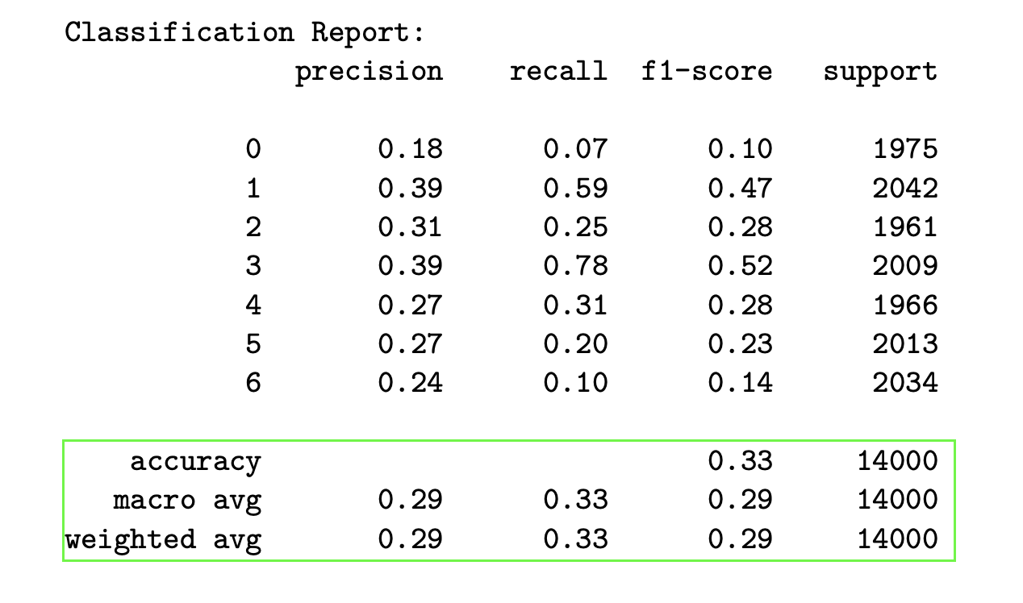
Advanced Techniques: CNN Model
Model: Custom CNN Classifier
Training Details:
Epochs: 10
Loss Trend: Decreased from 1.8352 (Epoch 1) to 1.7523 (Epoch 10)
Test Results:
Accuracy: 32.8%
Weighted F1 Score: 28.9%

Slide 15
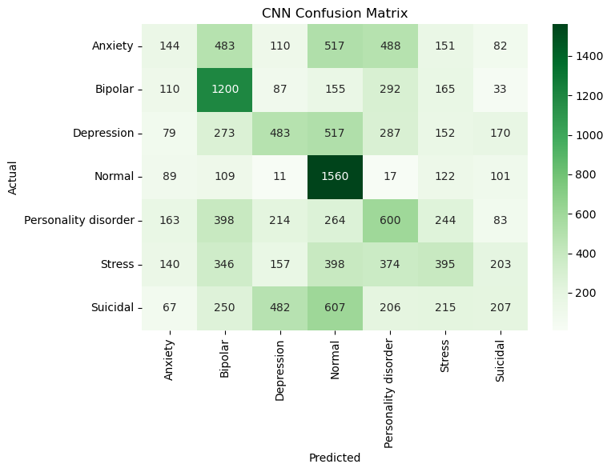
CNN Classifier - Confusion Matrix
Key Observations:
Poor performance across classes (e.g., only 144 correct for Anxiety out of 1,975)
High misclassification rates (e.g., 517 Anxiety samples predicted as Normal)

Slide 16
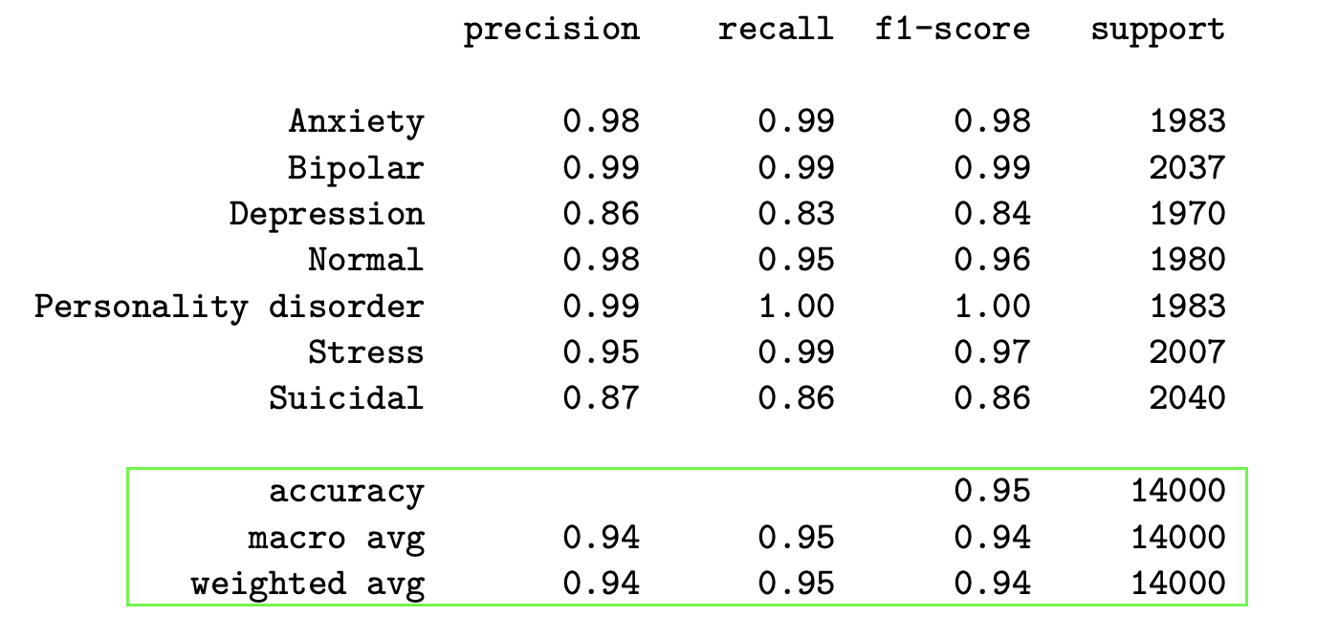
Advanced Techniques: BERT Model
Model: BERT (bert-base-uncased)
Training Details:
Epochs: 4
Batch Size: 16
Test Results:
Accuracy: 94.5%
Weighted F1 Score: 94.5%
Evaluation Loss: 0.294

Slide 17
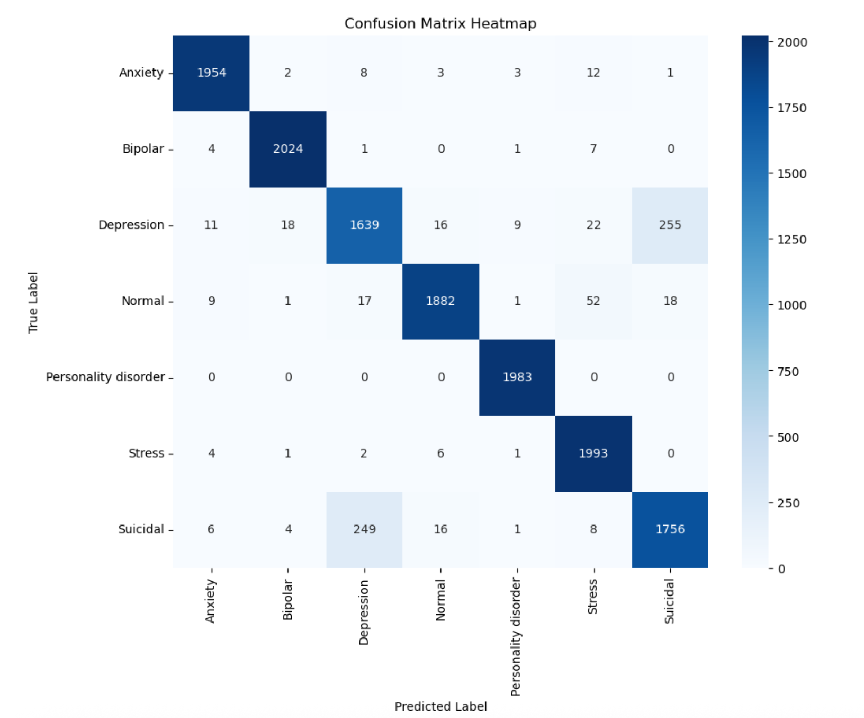
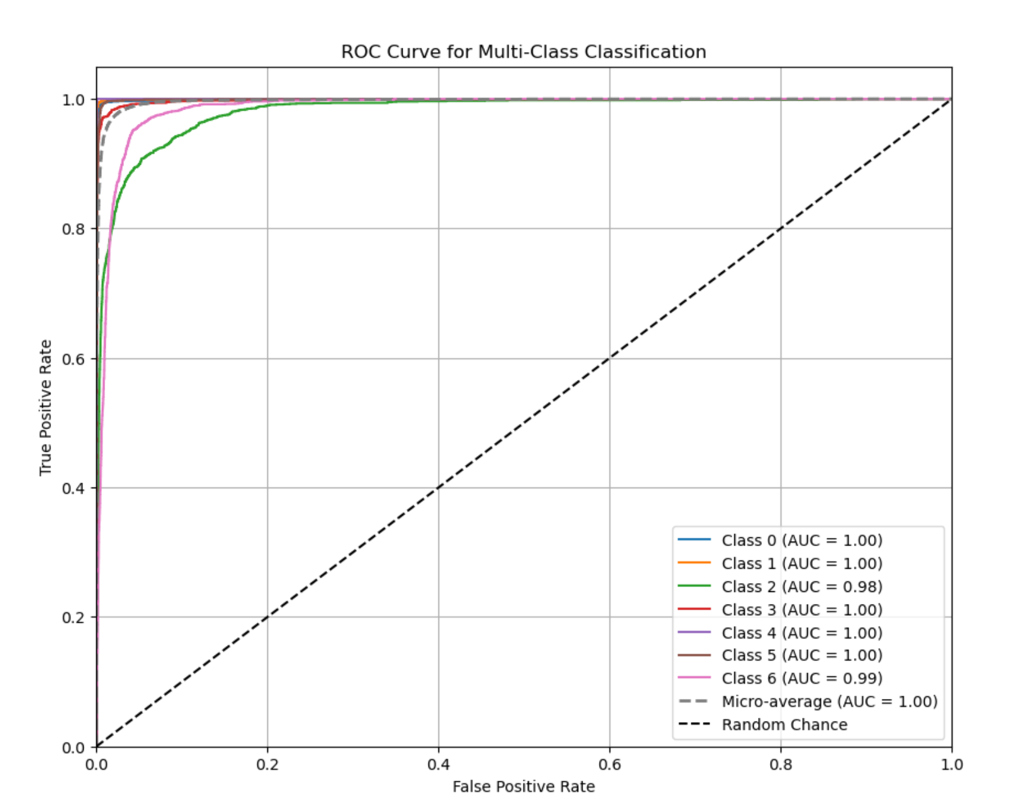
BERT - Confusion Matrix
Key Observations:
Strong performance for Personality Disorder (near-perfect classification)
Depression and Suicidal have more misclassifications (e.g., 255 Depression samples predicted as Suicidal)

Slide 18
Conclusion
BERT outperformed CNN significantly (94.5% vs. 32.8% accuracy).
Balancing the dataset improved model fairness across classes.
SGD with Momentum and tuned batch size (3,500) was the most effective optimizer.
Future Work: Explore hybrid models or fine-tune CNN architecture for better performance.

Slide 19
References
Dataset link - Sentiment Analysis for Mental Health Dataset
Google Colab – sp25_DsoDusKan_FPA05.ipynb
About BERT - https://www.geeksforgeeks.org/explanation-of-bert-model-nlp/
Presentation video link - Click here for video of this presentation

