Slide 1
HR Analytics– Case Study
Group Members:
Amitava Maity
Arpan Kumar Nandi
Ajay Kumar
Rasika Apte

Slide 2
In this case we are required to model probability of attrition using logistic regression. The results thus obtained will be used by the management to understand what changes they should make to their workplace, in order to get most of their employees to stay.
The following questions are among the ones they would like answered
What proportion of our staff are leaving?
Where is it occurring?
Can we predict future Attrition?
If so, how well can we predict?
The analysis needs to be done for answering below questions :
Identify trends in leavers' behaviour and the reasons employees change jobs/organisations
Identify the employers' perspective on employees' reasons for leaving
Identify retention strategies that have a positive influence on retention.

Slide 3
Collect and Manage the Data
After load the datasets, we have found that we have following information for analysis. We have good dataset for 2015, the data consist of -
Employee daily In Out data
Employee general data, performance data and survey data
Attributes | Attributes | Attributes
EmployeeID | Age | Attrition
BusinessTravel | Department | DistanceFromHome
Education | EducationField | EmployeeCount
Gender | JobLevel | JobRole
MaritalStatus | MonthlyIncome | NumCompaniesWorked
Over18 | PercentSalaryHike | StandardHours
StockOptionLevel | TotalWorkingYears | TrainingTimesLastYear
YearsAtCompany | YearsSinceLastPromotion | YearsWithCurrManager
EnvironmentSatisfaction | JobSatisfaction | WorkLifeBalance
JobInvolvement | PerformanceRating | MeanHoursInOffice

Slide 4
Problem solving methodology
Step 1:
Data load cleanup
Load data
Data cleanup
NA correction and Date formatting
Outlier detection for desired variable
Final dataset for analysis.
Step 2:
Selecting features to be analyzed and univariate analysis
Finalize columns to be analyzed
Derive distribution and character of selected columns.
Derive decision from selected features.
Perform EDA
Step 3:
Model Building
Build Logistic Regression Model
Reevaluate the model multiple time and remove insignificant variable
Build Final Model
Step 4:
Model Validation
Identify ultimate cutoff value and rebuild the model using new cutoff value
Confusion Matrix
Calculate lift and Gain
Calculate KS Statistics

Slide 5
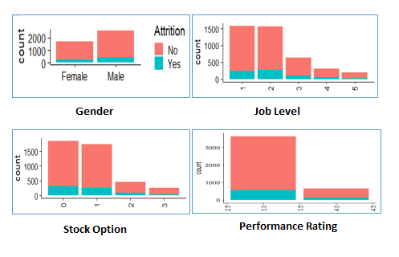
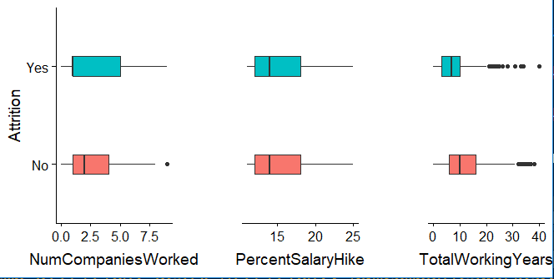
EDA
Summary of EDA
Male and Single employees are more prone to Attrition
Employee with job level2 and who are having no stock options are more prone to attrition
Employee who got comparatively lower rating are more prone to attrition
There are some outlier in Monthly Income, NumCompaniesWorked, TotalWorkingYears, TrainingTimesLastYear, YearsAtCompany, YearsSinceLastPromotion, YearsWithCurrManager, MeanHoursInOffice fields, those need to be taken care.
Employees who have worked in more companies and who have less experience are more prone to attrition
Employees who spend more years at company are less likely to quit.
Notes:
<number>

Slide 6
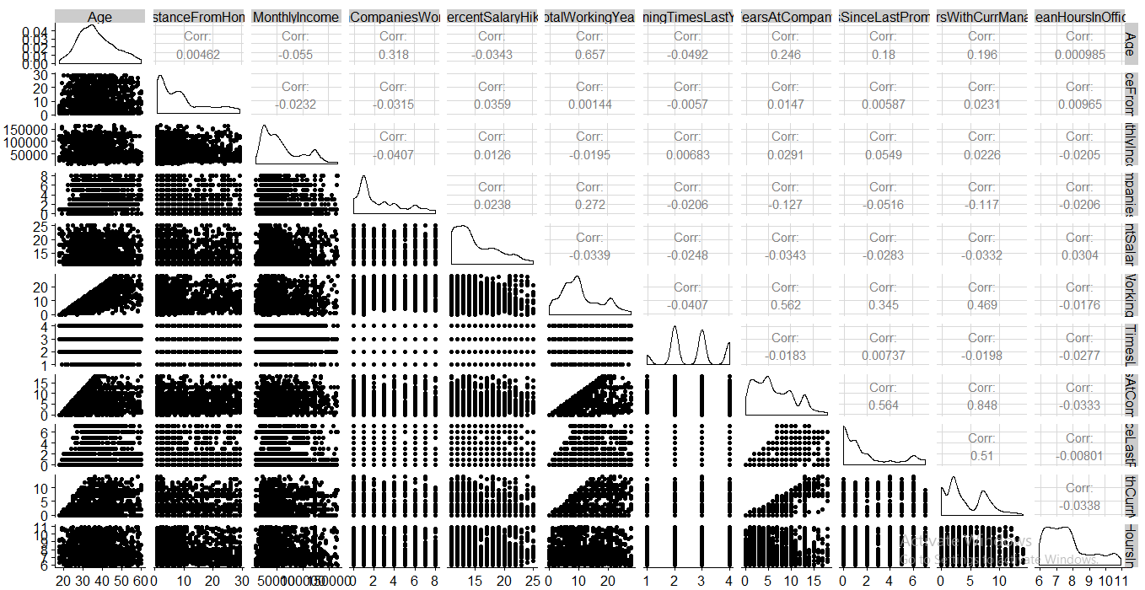
Correlation Matrix
Notes:
<number>

Slide 7
Data Cleaning: Model Data Preparation
Below variables seem to be have strong correlation –
Age & TotalWorkingYears
YearsAtCompany & TotalWorkingYears
YearsAtCompany & YearsWithCurrManager
YearsSinceLastPromotion & YearsWithCurrManager
Scale continues variable
Create dummy variable from categorical variable
Calculate percentage of attrition - 16.16%
Split full data set into training and test data

Slide 8
Model Building: Logistic Regression
Logistic Regression :
Initial model Model_1: Summary of the first model is given below
Model_2: Use stepAIC function and create 2nd model
Insignificant variable: JobLevel.x2 is insignificant
Null deviance | 2661.4
Residual deviance | 2012.4
AIC | 2124.4
Coeff | 0.64001
Null deviance | 2661.4
Residual deviance | 2028.4
AIC | 2098
Coeff | 0.75905

Slide 9
Model Building: Logistic Regression
After having 28 iteration we came up with our final model –
Model_28: Summary of the model is given below
Null deviance | 2661.4
Residual deviance | 2019.7
AIC | 2239.7
Coeff | -2.1247
Fields | Std. Error | Z Value | P value | Star
NumCompaniesWorked | 0.05768 | 5.156 | 2.52E-07 | ***
TotalWorkingYears | 0.08116 | -8.375 | 2E-16 | ***
YearsSinceLastPromotion | 0.06774 | 6.672 | 2.53E-11 | ***
YearsWithCurrManager | 0.08369 | -4.439 | 9.05E-06 | ***
MeanHoursInOffice | 0.05135 | 12.34 | 2E-16 | ***
BusinessTravel.xTravel_Frequently | 0.12845 | 5.093 | 3.53E-07 | ***
MaritalStatus.xSingle | 0.11105 | 8.006 | 1.18E-15 | ***
EnvironmentSatisfaction.x4 | 0.12312 | -3.672 | 0.000241 | ***
JobSatisfaction.x4 | 0.12722 | -5.542 | 2.99E-08 | ***

Slide 10
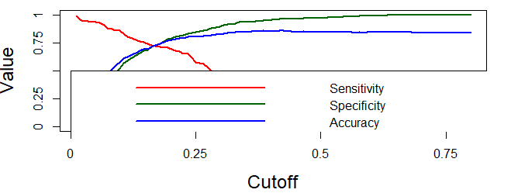
Model Evaluation
General Confusion Matrix: Use probability cutoff of 50%
Sensitivity : 0.17225
Specificity : 0.97965
General Confusion Matrix: Use probability cutoff of 40%
Sensitivity : 0.32057
Specificity : 0.96392
Sensitivity has been increased when we decrease the cutoff, here we are keen to calculate eventual sensitivity value because this is our objective of this case study.
Draw plot for sensitivity, specificity and accuracy to identify the cutoff value for this model
Cuttoff = 0.1696
Actual | Predicted
 | No | Yes
No | 1059 | 22
Yes | 173 | 36
For Cutoff 50%
Actual | Predicted
 | No | Yes
No | 1042 | 39
Yes | 142 | 67
For Cutoff 40%

Slide 11
Model Validation
Build final model using cutoff value of 0.1696
Lift and Gain
In lift and gain chart 5th Decile is having cumulative gain 83.3% which indicates that it is good model.
KS Statistics of this model is 46.49% that means it’s a good model
Accuracy | 0.7295
Sensitivity | 0.7368
Specificity | 0.7280

Slide 12
Summary
Throughout the analysis, I have learned several important things
Features such as Year Since Last Promotion, Total Working Year, Mean Hours In Office, Job Satisfaction, Environmental Satisfaction, Years with Current Manager appear to play a role in employee attrition.
There seems to be a relation between marital status and attrition
There is a tension between probability threshold and the number of employees who are accurately predicted as potential churners. A high probability threshold would end in a high number of errors. The business relevance is predict attrition well, rather than non attrition hence a lower probability threshold is chosen.
Model is biased towards finding the employee who are about to leave the company
The confusion matrix shows that of all the people who are going to leave the company, our algorithm identifies about 72% of them accurately.

