Slide 1
RELease 1
Class: SPM01
Group: A6
Date： 2024.3.31

Slide 2
Contents
Product Backlog
Release Planning
Story Mapping

Slide 3

Product Backlog Release 1(MVP)
ID | Story | Estimation | Priority
1.1 | As a user, I want to find out the goods by selecting in key words so that I can find the goods I need. |  | 1
1.9 | As an unregistered user, I want to search for the corresponding product by keyword. |  | 2
1.2 | As a user, I want to filter the result by price/category/seller ratings so that I can compare different goods with others. |  | 3
1.14 | As a merchant, I want the ability to edit my store information, so that I can customize and update my shop name, logo, description, and other details, reflecting the unique identity and branding of my business. |  | 4
1.11 | As a merchant, I want to manage my products, including listing and delete them, as well as categorizing them, so that I can maintain an organized and updated inventory. |  | 5
1.3 | As a user, I want to add/delete the goods in shopping cart so that I can manage my cart. |  | 6
1.8 | As an unregistered user, I want to be able to click through to see the details of the product, such as price, style, etc. |  | 7
1.4 | As a user, I want to checkout cart so that I can pay for my goods. |  | 8
1.5 | As a user, I want to track my order’s status so that I can know when I can get my goods. |  | 9
1.12 | As a merchant, I want to manage orders, specifically the ability to view order statuses, so that I can keep track of the progress and status of each transaction. |  | 10
1.13 | As a merchant, I want to integrate logistics information, so that I can seamlessly connect with logistics companies and achieve real-time updates and queries of order shipping information, ensuring smooth delivery to my customers. |  | 11
1.6 | As a user, I want to change my address and other information so that I can manage my profile. |  | 12
1.10 | As an unregistered user, I want to see promotions and other activities on the home page. |  | 13

Slide 4
Product Backlog Release 2
ID | Story | Estimation | Priority
2.1 | As a user, I want to see where my delivery guy is on the route to my address. |  | 15
2.5 | As a merchant, I want order statistics and analysis functionality, so that I can view statistical data on orders and generate charts, enabling informed decision-making and optimization of my sales strategies. |  | 16
2.2 | As a user, I want to have flexible online payment options so that I can choose any method of my choice. |  | 17
2.3 | As a user, I want to view the photos and details of the goods so that I can better choose what I like. |  | 18
2.6 | As a merchant, I want an online customer service system, so that I can respond to customer inquiries and questions in real-time, providing exceptional customer support and satisfaction. |  | 19
2.4 | As a user, I want to chat with merchants to better know the detail of the goods. |  | 20

Slide 5
Product Backlog Release 3
ID | Story | Estimation | Priority
3.2 | As a user, I want to comment for what I have purchased so that I can show my opinions to the goods. |  | 21
3.4 | As a merchant, I want to manage customer reviews, so that I can address any complaints or suggestions, respond to feedback, and maintain a positive reputation for my business. |  | 22
3.5 | As a merchant, I want to conduct promotional activities, so that I can attract customers and increase sales through offers like coupons, discounts, and special deals. |  | 23
3.1 | As a user, I want to use coupon so that I can pay less money. |  | 24
3.3 | As a user, I want to be able to repeat my previous orders(with or without modifications) at the click of the button. |  | 25
3.6 | As a merchant, I want to establish a membership system, so that I can provide benefits like reward points to my loyal customers, fostering a sense of community and rewarding repeat purchases. |  | 26

Slide 6
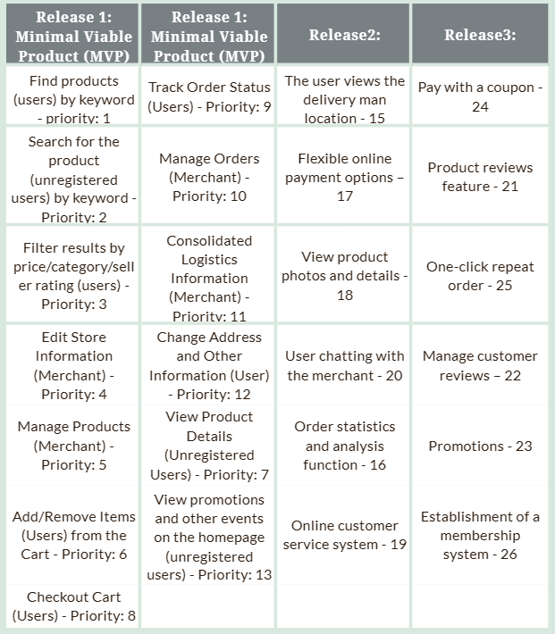

Release Planning

Slide 7
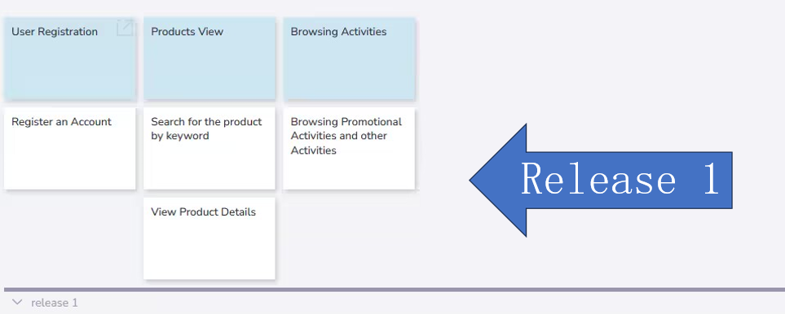
Story Mapping
Unregistered user

Slide 8
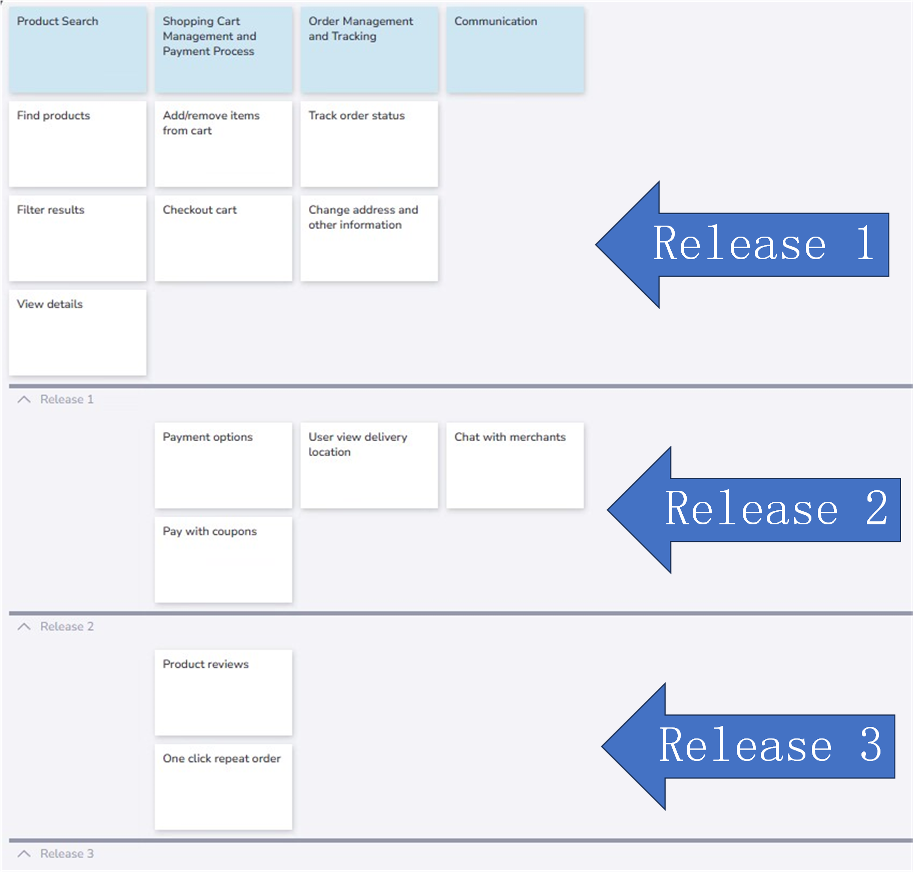
Story Mapping
registered user

Slide 9
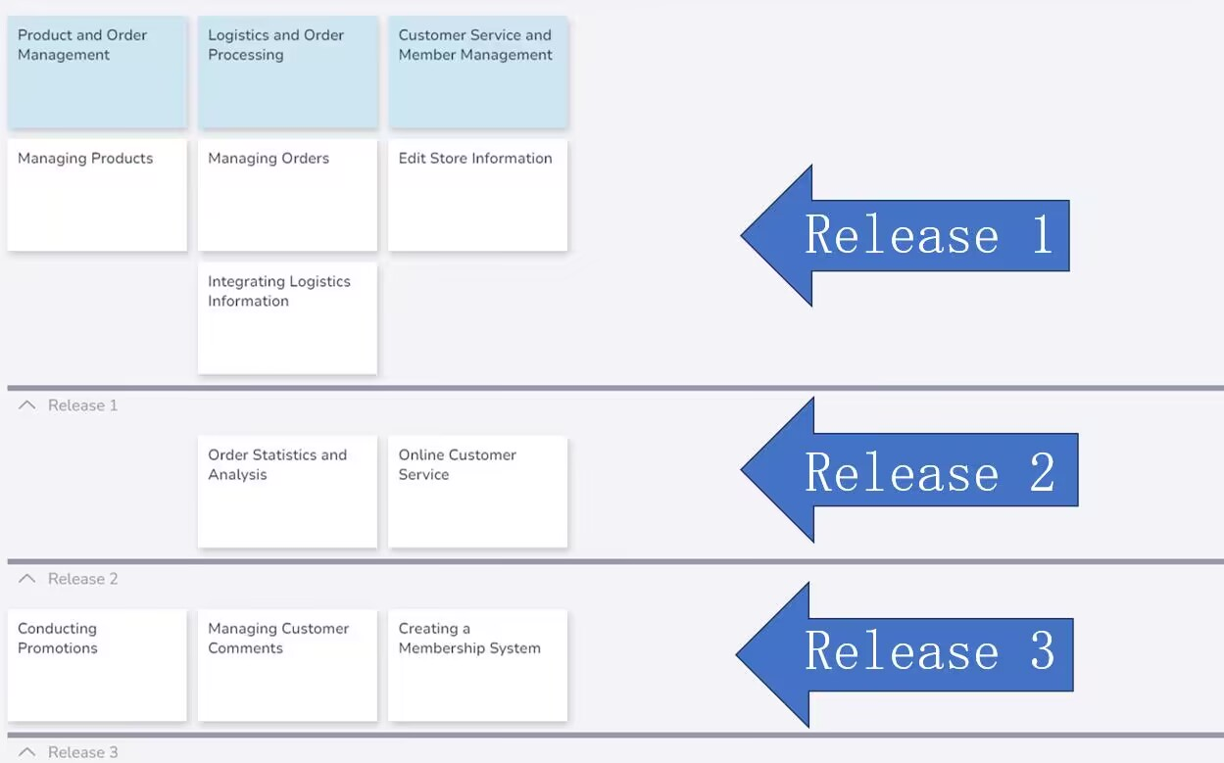
Story Mapping
merchant

