Slide 1

Austin Staton
Vice-President; UofSC Cybersecurity
October 8th, 2019
Notes:
This presentation will be delivered to UofSC Army ROTC Cyber on October 8th, 2019 at 1500.
-- Give a background of myself. Why am I semi-qualified to present to these people?
-- Gauge audience experience. Remember, not all of Army Cyber is technical. So, ask some questions to gain knowledge of my audience.
--Check to ensure people have heard of Virtual Machines.

Slide 2
What is Kali Linux?
Notes:
Explain what Linux is, without the Kali --
It’s just an operating system, like Windows or OSX.

Slide 3
Why do we care?
Notes:
This is a very fair question to ask. Be prepared to defend one’s position/opinion.

Slide 4
What’s better?
Windows, OSX, etc.
Proprietary software
better support, but less customization
Compatibility
Linux
Open Source
Performance
less Bloatware

Slide 5
What is Kali Linux?
Kali Linux is a Debian-based Linux distribution aimed at advanced Penetration Testing and Security Auditing. Kali contains several hundred tools which are geared towards various information security tasks, such as Penetration Testing, Security research, Computer Forensics and Reverse Engineering. Kali Linux is developed, funded and maintained by Offensive Security, a leading information security training company.
Notes:
Kali Linux is nothing special -- it is simply an operating system that comes with pre-installed toolkits. It is free to download.

Slide 6
Popular Toolkits
Nmap -- Port Scanning
JohnTheRipper & RainbowCrack -- Password Cracking
Radare2 -- Reverse Engineering
Metasploit -- Penetration Testing
Wireshark -- Packet Sniffing
Scalpel -- Data Recovery
Notes:
Some of these I can speak on more comfortably than others. By no means am I an expert on all of them.

Slide 7
Nmap
Port Scanning toolkit
Commonly used for reconnaissance and vulnerability discovery
Notes:
Explain what port scanning is. Ensure to describe what a port is and what an IP range is. How it tests IP ranges and their ports. Describe what makes a port “vulnerable” (loosely, it being open). W
Show the script of scanning the ranges of ip addresses. Talk about how Intrusion Detection Systems handle these scans.

Slide 8

Nmap (cont.)

Slide 9
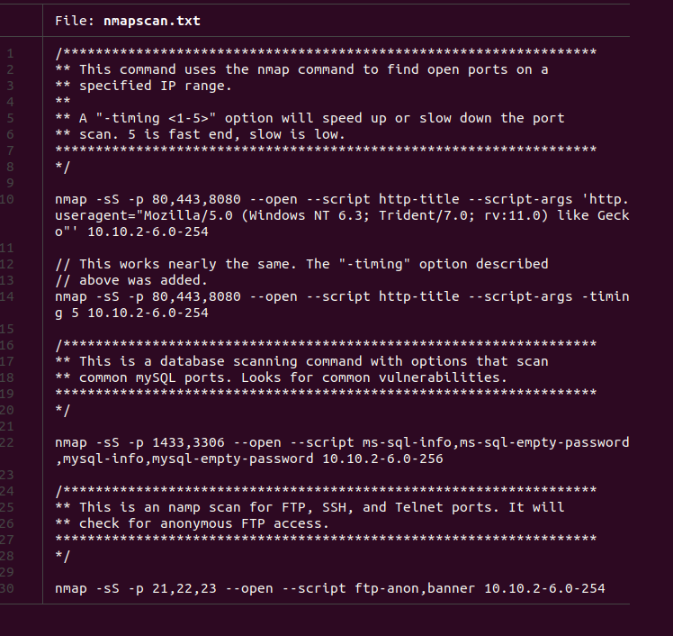
Nmap (cont.)

Slide 10
JohnTheRipper & RainbowCrack
How are passwords stored?
https://hashes.org/leaks.php
Plaintext
Hashing
SHA-256
Hashtext
Notes:
Use the $ sha256sum of example.txt and how the slightest change makes an ENTIRELY new hash.
Mention salting, but not heavily.
Show the list of password hashes.

Slide 11
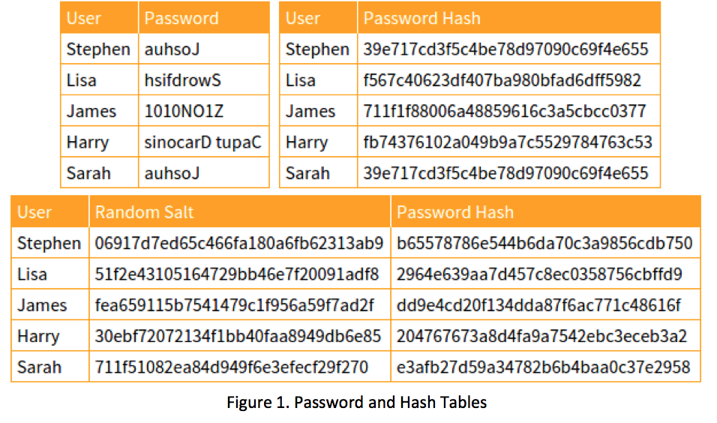
JohnTheRipper & RainbowCrack (cont.)
http://project-rainbowcrack.com/table.htm
Notes:
Hint at the size of a rainbow table. Make sure to use ORIGINAL passwords.

Slide 12
Radare2
What is Reverse Engineering?
High-Level Languages->...->Assembly ->...->Binaries
How do we interpret these collections of numbers?
https://github.com/aj-staton/assembly/
Notes:
$r2, then use ie to get entrypoints to the program,
Do a $ s main, then $ pdf to analyse the main function. Look how things connect and link together.

Slide 13
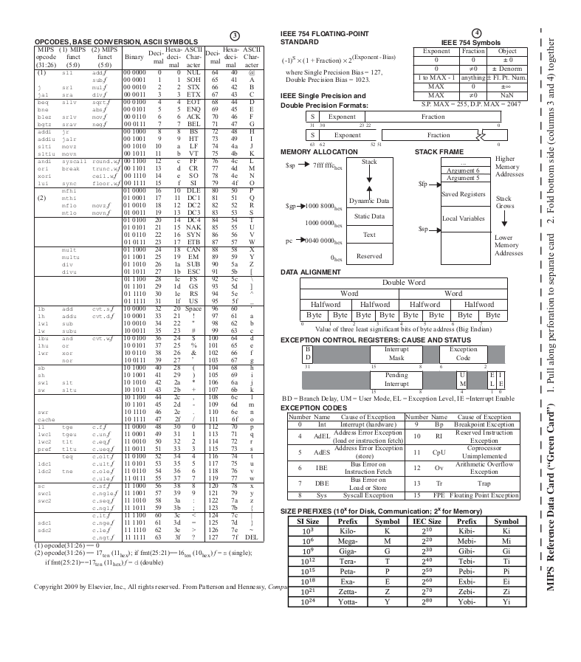

Slide 14

Metasploit
Metasploit is a toolkit that stores vulnerabilities, along with their exploits.
Mainly used as a Penetration Testing toolkit.
Notes:
Msfconsole
show exploits
Show payloads

Slide 15
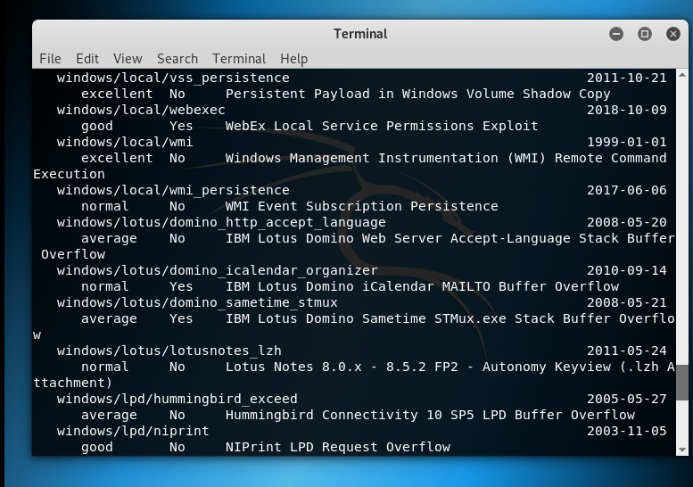

Slide 16
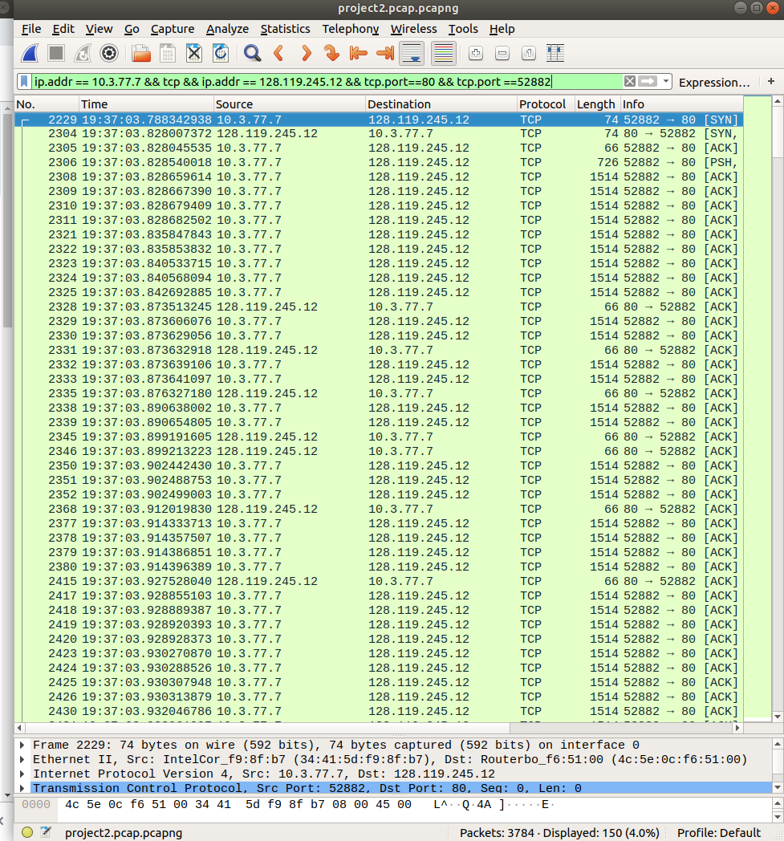
Wireshark
Monitors network traffic
Can be used to intercept passwords, files, or other desired information
Notes:
ajstaton@staton:~$ sudo ifconfig wlp108s0 down
ajstaton@staton:~$ sudo iwconfig wlp108s0 mode monitor
ajstaton@staton:~$ sudo ifconfig wlp108s0 up

Slide 17
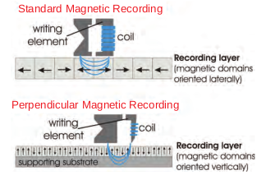
Scalpel
How is data stored on a disk?

Slide 18
Scalpel (cont.)
File Signatures (a.k.a. “Magic Numbers”) identify the leading, and occasionally trailing, bits of a file.
This strategy of data recovery relies on no specific file system.
File Type | Leading Bits | Trailing Bits
JPEG | 0xFFD8FFE3 | 0xFFD9
https://filesignatures.net/index.php
Notes:
Take the hexdump of the file.

Slide 19
Questions?

Slide 20
Resources
www.overthewire.org -- Bandit War Games
www.kali.org -- Kali Linux Image Download
UofSC Cybersecurity:
Mondays at 1900 in SWGN 2A14
My Email Address:
me@gmail.com

