Slide 1
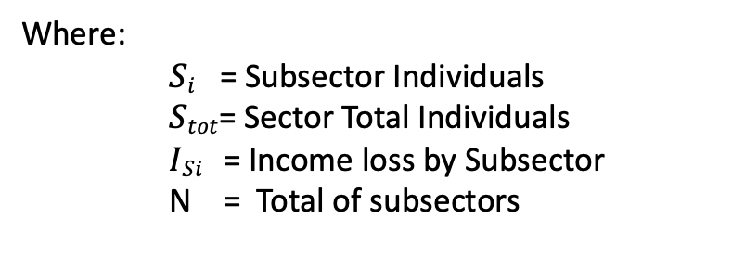

$$Fraction Affected\left(Sector\right)= \sum_{i}^{N}{\left(\frac{Si}{Stot}\right)∗P\left(ISi\right) }$$
Where:
$Si$ = Subsector Individuals
$Stot$= Sector Total Individuals
$ISi$ = Income loss by Subsector
N = Total of subsectors
Description: The fraction affected by sector is represented by the cumulative probability of each subsector weighted by its relative proportion of the sector as a whole.

Slide 2
Decision Tree
Job guaranteed [P( I_{si} ) = 1]
yes
Government Sector
no
yes
no

