Slide 1
QueueSense AI
ML-Powered Retail Crowd Analysis & Queue Optimization
From a single camera frame: people count, density heatmap, and an optimal queue zone.

Slide 2
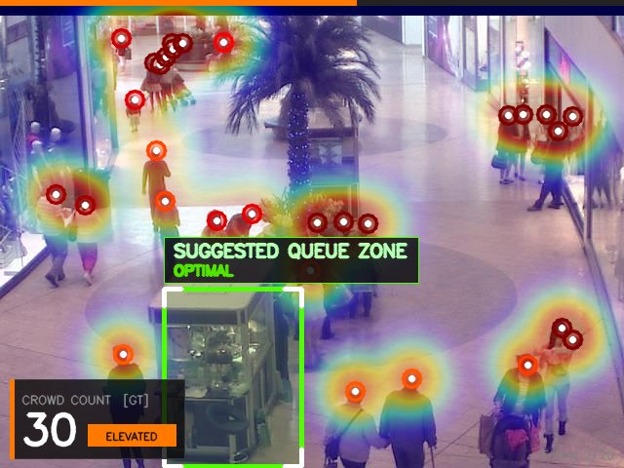
1
Problem Statement & Objectives
Retail stores and malls need real-time crowd visibility — manual headcounts don’t scale, and CCTV footage goes largely unused for actionable insight.
From a single camera frame, the system should:
Count accurately — exact people count per frame
Visualize density — Gaussian KDE heatmap of crowd concentration
Suggest queue zones — lowest-density open area via sliding-window search
Generalize via a trained CNN — works on new frames, no manual annotation needed
System output: count + heatmap + queue zone

Slide 3
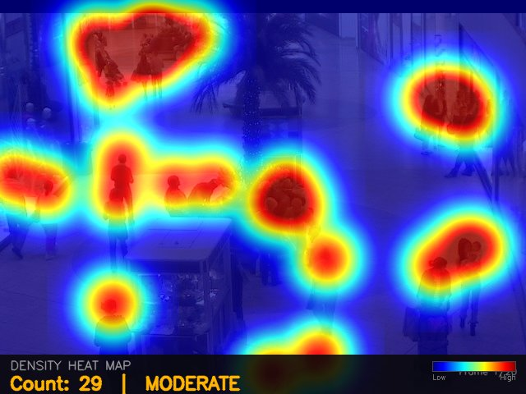
2
Dataset + EDA / Preprocessing
2,000
13–53
31.2
35
frames, 640×480 px
people per frame
mean count / frame
alert threshold (calibrated)
Example: Gaussian density map
Preprocessing Pipeline
Head points → per-frame Gaussian density (KDE)
Sigma adaptively shrinks in dense regions (KDTree nearest-neighbour spacing)
Invariant: sum(density) = true count — preserved through every resize
Secondary dataset: ShanghaiTech Part B pretrains the CNN before Mall fine-tuning

Slide 4
3
Methodology & Models
Camera Frame
Density Estimation
GT Mode: head positions (exact)
CNN Mode: SimpleDensityCNN (predicted)
Density Map
Queue Zone Suggestion
Model: SimpleDensityCNN
489,705
Small U-Net: encoder 16→32→64→128 channels, skip connections
1×1 conv + ReLU head enforces non-negative density
Training: ShanghaiTech pretrain → Mall fine-tune
Loss = MSE(density) + 0.001 × |predicted count − true count|
trainable parameters
1,700 / 300
train / val frames (85/15 split)

Slide 5
4
Results & Evaluation
2.6×
more accurate than the non-ML background-subtraction baseline
3.01 MAE
≈ 10% relative error on counts averaging ~31 people (RMSE 3.81, epoch 9 of 12)
Key insight: a lightweight ~489K-parameter model, briefly fine-tuned, beats the classical baseline by a wide margin — the density-map training target (preserving exact counts) drives most of the gain, not model size.

Slide 6
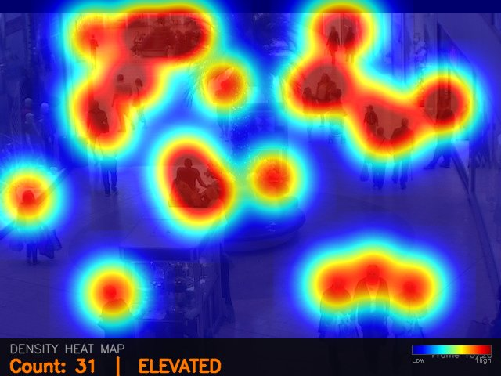
5
Demo + Conclusion / Future Work
Live Demo
Run generate_frames.py live — GT-mode heatmap (exact) vs. CNN-mode heatmap (predicted), HUD with live count + crowd alert, and the queue-zone overlay.
Conclusion
A single camera frame becomes a count, a density heatmap, and an actionable queue placement — generalizing beyond annotated data.
Future Work
Train / evaluate on denser scenes (ShanghaiTech-scale crowds)
Temporal smoothing across video frames
Multi-camera fusion for store-wide queue optimization
Live heatmap with crowd-level alert

