Slide 1
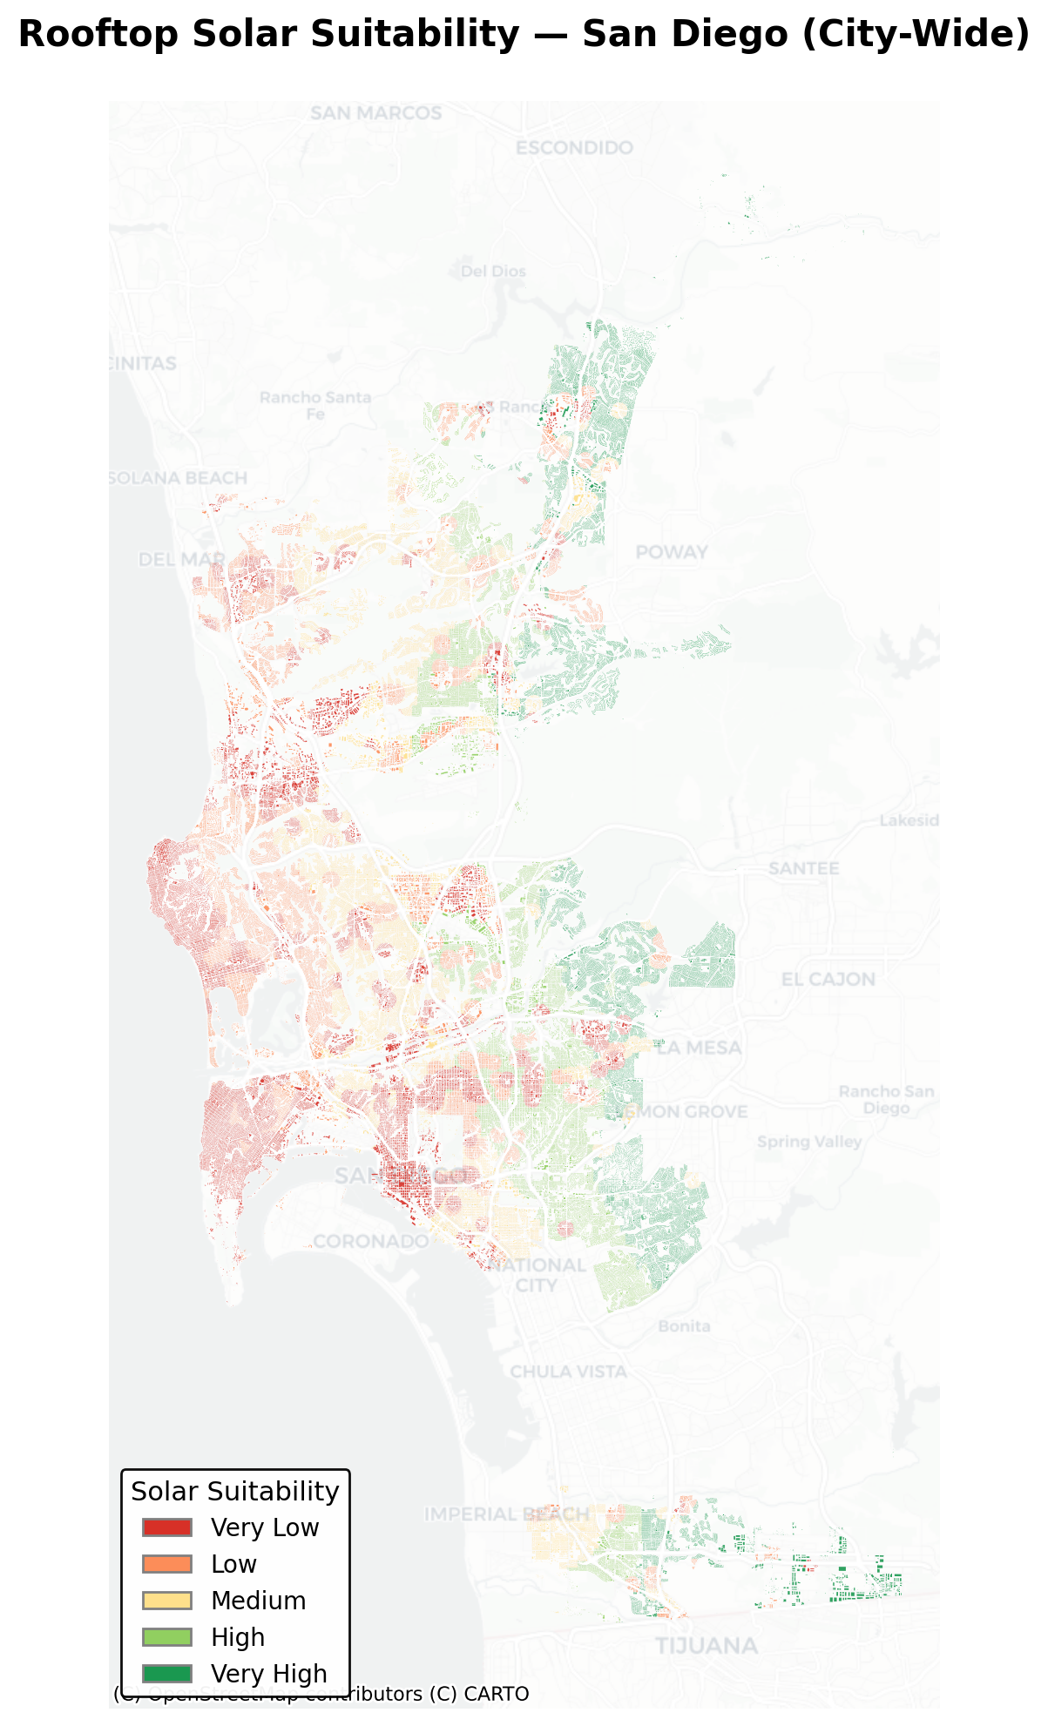
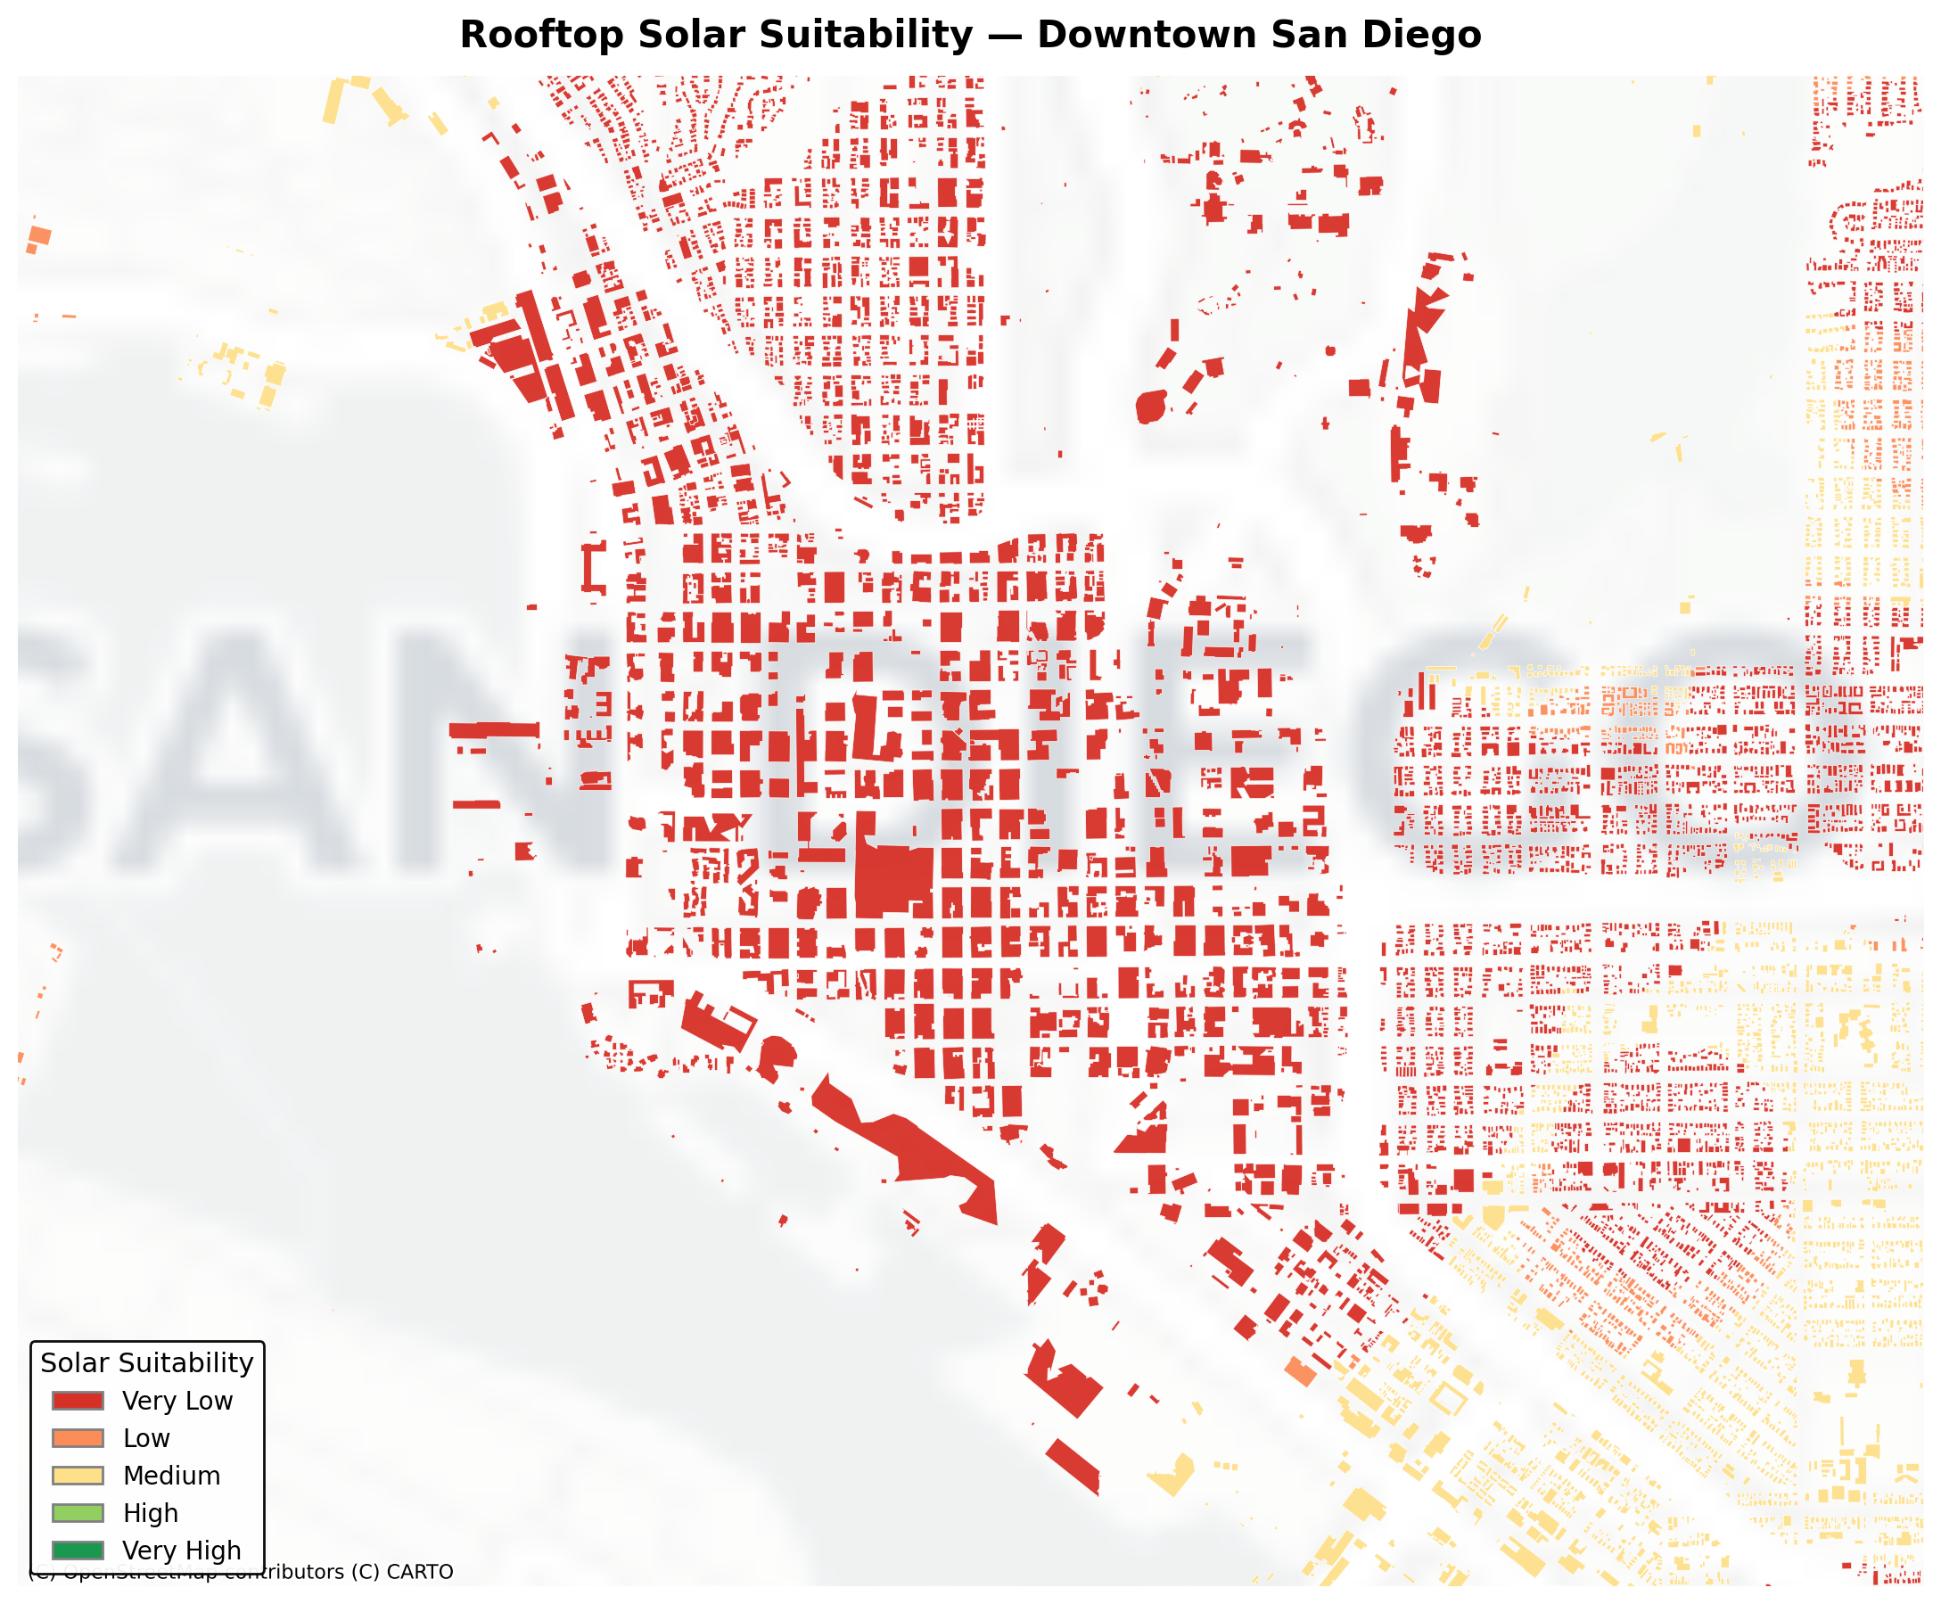
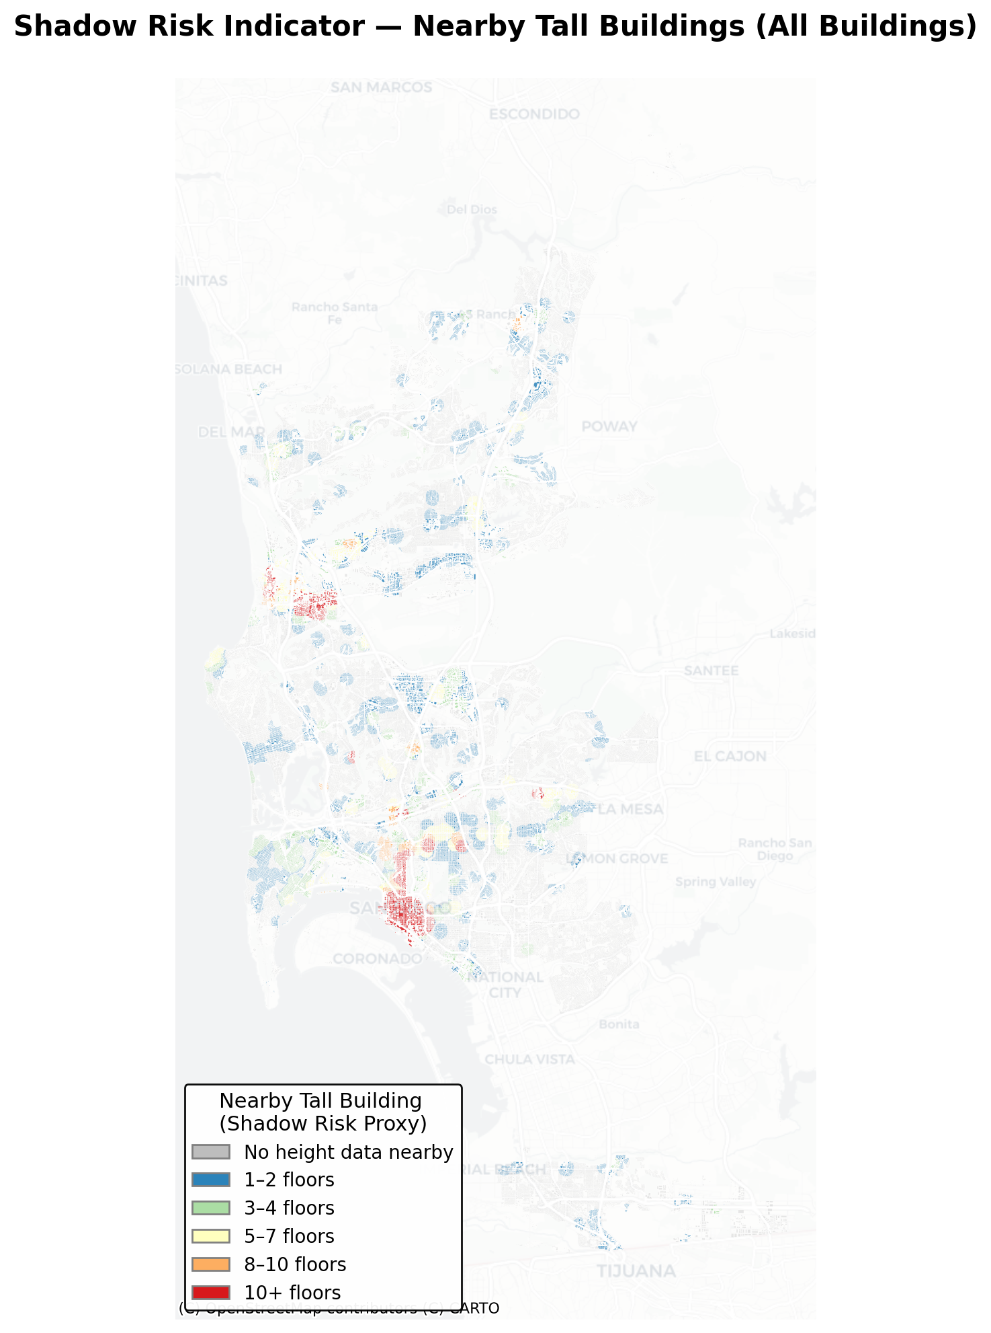
ROOFTOP SOLAR
☀
SUITABILITY ASSESSMENT
San Diego, California — Geospatial Analysis
SOLAR ENERGY POTENTIAL
Abdullah Jamil (BSCS-23136)
Session: Spring 2025 Supervisor: Dr. Adnan Siddique Course: Spatial Data Science
01 INTRODUCTION
06 SOLAR SUITABILITY MAP — SAN DIEGO
05 METHODOLOGY
Rooftop solar energy is a cornerstone of urban sustainability. Yet solar potential varies dramatically between buildings based on irradiance, roof size, and shading from surrounding structures. This study develops a scalable geospatial pipeline to assess and rank every building in San Diego by its rooftop solar suitability, enabling data-driven targeting of solar incentive programmes.
1. City Boundary
Extract San Diego polygon from CA TIGER/Line shapefile
2. Clip Buildings
Clip 322K footprints to city limits → cache GeoPackage
3. Height Spatial Join
Join OSM building heights to footprints
4. Sample GHI
Sample annual irradiance at building centroids
02 OBJECTIVES
5. Shadow Penalty
Height-based shadow score from tall neighbours
Assess solar potential for all San Diego buildings
6. Energy Estimate
Integrate irradiance, roof area & shadow data
Energy = Roof Area × GHI × η × (1 – Shadow)
7. Classify
Classify 322,863 buildings into suitability tiers
Rank & classify into High / Moderate / Low tiers
Export results as GeoPackage, Shapefile & CSV
03 DATA SOURCES
08 ZOOMED VIEW
US Census TIGER/Line 2023
California city boundary shapefile
Microsoft Building Footprints
~3.4 GB California building polygons
OpenStreetMap / Overpass
Building height tags for shadow proxy
PVGIS — EU JRC
09 SHADOW PROXY MAP
GHI, DNI, PVOUT raster layers (GeoTIFF)
322,863
~1,295 km²
5–7 kWh/m²/d
3 Tiers
04 Problem Statement
Buildings Analyzed
Average GHI
Suitability Classes
Study Area
How can every rooftop in San Diego be systematically ranked for solar viability using open geospatial data?
Urban solar deployment is inefficient without spatial targeting. Existing incentive programs lack building-level suitability data, leading to missed opportunities in high-potential zones and wasted outreach in low-potential areas. This study addresses that gap by creating a reproducible, city-wide suitability score for all 322,863 buildings in San Diego, combining three key factors: annual global horizontal irradiance (GHI), rooftop area, and height-based shadow exposure.
07 SUITABILITY CLASSIFICATION SCHEME
HIGH SUITABILITY
MODERATE SUITABILITY
LOW SUITABILITY
10 Results And Discussions
Large roof area (>80 m²) • GHI > 5.5 kWh/m²/day • Minimal shadow penalty (<20%) • Best ROI for solar investment
Medium roof (40–80 m²) • GHI 4.5–5.5 kWh/m²/day • Moderate shading • Viable with optimised panel placement
Small roof (<40 m²) • GHI < 4.5 kWh/m²/day • High shadow penalty (>40%) • Not cost-effective currently
San Diego ranks among the top US cities for rooftop solar viability. Key findings:
~40% of buildings are High or Moderate suitability, a significant addressable solar market
Suburban zones (Mira Mesa, Mission Valley) show consistently High scores
Urban cores score lower due to building height shadow effects
Commercial flat rooftops yield the highest absolute energy potential per building
Keep the font 32 points, preferably; This study demonstrates city-wide rooftop solar suitability can be assessed systematically using open geospatial data in a reproducible Python pipeline.
CONCLUSION:
This study demonstrates that city-wide rooftop solar suitability can be assessed systematically by combining building footprints, solar irradiance rasters, and height-based shadow proxies in a reproducible geospatial pipeline. Results enable spatially-targeted solar incentive deployment across San Diego.
Data: US Census TIGER · Microsoft Building Footprints · OpenStreetMap · PVGIS EU JRC | Tools: Python · GeoPandas · Rasterio · Contextily · Matplotlib | Spatial Data Science — BSCS23136

