Slide 1
Home Mortgage Defaulter classification
By
Aman
Premkumar
Ashwin
Pavan
Kapila
Mentors:
Dipiyaman
Viswas

Slide 2
Mortgage defaulter Prediction
Objective: To predict if a Mortgage borrower will default the loan.
This project is aimed at developing an analytical model to classify a mortgage borrower if he/she will be delinquent/default on the repayments.
We have utilized the relationship of past/existing borrowers, loan characteristics to identify the significant attributes that influence delinquency and use those to predict the probability of delinquency for future borrowers.
The outcome of this analytical approach is the probability of a borrower being delinquent given their attributes which were identified as significant influencers during the modelling exercise.
We have used the publicly available loan borrower and performance data from FannieMae.

Slide 3
Tools, Technologies and Platform
Tool/Technology/Aids | Usage
Blackrock Methods, Citi MBS guide. | Documents to understand Mortgage market and basic principles.
Python and Machine Learning packages | Data cleansing and formatting. Data visualization. Analytical Modelling
Kaggle | Computing platform.

Slide 4
Data Analysis Fannie Mae 2015 Q1(Loan Acquisition and Performance)

Slide 5
Data Dictionary
Field Name | Details
LOAN IDENTIFIER
ORIGINATION CHANNEL | An identifier that denotes the origination channel used by the party that delivered the loan to Fannie Mae. (Retail, Broker, Correspondent)
SELLER NAME | The name of the entity that delivered the mortgage loan to Fannie Mae.
ORIGINAL INTEREST RATE
ORIGINAL UPB | “Current Scheduled Unpaid Principal Balance (UPB)” for all the mortgage loans in the MBS pool as of the issue date.
ORIGINAL LOAN TERM
ORIGINATION DATE
FIRST PAYMENT DATE
ORIGINAL LOAN-TO-VALUE (LTV) | express the ratio of a loan to the value of an asset purchased
ORIGINAL COMBINED LOAN-TO-VALUE (CLTV) | combined loan to value (CLTV) is the same calculation made for the sum of all loans taken out on the property
NUMBER OF BORROWERS
ORIGINAL DEBT TO INCOME RATIO | DTI is calculated by dividing total recurring monthly debt by gross monthly income, and it is expressed as a percentage
BORROWER CREDIT SCORE AT ORIGINATION | Credit Score
FIRST TIME HOME BUYER INDICATOR
LOAN PURPOSE | An indicator that denotes if a mortgage loan in a pool is either a purchase money mortgage or refinance mortgage. Mortgage loans that were modified prior to delivery in lieu of refinance and then delivered to Fannie Mae are disclosed as “refinance”. • P = Purchase, • C = Cash-out Refinance,• R = No Cash-out Refinance • U = Refinance – Not Specified.
PROPERTY TYPE | SF = Single-Family • CO = Condo • CP = Co-Op • MH = Manufactured Housing • PU = PUD
NUMBER OF UNITS | The number of units(1-4) comprising the related mortgaged property.
OCCUPANCY TYPE | • P = Principal • S = Second • I = Investor • U = Unknown
PROPERTY STATE
ZIP CODE SHORT
PRIMARY MORTGAGE INSURANCE PERCENT | lenders require private mortgage insurance as part of a conventional loan to protect them in case you end up in foreclosure. PMI is also required if you refinance your mortgage with less than 20 percent equity. PMI typically costs between 0.5% to 1% of the entire loan amount on an annual basis
PRODUCT TYPE | A code that denotes if a mortgage loan is a fixed-rate or adjustable-rate mortgage. FRM – Fixed-rate mortgage loan
CO-BORROWER CREDIT SCORE AT ORIGINATION
MORTGAGE INSURANCE TYPE | A code indicating the source of the Mortgage Insurance premium payment. • 1 = Borrower Paid • 2= Lender Paid • 3 = Investor Paid • Blank = None
RELOCATION MORTGAGE INDICATOR | An indicator that denotes whether or not the type of mortgage loan is a relocation mortgage loan, made to borrowers whose employers relocate their employees. • Y = Yes • N = No

Slide 6
Data-High level Inference
2015 Q1 data set contains 4.5 lakh borrower information
Delinquency status is stated in terms of no. of days since the last monthly payment.
As rule of thumb we categorized borrowers who are delinquent for more than 90 days as defaulters.
Approximately 1/3rd of borrowers delinquency status was unknown.
We studied the characteristics of borrowers with unknown delinquency status and borrowers who were categorized as defaulters/Regular.
The inferences made was used to assume the delinquency status.
Following plots and graphs is categorized under 3 status (Regular, Defaulters, Unknown)

Slide 7
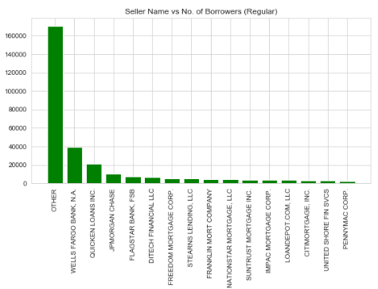
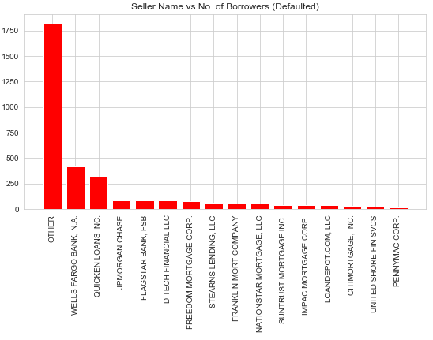
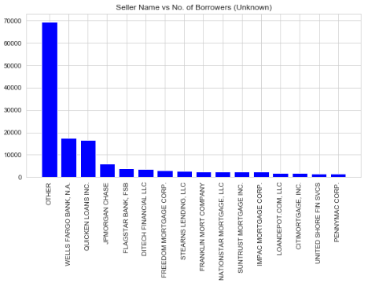
Loan Provider Vs No. of Borrowers
There seems to be no difference in the borrower distribution pattern between 3 status.
The borrowers with unknown status looks to more closely align with Regular category.

Slide 8
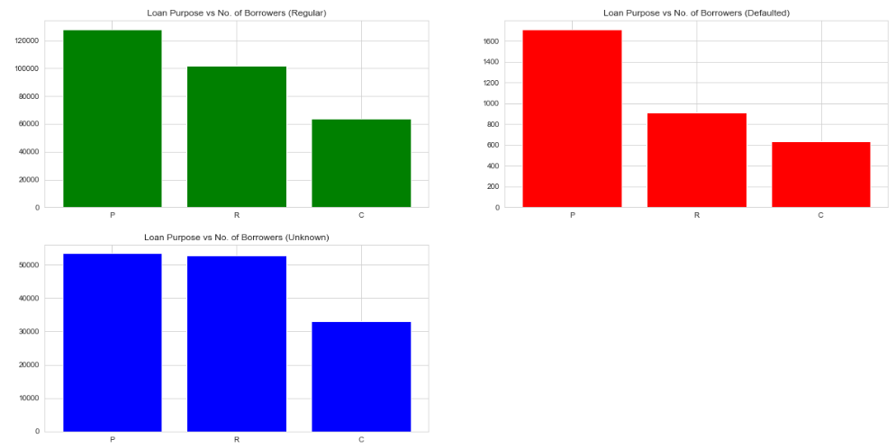
Loan Purpose Vs. No. of Borrowers
There seems to be no difference in the loan purpose distribution pattern between 3 status.
Most borrowers took mortgages for Purchase of property.
The borrowers with unknown status looks to more closely align with Regular category.
P = Purchase
C = Cash-out Refinance
R = No Cash-out Refinance

Slide 9
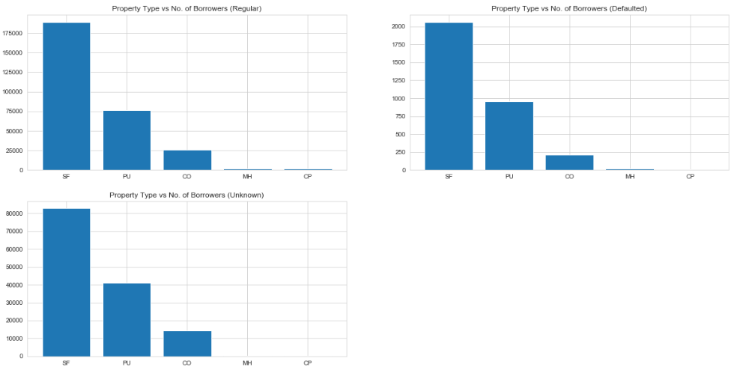
Type of Property Vs. No of Borrowers

Slide 10
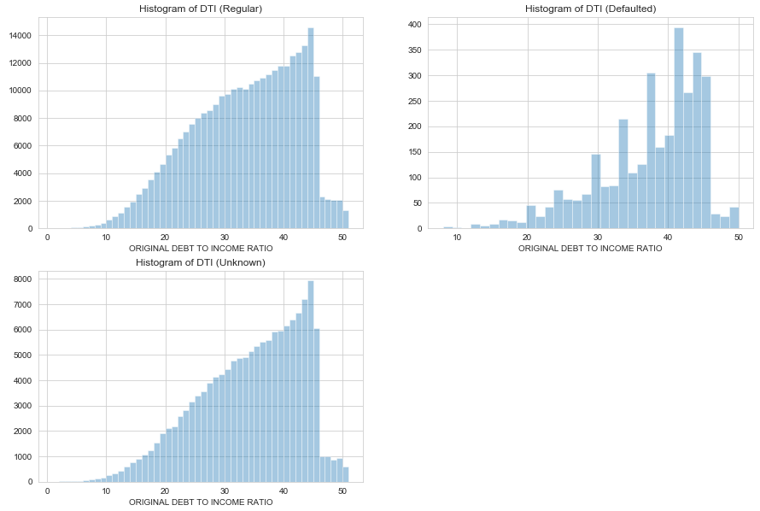
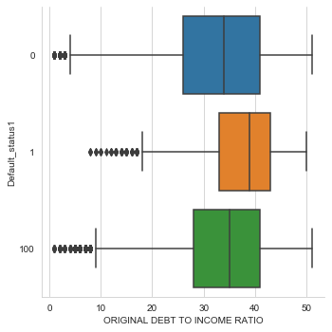
Debt to Income ratio distribution of borrowers
Boxplot shows that the borrowers who are regular (0) in payment has lower DTI.
A lower DTI implies low debt or higher income
Defaulters (1) have their DTI spread on the higher side.

Slide 11
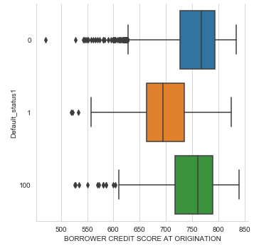
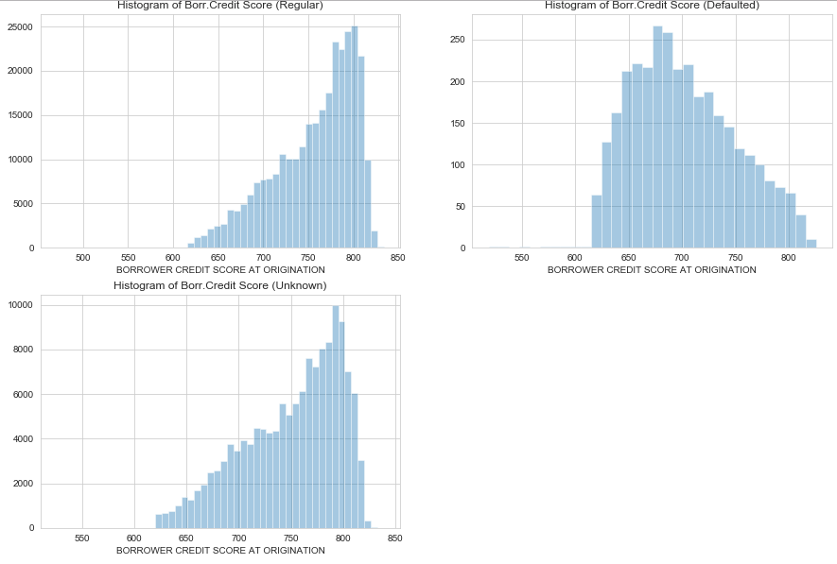
Credit Score Distribution
Boxplot shows that the borrowers who are regular (0) in payment has higher Credit score.
Defaulters (1) have their credit score spread on the higher side.

Slide 12
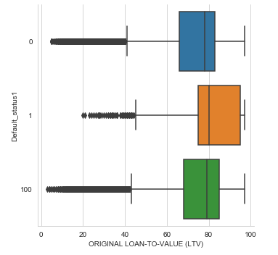
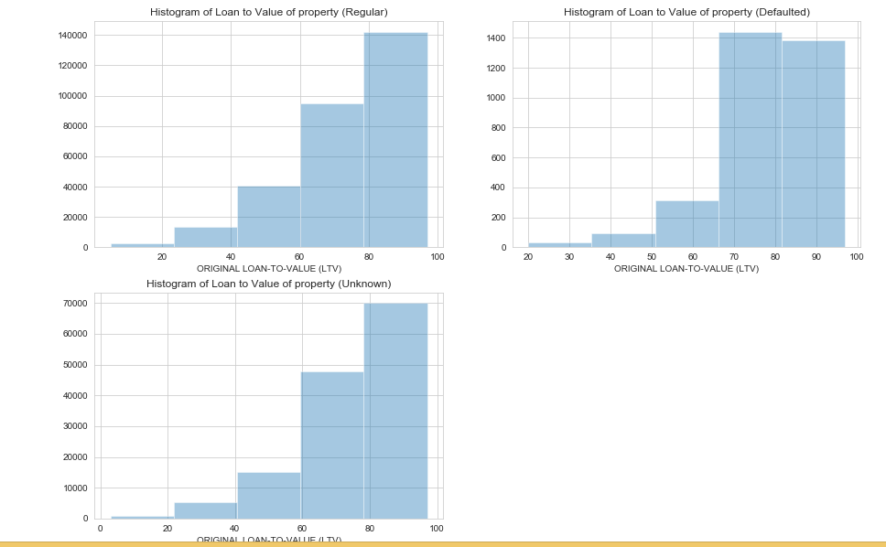
Loan to Property value
Boxplot shows that the borrowers who are regular (0) in payment has lower loan to property value
Defaulters (1) have their LTV spread on the higher side.

Slide 13
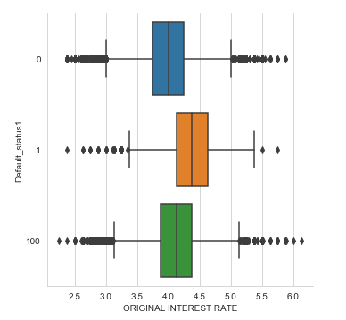
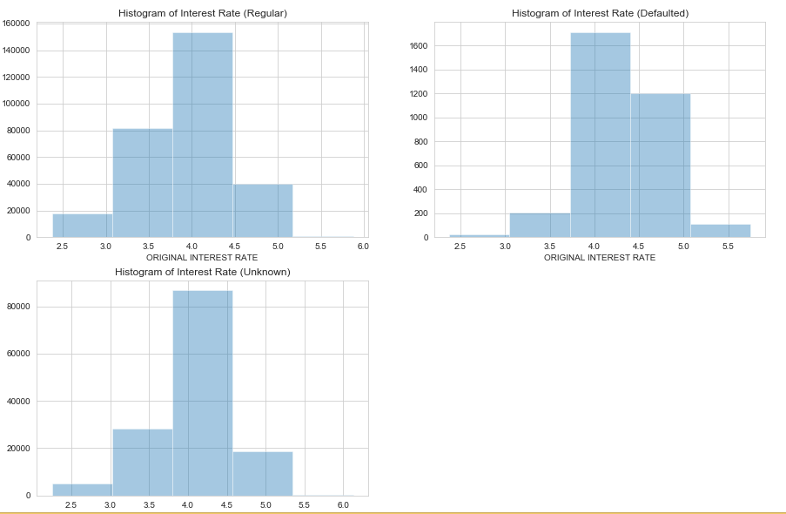
Interest rate Distribution
Boxplot shows that the borrowers who are regular (0) in payment has lower rate of interest.
Defaulters (1) have their interest spread on the higher side.

Slide 14
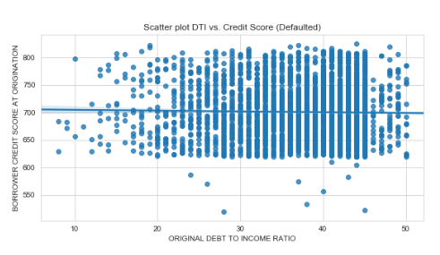
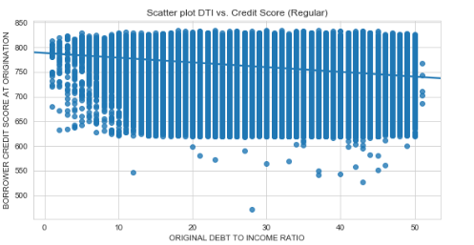
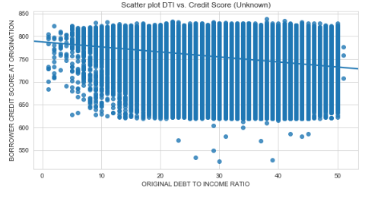
Relationship between Debt-to-Income ratio and Credit score

Slide 15
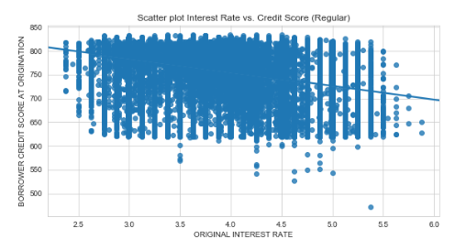
Relationship between Interest rate and Credit Score

Slide 16
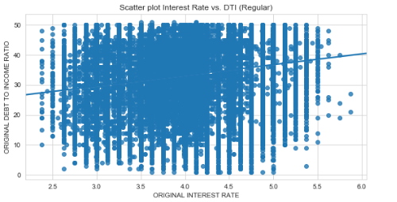
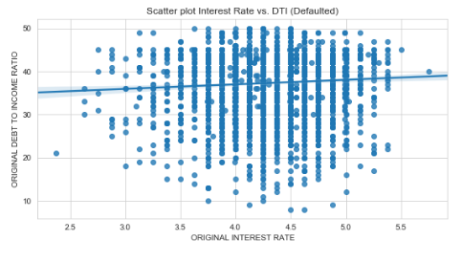
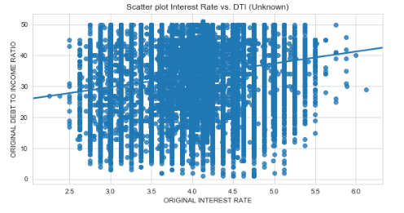
Relationship between Interest rate and Debt-Income Ratio

Slide 17
Data Cleaning and Merging
Clean-up
Merging
Delinquency Extraction
Trim Seller names(for visualization), removal of null values
Merging the columns from
Loan and borrower attributes file
Loan repayment performance file
Multiple values for a given borrower
Challenges:
Repayment file was 1.5GB in size containing 10 million rows.
Computing resources – 8GB memory wasn’t enough. Kaggle Notebook with 18GB memory and 4 core CPU was used to model and program
Delinquency status extraction – Code runtime

Slide 18
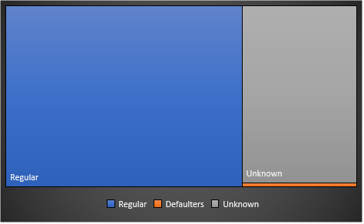
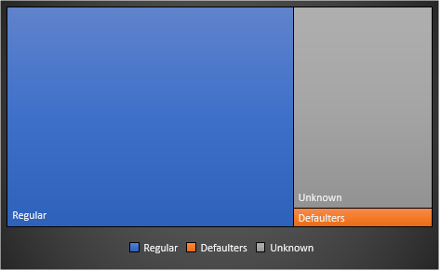
Data Assumptions
Criteria 1
Assume unknown status code as non-defaulters
Criteria 2
Assume unknown status borrowers with DTI>40% and Credit score <700 as defaulters

Slide 19
Modelling Basis
Predictive Modelling – Classification algorithm: To predict Defaulter/Non-Defaulter
Logistic Regression Multiple iterations (various combinations of predictors)
Ensemble methods Random Forest
Gradient Boosting
Neural Network – 2 layers
Usage of Random over-sampling and Under-sampling

Slide 20
Logistics Regression Modelling: Criteria 1 - Unknown status code as non-defaulters

Slide 21
Logistics Regression Modelling: Criteria 2 - Unknown status borrowers with DTI>40% and Credit score <700 as defaulters

Slide 22
Model Parameter comparison: Criteria 1 - Unknown status code as non-defaulters

Slide 23
Model Parameter comparison: Criteria 2 - Unknown status borrowers with DTI>40% and Credit score <700 as defaulters
Most Optimal
D- 86%, ND – 89%
Accuracy – 89%

Slide 24
Summary
89% accurate classification.(86% accuracy in Defaulter and 89% accuracy in Non-Defaulter classification)
Important attributes that is required for prediction
ORIGINATION CHANNEL
ORIGINAL INTEREST RATE
ORIGINAL UPB
ORIGINAL LOAN TERM
ORIGINAL LOAN-TO-VALUE (LTV)
ORIGINAL DEBT TO INCOME RATIO
BORROWER CREDIT SCORE AT ORIGINATION
FIRST TIME HOME BUYER INDICATOR
PROPERTY TYPE

