Slide 1
Structure and Object Oriented Analysis and Design
Janvi & Ansh

Slide 2
Review Questions
What is web app and mounting app on web
What is overarching reason for designing ERP system

Slide 3
What is Web app
A web-based application
Web apps are delivered through a network or browser such as Chrome
Access through internet or intranet
E.g. Gmail, twitter etc.

Slide 4
What makes it different from website ?
Web applications are designed for interaction with end users.
Websites basically contains static content.
The user of web applications can read the content and can also manipulate it.

Slide 5
Advantage of mounting an application on web
Cross platform compatibility
Free from Downloading needs
Accessibility
Cost Efficient
More manageable
Highly deployable
Secure live data
Runs easy

Slide 6
ERP
The acronym ‘ERP’ refers to “enterprise resource planning“.
Overarching structure
Uses different department information to construct a common database.
Centralize
E.g. Microsoft Dynamics 365, Oracle etc.

Slide 7
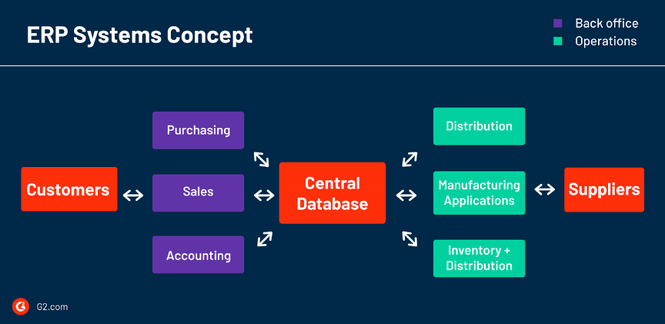
Concept of ERP

Slide 8
Work include in ERP
ERP
Sales
Service
E-commerce
supply chain
Warehouse

Slide 9
Advantages of ERP system
Enhancing business report
Ensure transparency
Provide real-time Data and cloud Security
Management optimization
Increase productivity
Monitor profitability
Avoid errors

Slide 10
THANK YOU!

