Slide 1
Linux-minifirewall
Created by
Aman Agarwal - 15114006
Anubhav Jain - 15114014
Devesh Masane - 15114023
Dhanraj Sahu - 15114024
Harsh Kumar Bansal - 15114033

Slide 2
OBJECTIVE
Our objective is to build a firewall that blocks unauthorized access while permitting authorized communications.Firewalls have several types. In this project, we focus on a very simple type, the packet filter. Packet filters act by inspecting the packets. All datagrams entering or leaving the intranet pass through the firewall, which examines each datagrams and blocks those that do not meet the specified security criteria.
The firewall can BLOCK or UNBLOCK (LOG) packets according to a set of rules. The rule will be added to Packet filters which often use a combination of the packet's source and destination address, its protocol (TCP/UDP) traffic, the port number from a certain source IP network to a destination port will be blocked. .

Slide 3
PURPOSE
Fairly effective and transparent to user.
Configured with a table of laws that characterize the packets by the IP addresses of source, destination, ports, protocol etc.
Manager to specify how the router should dispose off each datagram.
The filter can be configured in two modes.
Route the datagrams while the IP combinations in the laws define the datagrams that need to be blocked.
The other configuration is the reverse in which the default action is blocking for the datagram and only the datagrams which abide by the filter laws are routed correctly.

Slide 4
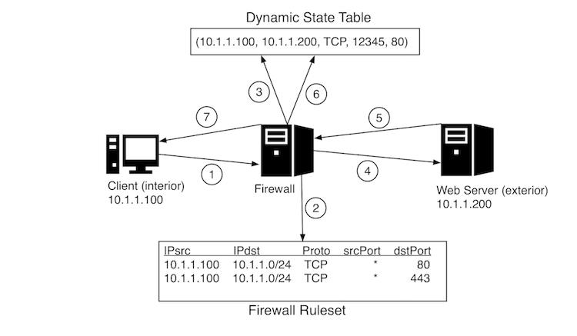
WORKING OF THE PROJECT

Slide 5
Explanation of getopt_long() Prototype
int getopt_long (int argc, char *const *argv, const char *shortopts, const struct option *longopts, int *indexptr)
argc and argv are the argument count and argument vector, the same as the two input parameters in the standard main prototype.
char *short_options = "hod:s:m:p:t:n:q:c:a:";
longopts describes the long options to accept, which is an array of struct option. longopts must be terminated by a struct option of all 0s.
For all options, getopt_long stores the matched option’s index in array longopts to *indexptr. You can access the name of the option by longopts[*indexptr].name.

Slide 6
INNER WORKING OF THE FIREWALL :
The set of rules defined by the user utility are implemented in the firewall with the help of a kernel module.
Linux kernel modules are a piece of software that can be loaded/unloaded upon request, either at system start up, or dynamically when the system is up and running. Kernel modules extends the functionalities of the Linux kernel without re-compiling and rebooting the Linux system. Lots of Linux drivers are written as kernel modules and loaded when a compatible device is detected. Linux kernel module exists as .ko file on Linux file system.
The output of the kernel module can be viewed by the commands : tail -f /var/log/syslog OR dmesg.

Slide 7
MEMORY ALLOCATION :
There’re two functions available to allocate memory from heap in Linux kernel process
vmalloc
kmalloc
PROCFs
It can act as a bridge connecting the user space and the kernel space. User space program can use proc files to read the information exported by kernel.
The registered read callback function is triggered when user space program read the proc file. The write callback function is called when user space program writes to the proc file
kernel code must use copy_from_user function to get the data and copy_to_user to write in buffer.

Slide 8
NETFILTER
NF_IP_PRE_ROUTING → NF_IP_LOCAL_IN (USED)
NF_IP_PRE_ROUTING → NF_IP_FORWARD→ NF_IP_POST_ROUTING
NF_IP_LOCAL_OUT→ NF_IP_POST_ROUTING (USED)
KERNEL HOOK FUNTION CALLBACK
NF_ACCEPT - let the packet pass. (USED)
NF_DROP - drop the packet. (USED)
NF_STOLEN - take the packet and don’t let the packet pass.
NF_QUEUE - queue the packet, usually for userspace handling.
NF_REPEAT - call the hook again.

Slide 9
Conclusion
This project depicts a simple firewall displaying the most basic idea of what a firewall is and how it works using packet filtering method. This project displays a very clear implementation of the customized firewall using packet filtering method .
Basically, it is project for
learn how to write a linux kernel module.
learn how to bridge user space and kernel space.
enhance network perspective.

