Slide 1
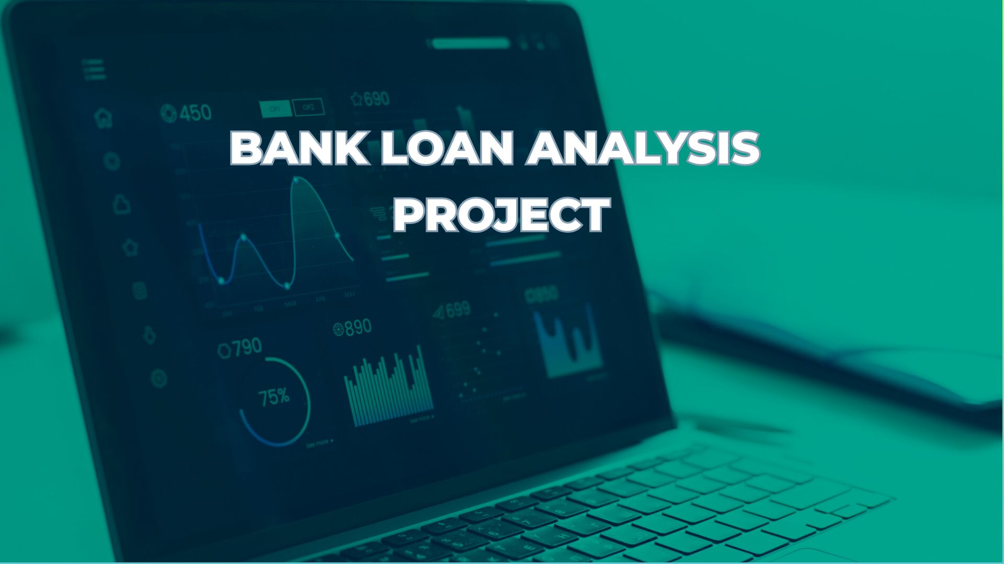

Slide 2

Group Member

Slide 3
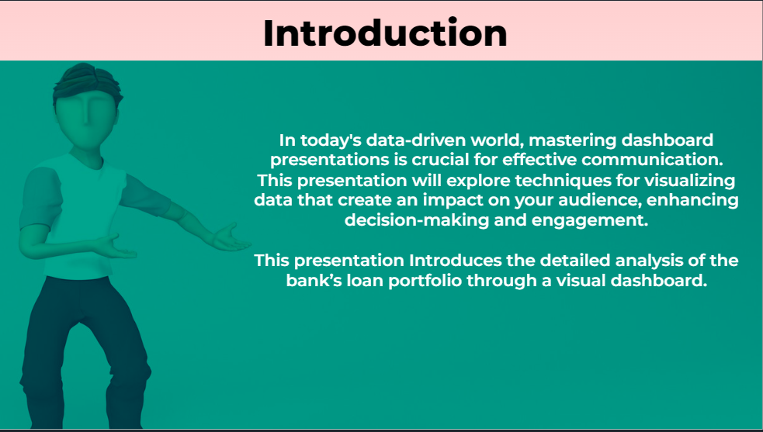

Slide 4
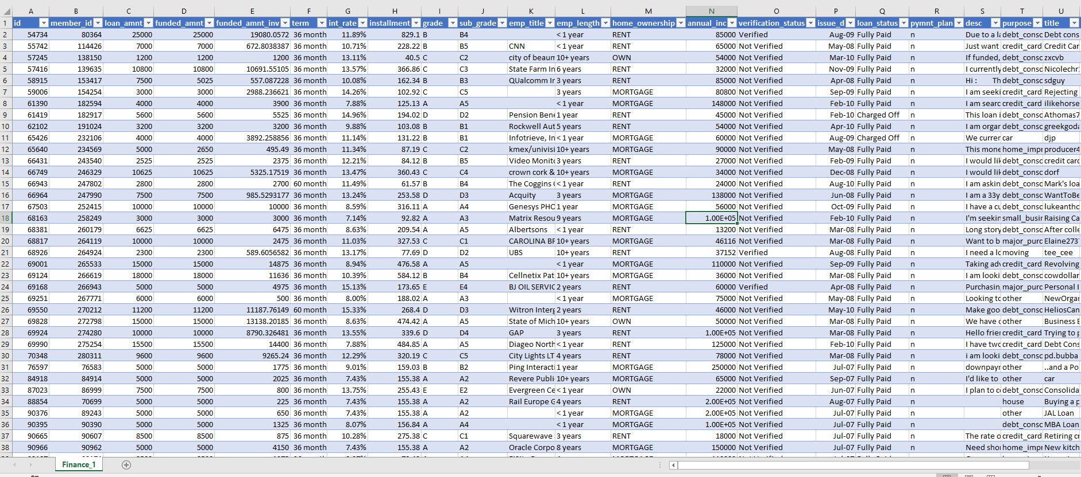
Data Transformation
Bank Loan Analysis Project

Slide 5
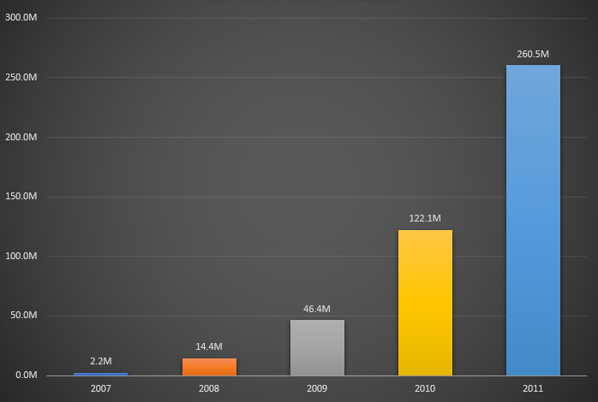
KPI 1 :-
Bank Loan Analysis Project
Year Wise Loan Amount
Observation :-
Year 2011 has Highest Loan Amount
Every Year Loan Amount is Increasing
Suggestions :-
Loan Amount is Increasing in a Good Rate if Bank focus on Increasing Number Of Customer every Year then it will Grow more Rapidly

Slide 6
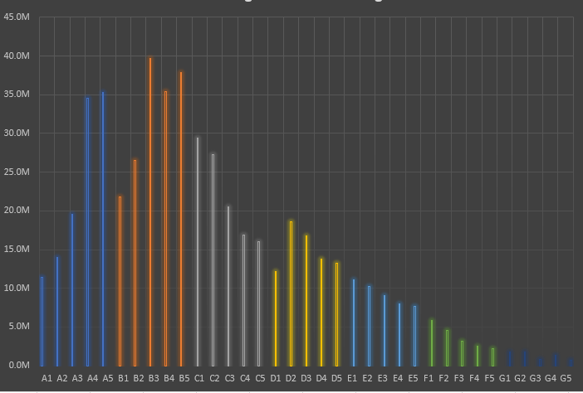
KPI 2 :-
Bank Loan Analysis Project
Grade & Sub Grade Wise Revolving Balance
Observation :-
SubGrade B3 has highest Revolving Balance
Grade ‘G’ has Lowest Revolving Balance
Suggestions :-
Focus on ‘B’ Grade it has highest Revolving Balance

Slide 7
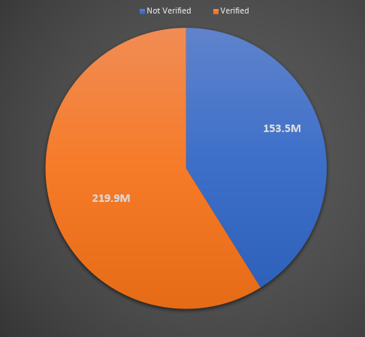
KPI 3 :-
Bank Loan Analysis Project
Total Payment for Verified & non Verified Customer
Observation :-
58.9 Percent of Total payment are Verified Customer
153 million of Total Payment are non Verified Customer
Suggestions :-
Focus on Non-Verified Customer they are Increasing Every Year

Slide 8
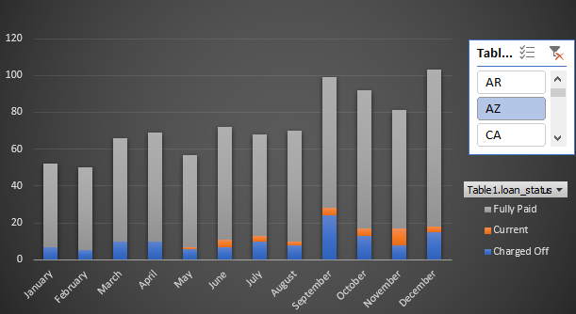
KPI 4 :-
Bank Loan Analysis Project
State Wise And Month wise Loan Status
Observation :-
December Month Has highest Count of Loan Status 4433
January has Lowest Count of Loan Status
Suggestions :-
Focus on Month From January to April its has the lowest Loan opening during Starting of the Year

Slide 9
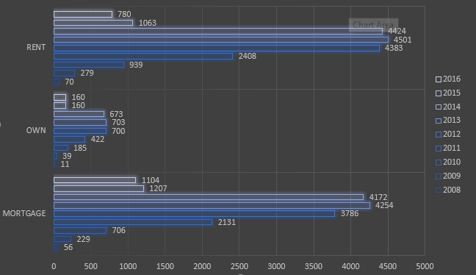
KPI 5 :-
Bank Loan Analysis Project
Home Ownership Vs Last Payment Date
Observation :-
Rent And Mortgage Type got higher in loan Count
Year 2011 to 2013 has highest number of loans
Suggestions :-
Focus on Own home Ownership Type it got least loan

Slide 10
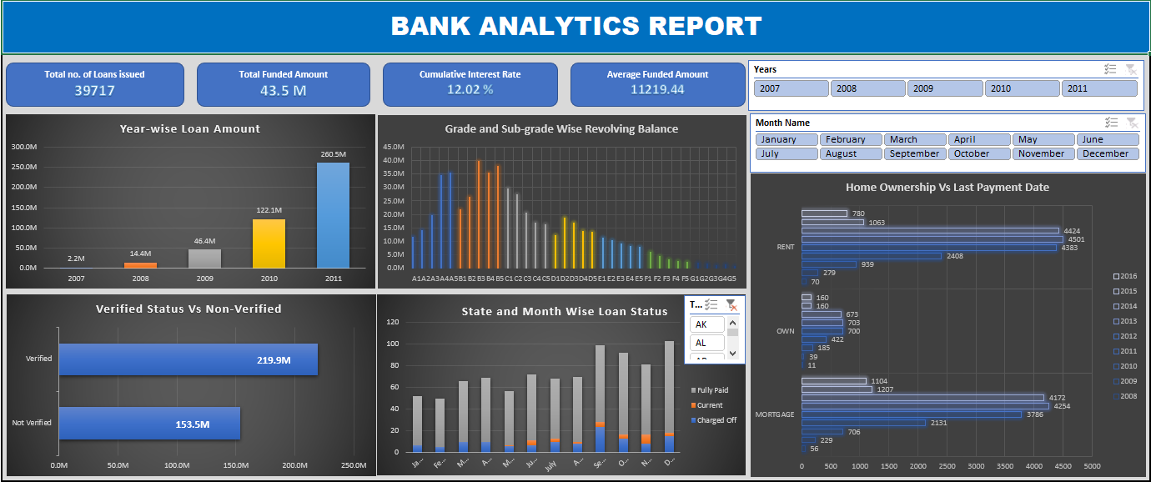
EXCEL DASHBOARD
Bank Loan Analysis Project

Slide 11
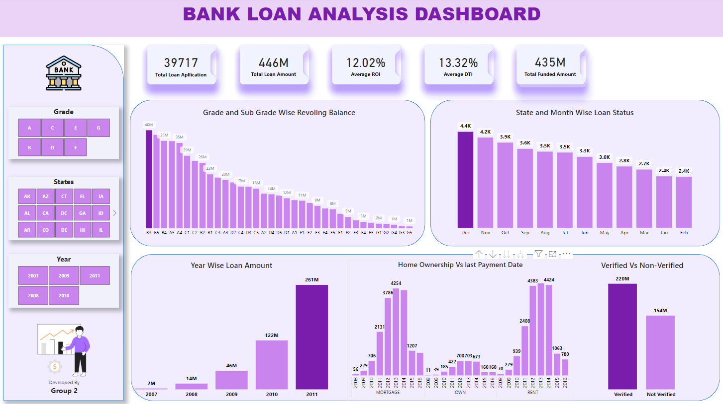
POWER BI DASHBOARD
Bank Loan Analysis Project

Slide 12
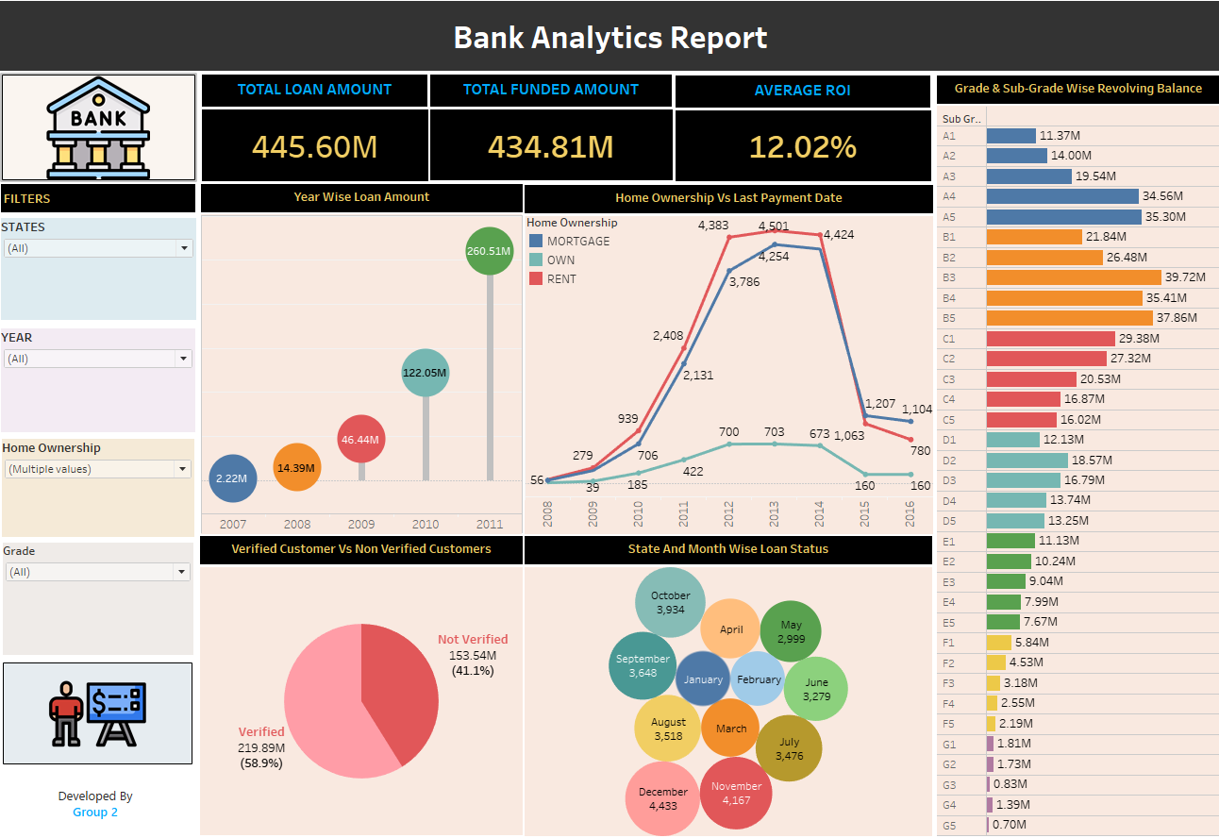
TABLEAU DASHBOARD
Bank Loan Analysis Project

Slide 13
THANK YOU

