Slide 1
ODDS AGAINST ODDS
ANAND JOSEPH MARATTUKALAM
PIYUSH TRIPATHI
PRADYUMNA NEOG
SAURABH PALASPAGAR

Slide 2
GOALS
Analyze the drawbacks and shortcomings of Soccer betting companies operating in English Premier League.
Compare the performance of the betting systems with different classes of referees on divided based on aggression in which they control the game(Aggressive, Neutral, Lenient).
Identify whether anomalous weather conditions(Rain, Hail, ThunderStorm) affect the performance of the betting systems.

Slide 3
MOTIVATION
Trying to find the shortcomings in existing betting systems, thus providing possible insights to the betting companies on how to improve their current system.
Identifying existing loopholes in each betting system that gambling enthusiasts could exploit to help improve their odds.

Slide 4
BETTING PLAYBOOK
Betting Company Definitions
HW - Home Team Win Odds
AW - Away Team Win Odds
DW - Draw Odds
User Defined Performance Definitions
BM = Lowest Odd value
OO = Odd value of Outcome
Prediction Error Rate = (OO - BM)/(HW+AW+DW)

Slide 5
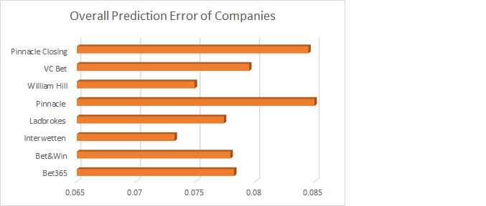
BETTING STATISTICS

Slide 6
REFEREE PLAYBOOK
DataSet Definitions
HF - No of Home Team Fouls
AF - No of Away Team Foul
HY - No of Home Team Yellow Cards
AY - No of Away Team Yellow Cards
HR - No of Home Team Red Cards
AR - No of Away Team Red Cards
AS - Aggressiveness Score
User Defined Definitions
AS = (HF+AF)*4+(HY+AY)*10+(HR+AR)*25

Slide 7
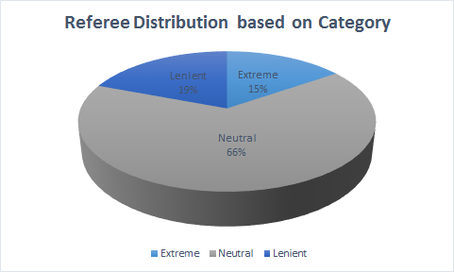
REFEREE STATISTICS

Slide 8
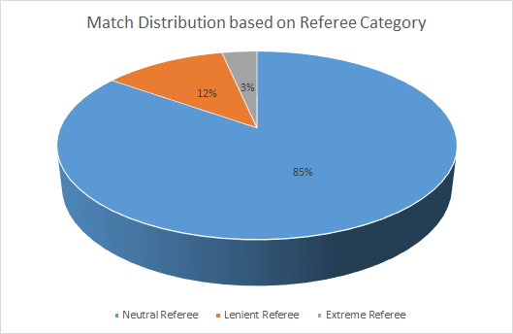
REFEREE STATISTICS

Slide 9
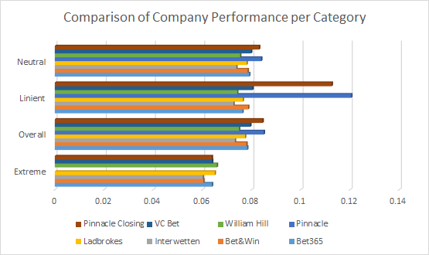
REFEREE STATISTICS

Slide 10
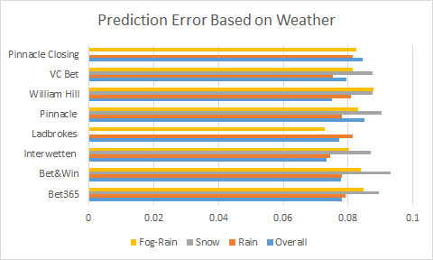
WEATHER STATISTICS

Slide 11
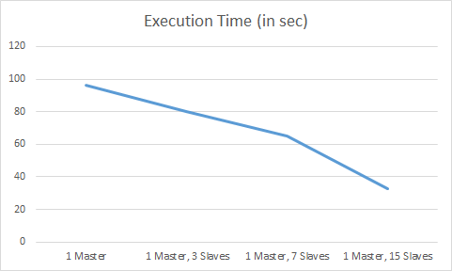
CLUSTER STATISTICS

Slide 12
WEAKNESS AND FUTURE IMPROVEMENTS
Weakness and Limitations
Limited availability of suitable datasets.
Available data sets are incomplete.
Future Improvements
Do analyze on crowd attendance.
Improve the weather data set.

Slide 13
CONCLUSION
Identified Prediction Performance Rate varied with the aggressiveness of the Referees.
Learned different betting companies Prediction Performance varied highly on matches conducted by Lenient Referees.
Made a crucial observation that Aggressive Referees are assigned fewer matches.
Found of Prediction Performance Rate varied with different weather conditions.

