Slide 1

Weather Forecasting
Submitted By:
Aman Jaiswal- 137
Yash Chandra Verma - 196
Submitted To:
Dr. Uma Das

Slide 2
Contents
Introduction
Applications
Different Approaches
First Approach
Second Approach
Conclusion

Slide 3
Introduction
Weather Forecasting is the prediction of the state of the atmosphere for a given location using the application of science and technology.
Weather conditions changes rapidly, so `weather forecasting’ is a vital process.
This includes temperature, rain, cloudiness, wind speed and humidity.

Slide 4
Applications
Following are some area where weather forecasting are useful-
Air traffic
Agriculture
Forestry
Reduce loss in disasters like cyclone, flood etc.
Navy, Military
And many more.

Slide 5
Different Approaches
Machine Learning Approach (Linear Regression)
Deep Learning Approach (LSTM)

Slide 6
Machine Learning Approach
Here we have used linear regression. Now learning of the linear regression model could be done by four ways, from which we have only used following two ways-
OLS method,
Regularization method.
Learning a linear regression model means estimating the values of the coefficients used in the representation with the data that we have available.

Slide 7

Temperature prediction
Dataset used here is available on Open Government Data
Linear regression model used here was trained on technique called OLS
Result obtained-

Slide 8
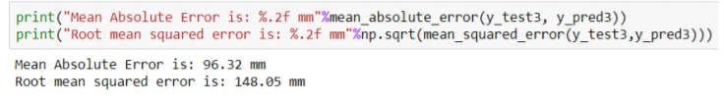
Rainfall prediction
Dataset used here is available on Open Government Data
Linear regression model is trained on the Regularization
Result-

Slide 9
Deep Learning Approach
Mainly, we used LSTM(long short term memory) here.
LSTM networks are a type of recurrent neural network capable of learning order dependence in sequence prediction problems.
A common LSTM unit is composed of a cell, an input gate, an output gate and a forget gate.

Slide 10
LSTM cont.
Forget Gate- This gate decides what information should be thrown
away or kept.
Update/Input Gate- To update the cell state, we have the input gate.
Output Gate- The output gate decides what the next hidden state should be.
Each LSTM cell works similarly.

Slide 11
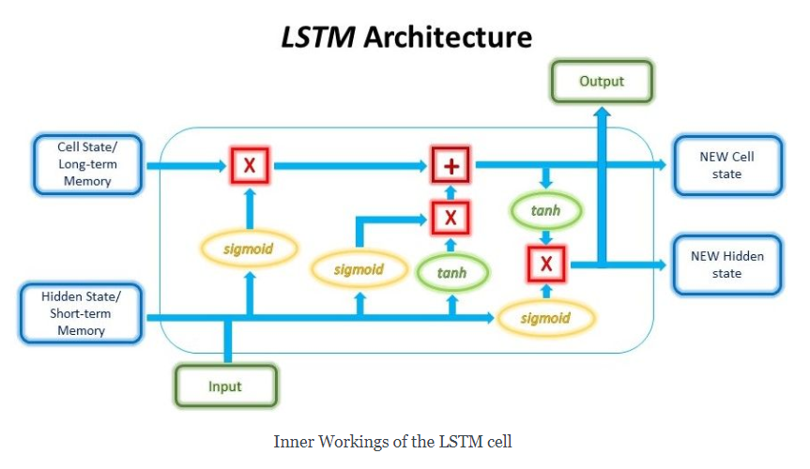

Slide 12
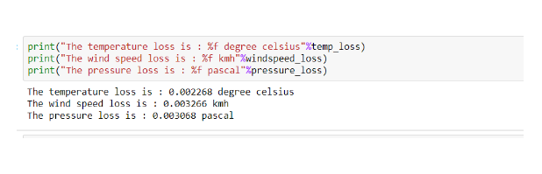
Result

Slide 13
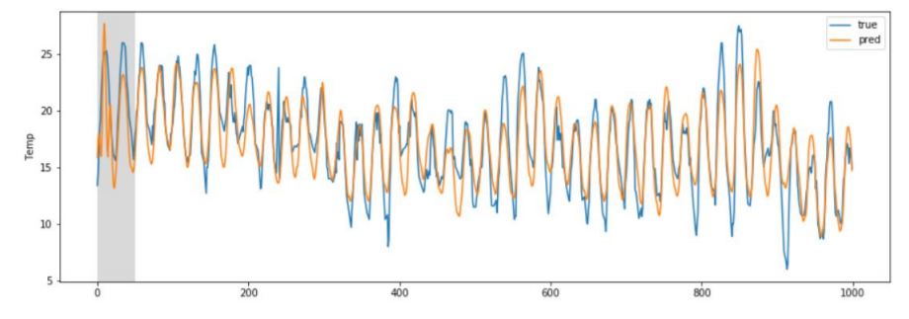
Result cont.

Slide 14
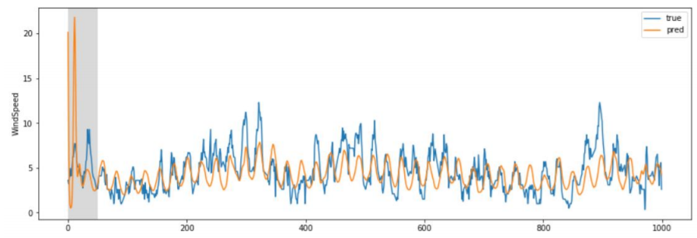
Result cont.

Slide 15
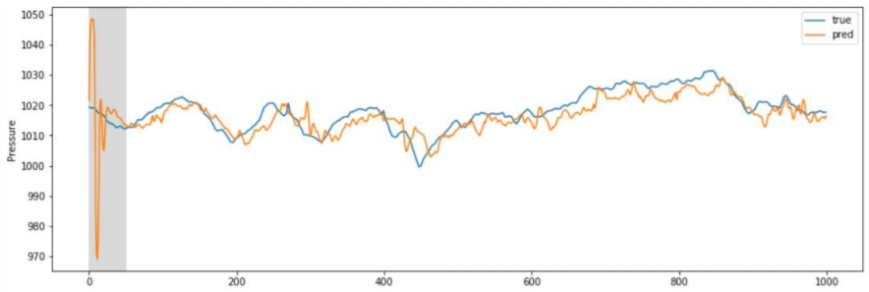
Result cont.

Slide 16
Conclusion
Deep learning approach outperform linear regression approach.
The Error in linear regression was higher in comparison to error in deep learning approach.
This is so because deep learning model build a complex relation between features and outcomes where linear regression fails to build such complex relation.-

Slide 17
Future Work
For future improvements, following step we thought to took-
Replacing model with a latest/different model
Using other robust datasets
Predicting result on more attributes
Training model on higher session

Slide 18
References
Parmar, Aakash & Mistree, Kinjal & Sompura, Mithila. (2017). Machine Learning Techniques for Rainfall Prediction: A Review.
Pooja Malik, Prof. Saranjeet Singh, Binni Arora. An Effective Weather Forecasting Using Neural Network
Abhishek, Kumar & Singh, M. & Ghosh, Saswata & Anand, Abhishek. (2012). Weather Forecasting Model using Artificial Neural Network. Procedia Technology. 4. 311–318. 10.1016/j.protcy.2012.05.047
Long Short-Term Memory Recurrent Neural Network Architectures for Large Scale Acoustic Modeling. Has¸im Sak, Andrew Senior, Franc¸oise Beaufays
Mateo, Fernando & Carrasco, Juan José & Sellami, Abderrahim & Millán-Giraldo, Mónica & Domínguez, Manuel & Olivas, Emilio. (2013). Machine learning methods to forecast temperature in buildings.

Slide 19
Thank You:)

