Slide 1

Title Slide
Thermo-fluidic design for the Inner System: updates and uncertainties
Rafael Coelho Lopes de Sá
ITK cooling meeting
June 17th, 2020

Slide 2
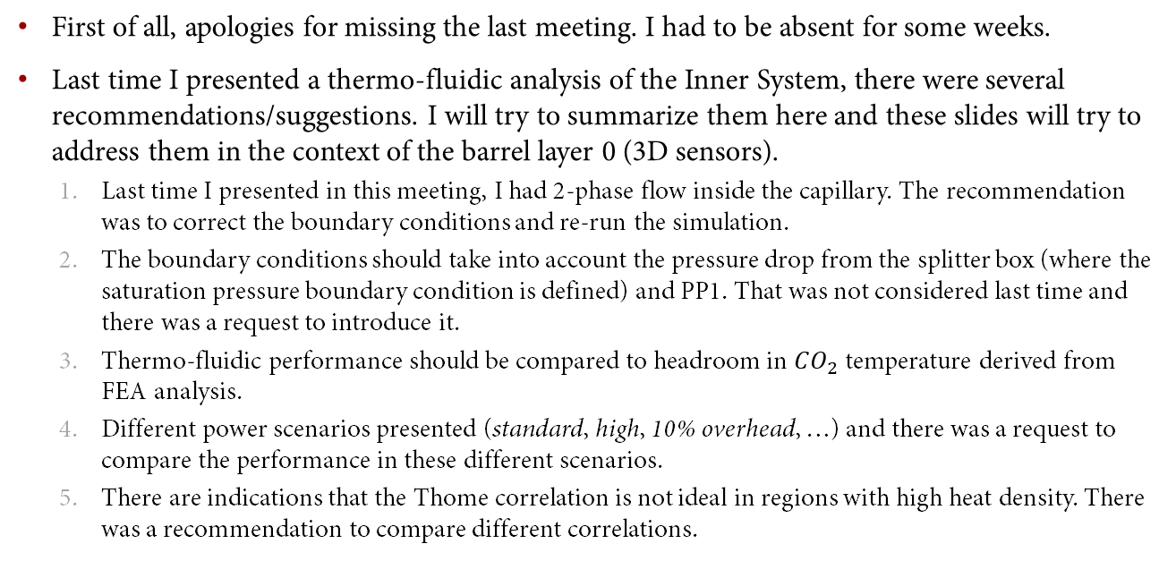
Brief introduction
First of all, apologies for missing the last meeting. I had to be absent for some weeks.
Last time I presented a thermo-fluidic analysis of the Inner System, there were several recommendations/suggestions. I will try to summarize them here and these slides will try to address them in the context of the barrel layer 0 (3D sensors).
Last time I presented in this meeting, I had 2-phase flow inside the capillary. The recommendation was to correct the boundary conditions and re-run the simulation.
The boundary conditions should take into account the pressure drop from the splitter box (where the saturation pressure boundary condition is defined) and PP1. That was not considered last time and there was a request to introduce it.
Thermo-fluidic performance should be compared to headroom in $CO_{2}$ temperature derived from FEA analysis.
Different power scenarios presented (standard, high, 10% overhead, …) and there was a request to compare the performance in these different scenarios.
There are indications that the Thome correlation is not ideal in regions with high heat density. There was a recommendation to compare different correlations.

Slide 3
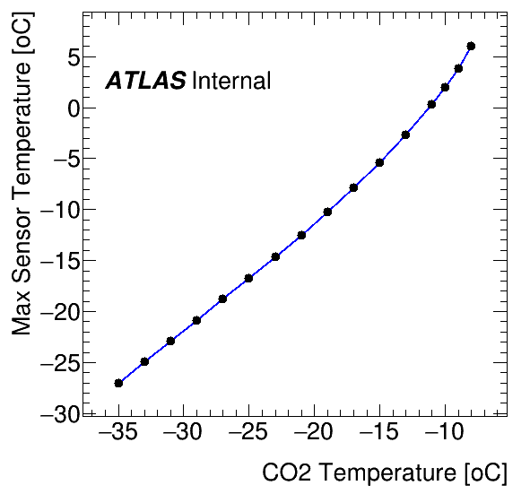
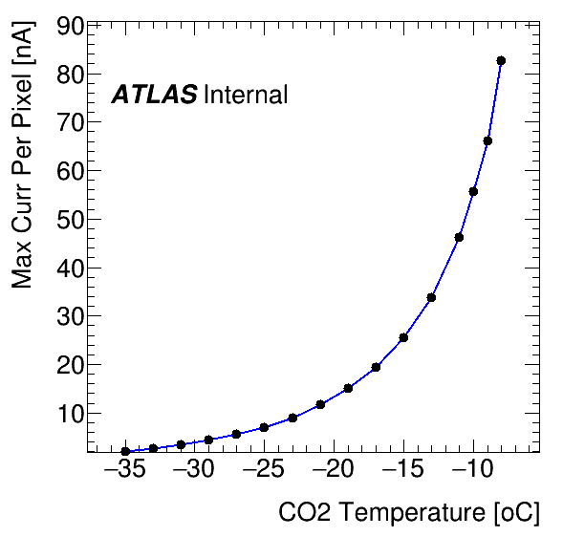
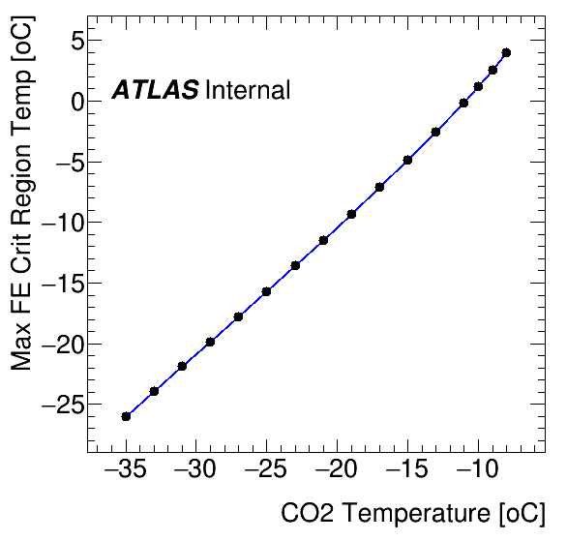

Layer 0 FEA re-analysis
Recently, a new power model for the 3D sensors was released and we were asked to perform a re-analysis of the thermal behavior.
https://indico.cern.ch/event/906398/contributions/3818314/attachments/2016784/3371007/NewThermalFEARound_07042020_DAF_VR4.pdf
I presented some details of this re-analysis in the US ITk Pixel this week
https://indico.cern.ch/event/929490/contributions/3907498/attachments/2057483/3450621/3DsensorPowerUpdate.pdf
Three observables were studied: sensor maximum temperature, maximum current per pixel, and maximum FE temperature in the critical region.
The red lines show the design criteria. The maximum current per pixel limits the $CO_{2}$ to $−{22.5}^{o}C$ and the maximum temperature in the FE in the critical region limits the $CO_{2}$ temperature to $−{27}^{o}C$.

Slide 4
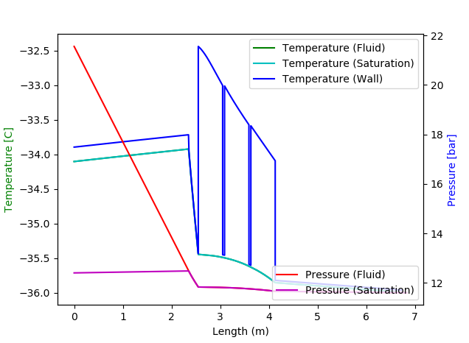
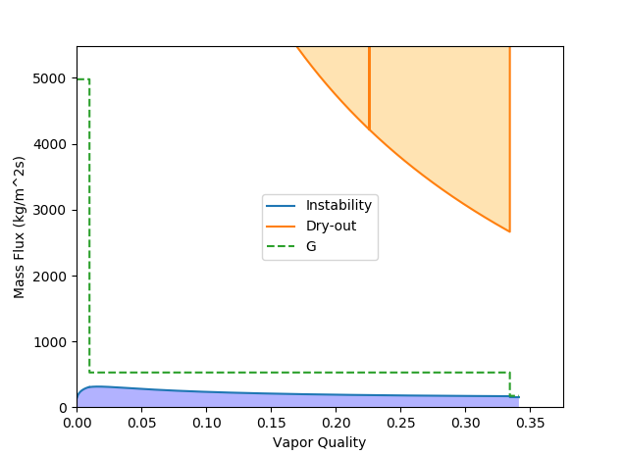
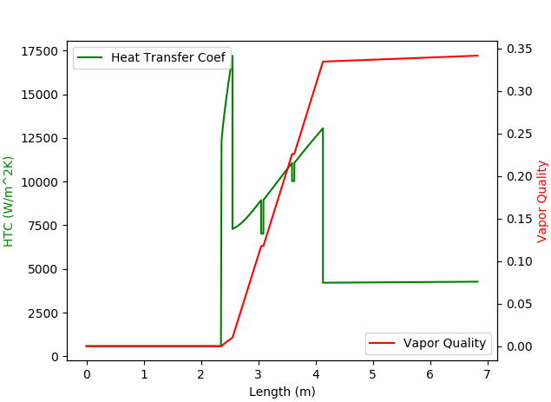

Fixing boundary conditions
Last time, when I presented temperature and pressure plots, it was pointed out that the boundary conditions were not correct. I changed the code to search for the following condition:
Fixed saturation pressure at the end of the exhaust line (I will comment on the extra flex line on the next slide)
Fixed vapor quality at beginning of evaporator (1% - same value used for the FEA shown in the last page)
Total $ΔP=10bar$ (between each PP1… question: should it be between splitter boxes?)

Slide 5
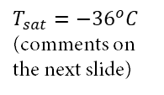


Some comments after fixing boundary conditions
The dimension of the elements is still quite loosely defined in the Inner System. Especially the capillaries/exhaust ID and length.
For this plot, I am using an exhaust with ID 4mm and length over the endcap quarter-shell. Last time I used 3mm and one of the comments pointed out that it was on the small side.
This particular plot uses capillaries of ID=0.75mm. The length converges to 2.55m, which is acceptable (less than the QS and, probably with space for welding)
I will be working here with the observable “worst evaporator temperature”. That is what can be compared to the values on slide 2 (from the FEA).
You see that in nominal condition our WET is below $−{35}^{o}C$, validating the design.
Worst evaporator temperature.
$$x=1\%$$
$$T_{sat}=−{36}^{o}C$$
(comments on the next slide)

Slide 6
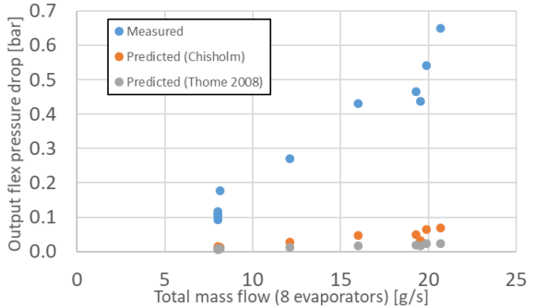
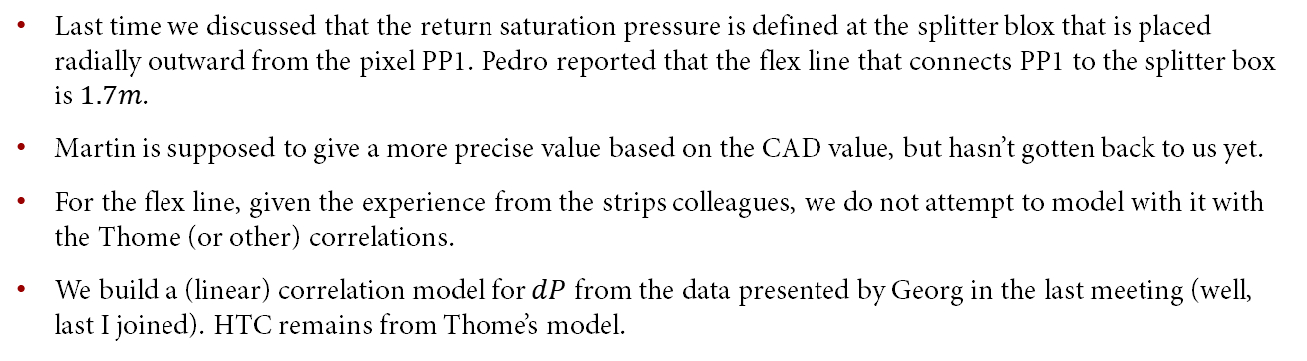
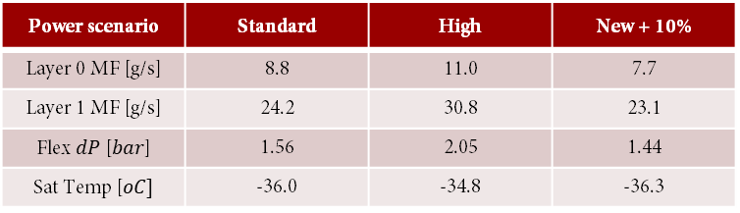
Pressure drop in flex
Last time we discussed that the return saturation pressure is defined at the splitter blox that is placed radially outward from the pixel PP1. Pedro reported that the flex line that connects PP1 to the splitter box is $1.7m$.
Martin is supposed to give a more precise value based on the CAD value, but hasn’t gotten back to us yet.
For the flex line, given the experience from the strips colleagues, we do not attempt to model with it with the Thome (or other) correlations.
We build a (linear) correlation model for $dP$ from the data presented by Georg in the last meeting (well, last I joined). HTC remains from Thome’s model.
The dashed line is merely illustrative, not the linear fit we used.
Power scenario | Standard | High | New + 10%
Layer 0 MF [g/s] | 8.8 | 11.0 | 7.7
Layer 1 MF [g/s] | 24.2 | 30.8 | 23.1
Flex $dP$ [$bar$] | 1.56 | 2.05 | 1.44
Sat Temp [$oC]$ | -36.0 | -34.8 | -36.3
We are still reworking the endcap power distribution (see Neal’s presentation in the US ITk meeting yesterday). Details will follow when we converge.

Slide 7
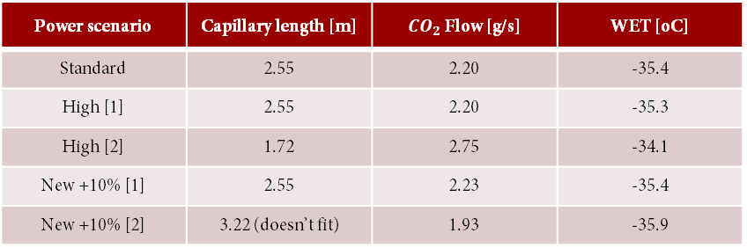
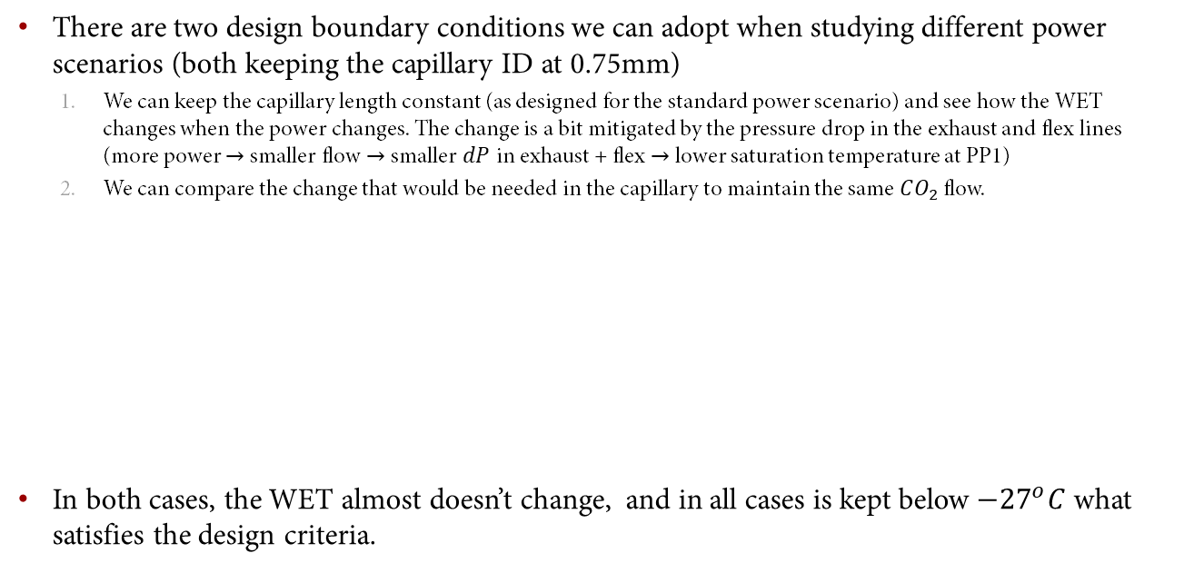
Trying different power scenarios
There are two design boundary conditions we can adopt when studying different power scenarios (both keeping the capillary ID at 0.75mm)
We can keep the capillary length constant (as designed for the standard power scenario) and see how the WET changes when the power changes. The change is a bit mitigated by the pressure drop in the exhaust and flex lines (more power $→$ smaller flow $→$ smaller $dP$ in exhaust + flex $→$ lower saturation temperature at PP1)
We can compare the change that would be needed in the capillary to maintain the same $CO_{2}$ flow.
In both cases, the WET almost doesn’t change, and in all cases is kept below $−{27}^{o}C$ what satisfies the design criteria.
Power scenario | Capillary length [m] | $CO_{2}$ Flow [g/s] | WET [oC]
Standard | 2.55 | 2.20 | -35.4
High [1] | 2.55 | 2.20 | -35.3
High [2] | 1.72 | 2.75 | -34.1
New +10% [1] | 2.55 | 2.23 | -35.4
New +10% [2] | 3.22 (doesn’t fit) | 1.93 | -35.9

Slide 8

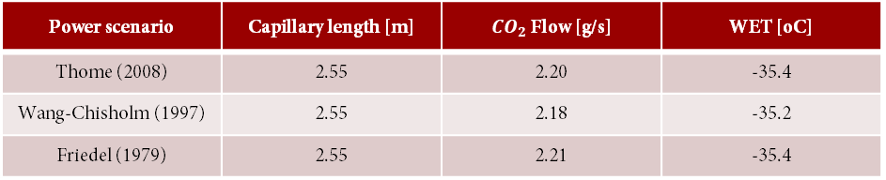
Different correlation function
Last time there was a discussion about trying different correlation models for the evaporator regions. We introduced several correlation models described in the book shown on the right.
Here we compare the effect of changing the Thome (2008) correlation to the Friedel (1979) and the Wang (1997) version of the Chisholm correlations (this version seems to be fitted in fluxes “similar” to the ones we have).
Here we just study the change in flow, not in capillary length. Negligible differences are observed in the relevant observables.
Power scenario | Capillary length [m] | $CO_{2}$ Flow [g/s] | WET [oC]
Thome (2008) | 2.55 | 2.20 | -35.4
Wang-Chisholm (1997) | 2.55 | 2.18 | -35.2
Friedel (1979) | 2.55 | 2.21 | -35.4

Slide 9
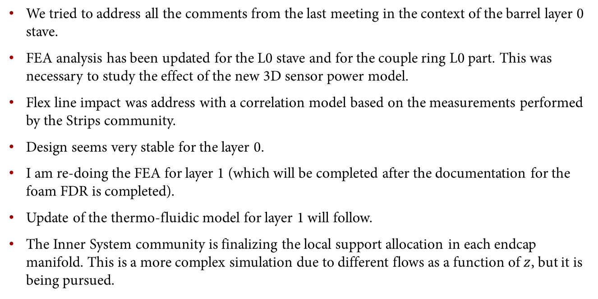
Conclusion
We tried to address all the comments from the last meeting in the context of the barrel layer 0 stave.
FEA analysis has been updated for the L0 stave and for the couple ring L0 part. This was necessary to study the effect of the new 3D sensor power model.
Flex line impact was address with a correlation model based on the measurements performed by the Strips community.
Design seems very stable for the layer 0.
I am re-doing the FEA for layer 1 (which will be completed after the documentation for the foam FDR is completed).
Update of the thermo-fluidic model for layer 1 will follow.
The Inner System community is finalizing the local support allocation in each endcap manifold. This is a more complex simulation due to different flows as a function of $z$, but it is being pursued.

Slide 10
Closing Slide

