Slide 1
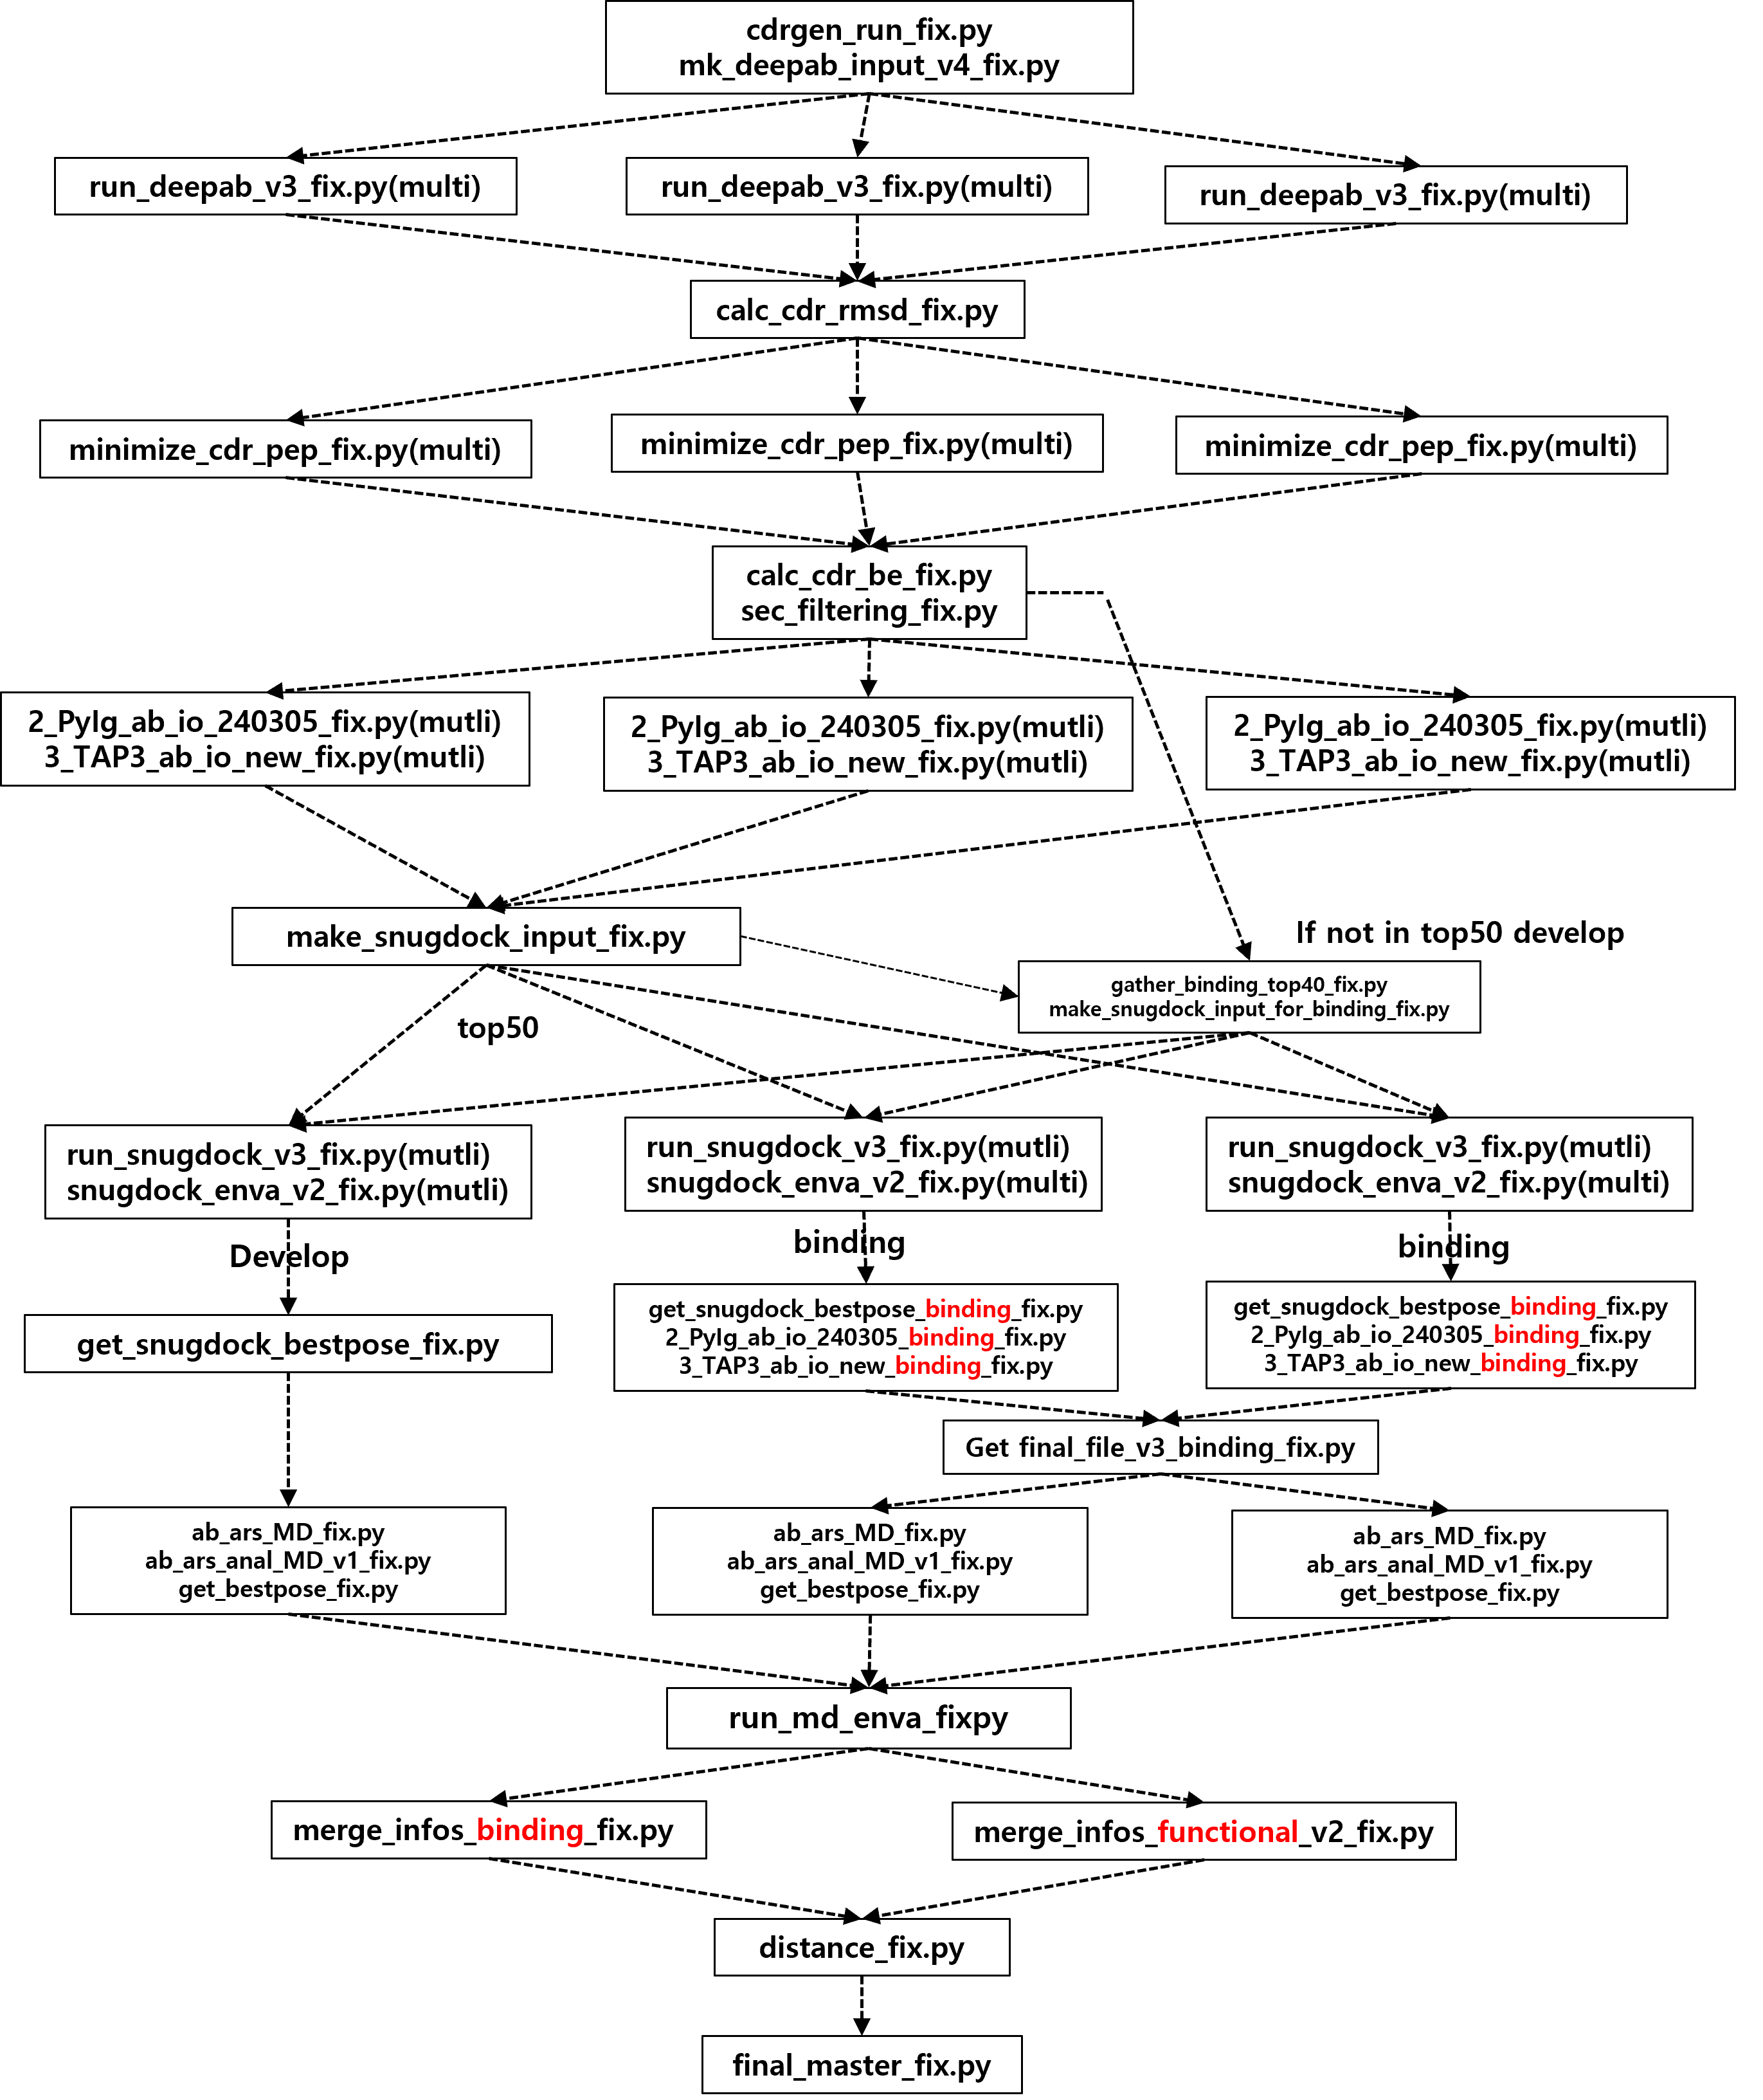
Abscan workflow
Develop
Binding
Develop
Binding option
전체 Test 시간 : 2h

Slide 2
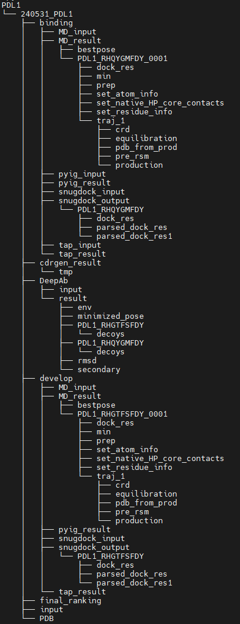
실행 위치
user1@10.0.47.99:/lwork01/iojeong/0531
Conda 환경:
CPU 10.0.47.99 (abscan)
GPU 10.0.88.1 - Deepab 실행 (py3.7)
d83{151,152} - MD 실행 (python2)
디렉토리는 항원(PDL1) , 날짜_항원(ex 240531_PDL1) 순으로 되어있음.
사전준비 디렉토리:
/lwork01/iojeong/0531/PDL1/240531_PDL1/input/
-rw-rw-r– 1 user1 user1 83212 May 31 11:51 5xxyA_antigen_filled.pdb
-rw-rw-r– 1 user1 user1 41 Jun 3 16:12 PDL1_epitope
-rw-rw-r– 1 user1 user1 142 May 31 11:51 PDL1_pdb_information.txt
Test sample
Develop pipeline : PDL1_RHGTFSFDY
Binding pipeline : PDL1_RHQYGMFDY

Slide 3

python cdrgen_run_fix.py 240531_PDL1 (1m)
For test
Usage > python cdrgen_run_fix.py [ result folder]
Example> python cdrgen_run_fix.py 240531_PDL1
Input> /lwork01/iojeong/0531/PDL1/240531_PDL1/input/PDL1_epitope
Output> /lwork01/iojeong/0531/PDL1/240531_PDL1/cdrgen_result/*_total_result.txt
**기존 github 버전에서 input 디렉토리만 바뀜
PDL1_epitope (19개 리스트중 2개만 test)
내부의 CDRgenerator_fix.py 에서
Log #처리
python mk_deepab_input_v4_fix.py 240531_PDL1 chothia (16s)
Usage > python mk_deepab_input_v4_fix.py [ result folder] [ numbering scheme]
Example> python mk_deepab_input_v4_fix.py 240531_PDL1 chothia
Input> /lwork01/iojeong/0531/PDL1/240531_PDL1/cdrgen_result/*_E_total_result.txt
Output> /lwork01/iojeong/0531/PDL1/240531_PDL1/DeepAb/input/*.fasta
/lwork01/iojeong/0531/PDL1/240531_PDL1/DeepAb/result/*_epi_cdr_set.txt
/lwork01/iojeong/0531/PDL1/240531_PDL1 /PDB/ori_env_isc_score.txt
**기존 github 버전에서
1.web 이용하는 파트 change
2.ori_env_isc_score.txt 생성파트 끌어옴

Slide 4
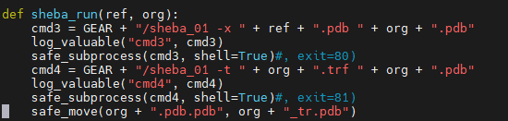
python run_deepab_v3_fix.py PDL1_RHGTFSFDY 240531_PDL1 gpu 0 (30min)
Usage > python run_deepab_v3_fix.py [ fasta file( without .fasta) [ result folder] [ gpu /cpu ] [ gpu dev id or ‘-’]
Example> python run_deepab_v3_fix.py PDL1_RHGTFSFDY 240531_PDL1 gpu 0
Input> /lwork01/iojeong/0531/PDL1/240531_PDL1/DeepAb/input/PDL1_RHGTFSFDY.fasta
Output> /lwork01/iojeong/0531/PDL1/240531_PDL1/DeepAb/result/PDL1_ RHGTFSFDY/PDL1_RHGTFSFDY.deepab.pdb
** 가상환경으로 10.0.88.1의 py3.7사용 conda activate py3.7 ( GPU사용)
python calc_cdr_rmsd_fix.py 240531_PDL1 (7s)
Usage > python calc_cdr_rmsd_fix.py [ result folder]
Example> python calc_cdr_rmsd_fix.py 240531_PDL1
Input>/lwork01/iojeong/0531/PDL1/240531_PDL1/DeepAb/result/PDL1_RHGTFSFDY/PDL1_RHGTFSFDY.deepab.pdb
Output> >/lwork01/iojeong/0531/PDL1/240531_PDL1/DeepAb/result/rmsd/PDL1_total_rmsd.txt
/lwork01/iojeong/0531/PDL1/240531_PDL1/DeepAb/result/*_CDRH3.pdb *.deepab_tr.pdb , *_H3.pdb
**기존 github에서 calc_cdr_rmsd_be_fix.py에서 분할(calc_cdr_rmsd_fix.py, minimize_cdr_pep_fix.py, calc_cdr_be_fix.py)
Sheba_01 실행 문제 exit #처리

Slide 5
Python minimize_cdr_pep_fix.py PDL1_RHGTFSFDY 240531_PDL1 (17s)
Usage > python minimize_cdr_pep_fix.py [ fasta file] [ result folder]
Example> python minimize_cdr_pep_fix.py PDL1_RHGTFSFDY 240531_PDL1
Input> >/lwork01/iojeong/0531/PDL1/240531_PDL1/DeepAb/result/PDL1_RHGTFSFDY_CDRH3.pdb
/lwork01/iojeong/0531/PDL1/240531_PDL1/input/5xxyA_antigen_filled.pdb
Output> /lwork01/iojeong/0531/PDL1/240531_PDL1/DeepAb/result/final_*.pdb
/lwork01/iojeong/0531/PDL1/240531_PDL1/DeepAb/result/minimized_pose/final_*_0001.pdb
python calc_cdr_be_fix.py 240531_PDL1 (1s)
Usage > python calc_cdr_be_fix.py [ result folder]
Example> python calc_cdr_be_fix.py 240531_PDL1
Input> /lwork01/iojeong/0531/PDL1/240531_PDL1/DeepAb/result/minimized_pose/final_*_0001.pdb
Output> /lwork01/iojeong/0531/PDL1/240531_PDL1/DeepAb/result/env/PDL1_enva_result.txt
/lwork01/iojeong/0531/PDL1/240531_PDL1/DeepAb/result/PDL1_final_enva_stats.txt
/lwork01/iojeong/0531/PDL1/240531_PDL1 /DeepAb/result/PDL1_final_rmsd_stats.txt
Sheba_01 실행 문제 exit #처리

Slide 6
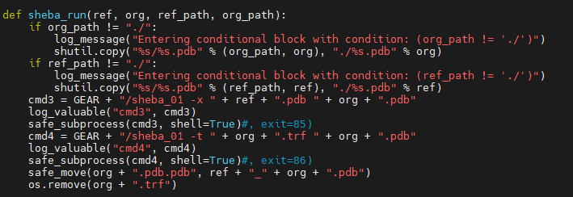
python sec_filtering_fix.py 240531_PDL1 (0.1s)
For test
heavy 70% light 50% >> heavy 30% , light 10%
Usage > python sec_filtering_fix.py [ result folder]
Example> python sec_filtering_fix.py 240531_PDL1
Input> /lwork01/iojeong/0531/PDL1/240531_PDL1/DeepAb/result/*_tr.pdb
Output> /lwork01/iojeong/0531/PDL1/240531_PDL1/develop/*_new_numbering.pdb
/lwork01/iojeong/0531/PDL1/240531_PDL1/DeepAb/result/PDL1_deepab_info.txt
/lwork01/iojeong/0531/PDL1/240531_PDL1/DeepAb/result/PDL1_total_sec_result.txt
** for test : use line 298 , for production use line 297
Python 2_PyIg_ab_io_240305_fix.py PDL1_RHGTFSFDY.deepab_new_numbering.pdb aho 240531_PDL1 (3min)
*binding과 develop에 상관없이 모든 샘플들 전부 돌려야함. (develop 상위 40개 가져오기 위해)
Usage > python 2_PyIg_ab_io_240305_fix.py [ PDB ] [ numbering scheme] [ result folder]
Example> python 2_PyIg_ab_io_240305_fix.py PDL1_RHGTFSDY.deepab_new_numbering.pdb aho 240531_PDL1
Input> /lwork01/iojeong/0531/PDL1/240531_PDL1/develop/PDL1_RHGTFSFDY.deepab_new_numbering.pdb
Output> /lwork01/iojeong/0531/PDL1/240531_PDL1/develop/pyig_result/PDL1_RHGTFSFDY_pyig.tsv
Sheba_01 실행 문제 exit #처리

Slide 7
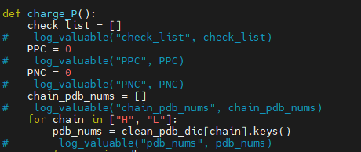
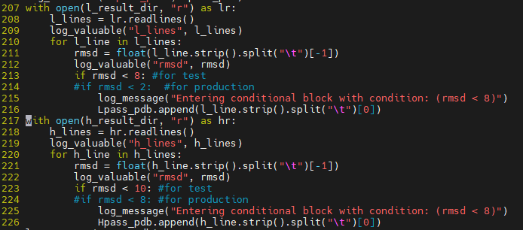
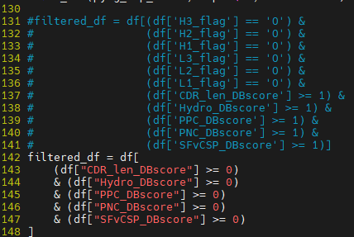
Python 3_TAP3_ab_io_new_fix.py PDL1_RHGTFSFDY.deepab_new_numbering.pdb imgt 240531_PDL1 (1m)
*binding과 develop에 상관없이 모든 샘플들 돌려야함. (develop 상위 40개 가져오기 위해)
Usage > python 3_TAP3_ab_io_new_fix.py [ PDB ] [ numbering scheme] [ result folder]
Example> python 3_TAP3_ab_io_new_fix.py PDL1_RHGTFSFDY.deepab_new_numbering.pdb imgt 240531_PDL1
Input> /lwork01/iojeong/0531/PDL1/develop/PDL1_RHGTFSFDY.deepab_new_numbering.pdb
Output> /lwork01/iojeong/0531/PDL1/develop/tap_result/PDL1_RHGTFSFDY_tap.tsv
*open(~,’a’) >> open(~,’w’) 로 바꿈
Log #처리
For test
python make_snugdock_input_fix.py 240531_PDL1 (2s)
Usage > python make_snugdock_input_fix.py [ result folder]
Example> python make_snugdock_input_fix.py 240531_PDL1
Input> /lwork01/iojeong/0531/PDL1/240531_PDL1/develop/pyig_result/*_pyig.tsv
/lwork01/iojeong/0531/PDL1/240531_PDL1/develop/tap_result/*_tap.tsv
/lwork01/iojeong/0531/PDL1/240531_PDL1 /develop/*.deepab_new_numbering.pdb
Output> /lwork01/iojeong/0531/PDL1/240531_PDL1/develop/snugdock_input/*.LHA_sorted.pdb
/lwork01/iojeong/0531/PDL1/240531_PDL1/develop/develop_pyig_tap_info.tsv
/lwork01/iojeong/0531/PDL1/240531_PDL1/develop/develop_top50.tsv
** use line 142-148 for test and use line 131-141 for production(pyig-tap filter)
use line 213 , 223 for test and use line 214, 224 for production(rmsd)

Slide 8
Python run_snugdock_v3_fix.py 240531_PDL1 PDL1_RHGTFSFDY 1 develop (28min)
Usage > python run_snugdock_v3_fix.py [ result folder] [ PDB] [ N.of.conf] [ develop or binding]
for test → nconf = 1
for production -> nconf = 1000
Example> python run_snugdock_v3_fix.py 240531_PDL1 PDL1_RHGTFSFDY 30 develop
Input> /lwork01/iojeong/0531/PDL1/develop/snugdock_input/PDL1_RHGTFSFDY.LHA_sorted.pdb
Output> /lwork01/240531_PDL1_abs_tmp_work/PDL1_RHGTFSFDY
python snugdock_enva_v2_fix.py PDL1_RHGTFSFDY 240531_PDL1 (4s per 1 conformer)
Usage > python snugdock_enva_v2_fix.py [ PDB] [ result folder] [ develop or binding]
Example> python snugdock_enva_v2_fix.py PDL1_RHGTFSFDY 240531_PDL1 develop
Input> /lwork01/240531_PDL1_abs_tmp_data/PDL1_RHGTFSFDY
Output> /lwork01/iojeong/0531/PDL1/240531_PDL1/develop/snugdock_output/PDL1_RHGTFSFDY

Slide 9
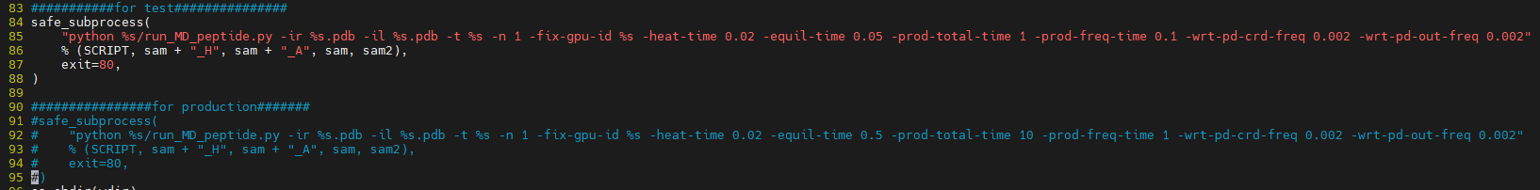
python get_snugdock_bestpose_fix.py PDL1_RHGTFSFDY 240531_PDL1 (3s)
Usage > python get_snugdock_bestpose_fix.py [ PDB] [ result folder]
Example> python get_snugdock_bestpose_fix.py PDL1_RHGTFSFDY 240531_PDL1
Input> /lwork01/iojeong/0531/PDL1/develop/snugdock_output/PDL1_RHGTFSFDY
Output> /lwork01/iojeong/0531/PDL1/develop/MD_input/PDL1_RHGTFSFDY_0001.pdb
python ab_ars_MD_fix.py --pdb PDL1_RHGTFSFDY_0001 --sample 240531_PDL1 --pipeline develop --gpu-id 0 (44min)
Usage > python ab_ars_MD_fix.py --pdb [ PDB] --sample [ result folder] --pipeline [ develop/binding] --gpu-id [0/1]
Example> python ab_ars_MD_fix.py --pdb PDL1_RHGTFSFDY_0001 –sample 240531_PDL1 –pipeline develop –gpu-id 0
Input> /lwork01/iojeong/0531/PDL1/develop/MD_input/PDL1_RHGTFSFDY_0001.pdb (GPU)
Output> /lwork01/abs_tmp_work/ (GPU)
Develop, binding >>> PDL1_RHGTFSFDY_0001 형태로 통일
**for test 84~88 for production 91~95
/lwork01/iojeong/0531/code/develop/original/ab_ars_MD.py
use line 84-88 for test and use line 91-95 for production

Slide 10
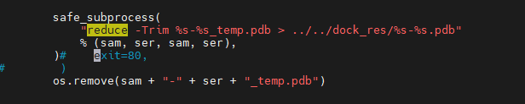
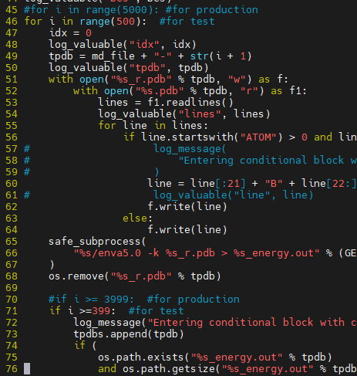
python ab_ars_anal_MD_v1_fix.py --pdb PDL1_RHGTFSFDY_0001 –sample 240531_PDL1 –pipeline develop (5min)
Usage > python ab_ars_anal_MD_v1_fix.py --pdb [ PDB] --sample [ result folder] --pipeline [ develop/binding]
Example> python ab_ars_anal_MD_v1_fix.py --pdb PDL1_RHGTFSFDY_0001 –sample 240531_PDL1 –pipeline binding
Input> /lwork01/abs_tmp_work/PDL1_RHGTFSFDY_0001/traj_1/production/*.crd (GPU)
Output> /lwork01/abs_tmp_work/PDL1_RHGTFSFDY_0001/dock_res/*.pdb (GPU)
python get_bestpose_fix.py 240531_PDL1 PDL1_RHGTFSFDY_0001 develop (14s)
Usage > python get_bestpose_fix.py [ result folder] [PDB] [ develop/binding]
Example> python get_bestpose_fix.py 240531_PDL1 PDL1_RHGTFSFDY_0001 develop
Input> /lwork01/abs_tmp_work/PDL1_RHGTFSFDY_0001/ (GPU)
Output> /lwork01/iojeong/0531/PDL1/240531_PDL1/develop/MD_result/PDL1_RHGTFSFDY_0001
/lwork01/iojeong/0531/PDL1/240531_PDL1/develop/MD_result/bestpose/PDL1_RHGTFSFDY_0001-414.pdb (GPU)
**for test 46, 71 for production 45, 70
Log, exit # 처리
Log #처리

Slide 11
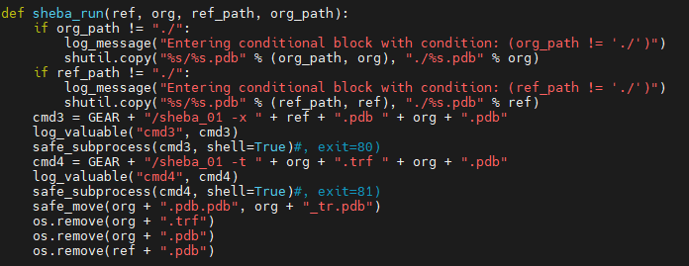
python run_md_enva_fix.py 240531_PDL1 develop (2s)
Usage > python run_md_enva_fix.py [ result folder] [ develop/binding]
Example> python run_md_enva_fix.py 240531_PDL1 binding
Input> /lwork01/iojeong/0531/PDL1/240531_PDL1/develop/MD_result/bestpose/PDL1_RHGTFSFDY_0001-414.pdb
Output> /lwork01/iojeong/0531/PDL1/240531_PDL1/develop/MD_result/bestpose/PDL1_RHGTFSFDY_0001-414.env_result
exit # 처리

Slide 12
Binding 영역
python cdrgen_run_fix.py
python mk_deepab_input_v4_fix.py
python run_deepab_v3_fix.py PDL1_RHQYGMFDY 240531_PDL1 gpu 0 (28min) (develop과 같이 돌림)
Usage > python run_deepab_v3_fix.py [ fasta file( without .fasta) [ result folder] [ gpu /cpu ] [ gpu dev id or ‘-’]
Example> python run_deepab_v3_fix.py PDL1_RHQYGMFDY 240531_PDL1 gpu 0
Input> /lwork01/iojeong/0531/PDL1/240531_PDL1/DeepAb/input/PDL1_RHQYGMFDY.fasta
Output> /lwork01/iojeong/0531/PDL1/240531_PDL1/DeepAb/result/PDL1_RHQYGMFDY/PDL1_RHQYGMFDY.deepab.pdb
** 가상환경으로 10.0.88.1의 py3.7사용 conda activate py3.7 ( GPU사용)
Python calc_cdr_rmsd_fix.py(8s)
Python minimize_cdr_pep_fix.py PDL1_RHQYGMFDY 240531_PDL1 (1m) (develop과 같이 진행)
Usage > python minimize_cdr_pep_fix.py [ fasta file] [ result folder]
Example> python minimize_cdr_pep_fix.py PDL1_RHQYGMFDY 240531_PDL1
Input> >/lwork01/iojeong/0531/PDL1/240531_PDL1/DeepAb/result/PDL1_RHQYGMFDY_CDRH3.pdb
/lwork01/iojeong/0531/PDL1/240531_PDL1/input/5xxyA_antigen_filled.pdb
Output> /lwork01/iojeong/0531/PDL1/240531_PDL1/DeepAb/result/final_*.pdb
/lwork01/iojeong/0531/PDL1/240531_PDL1/DeepAb/result/minimized_pose/final_*_0001.pdb

Slide 13
python calc_cdr_be_fix.py 240531_PDL1(1s)
python sec_filtering_fix.py(1s)
Python 2_PyIg_ab_io_240305_fix.py(develop)
Python 3_TAP3_ab_io_new_fix.py(develop)
python gather_binding_top40_fix.py 240531_PDL1 (1s)
Usage > python gather_binding_top40_fix.py [ result folder]
Example> python gather_binding_top40_fix.py 240531_PDL1
Input> /lwork01/iojeong/0531/PDL1/240531_PDL1/DeepAb/result/*.deepab_tr.pdb
/lwork01/iojeong/0531/PDL1/240531_PDL1/DeepAb/result/PDL1_sec_final_enva_stats.txt
/lwork01/iojeong/0531/PDL1/240531_PDL1/DeepAb/result/PDL1_sec_final_rmsd_stats.txt
Output> /lwork01/iojeong/0531/PDL1/240531_PDL1/binding/snugdock_input/*.deepab_tr.pdb
python make_snugdock_input_for_binding_fix.py 240531_PDL1(2s)
Usage > python make_snugdock_input_for_binding_fix.py [ result folder]
Example> python make_snugdock_input_for_binding_fix.py 240531_PDL1
Input> /lwork01/iojeong/0531/PDL1/240531_PDL1/DeepAb/result/*.deepab_tr.pdb
/lwork01/iojeong/0531/PDL1/240531_PDL1/DeepAb/result/PDL1_sec_final_enva_stats.txt
/lwork01/iojeong/0531/PDL1/240531_PDL1/DeepAb/result/PDL1_sec_final_rmsd_stats.txt
Output> /lwork01/iojeong/0531/PDL1/240531_PDL1/binding/snugdock_input/*.LHA_sorted.pdb

Slide 14
Python run_snugdock_v3_fix.py 240531_PDL1 PDL1_RHQYGMFDY 2 binding (30min)
Usage > python run_snugdock_v3_fix.py [ result folder] [ PDB] [ N.of.conf] [ develop or binding]
for test → nconf = 2(enva , isc 기반으로 best pose 두개 뽑기 때문)
for production -> nconf = 1000
Example> python run_snugdock_v3_fix.py 240531_PDL1 PDL1_RHQYGMFDY 2 binding
Input> /lwork01/iojeong/0531/PDL1/binding/snugdock_input/PDL1_RHQYGMFDY.LHA_sorted.pdb
Output> /lwork01/240531_PDL1_abs_tmp_work/PDL1_RHQYGMFDY
python snugdock_enva_v2_fix.py PDL1_RHQYGMFDY 240531_PDL1 (6s per 2 conformer)
Usage > python snugdock_enva_v2_fix.py [ PDB] [ result folder] [ develop or binding]
Example> python snugdock_enva_v2_fix.py PDL1_RHQYGMFDY 240531_PDL1 binding
Input> /lwork01/240531_PDL1_abs_tmp_data/PDL1_RHQYGMFDY
Output> /lwork01/iojeong/0531/PDL1/240531_PDL1/binding/snugdock_output/PDL1_RHQYGMFDY

Slide 15
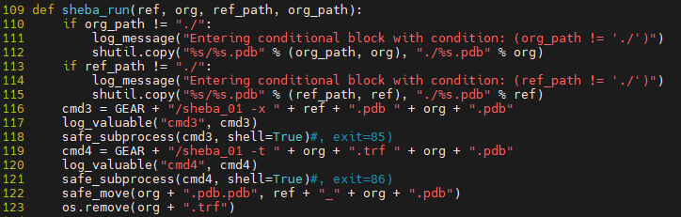
python get_snugdock_bestpose_binding_fix.py PDL1_RHQYGMFDY 240531_PDL1 (2s)
Usage > python get_snugdock_bestpose_binding_fix.py [ PDB] [ result folder]
Example> python get_snugdock_bestpose_binding_fix.py PDL1_RHQYGMFDY 240531_PDL1
Input> /lwork01/iojeong/0531/PDL1/240531_PDL1/binding/snugdock_output/PDL1_RHQYGMFDY
Output> /lwork01/iojeong/0531/PDL1/240531_PDL1/binding/pyig_input/PDL1_RHQYGMFDY.LHA_sorted_0001_0001_new_numbering.pdb
/lwork01/iojeong/0531/PDL1/240531_PDL1/binding/pyig_input/PDL1_RHQYGMFDY.LHA_sorted_0001_0002_new_numbering.pdb
/lwork01/iojeong/0531/PDL1/240531_PDL1/binding/tap_input/PDL1_RHQYGMFDY.LHA_sorted_0001_0001_new_numbering.pdb
/lwork01/iojeong/0531/PDL1/240531_PDL1/binding/tap_input/PDL1_RHQYGMFDY.LHA_sorted_0001_0002_new_numbering.pdb
python 2_PyIg_ab_io_240305_binding_fix.py PDL1_RHQYGMFDY aho 240531_PDL1 (2m)
Usage > python 2_PyIg_ab_io_240305_binding_fix.py [ PDB ] [ numbering scheme] [ result folder]
Example> python 2_PyIg_ab_io_240305_binding_fix.py PDL1_RHQYGMFDY aho 240531_PDL1
Input> /lwork01/iojeong/0531/PDL1/240531_PDL1/binding/pyig_input/PDL1_RHQYGMFDY.*.pdb
Output> /lwork01/iojeong/0531/PDL1/240531_PDL1/binding/pyig_result/PDL1_RHQYGMFDY_pyig.tsv
Exit # 처리

Slide 16
python 3_TAP3_ab_io_new_binding_fix.py PDL1_RHQYGMFDY imgt 240531_PDL1 (1m)
Usage > python 3_TAP3_ab_io_new_binding_fix.py [ PDB ] [ numbering scheme] [ result folder]
Example> python 3_TAP3_ab_io_new_binding_fix.py PDL1_RHQYGMFDY imgt 240531_PDL1
Input> /lwork01/iojeong/0531/PDL1/240531_PDL1/binding/tap_input/PDL1_RHQYGMFDY.*.pdb
Output> /lwork01/iojeong/0531/PDL1/240531_PDL1/binding/tap_result/PDL1_RHQYGMFDY_tap.tsv
Log # 처리
python get_final_file_v3_binding_fix.py 240531_PDL1 (1s)
Usage > python get_final_file_v3_binding_fix.py [ result folder]
Example> python get_final_file_v3_binding_fix.py 240531_PDL1
Input> /lwork01/iojeong/0531/PDL1/240531_PDL1/binding/tap_result/PDL1_RHQYGMFDY_tap.tsv
/lwork01/iojeong/0531/PDL1/240531_PDL1/binding/pyig_result/PDL1_RHQYGMFDY_pyig.tsv
Output> /lwork01/iojeong/0531/PDL1/240531_PDL1/binding/MD_input/PDL1_RHQYGMFDY_0001.pdb

Slide 17
python ab_ars_MD_fix.py --pdb PDL1_RHQYGMFDY_0001 --sample 240531_PDL1 --pipeline binding --gpu-id 0 (31min)
Usage > python ab_ars_MD_fix.py --pdb [ PDB] --sample [ result folder] --pipeline [ develop/binding] --gpu-id [0/1]
Example> python ab_ars_MD_fix.py --pdb PDL1_RHQYGMFDY_0001 –sample 240531_PDL1 –pipeline binding–gpu-id 0
Input> /lwork01/iojeong/0531/PDL1/binding/MD_input/PDL1_RHQYGMFDY_0001.pdb
Output> /lwork01/abs_tmp_work/
use line 84-88 for test and use line 91-95 for production

Slide 18
python ab_ars_anal_MD_v1_fix.py --pdb PDL1_RHQYGMFDY_0001 –sample 240531_PDL1 –pipeline binding (4min)
Usage > python ab_ars_anal_MD_v1_fix.py --pdb [ PDB] --sample [ result folder] --pipeline [ develop/binding]
Example> python ab_ars_anal_MD_v1_fix.py --pdb PDL1_RHQYGMFDY_0001 –sample 240531_PDL1 –pipeline binding
Input> /lwork01/abs_tmp_work/PDL1_RHQYGMFDY_0001/traj_1/production/*.crd
Output> /lwork01/abs_tmp_work/PDL1_RHQYGMFDY_0001/dock_res/*.pdb
python get_bestpose_fix.py 240531_PDL1 PDL1_RHQYGMFDY_0001 binding (14s)
Usage > python get_bestpose_fix.py [ result folder] [PDB] [ develop/binding]
Example> python get_bestpose_fix.py 240531_PDL1 PDL1_RHQYGMFDY_0001 binding
Input> /lwork01/abs_tmp_work/PDL1_RHQYGMFDY_0001/
Output> /lwork01/iojeong/0531/PDL1/240531_PDL1/binding/MD_result/PDL1_RHQYGMFDY_0001
/lwork01/iojeong/0531/PDL1/240531_PDL1/binding/MD_result/bestpose/PDL1_RHQYGMFDY_0001-414.pdb
**for test 46, 71 for production 45, 70
Log, exit # 처리
Log #처리

Slide 19
python run_md_enva_fix.py 240531_PDL1 binding (2s)
Usage > python run_md_enva_fix.py [ result folder] [ develop/binding]
Example> python run_md_enva_fix.py 240531_PDL1 binding
Input> /lwork01/iojeong/0531/PDL1/240531_PDL1/binding/MD_result/bestpose/PDL1_RHQYGMFDY_0001-466.pdb
Output> /lwork01/iojeong/0531/PDL1/240531_PDL1/binding/MD_result/bestpose/PDL1_RHQYGMFDY_0001-466.env_result
exit # 처리

Slide 20
Final ranking
python merge_infos_functional_v2_fix.py 240531_PDL1 (38s) >>md로 dir 설정되어있어 snugdock 정보 x 였음
Usage > python merge_infos_functional_v2_fix.py [ result folder]
Example> python merge_infos_functional_v2_fix.py 240531_PDL1
Input> /lwork01/iojeong/0531/PDL1/240531_PDL1/cdrgen_result/tmp/*.txt
/lwork01/iojeong/0531/PDL1/240531_PDL1/develop/develop_total50.tsv
Output> /lwork01/iojeong/0531/PDL1/240531_PDL1/final_ranking/240531_PDL1_develop_annotation.tsv
python merge_infos_binding_fix.py 240531_PDL1 (34s)
Usage > python merge_infos_binding_fix.py [ result folder]
Example> python merge_infos_binding_fix.py 240531_PDL1
Input> /lwork01/iojeong/0531/PDL1/240531_PDL1/cdrgen_result/tmp/*.txt
/lwork01/iojeong/0531/PDL1/240531_PDL1/binding/240531_PDL1_pyig_tap_filtered.tsv
Output> /lwork01/iojeong/0531/PDL1/240531_PDL1/final_ranking/240531_PDL1_binding_annotation.tsv

Slide 21

python distance_fix.py 240531_PDL1 (1s) >> binding md best pose 제외 되어있었음
Usage > python distance_fix.py [ result folder]
Example> python distance_fix.py 240531_PDL1
Input> /lwork01/iojeong/0531/PDL1/240531_PDL1/binding/MD_result/bestpose/*_tr.pdb
/lwork01/iojeong/0531/PDL1/240531_PDL1/develop/MD_result/bestpose/*_tr.pdb
Output> /lwork01/iojeong/0531/PDL1/240531_PDL1/final_ranking/240531_PDL1_binding_distance.tsv
/lwork01/iojeong/0531/PDL1/240531_PDL1/final_ranking/240531_PDL1_develop_distance.tsv
python final_master_fix.py 240531_PDL1 (1s)
Usage > python final_master_fix.py [ result folder]
Example> python final_master_fix.py 240531_PDL1
Input> /lwork01/iojeong/0531/PDL1/240531_PDL1/final_ranking/240531_PDL1_binding_distance.tsv
/lwork01/iojeong/0531/PDL1/240531_PDL1/final_ranking/240531_PDL1_develop_distance.tsv
Output> /lwork01/iojeong/0531/PDL1/240531_PDL1/final_ranking/240531_PDL1_develop_master.tsv
/lwork01/iojeong/0531/PDL1/240531_PDL1/final_ranking/240531_PDL1_binding_master.tsv
/lwork01/iojeong/0531/PDL1/240531_PDL1/final_ranking/final_list.txt
final_list.txt

