Slide 1
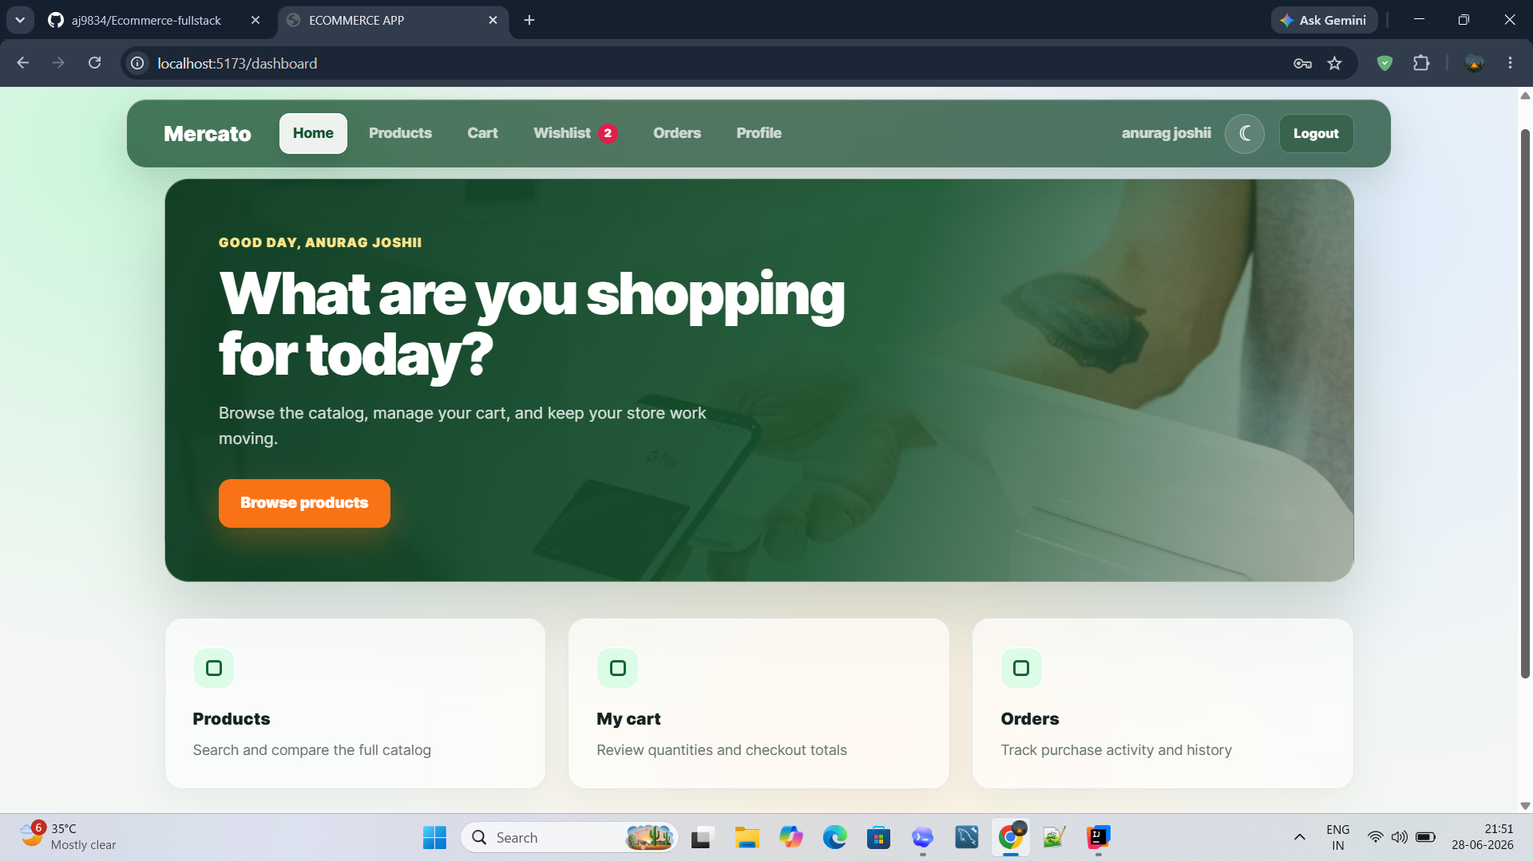
FULL STACK E-COMMERCE
Mercato
E-Commerce Application Presentation
A React + Spring Boot + MySQL shopping platform covering customer journeys, admin operations, payments, reviews, and database-backed integration.
12-slide project summary | 8 member modules
Dashboard experience
Mercato E-Commerce Full Stack Project
01

Slide 2
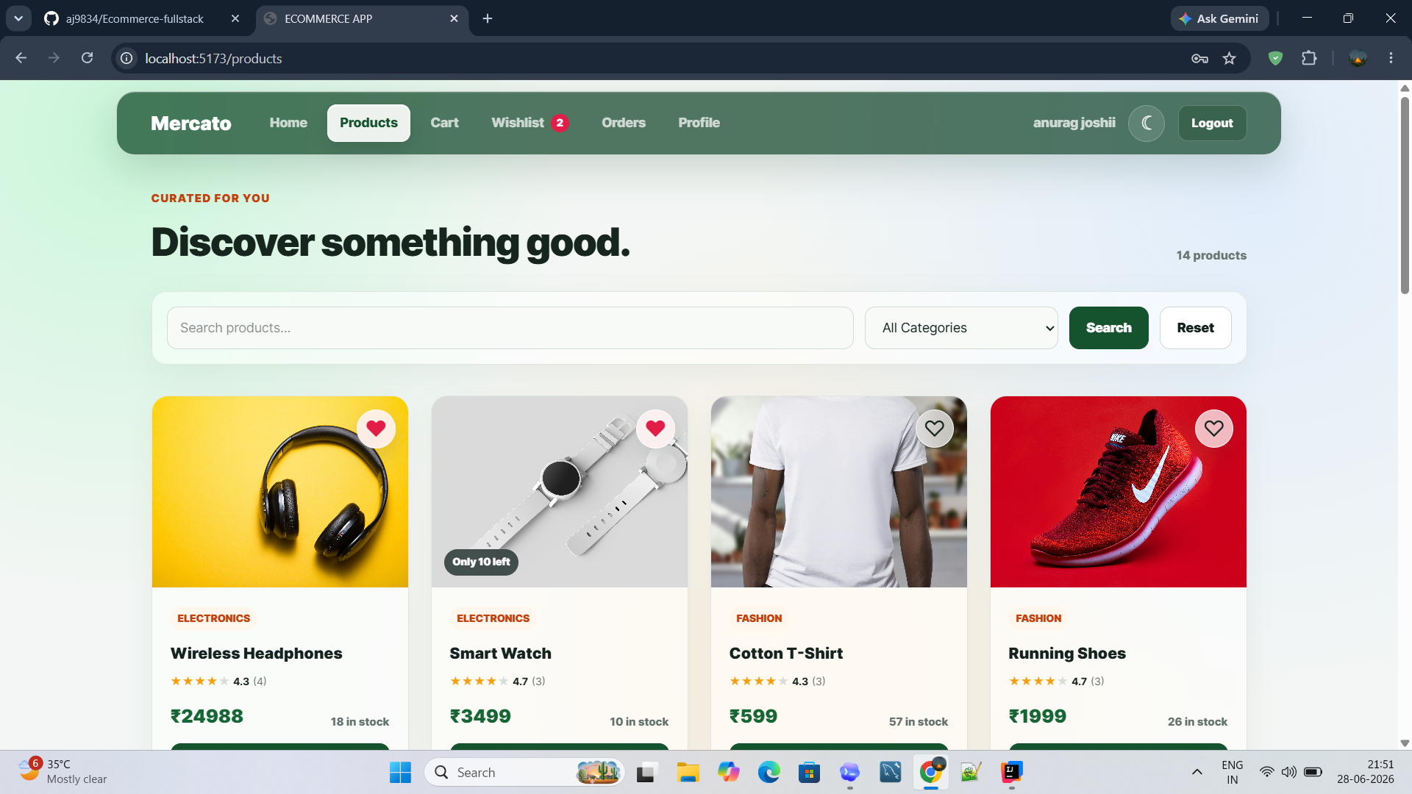
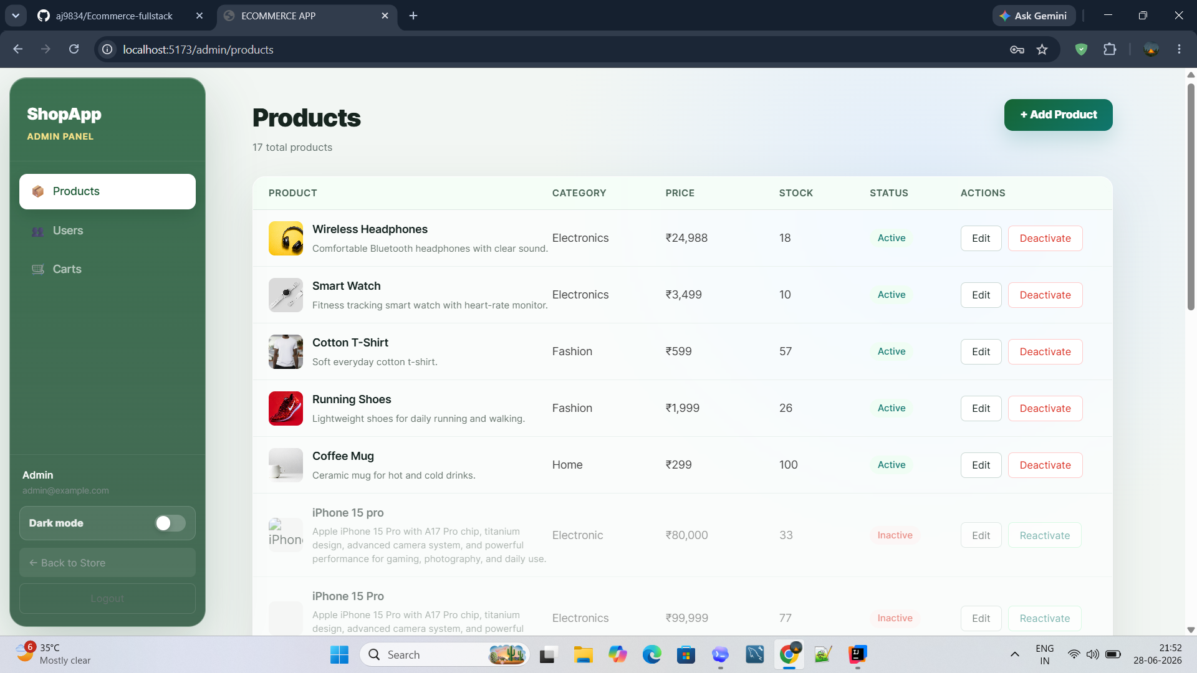
Problem, Scope and Team Modules
Problem statement is kept focused: make online shopping, order placement, and admin control work in one integrated system.
Member 1
Member 2
Introduction and system architecture
Authentication, security and profile
Member 3
Member 4
Product catalogue and discovery
Wishlist, rating, reviews and image upload
Customer catalogue
Member 5
Member 6
Cart and pricing state
Checkout, orders and Razorpay
Member 7
Member 8
Administration and role-based access
Operations, database integration and conclusion
Admin control
Mercato E-Commerce Full Stack Project
02

Slide 3
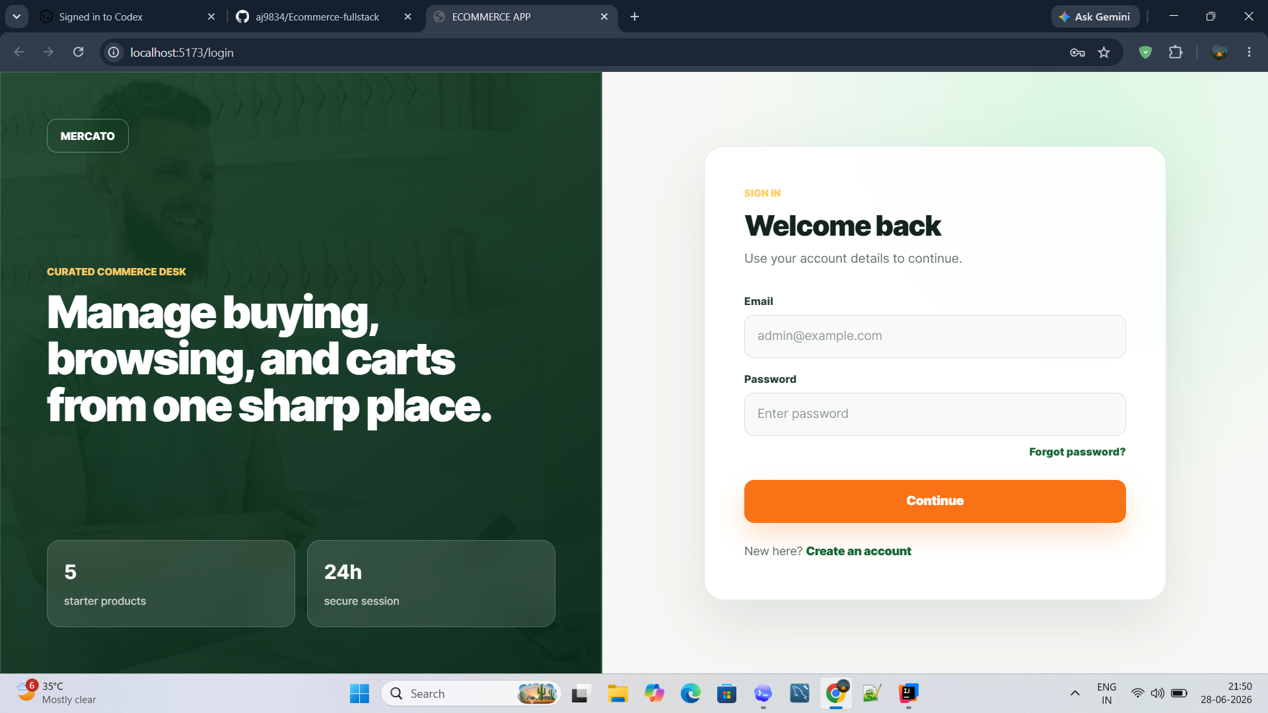
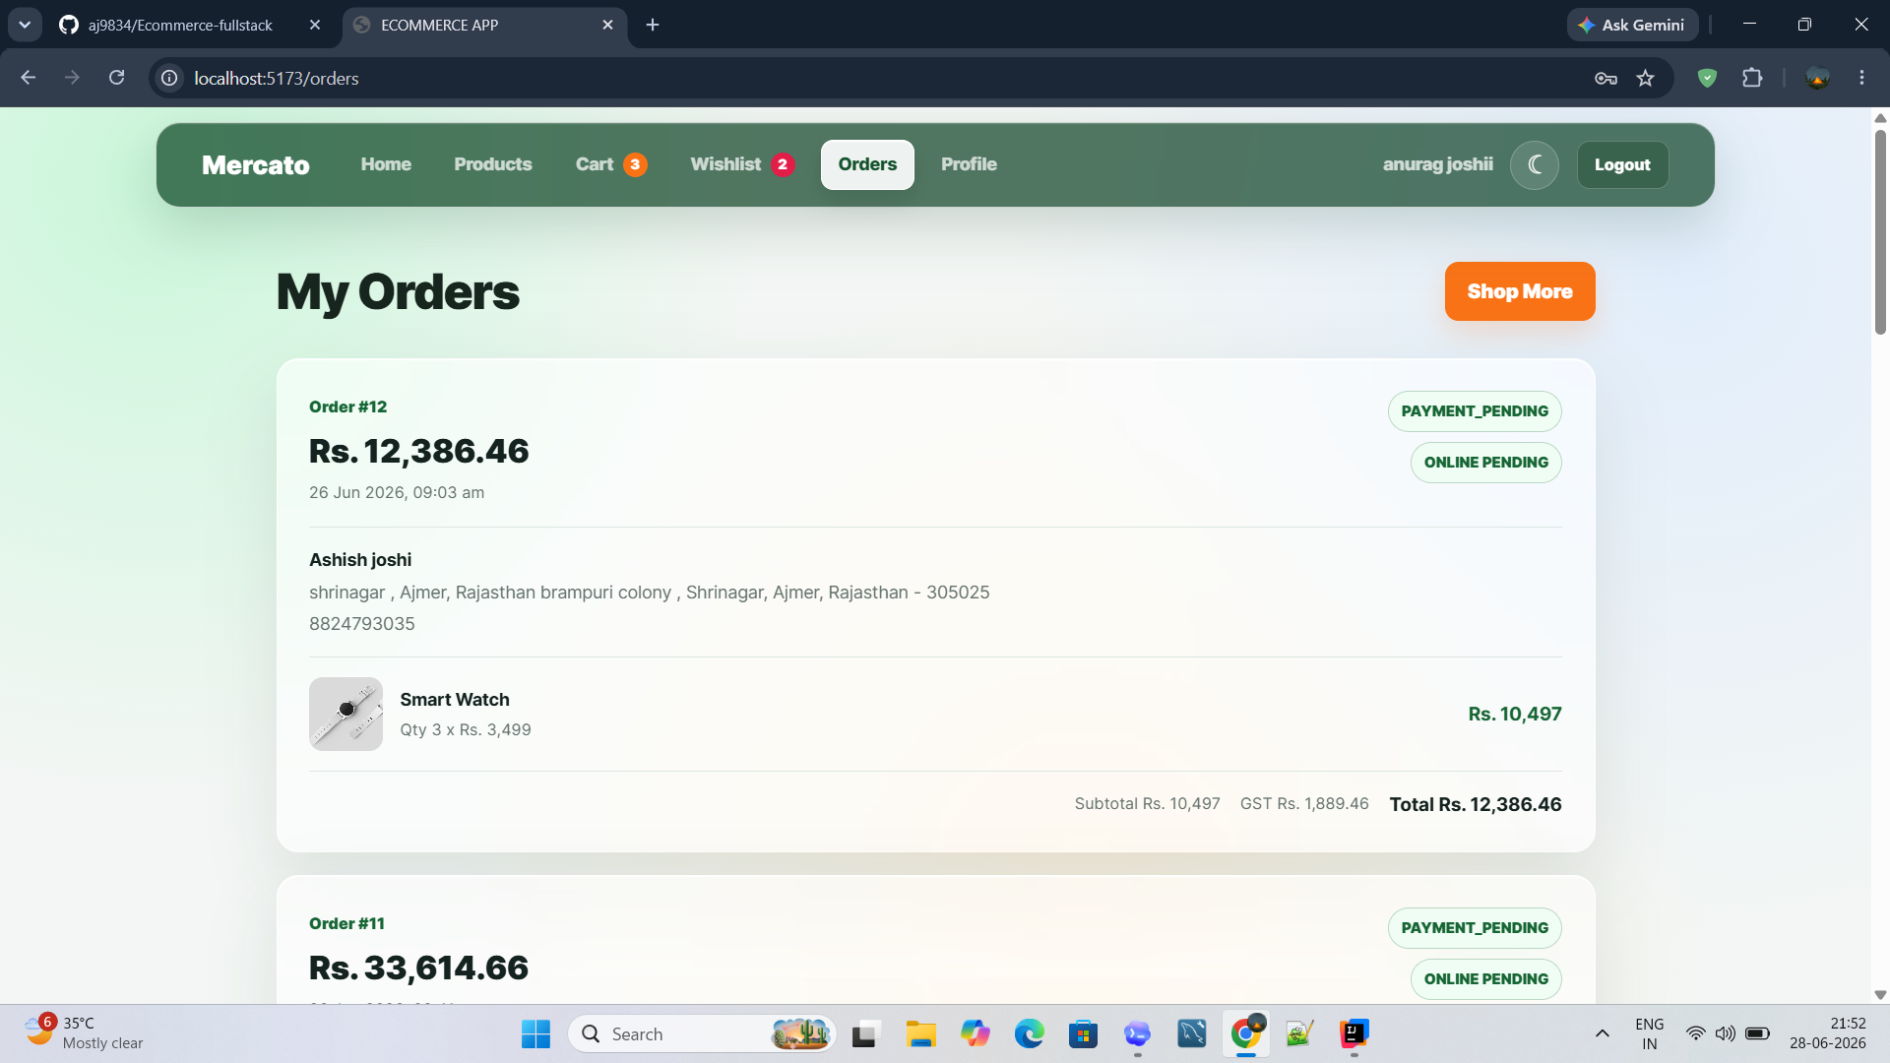
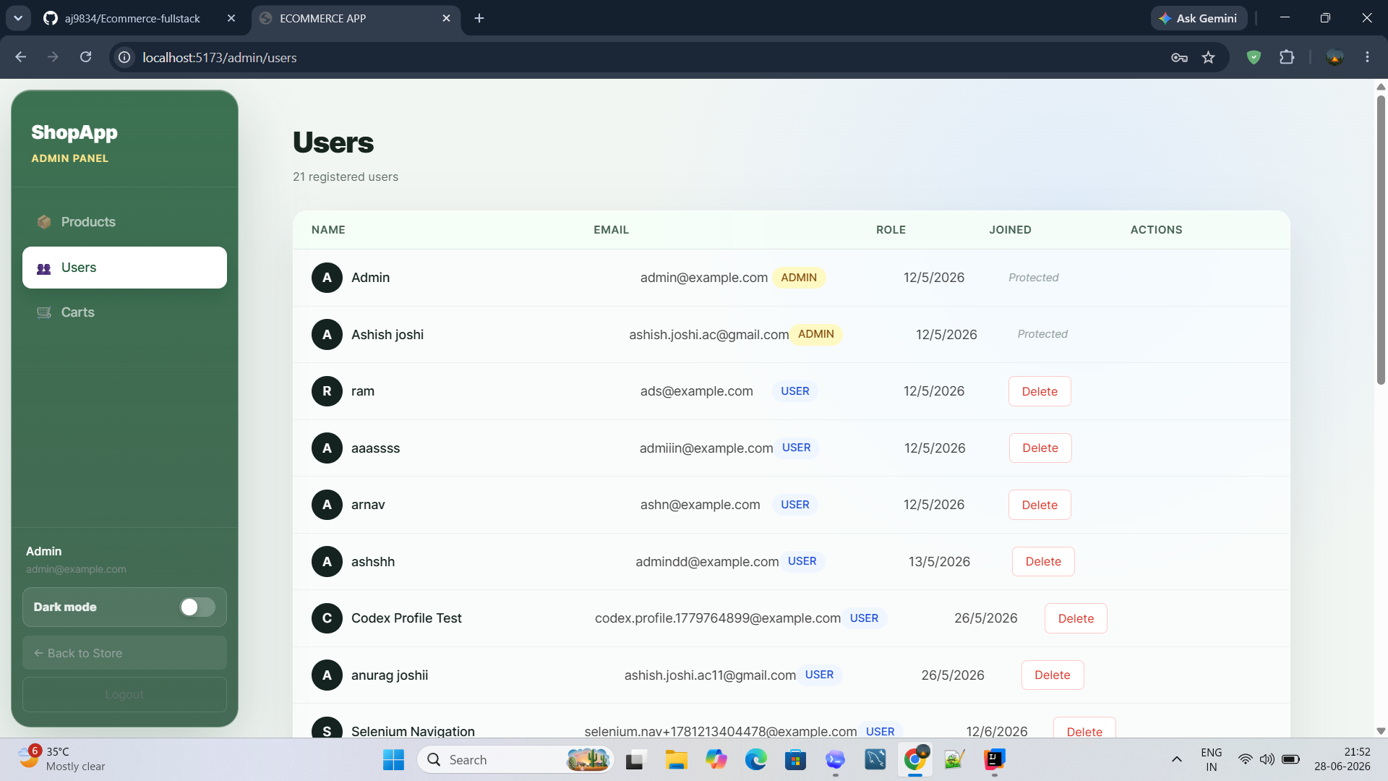
System Architecture
High-level project view without code: customer UI, admin UI, services, integrations and database.
Customer UI
React pages
API Layer
Auth, products, cart
Spring Boot
Business services
MySQL
Persistent records
Admin Panel
Role-based operations
JWT Security
Protected access
Razorpay
Payment gateway
Login
Dashboard
Orders
Admin users
Mercato E-Commerce Full Stack Project
03

Slide 4
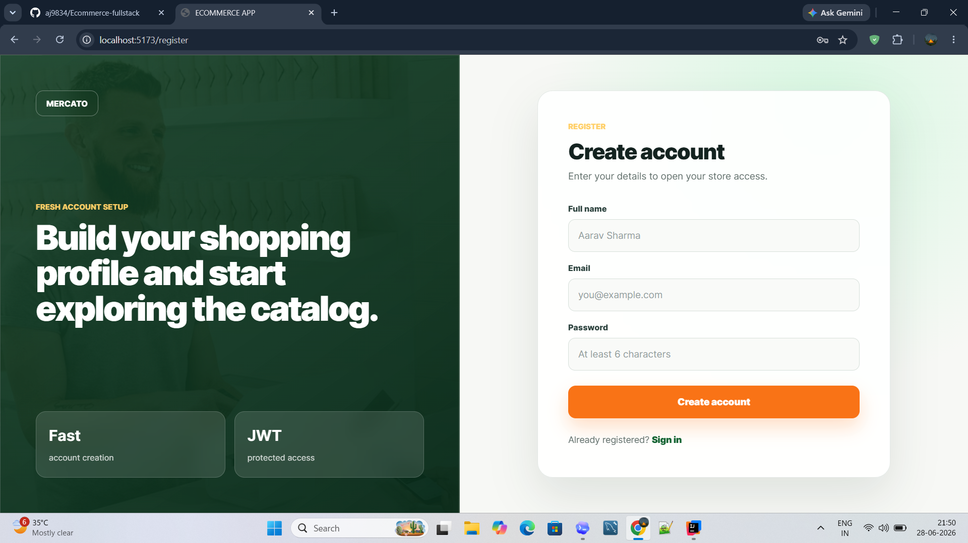
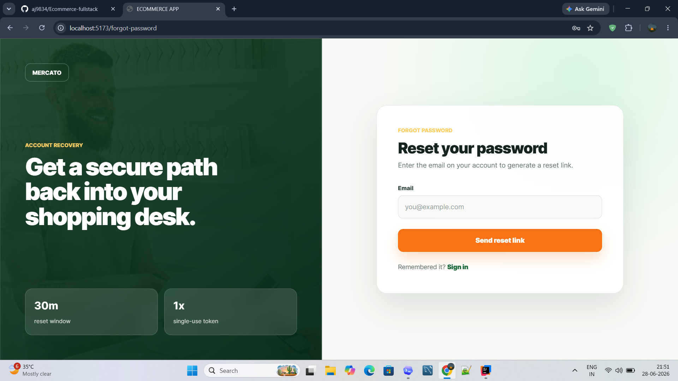
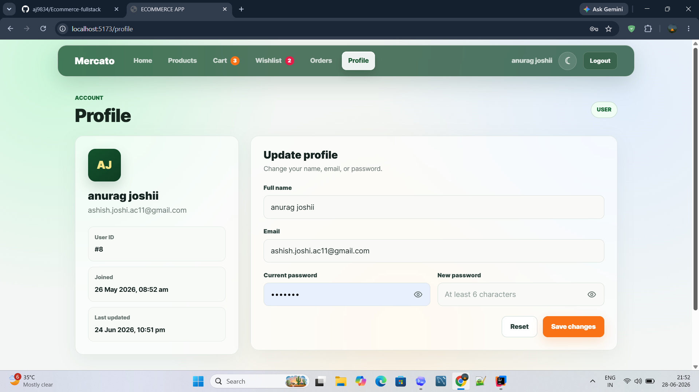
Authentication, Security and Profile
Member 2 module: user entry, account recovery, session protection and profile maintenance.
What this module demonstrates
Login, registration and forgot-password screens keep account access clear.
Sign in
Register
Session-based navigation separates protected customer pages from public pages.
Profile page allows account details and password changes from one place.
Password reset
Profile update
No code shown: behavior explained through screens
Mercato E-Commerce Full Stack Project
04

Slide 5
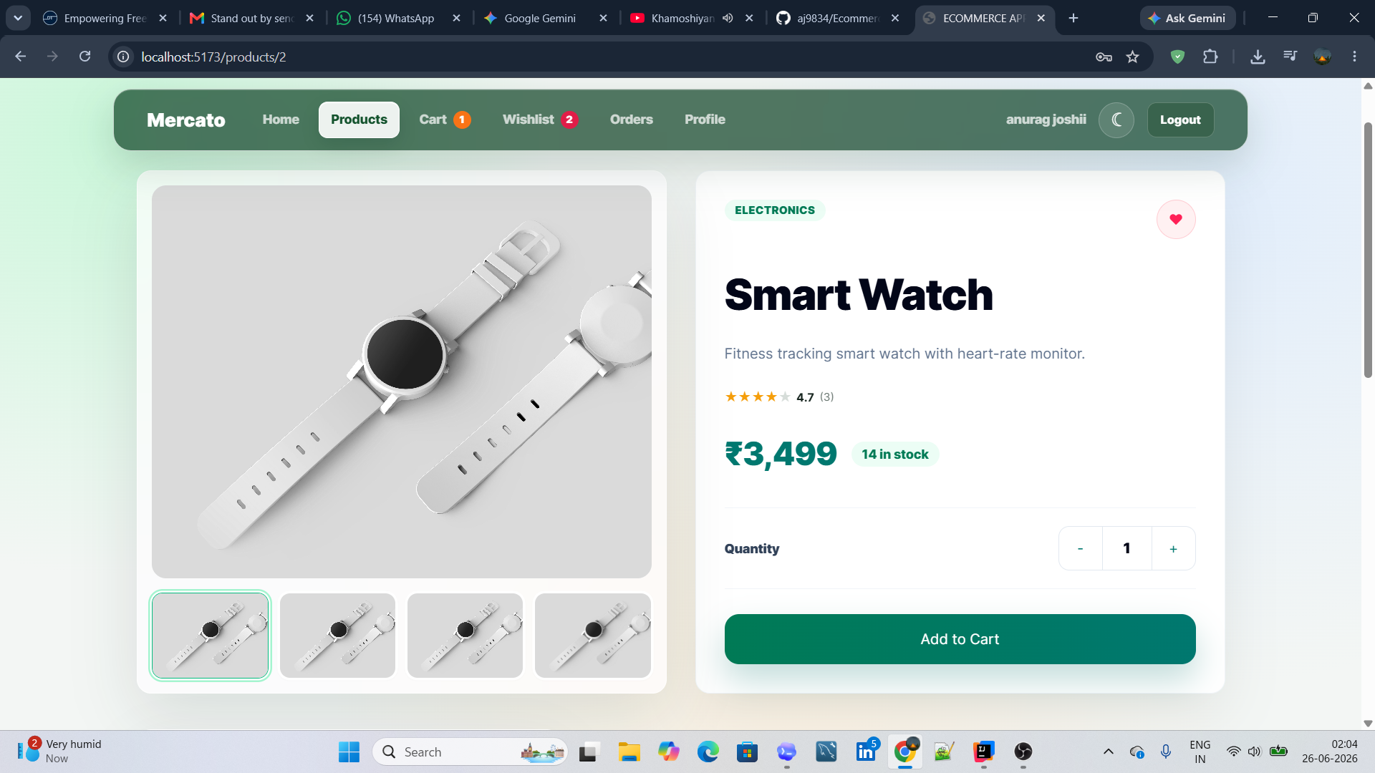
Product Catalogue and Discovery
Member 3 module: browse, filter, inspect details, track ratings and add items to cart.
Catalogue and search
Product detail
Discovery tools
Decision screen
Customer value
Search, category filtering, stock labels, ratings and wishlist entry points.
Product images, quantity selection, price, rating and add-to-cart action.
Less friction from browsing to cart selection.
Mercato E-Commerce Full Stack Project
05

Slide 6
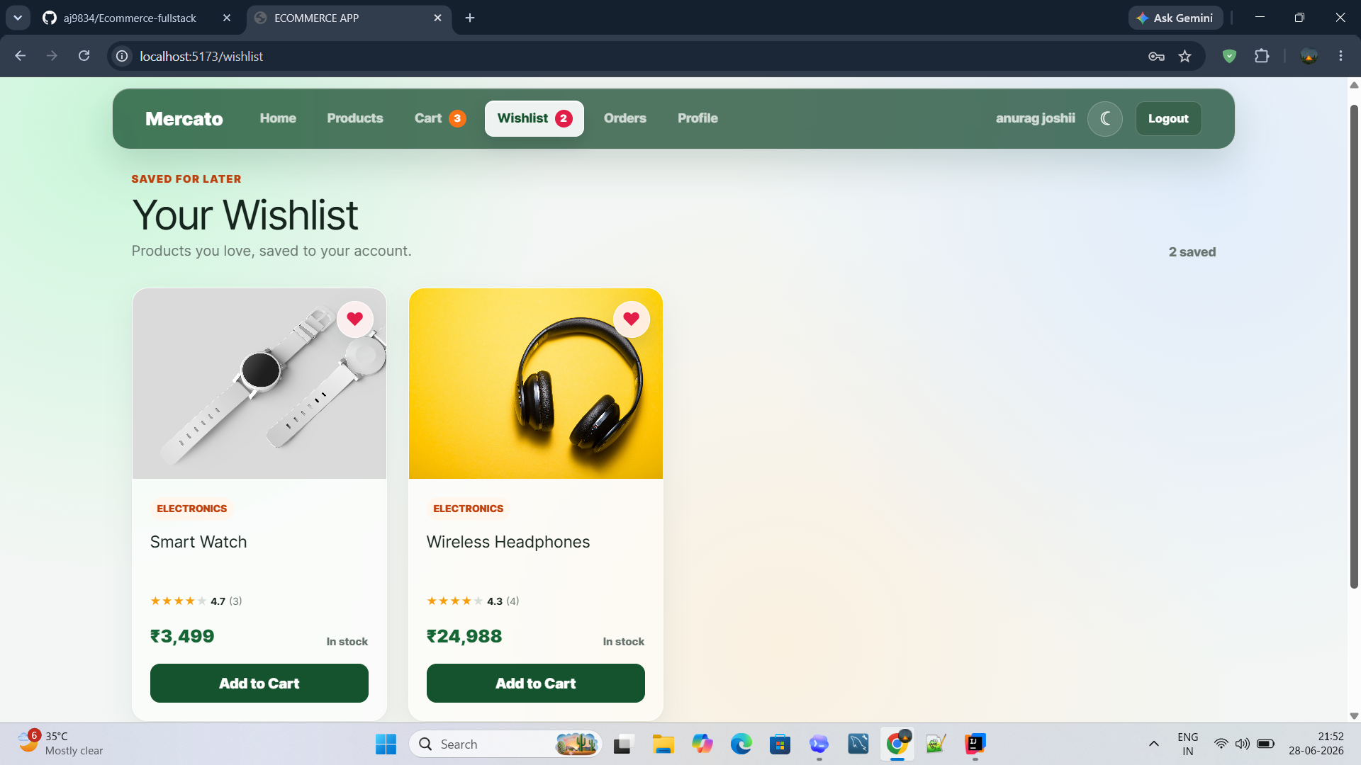
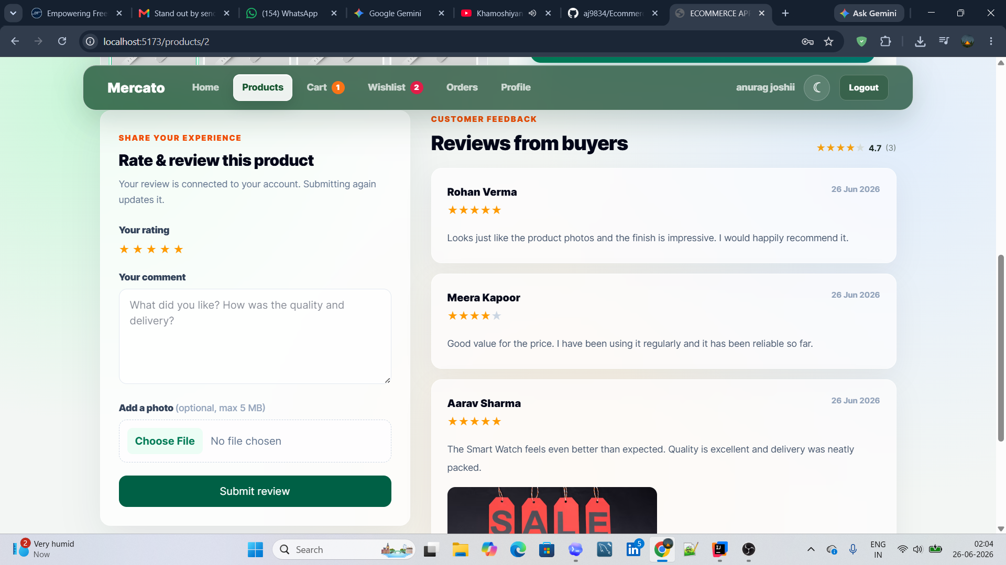
Wishlist, Ratings, Reviews and Image Upload
Member 4 module: saved products, buyer feedback, star rating and optional review images.
Wishlist
Reviews and upload
Product liked
Saved to wishlist
Review with stars
and photo
Trust signal for
future buyers
Mercato E-Commerce Full Stack Project
06

Slide 7
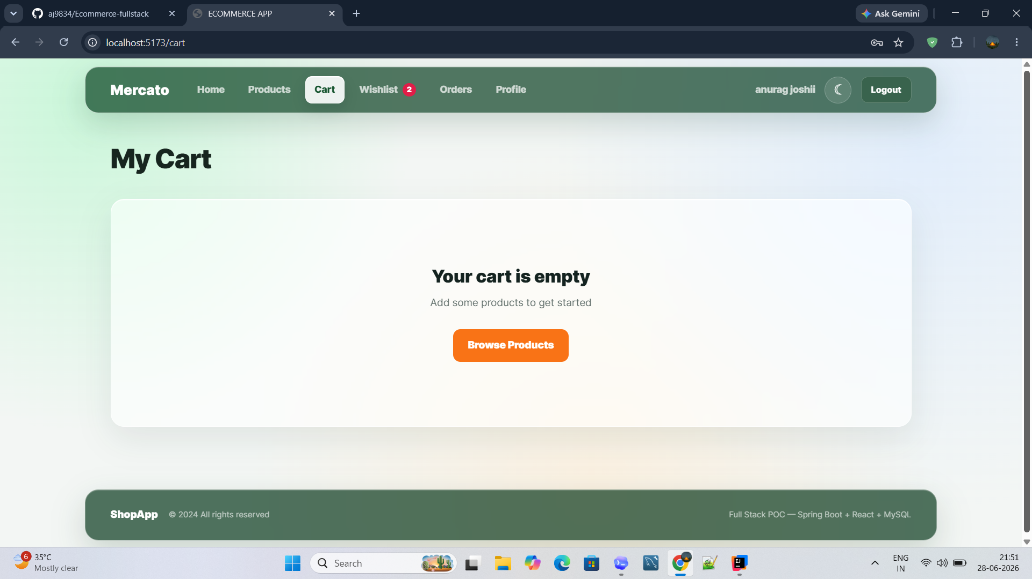
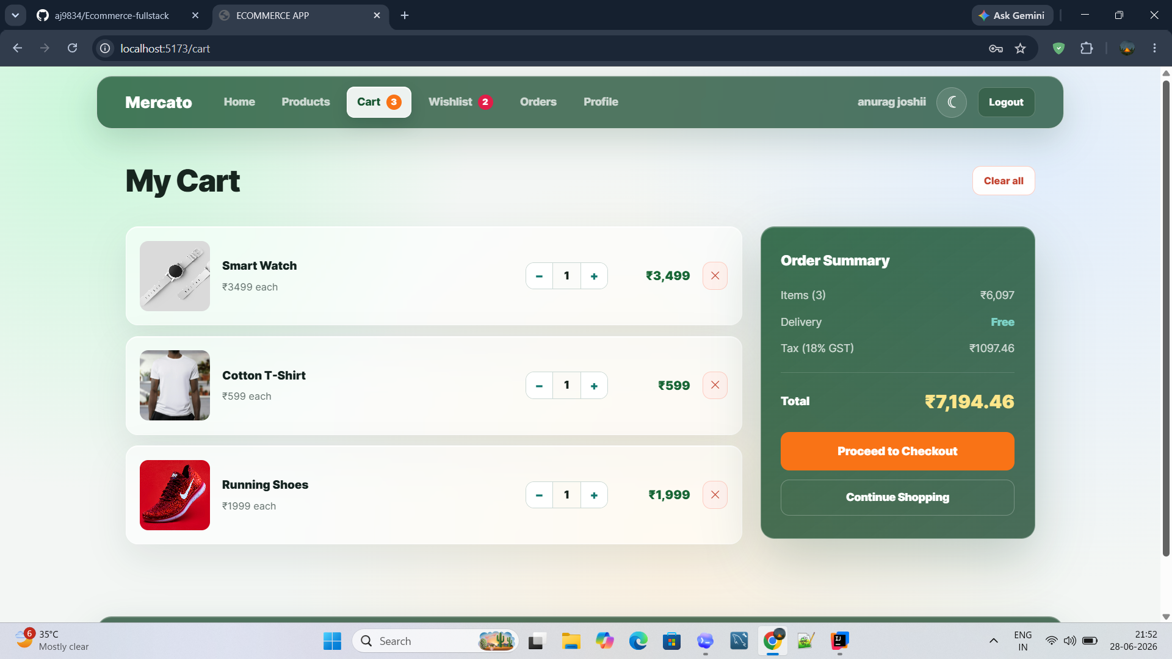
Cart and Pricing State
Member 5 module: cart is maintained as a live state with quantity changes, remove actions and pricing totals.
Empty cart state
Filled cart and totals
1
Empty state guides users back to products
2
Quantity controls update item subtotal
3
Order summary separates item amount, delivery, tax and total
Mercato E-Commerce Full Stack Project
07

Slide 8
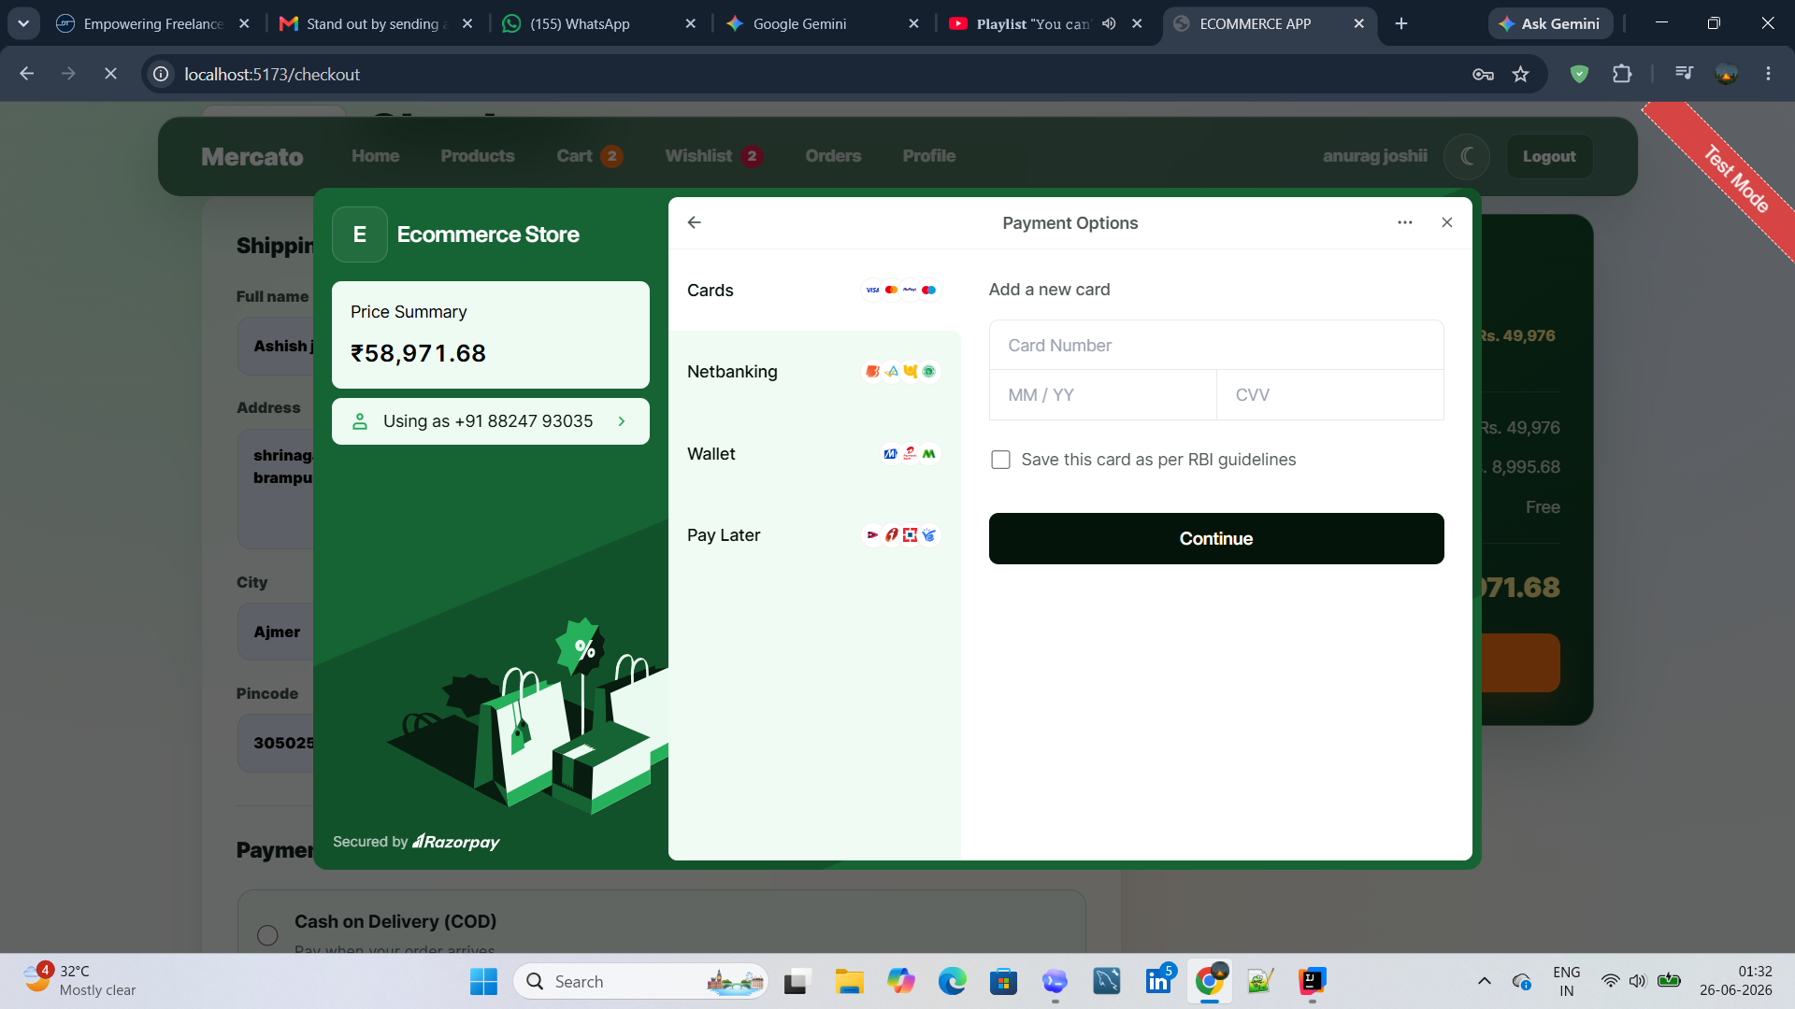
Checkout, Orders and Razorpay
Member 6 module: shipping details, payment gateway, order history and payment status tracking.
Razorpay checkout
Order history
Cart total
Shipping details
Razorpay payment
Order record
Status visible
Mercato E-Commerce Full Stack Project
08

Slide 9
Administration and Role-Based Access
Member 7 module: admin-only screens for products, users and store governance.
Admin products
User management
Admin role
User role
Protected actions
Maintains products and user accounts.
Accesses catalogue, cart, orders and profile.
Screens expose actions based on permission.
Mercato E-Commerce Full Stack Project
09

Slide 10
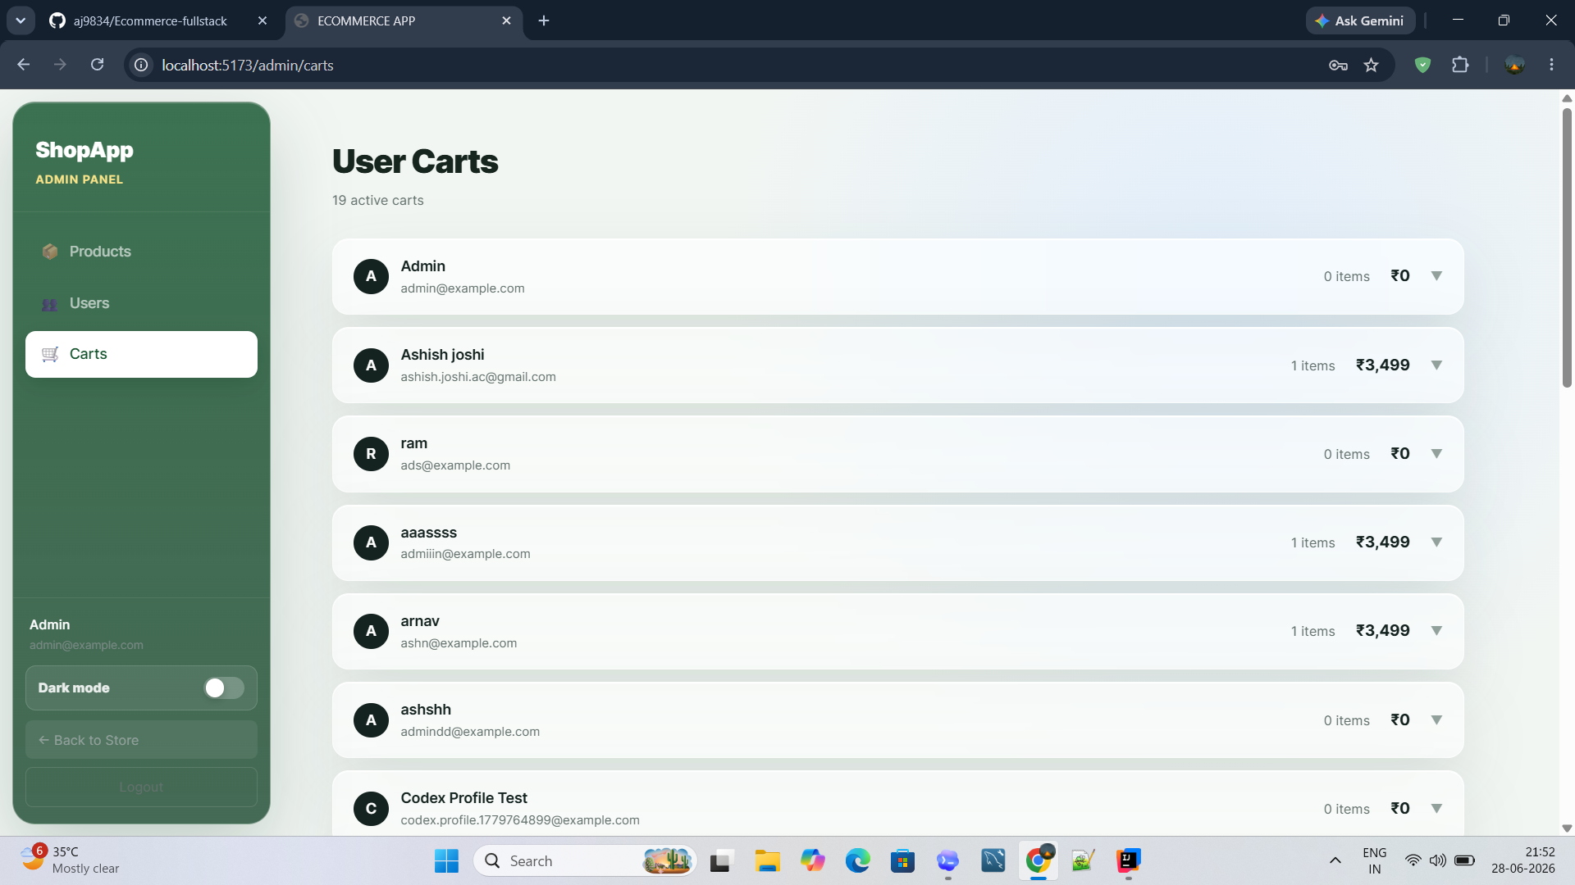
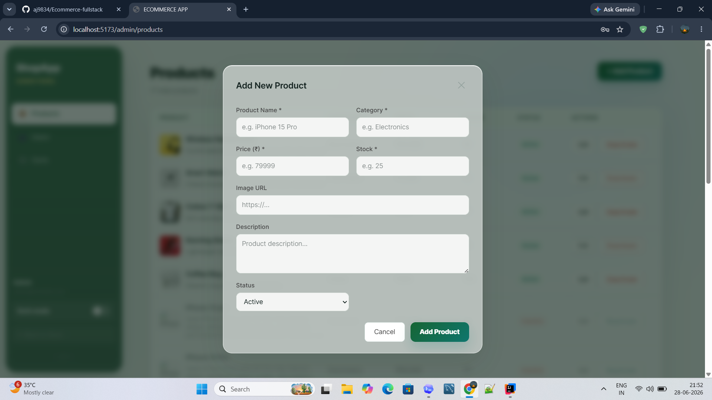
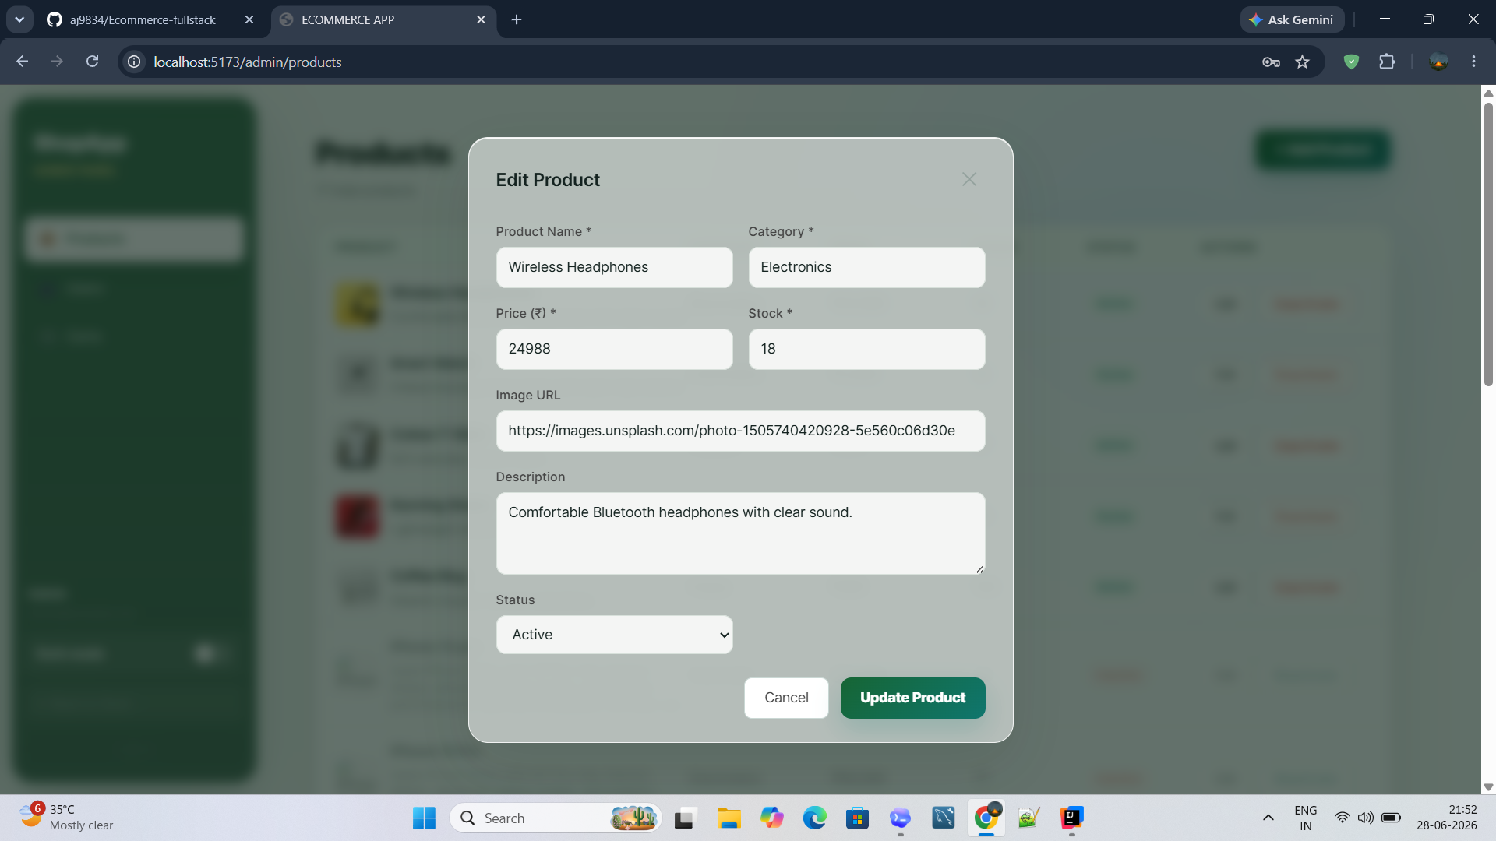
Admin Operations
Role-based operation screens for product maintenance and cart visibility.
User carts
Add product
Edit product
Operational coverage
Admin can add, edit, activate or deactivate product records.
Cart oversight shows active baskets, item counts and value by user.
The same visual language is reused across customer and admin surfaces.
Mercato E-Commerce Full Stack Project
10

Slide 11
Operations, Database and Complete Integration
Member 8 module: database-backed entities connect every screen into one full shopping journey.
User
Product
Cart
Order
Payment
Wishlist
Review
Admin
Uploads
Integration outcome
Authentication identifies the user, products feed the catalogue, cart state produces checkout totals, payment creates orders, and reviews/wishlist enrich the customer experience.
Mercato E-Commerce Full Stack Project
11

Slide 12
Conclusion
Mercato demonstrates a complete e-commerce workflow from account access to admin-managed operations.
Home
Cart
Payment
Project result
Future scope
Thank you
A working full stack shopping system with customer, order, payment, review and admin modules.
Small next step: analytics dashboard, richer recommendations and shipment tracking.
Presented by the 8-member project team.
Mercato E-Commerce Full Stack Project
12

