Slide 1
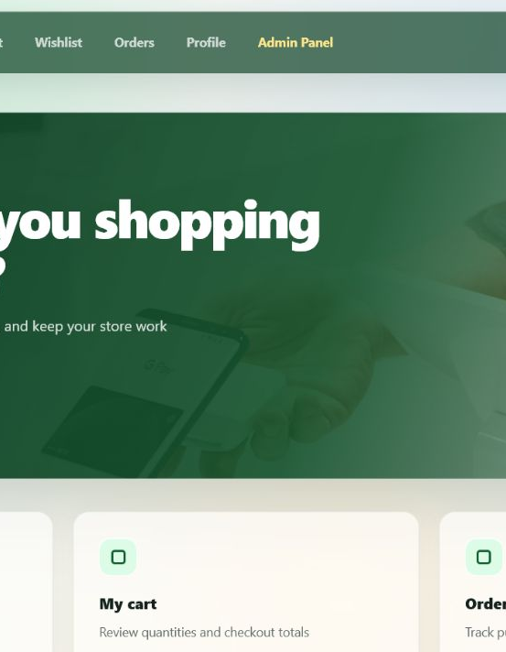
MINOR PROJECT / FULL-STACK ENGINEERING
MERCATO
A secure end-to-end e-commerce platform
React 19 • Spring Boot 3 • MySQL • JWT • Razorpay
TEAM MEMBERS
Radhika • Oshi • Annu • Ashish
Jay • Suraj • Varun • Kartik
Customer journey, business logic, security, persistence and administration
01

Slide 2
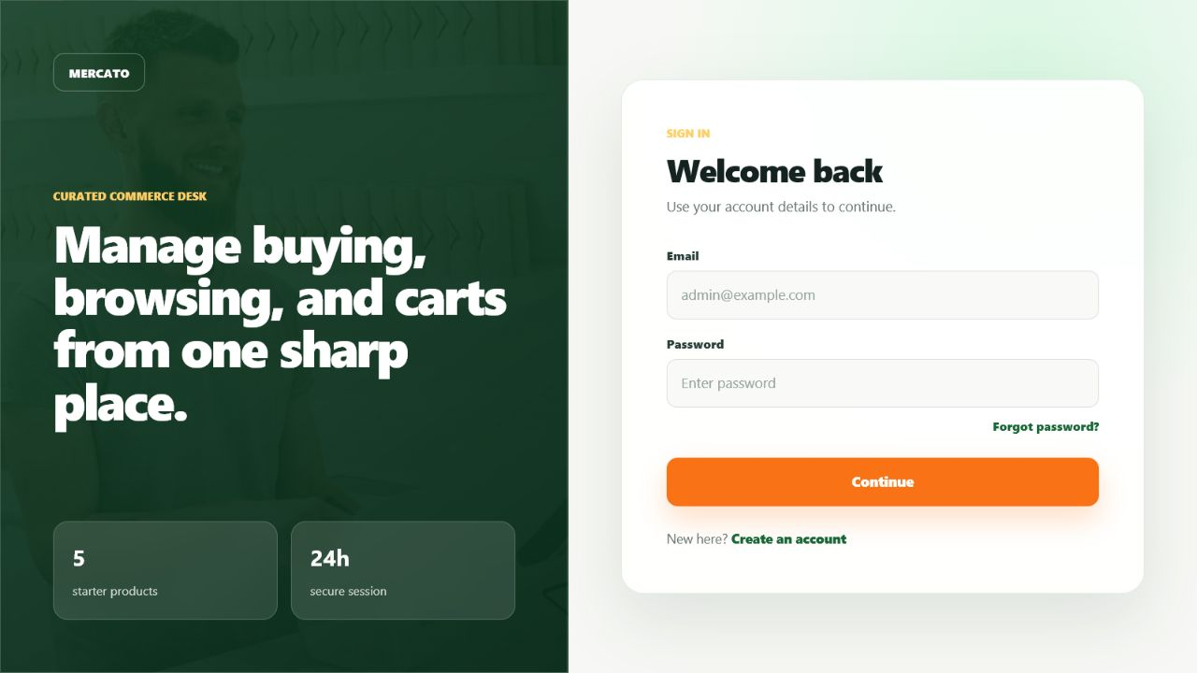
PROBLEM STATEMENT
One connected journey, with the server as the source of truth
THE PROBLEM
LIVE APPLICATION
Shopping actions are often fragmented across discovery, saved intent, cart and payment.
Browser values cannot be trusted for identity, stock, totals or payment success.
Administrators need controlled catalogue and user-cart visibility without exposing customer operations.
The project needs a traceable path from one click to durable database state and back.
IMPLEMENTED RESPONSE
A JWT-secured React SPA backed by transactional Spring services and relational persistence.
MERCATO / TECHNICAL PRESENTATION
02

Slide 3
SYSTEM ARCHITECTURE
A modular monolith with clear request and data boundaries
REACT SPA
AXIOS + JWT
SPRING BOOT
JPA / HIBERNATE
MYSQL
Pages • Context • Hooks
REST calls • Bearer token
Security • Controllers • Services
Repositories • ORM • Locks
8 relational tables • constraints
EXTERNAL ADAPTERS
RAZORPAY
GMAIL SMTP
FILE STORAGE
Order + signature
Reset link
Review images
Controller → service → repository separation keeps transport, business rules and persistence distinct.
DTO validation defines API contracts; MySQL constraints remain the final integrity boundary.
React owns interaction state; the backend owns roles, stock, totals, payment status and durable records.
MERCATO / TECHNICAL PRESENTATION
03

Slide 4
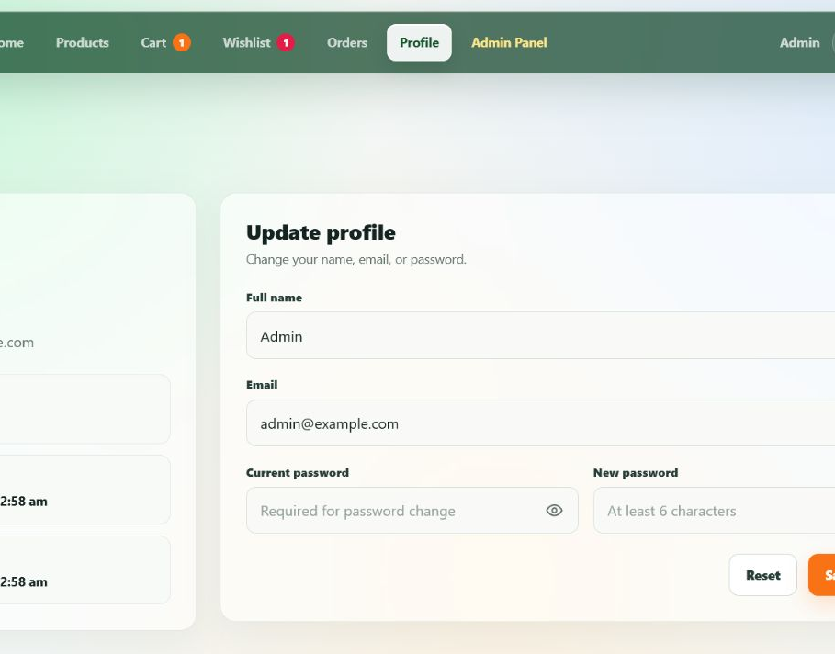
IDENTITY AND SECURITY
Authentication is stateless; authorization remains server-enforced
REGISTER / LOGIN
Validate → BCrypt → AuthenticationManager → signed 24-hour JWT
PROFILE & ROLE
Axios attaches the Bearer token; JwtFilter validates signature and expiry before protected controllers.
The current role is reloaded from MySQL as ROLE_USER or ROLE_ADMIN on every authenticated request.
Forgot-password stores only a SHA-256 token digest, expires after 30 minutes and is single-use.
Profile email changes issue a new JWT because the token subject is the user's email.
Frontend route guards improve UX; Spring Security is the real access-control boundary.
MERCATO / TECHNICAL PRESENTATION
04

Slide 5
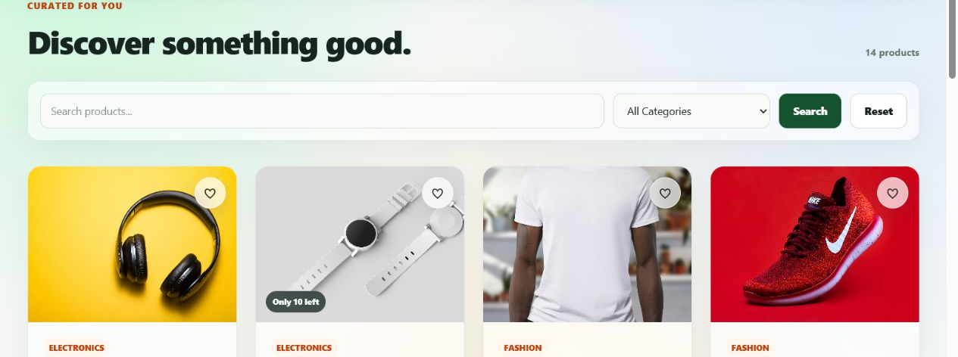
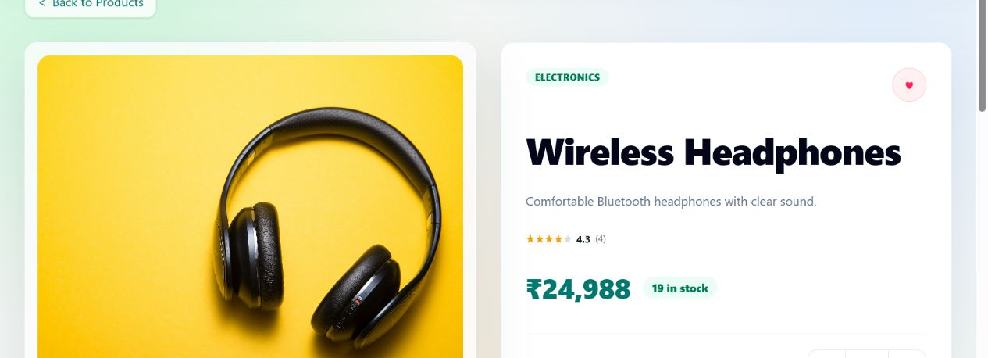
PRODUCT DISCOVERY
Active catalogue data is enriched with stock and review aggregates
Customer queries return only products where active = true.
CATALOGUE
Search supports keyword, category, both, or neither through one endpoint.
ProductResponse adds averageRating and reviewCount without exposing JPA entities.
The detail screen loads product and reviews concurrently and caps quantity at current stock.
PRODUCT DETAIL
Soft deletion preserves cart, review and order references while hiding the item from customers.
MERCATO / TECHNICAL PRESENTATION
05

Slide 6
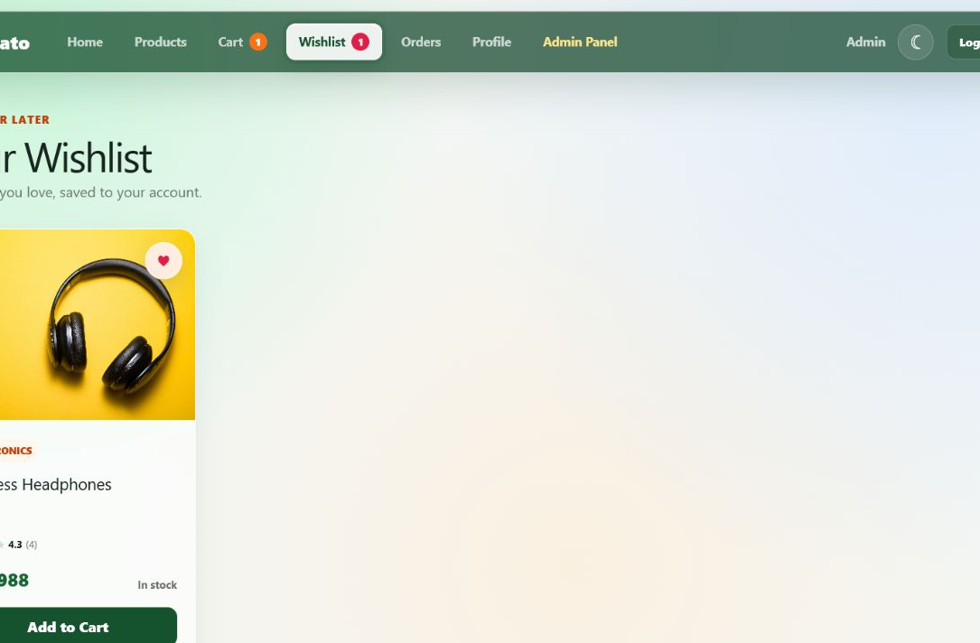
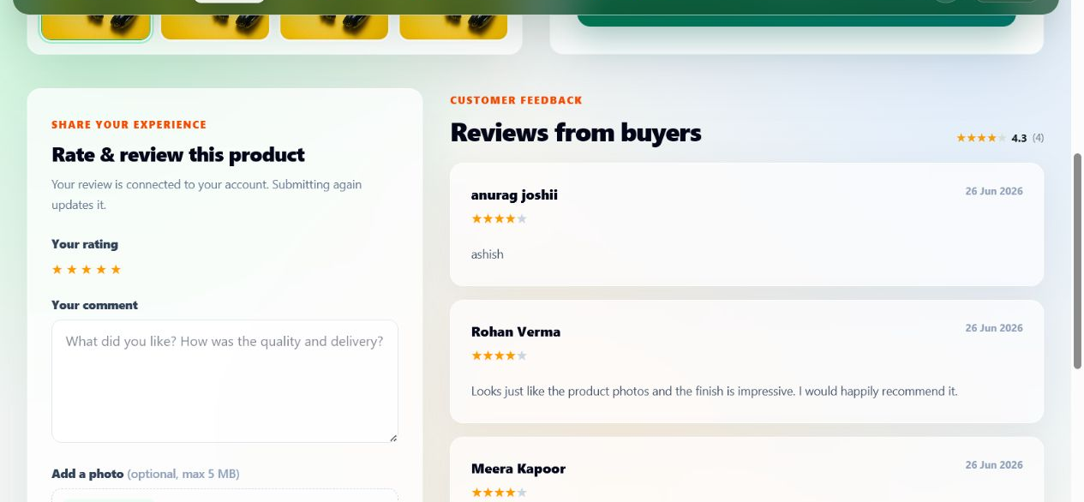
WISHLIST AND REVIEWS
Saved intent and customer feedback are account-linked, persistent features
WISHLIST
REVIEWS
OPTIMISTIC UI
UNIQUENESS
REVIEW UPSERT
MULTIPART + AGGREGATE
Heart toggles immediately; failure restores the previous Set.
One wishlist and one review row per user-product pair.
Submitting again updates rating, comment and optional image.
UUID image storage plus average/count refresh.
MERCATO / TECHNICAL PRESENTATION
06

Slide 7
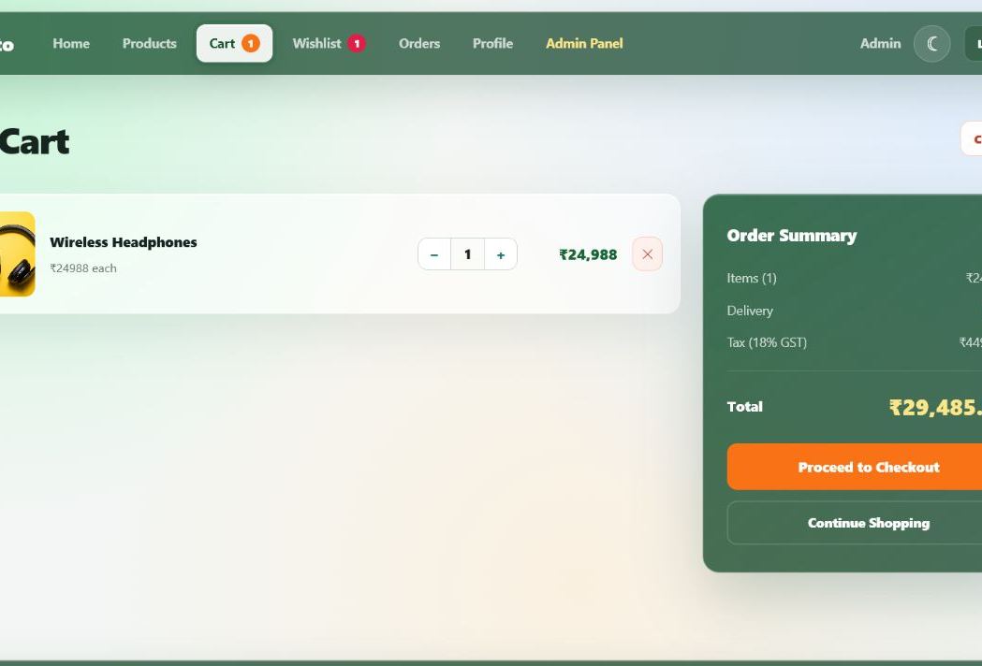
CART AND PRICING STATE
A persistent, user-owned aggregate bridges discovery and checkout
CORE RULE
PERSISTENT CART
The authenticated user's cart—not a userId in the payload—defines ownership.
One cart per user is created lazily on the first read or add.
Repeated adds merge quantity and preserve the add-time unit-price snapshot.
Update and delete verify that the cartItem belongs to the current user's cart.
Active state and stock are checked on add/update; quantity ≤ 0 removes the line.
The UI previews GST, but checkout recalculates the authoritative total.
MERCATO / TECHNICAL PRESENTATION
07

Slide 8
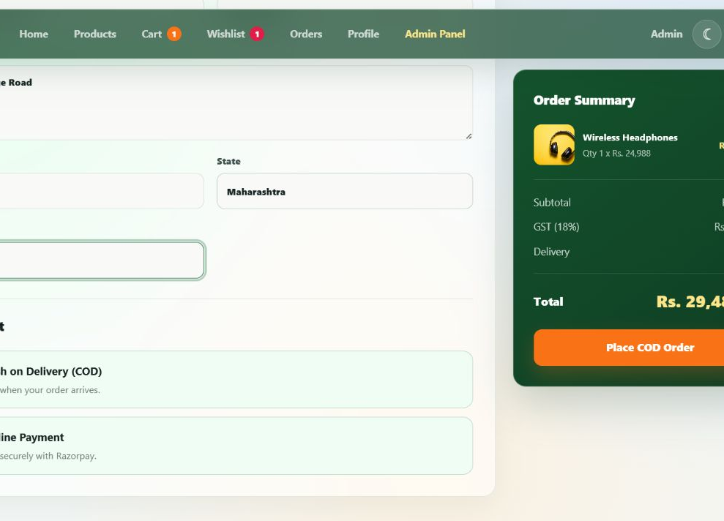
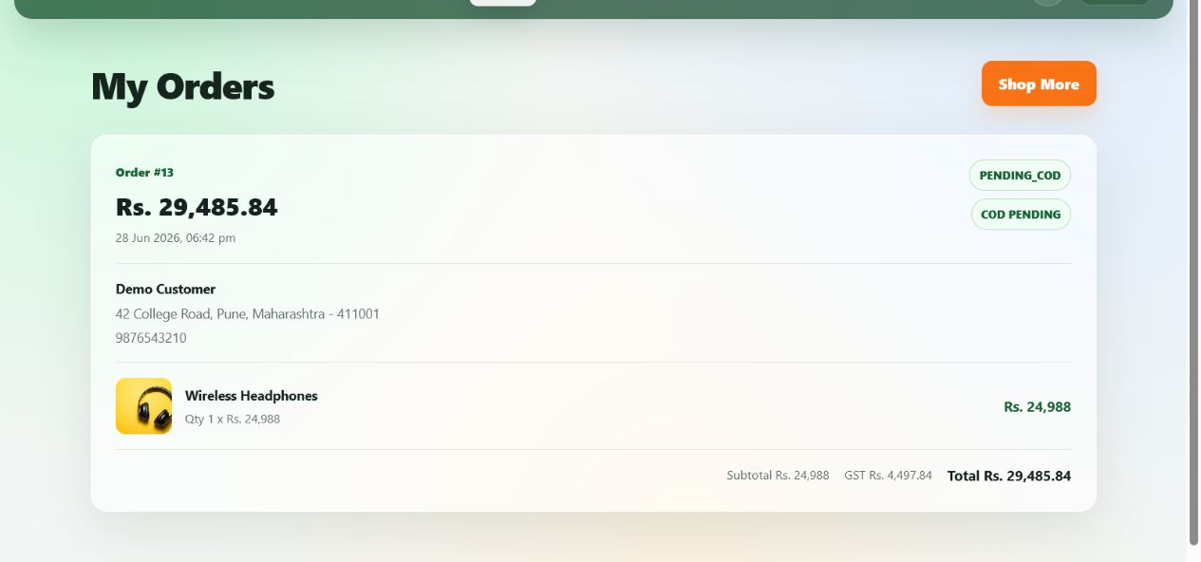
CHECKOUT AND PAYMENT
Order creation locks stock, snapshots history and verifies online payment server-side
CHECKOUT
@Transactional keeps stock decrement, order snapshots and cart clearing atomic.
PESSIMISTIC_WRITE product locks prevent concurrent overselling.
BigDecimal calculates subtotal + 18% GST + free delivery on the server.
COD creates PENDING_COD; online creates PAYMENT_PENDING then verifies the Razorpay signature.
Current limitation: cancelled online payment keeps the pending order and reserved stock.
ORDER HISTORY
MERCATO / TECHNICAL PRESENTATION
08

Slide 9
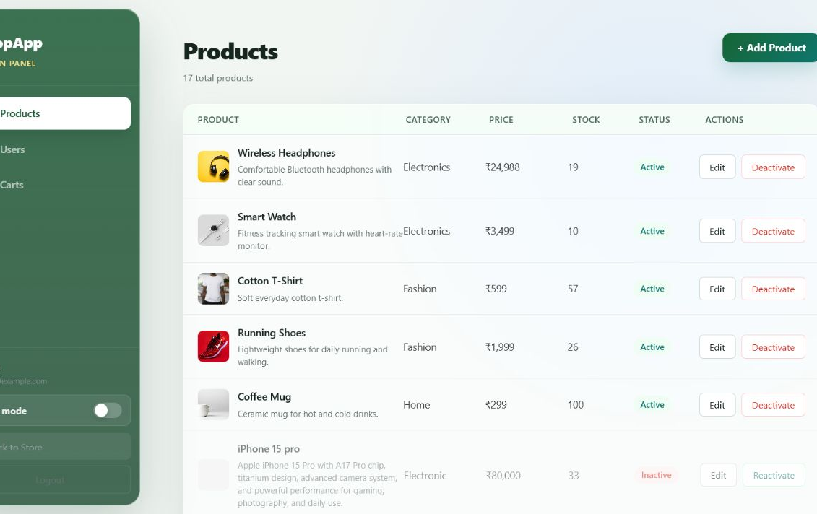
ROLE-BASED ADMINISTRATION
Operational control is separated from the customer experience
ADMIN CATALOGUE
SECURITY BOUNDARY
/api/admin/** requires ROLE_ADMIN in Spring Security.
View active and inactive products.
Create, update, deactivate and reactivate catalogue items.
List users while blocking deletion of ADMIN accounts.
Inspect user carts without exposing a customer-side control path.
Product removal is soft deletion: active becomes false.
MERCATO / TECHNICAL PRESENTATION
09

Slide 10
RELATIONAL MODEL AND DATA FLOW
Eight tables protect ownership, uniqueness and historical order state
DATABASE RULES
USERS
CARTS
CART ITEMS
Unique email, one cart per user, and unique user-product wishlist/review pairs.
identity • role
1 per user
qty • price
Foreign keys connect every commerce operation to a valid user and product.
ORDERS
ORDER ITEMS
status • totals
history snapshot
Cart item price and order item fields preserve commercial snapshots.
Checkout locks product rows and commits stock, order and cart changes together.
WISHLIST
PRODUCTS
unique pair
stock • active
Response DTOs return safe, purpose-specific JSON instead of entity graphs.
REVIEWS
rating • image
MERCATO / TECHNICAL PRESENTATION
10

Slide 11
TEAM OWNERSHIP AND LIVE DEMONSTRATION
Each presenter owns one vertical slice and its cross-module dependencies
PRESENTATION OWNERS
Oshi
Introduction & architecture
LIVE DEMO SEQUENCE
Radhika
Authentication & profile
1
Login → profile and role
2
Browse → search → product detail
Ashish
Catalogue & product detail
3
Save to wishlist → review
Jay
Wishlist & reviews
4
Add to cart → update quantity
Suraj
Cart & pricing state
5
Checkout → COD/Razorpay explanation
Varun
Checkout, orders & Razorpay
6
Order history → stock/database proof
Kartik
Administration
7
Admin product and user-cart view
Annu
Database, integration & conclusion
One user action remains traceable from React to MySQL—and back to the UI.
MERCATO / TECHNICAL PRESENTATION
11

