Slide 1

Mumbai/Bangalore
Final Project on
Banking Accounting
Submitted by:
Name Reg ID Under the Guidance of:
Shreeram Sah Telee Axis11JFSB1131 Mr. Nagelli Y Enock
Ajay Rajendra Kamble Axis11JFSB1124
Shreyash Jadhav Axis11JFSB1127
Aniket Kedar Axis11JFSB1128

Slide 2
CONTENTS
Introduction
Objective
Benefits
Modules
Technology Used
System Architecture
Future Work
References

Slide 3
INTRODUCTION
A system allowing individuals to perform banking activities at home, via the internet. The automated delivery of new and traditional banking products and services directly to customers through electronic, interactive communication channels. Some online banks are traditional banks which also offer online banking, while others are online only and have no physical presence.
The concept of Internet banking has been simultaneously evolving with the development of the world wide web. Programmers working on banking data bases came up with ideas for online banking transactions, some time during the 1980's. The online shopping promoted the use of credit cards through Internet. The first online banking service in United States was introduced, in October 1994.

Slide 4
OBJECTIVE
This Project aims the creation of a secure Internet banking System which is accessible to all the customer of bank, visitors as well as for the employee of the bank .In the Accounting application you can now:
1. Access your account online, download bank statements, and so forth.
2. Ask your bank to make payment on your behalf.
3. Transfer fund between accounts.

Slide 5
Benefits of Online Banking
Convenience: Unlike your corner bank, onlinebanking sites never close; they're available 24hours a day, seven days a week, and they're only amouse click away
Accessibility: If you're out of state or even out ofthe country when a money problem arises, you canlog on instantly to online bank and take care ofbusiness, 24/7.
Transaction speed: Online bank sites generallyexecute and confirm transactions at or quicker thanATM processing speeds

Slide 6
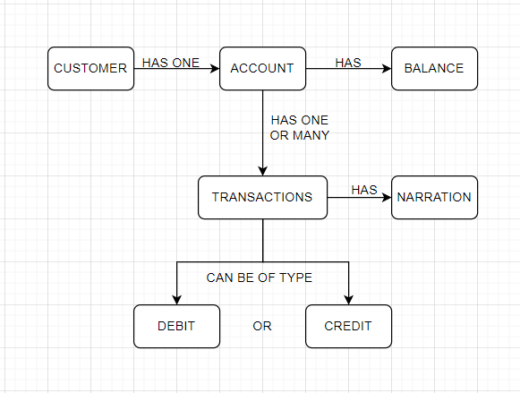
MODULES
Customer
Account
Transaction
Relation among Customer , Account and Transaction

Slide 7





Technology Used:

Slide 8
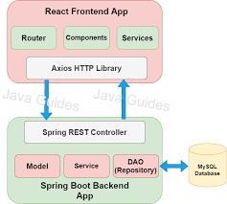
SYSTEM ARCHITECTURE

Slide 9
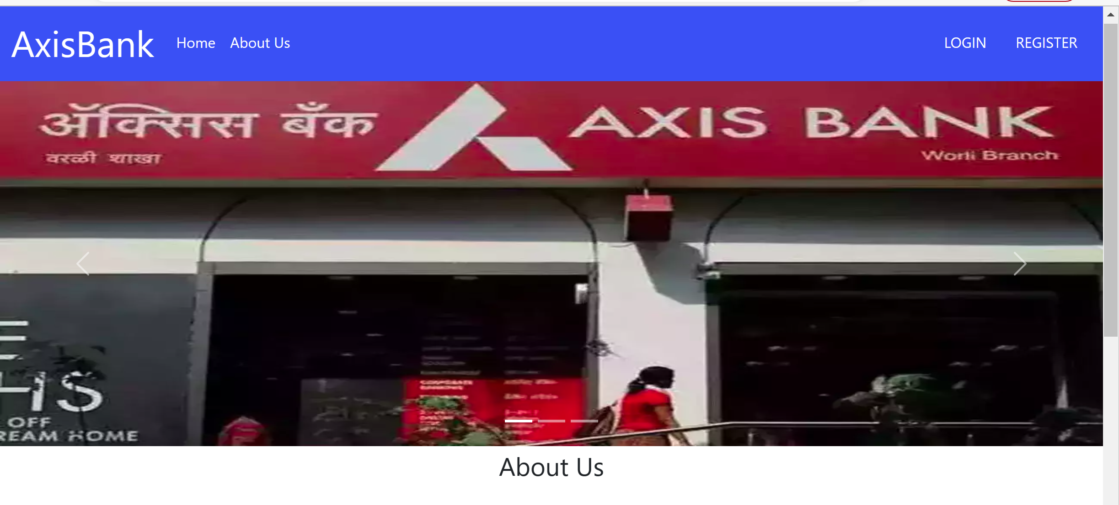
Home Page

Slide 10
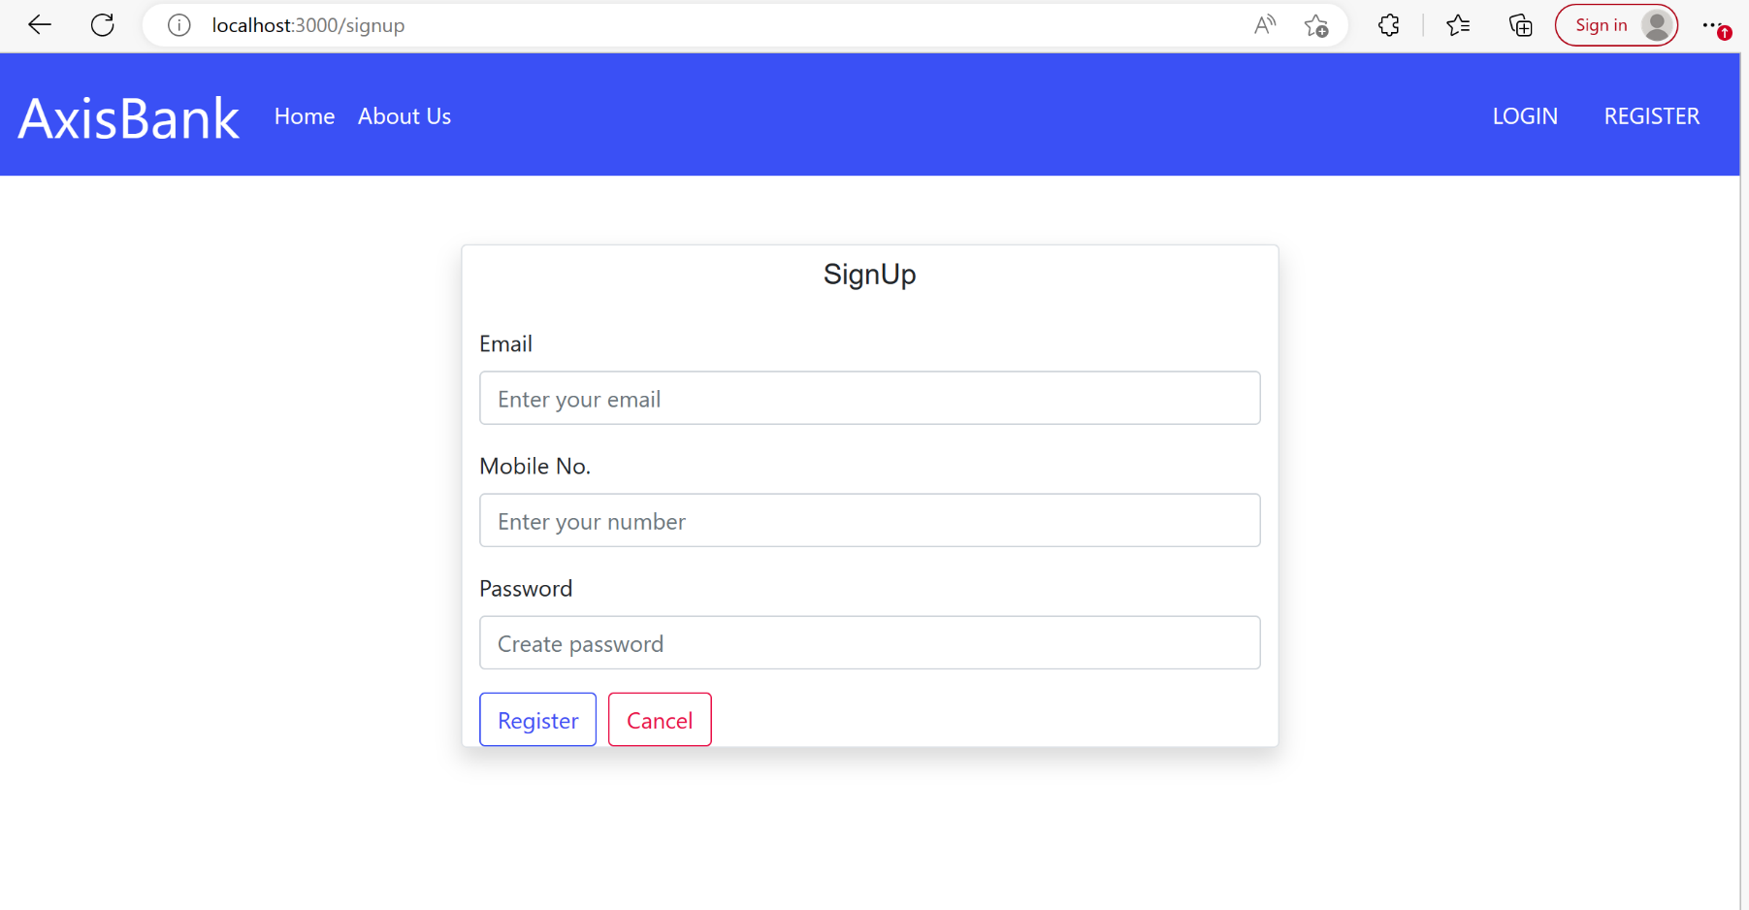
SignUp Page

Slide 11
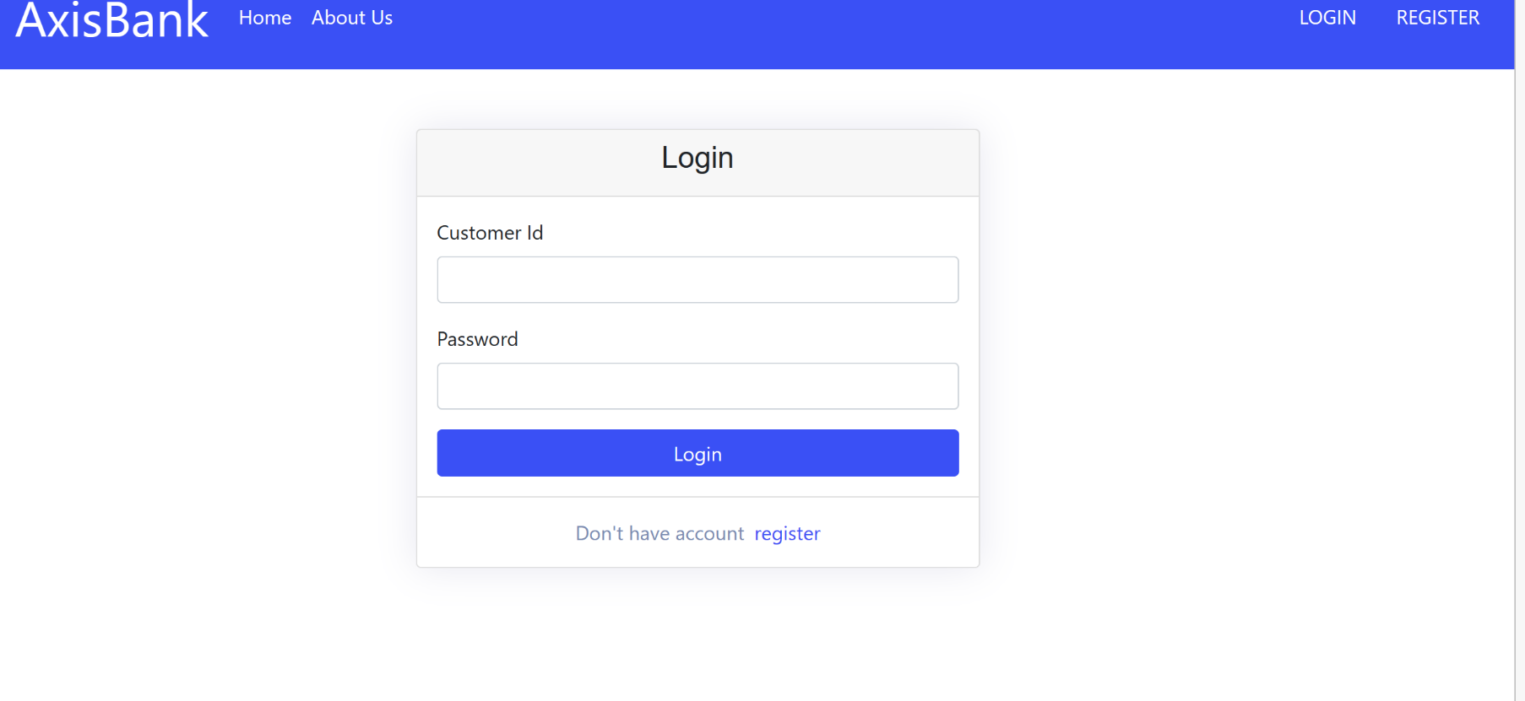
Login Page

Slide 12
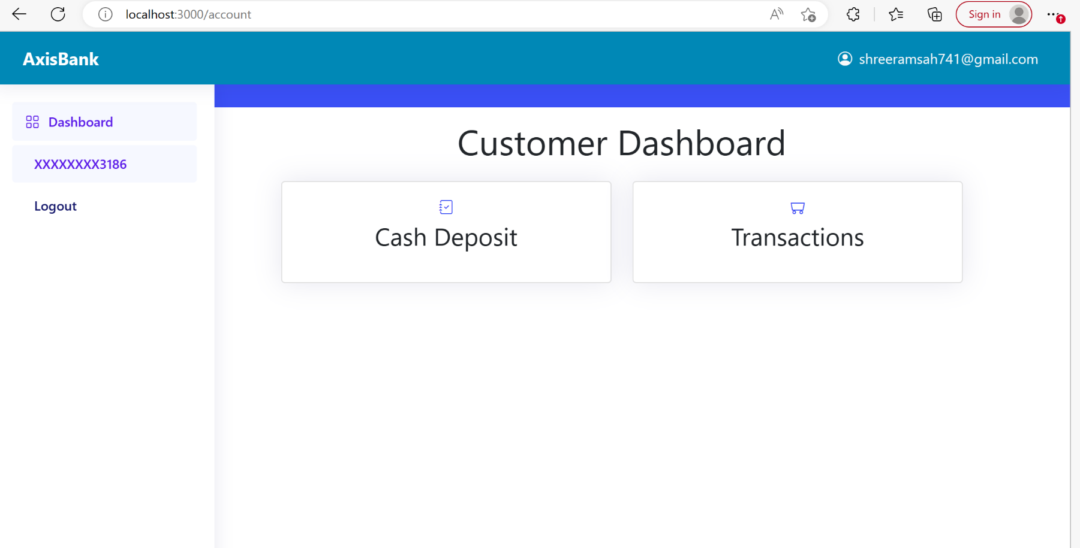
Customer Dashboard

Slide 13
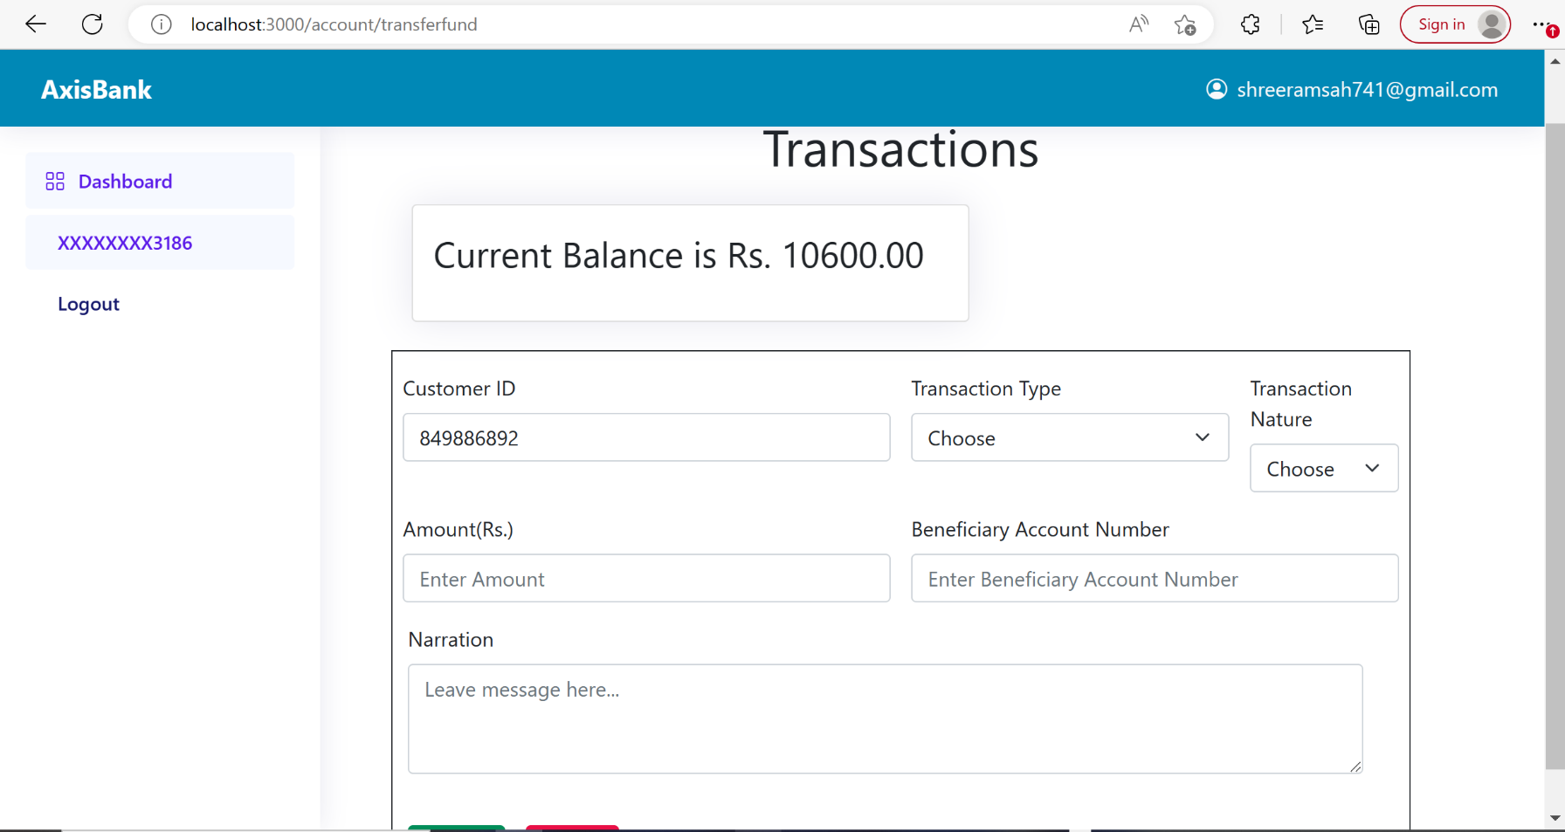
Transaction Page

Slide 14
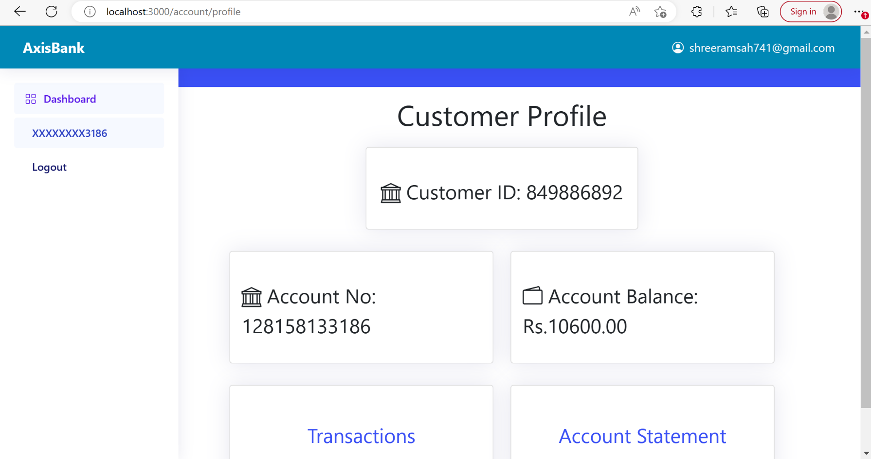
Customer Profile

Slide 15
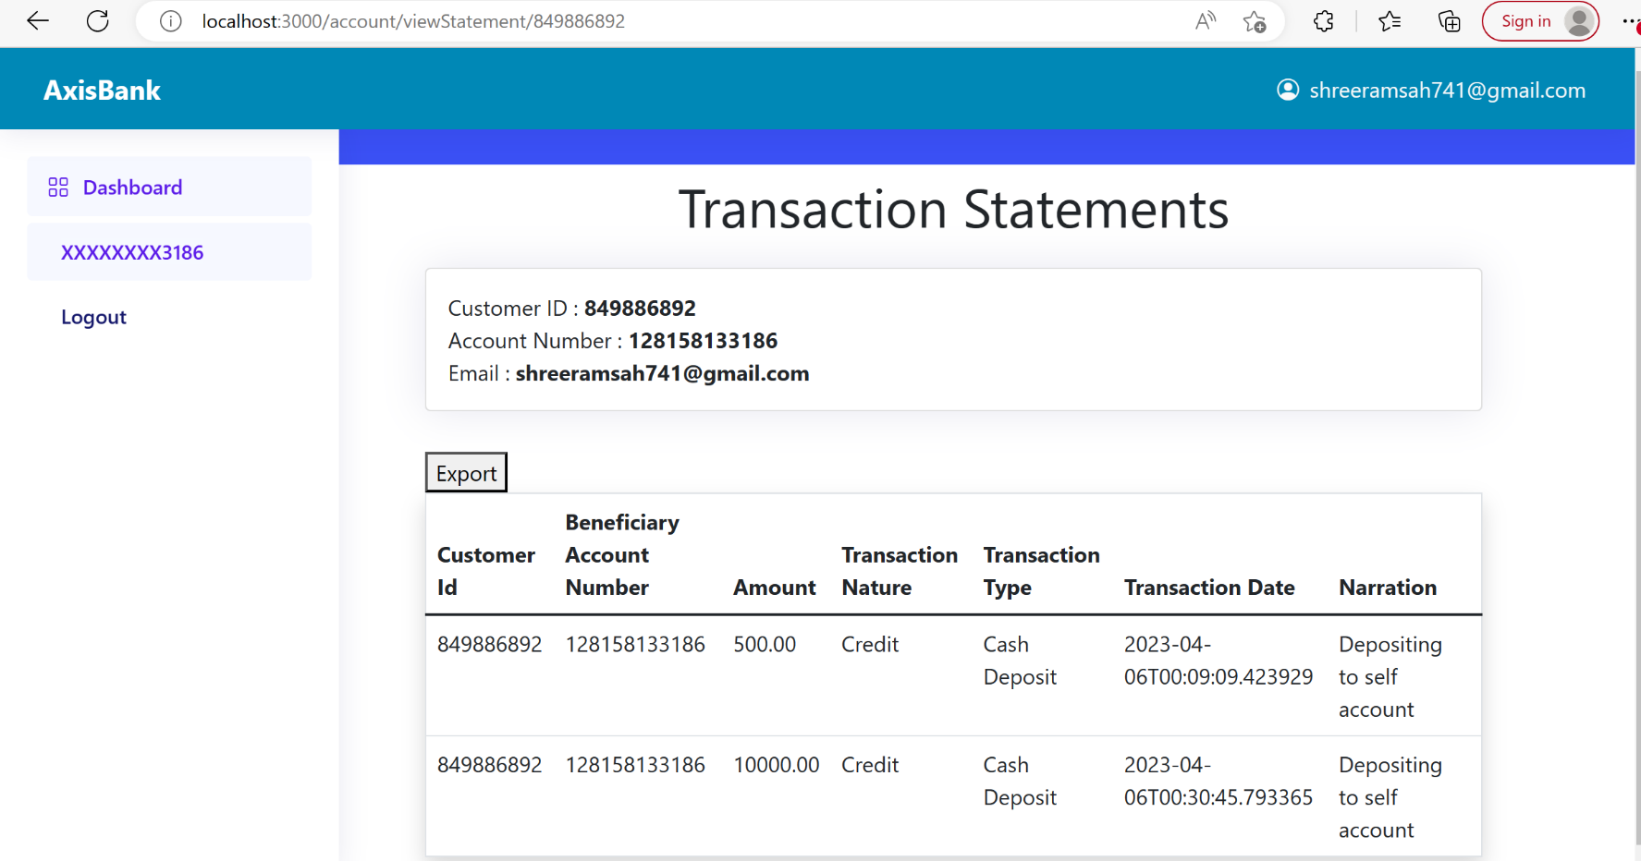
Transaction Statement Page

Slide 16
Future Work
Connect to real payment services like PhonePay,GooglePay etc.
Deployment(AWS)

Slide 17
Reference
JavaGuides
Youtube
And some more reference

Slide 18
Thank You

