Slide 1

Sampling-Based Gaussian Estimation of Probability of Collision for Safe Planning
Ajaay Chandrasekaran
April 16, 2018
Notes:
Published in 2012 IEEE International Conference on Robotics and Automation

Slide 2
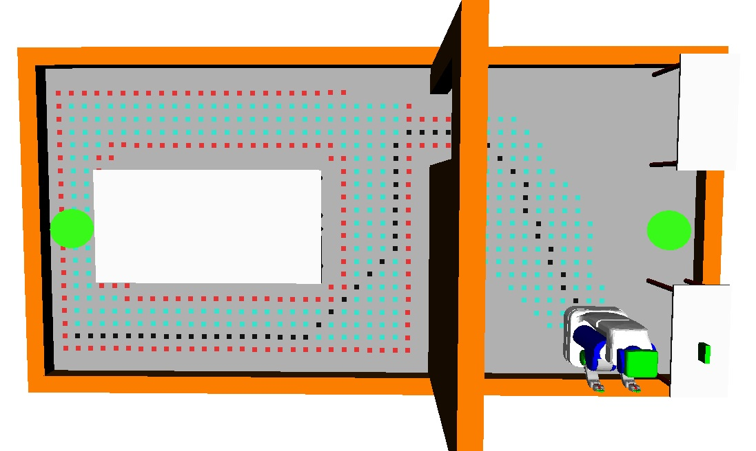
Research Motivation
Wish to quantify the safety of a motion plan before execution
Applications range from autonomous vehicles to the PR2 robot
Many planners compensate for the possibility of a collision
Notes:
Can be used inside a planner as a metric.
Emphasize safety in the context of obstacles
Safety is difficult to guarantee due to real world noise
The Astar path algorithm returns a shortest path, but not necessarily a safest path!
Why is this hard?

Slide 3
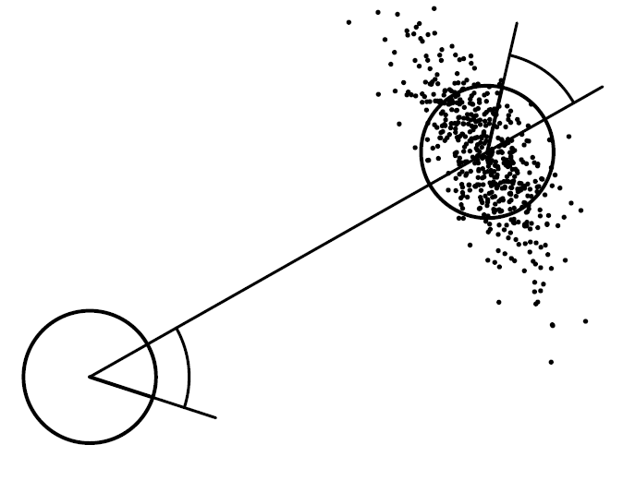
Problems
Real world uncertainty in
Robot motion
Sensor information
Monte-Carlo simulation takes too long
Requires many simulations of many particles
Collisions are dependent events
Motion Noise
Notes:
Monte carlo simulation: millions is too high
Execute a controller that simulates individual particles. Too expensive. One simulation = generate a million particles, then you have to simulate the million particles with noise. See what proportion of particles had a collision = p of collision for that simulation. Then, average all of the p’s of collision
Conservative: Underestimate of the probability
Can’t tree collision probabilities as independent events, otherwise you’ll highly overestimate the probability of collision with general analytical approaches that try to multiply proportions of particles colliding in individual particle distributions. Monte-Carlo would be more accurate in this case

Slide 4
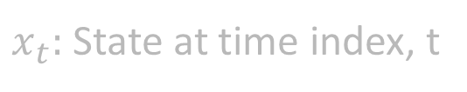
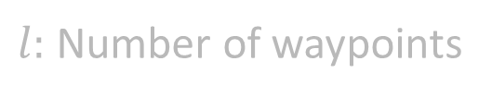
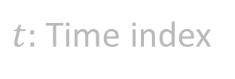


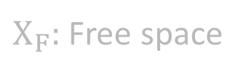

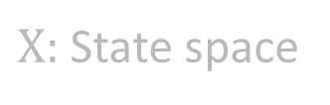
Goal
Quantify safety of a motion plan by accurately and quickly estimating the probability of a collision in presence of uncertainty
$$p\left(\bigvee_{t=0}^{l}{x_{t}∉Χ_{F}}\right)$$
$$∀t∈[0,l],x_{t}∈Χ$$
$Χ:$ State space
$Χ_{F}:$ Free space
$$Χ_{F}⊂Χ$$
$t:$ Time index
$x_{t}:$ State at time index, t
$l:$ Number of waypoints
Notes:
Conservative: If we are too conservative, planner will fail. If not conservative, then we expect more safety than there is.
Quickly: Must be efficient so that planner can run real time.

Slide 5
Outline
Prior Work
Proposed Method
Formulation
Approach
Gaussian Mixture Model Estimate Representation
Rejection Sampling for Distribution Truncation
Results (So Far)
PR2-Robot

Slide 6
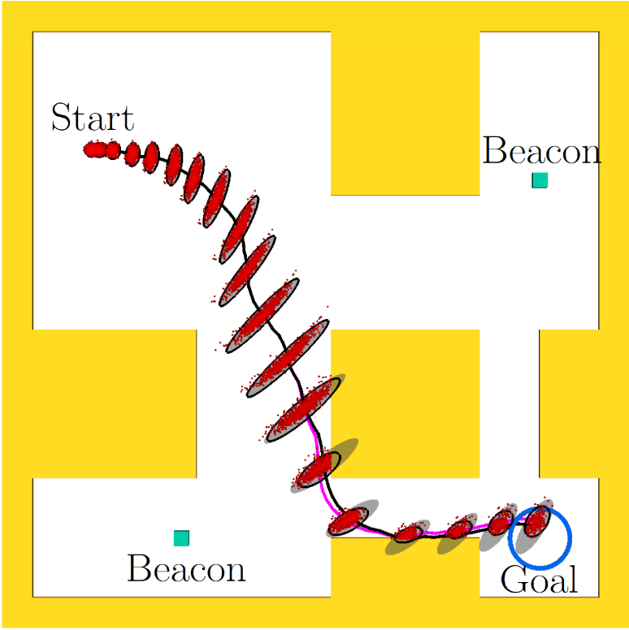
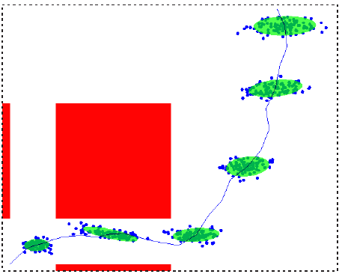
Prior Work
Constraint-based Gaussian Truncation
Linear chance constraints (Du Toit et al., RO ‘11)
Truncate a priori probability distributions along motion plan (Patil et al., ICRA ’12)
Caveats:
Assumes that we can form linear obstacle constraints in work-space
Generalizes only to point-robots
Patil’s method can degenerate in non-convex environments
Distance to Obstacle Check (van den Berg et al., RSS ‘10)
Caveat:
Incorrectly assumed independence between collision events along motion plan
Patil, ICRA ‘12
van den Berg et al., RSS ‘10
Notes:
Problem: Assumes independence!
Emphasize that this approach accounts for independence
Vanden berg’s approach uses distance to obstacle checker to compute probability of collision
Du Toit’s approach looks at probability of violating constraints. Do you know constraints?
My work attempts to solve both problems. Consider dependence of collisions and also handle fact that we have a C-Space

Slide 7
Outline
Prior Work
Proposed Method
Formulation
Approach
Gaussian Mixture Model Estimate Representation
Rejection Sampling for Distribution Truncation
Results (So Far)
PR2-Robot

Slide 8


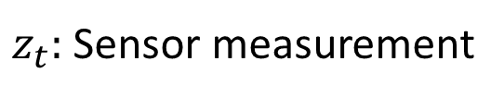
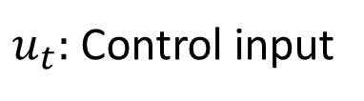
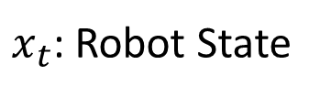
Formulation: Gaussian Uncertainty
Robot operating in uncertain environment with obstacles
Motion Model
Sensor Model
$x_{t}$: Robot State
$m_{t}:$ Gaussian random noise variable with variance $M_{t}$
$u_{t}:$ Control input
$n_{t}:$ Gaussian random noise variable with variance $N_{t}$
$z_{t}:$ Sensor measurement

Slide 9
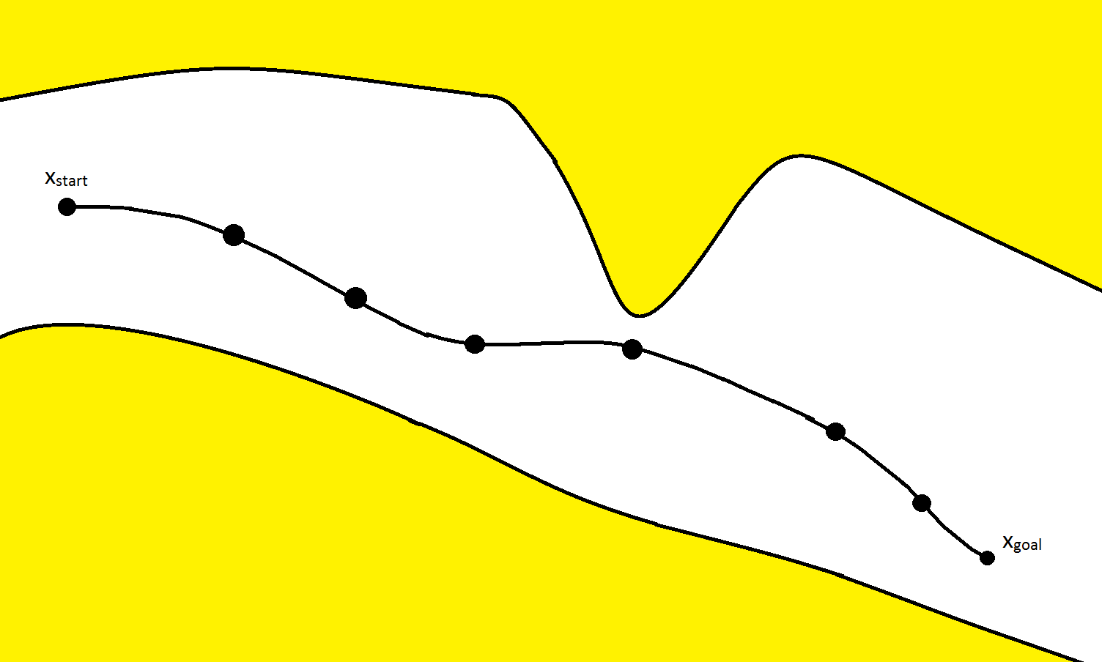
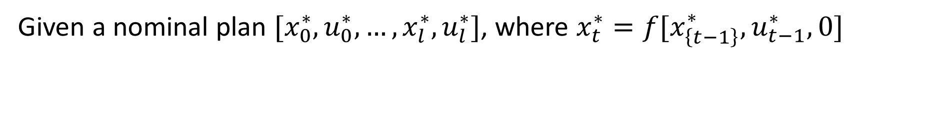
Formulation: Nominal Motion Plan
Given a nominal plan $[x_{0}^{∗}, u_{0}^{∗},…,x_{l}^{∗}, u_{l}^{∗}]$, where $x_{t}^{∗}=f[x_{\left\{t−1\right\}}^{∗}, u_{t−1}^{∗},0]$

Slide 10
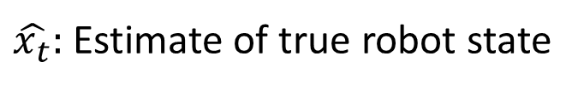
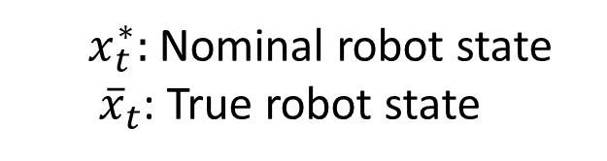


Formulation: EKF State Estimation
$${\hat{x}}_{t}$$
$$x_{t}^{∗}$$
$x_{t}^{∗}:$ Nominal robot state
${\overline{x}}_{t}$: True robot state
$\hat{x_{t}}:$ Estimate of true robot state

Slide 11
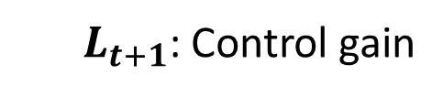
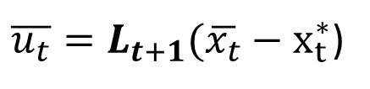
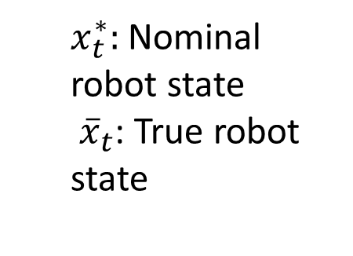
Formulation: Linear Feedback Control
$${\hat{x}}_{t}$$
$$x_{t}^{∗}$$
$x_{t}^{∗}:$ Nominal robot state
${\overline{x}}_{t}$: True robot state
$\overline{u_{t}}=L_{t+1}(\overline{x_{t}}−x_{t}^{∗}$)
$L_{t+1}$: Control gain
Compute ${\overline{u}}_{t}$, deviation from nominal control $u_{t}^{∗}.$

Slide 12
Outline
Prior Work
Proposed Method
Formulation
Approach
Gaussian Mixture Model Estimate Representation
Rejection Sampling for Distribution Truncation
Results (So Far)
PR2-Robot

Slide 13
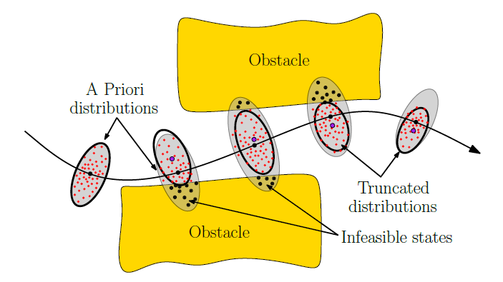

Overview of Approach
$${\hat{x}}_{t}$$
Cycle of propagation and truncation
Propagation of a Gaussian mixture estimate of robot state distribution
Sampling-Based Truncation of estimated robot state distribution
Attempt to capture distribution more accurately with multiple Gaussians
Notes:
GOAL: We want to truncate distribution to better capture non-Gaussian distributions!

Slide 14


Approach: Gaussian Mixture Model Estimate
Maintain mixture of $N$ Gaussians
Weights: $\left\{λ_{1}, λ_{2},…,λ_{N}\right\}$, $Σ_{i=1}^{N}λ_{i}=1$
Mixture: $\{N\left(μ_{1},σ_{1}^{2}\right), N\left(μ_{2},σ_{2}^{2}\right), …, N(μ_{N},σ_{N}^{2})\}$

Slide 15

Approach: Gaussian Mixture Model Estimate
Step 1: Initialize Gaussians with equal weight and same initial mean $x_{0}^{∗}$ (start state) and covariance

Slide 16
Approach: Gaussian Mixture Model Estimate
Step 2: Propagate individual Gaussians via motion model to next waypoint and update estimates via EKF

Slide 17

Approach: Rejection Sampling Truncation
Step 3: Sample $M$ particles from mixture model using weights $λ_{1},…,λ_{N}$.
Notes:
This is the C-Space. We don’t have to explicitly form the C-Space

Slide 18
Approach: Rejection Sampling Truncation
Step 3 (cont.): Total proportion of colliding particles estimates conditional probability of collision for current waypoint
Notes:
This is the C-Space. We don’t have to explicitly form the C-Space

Slide 19
Approach: Rejection Sampling Truncation
Step 4: Update mixture weights to be proportions of total non- colliding particles for the waypoint
Notes:
This is the C-Space. We don’t have to explicitly form the C-Space

Slide 20
Approach: Rejection Sampling Truncation
Step 4: Compute analytical mean and covariance of non-colliding configurations in each Gaussian and approximate as new Gaussian
Notes:
This is the C-Space. We don’t have to explicitly form the C-Space

Slide 21
Approach: Rejection Sampling Truncation
Step 5: Repeat Step 1 and propagate estimated truncated distributions
Notes:
This is the C-Space. We don’t have to explicitly form the C-Space

Slide 22

Approach: Notes
Multiply proportions of colliding particles for all waypoints to estimate total probability of collision
Approach Justification
Multiple Gaussians may capture truncated distributions better
Sampling in C-Space with collision-checking permits non-point robots
No requirement for already-known obstacle constraints

Slide 23
Outline
Prior Work
Proposed Method
Formulation
Approach
Gaussian Mixture Model Estimate Representation
Rejection Sampling for Distribution Truncation
Results (So Far)
PR2-Robot

Slide 24

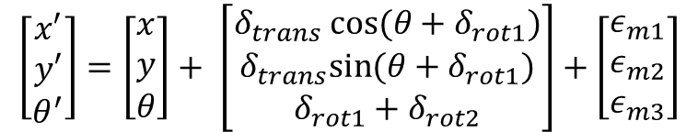

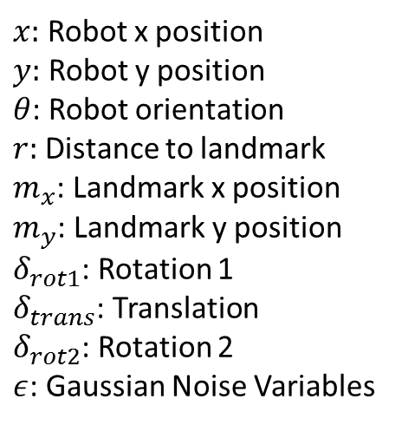
Evaluation: PR2 Robot
State and Control
$x_{t}={\left[x, y θ\right]}^{T}$ u = ${\left[δ_{rot1},δ_{trans},δ_{trans}\right]}^{T}$
Odometry Motion Model
Sensor Model
$x:$ Robot x position
$y:$ Robot y position
$θ$: Robot orientation
$r:$ Distance to landmark
$m_{x}$: Landmark x position
$m_{y}$: Landmark y position
$δ_{rot1}$: Rotation 1
$δ_{trans}$: Translation
$δ_{rot2}$: Rotation 2
$ε$: Gaussian Noise Variables
$$\left[\begin{aligned}x′ \\ y′ \\ θ^{′}\end{aligned}\right]=\left[\begin{aligned}x \\ y \\ θ\end{aligned}\right]+ \left[\begin{aligned}δ_{trans} cos⁡(θ+δ_{rot1}) \\ δ_{trans}sin⁡(θ+δ_{rot1}) \\ δ_{rot1}+δ_{rot2}\end{aligned}\right]+\left[\begin{aligned}ε_{m1} \\ ε_{m2} \\ ε_{m3}\end{aligned}\right]$$
$r=\sqrt{{\left(m_{x}−x\right)}^{2}+{\left(m_{y}−y\right)}^{2}}+ε_{Q}$
Thrun et al., Probabilistic Robotics, Chapters 5,6
Notes:
Odometry Motion Model as described by Thrun

Slide 25
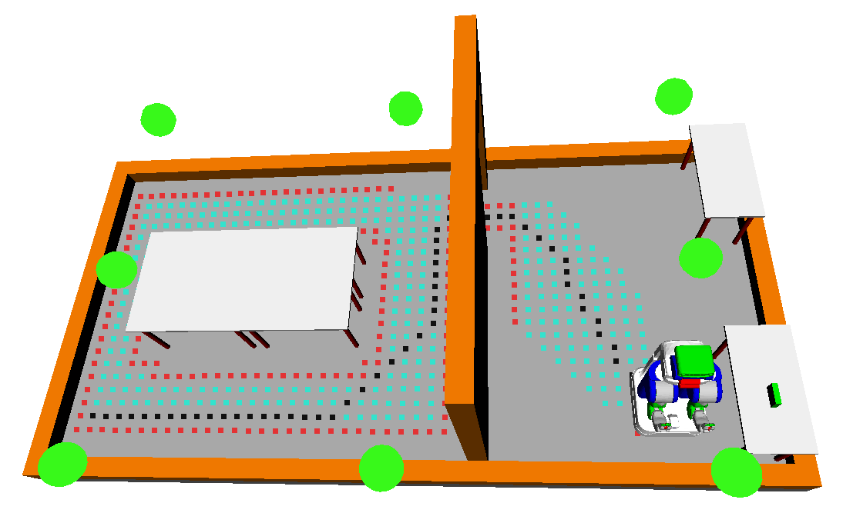
Experiment Setup
Implementation Details
Nominal plan computed using A* Algorithm in OpenRave
C++ implementation on 4-core Intel 2.20GHz i5 PC
Green Dots: Beacons for localization
Black Dots: Nominal motion plan

Slide 26
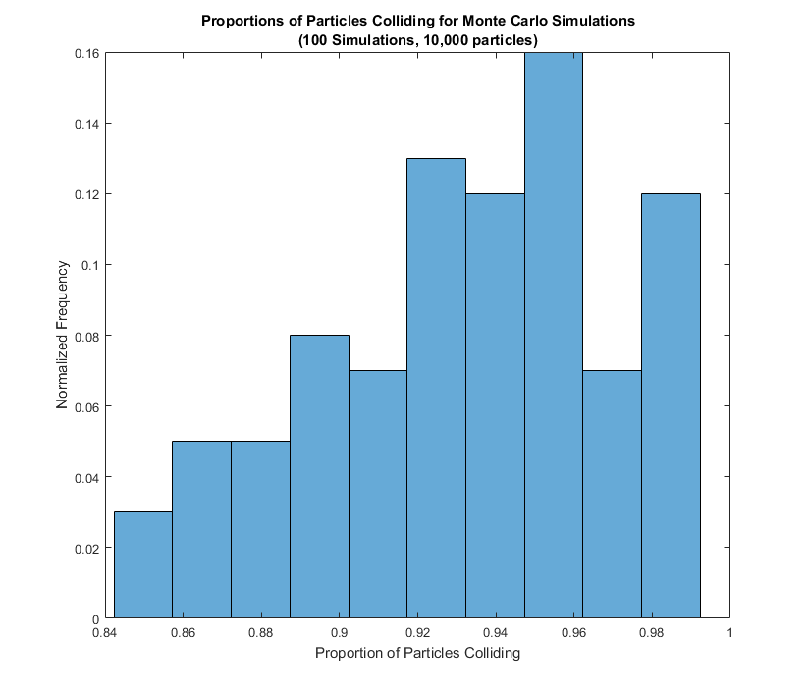
Experimental Results So Far
Monte Carlo Simulations of 10,000 particles to gauge ground truth probability of collision
N: 100 simulations
Min: 0.8423
Max: 0.9995
Mean: 0.9399
Std. Dev: 0.0416
~112 sec per simulation

Slide 27
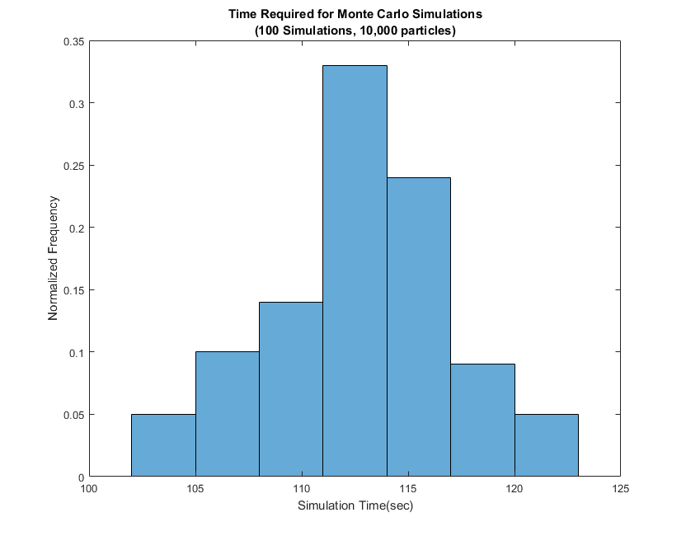
Experimental Results So Far (Cont.)
Time (sec) required for Monte Carlo Simulations of 10,000 particles
N: 100 simulations
Min: 103.6552
Max: 121.5551
Mean: 112.6999
Std. Dev: 4.0729
Total time: ~3 Hours
Notes:
Our goal is to beat the amount of time of doing the monte carlo simulations.
Ideally, may take same amount of time as one simulation and provide a good estimate of probability of collision

Slide 28
Conclusion and Future Work
Presented a method to compute probability of collision, which
considers conditional dependence of collisions
does not require linear constraints to represents obstacles
handles non-point robots given collision-checker
Next Steps
Implement method and compare to Monte Carlo Simulation ground truth
Test other environments
Test accuracy among different motion plans
Notes:
Method is applicable to wide variety of m planning under uncertainty methods

Slide 29
End

