Slide 1

Sampling-Based Gaussian Estimation of the Probability of Collision for Safe Planning
Ajaay Chandrasekaran
April 16, 2018
Notes:
Published in 2012 IEEE International Conference on Robotics and Automation

Slide 2
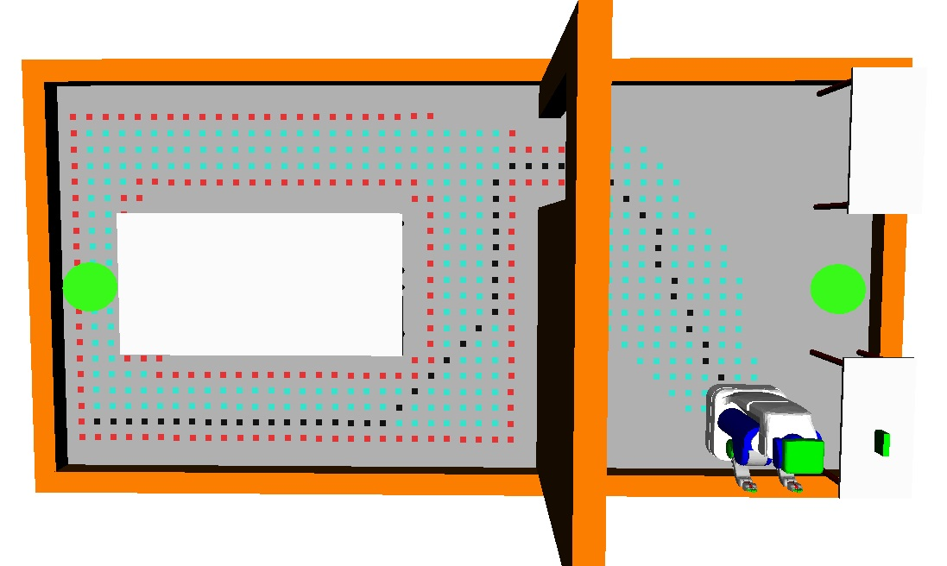
Research Motivation
Wish to quantify the safety of a motion plan before execution
Applications range from autonomous vehicles to the PR2 robot
Many planners compensate for the possibility of a collision
Notes:
Can be used inside a planner as a metric.
Emphasize safety in the context of obstacles
Safety is difficult to guarantee due to real world noise
The Astar path algorithm returns a shortest path, but not necessarily a safest path!
Why is this hard?

Slide 3
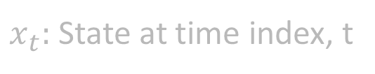
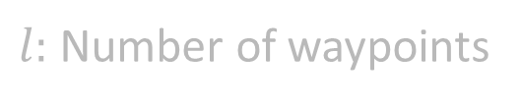
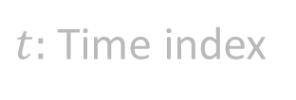


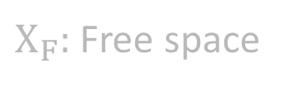

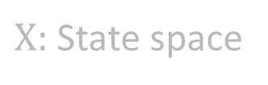
Goal
Quantify safety of a motion plan by estimating the probability of no collisions in presence of uncertainty
$$p\left(\bigwedge_{t=0}^{l}{x_{t}∈Χ_{F}}\right)$$
$$∀t∈[0,l],x_{t}∈Χ$$
$Χ:$ State space
$Χ_{F}:$ Free space
$$Χ_{F}⊂Χ$$
$t:$ Time index
$x_{t}:$ State at time index, t
$l:$ Number of waypoints
Notes:
Conservative: If we are too conservative, planner will fail. If not conservative, then we expect more safety than there is.
Quickly: Must be efficient so that planner can run real time.

Slide 4
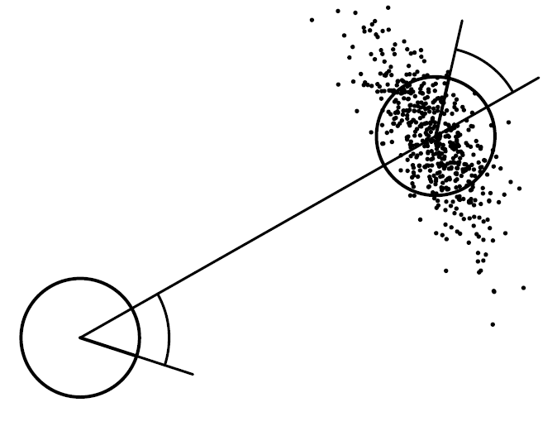
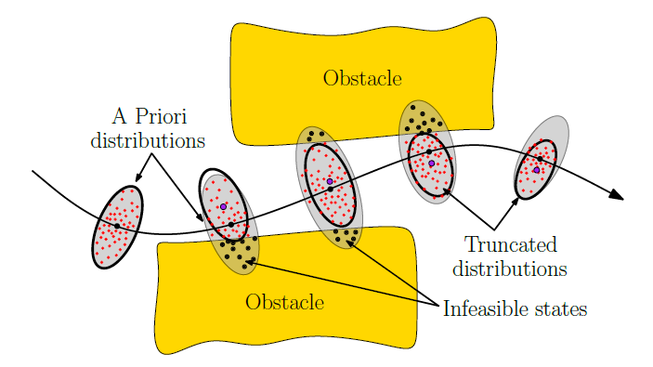
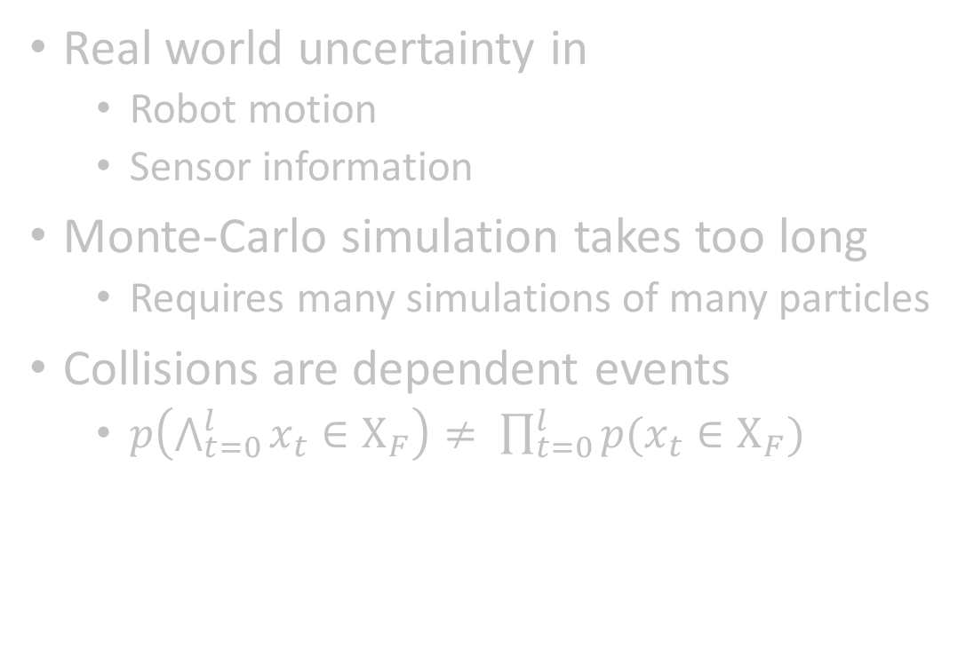
Problems
Real world uncertainty in
Robot motion
Sensor information
Monte-Carlo simulation takes too long
Requires many simulations of many particles
Collisions are dependent events
$p\left(\bigwedge_{t=0}^{l}{x_{t}∈Χ_{F}}\right)≠ \prod_{t=0}^{l}{p(x_{t}∈Χ_{F})}$
Motion Noise
MC Simulation
Notes:
Monte carlo simulation: millions is too high
Execute a controller that simulates individual particles. Too expensive. One simulation = generate a million particles, then you have to simulate the million particles with noise. See what proportion of particles had a collision = p of collision for that simulation. Then, average all of the p’s of collision
Conservative: Underestimate of the probability
Can’t tree collision probabilities as independent events, otherwise you’ll highly overestimate the probability of collision with general analytical approaches that try to multiply proportions of particles colliding in individual particle distributions. Monte-Carlo would be more accurate in this case

Slide 5
Outline
Prior Work
Proposed Method
Formulation
Approach
Gaussian Mixture Model Estimate Representation
Rejection Sampling for Distribution Truncation
Method Evaluation and Results
PR2-Robot

Slide 6
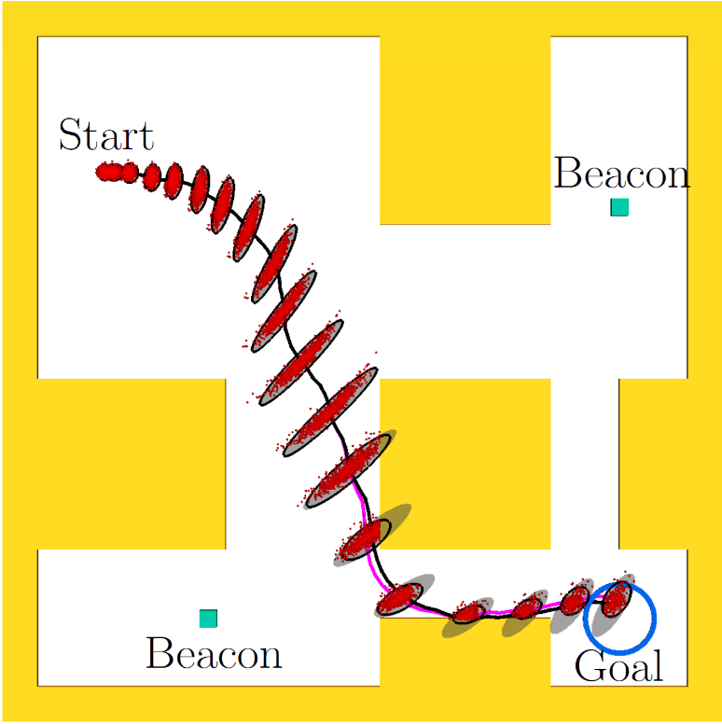
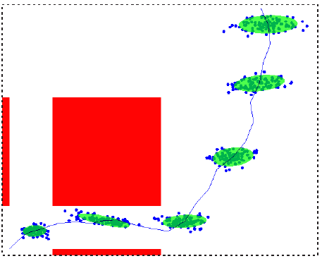
Prior Work
Constraint-based Gaussian Truncation
Linear chance constraints (Du Toit et al., RO ‘11)
Truncate a priori probability distributions along motion plan (Patil et al., ICRA ’12)
Caveats:
Assumes that we can form linear obstacle constraints in work-space
Generalizes only to point-robots
Patil’s method can degenerate in non-convex environments
Distance to Obstacle Check (van den Berg et al., RSS ‘10)
Caveat:
Incorrectly assumed independence between collision events along motion plan
Patil, ICRA ‘12
van den Berg et al., RSS ‘10
Notes:
Problem: Assumes independence!
Emphasize that this approach accounts for independence
Vanden berg’s approach uses distance to obstacle checker to compute probability of collision
Du Toit’s approach looks at probability of violating constraints. Do you know constraints?
My work attempts to solve both problems. Consider dependence of collisions and also handle fact that we have a C-Space

Slide 7
Outline
Prior Work
Proposed Method
Formulation
Approach
Gaussian Mixture Model Estimate Representation
Rejection Sampling for Distribution Truncation
Method Evaluation and Results
PR2-Robot

Slide 8


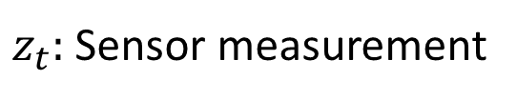
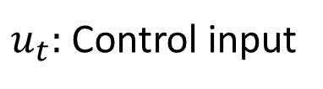
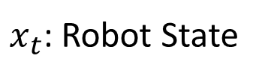
Formulation: Gaussian Uncertainty
Robot operating in uncertain environment with obstacles
Motion Model
Sensor Model
$x_{t}$: Robot State
$m_{t}:$ Gaussian random noise variable with variance $M_{t}$
$u_{t}:$ Control input
$n_{t}:$ Gaussian random noise variable with variance $N_{t}$
$z_{t}:$ Sensor measurement

Slide 9
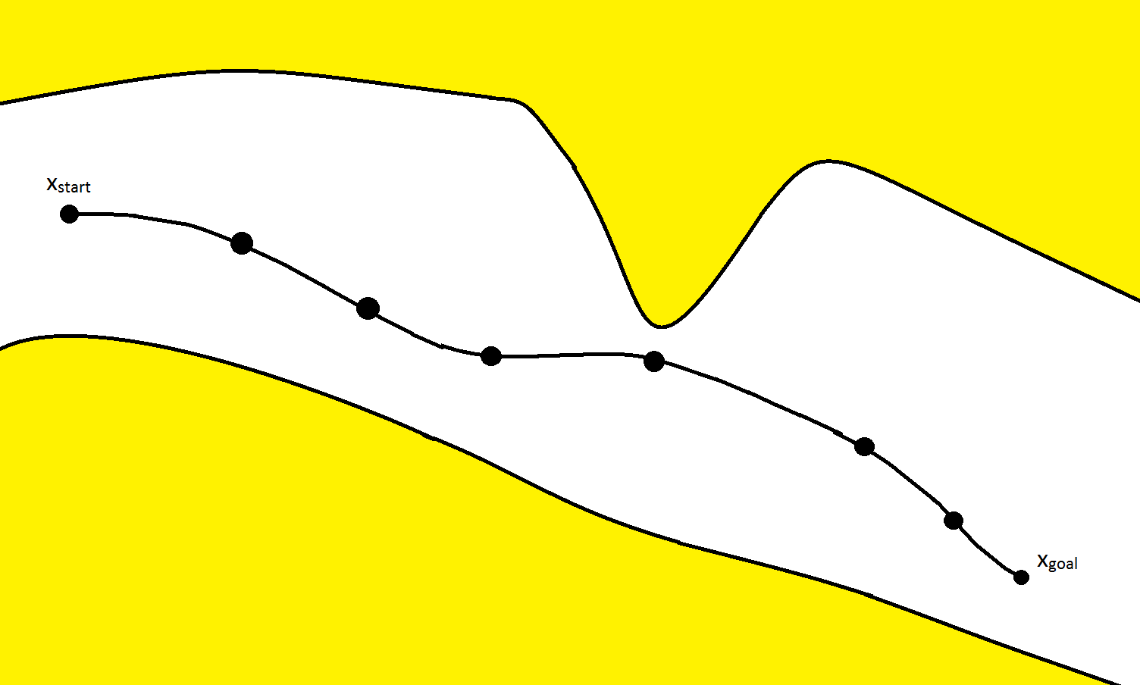
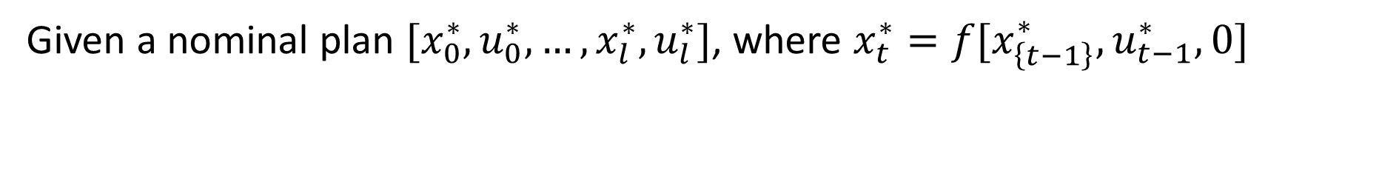
Formulation: Nominal Motion Plan
Given a nominal plan $[x_{0}^{∗}, u_{0}^{∗},…,x_{l}^{∗}, u_{l}^{∗}]$, where $x_{t}^{∗}=f[x_{\left\{t−1\right\}}^{∗}, u_{t−1}^{∗},0]$

Slide 10
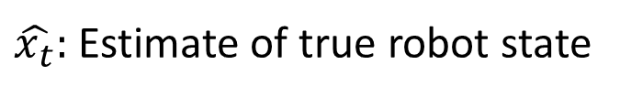
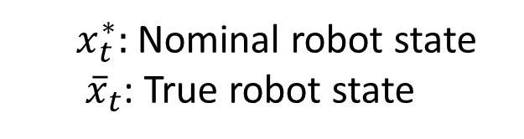


Formulation: EKF State Estimation
$${\hat{x}}_{t}$$
$$x_{t}^{∗}$$
$x_{t}^{∗}:$ Nominal robot state
${\overline{x}}_{t}$: True robot state
$\hat{x_{t}}:$ Estimate of true robot state

Slide 11
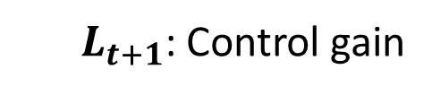
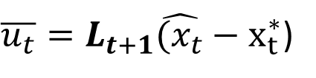
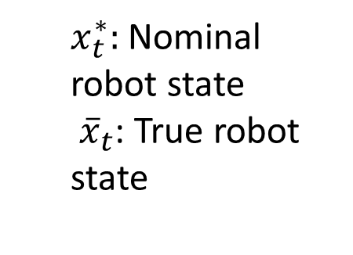
Formulation: Linear Feedback Control
$${\hat{x}}_{t}$$
$$x_{t}^{∗}$$
$x_{t}^{∗}:$ Nominal robot state
${\overline{x}}_{t}$: True robot state
$\overline{u_{t}}=L_{t+1}\hat{(x_{t}}−x_{t}^{∗}$)
$L_{t+1}$: Control gain
Compute ${\overline{u}}_{t}$, deviation from nominal control $u_{t}^{∗}.$

Slide 12
Outline
Prior Work
Proposed Method
Formulation
Approach
Gaussian Mixture Model Estimate Representation
Rejection Sampling for Distribution Truncation
Method Evaluation and Results
PR2-Robot

Slide 13

Overview of Approach
$${\hat{x}}_{t}$$
Cycle of propagation and truncation
Propagation of a Gaussian mixture estimate of robot state distribution
Sampling-Based Truncation of estimated robot state distribution
Generalize from propagation of one Gaussian to multiple Gaussians to better capture truncated distributions
Notes:
GOAL: We want to truncate distribution to better capture non-Gaussian distributions!

Slide 14

Approach: Algorithm
Maintain mixture of $N$ Gaussians
Weights: $\left\{λ_{1}, λ_{2},…,λ_{N}\right\}$, $Σ_{i=1}^{N}λ_{i}=1$
Mixture: $\{N\left(μ_{1},σ_{1}^{2}\right), N\left(μ_{2},σ_{2}^{2}\right), …, N(μ_{N},σ_{N}^{2})\}$
Step 1: Initialize Gaussians with equal weight and same initial covariance

Slide 15
Pros and Cons
Pros
Sampling in C-Space with collision-checking permits non-point robots
No requirement for already-known obstacle constraints
Faster than large number of MC Simulations
Cons
Computationally expensive sampling of large number of points
No guarantee of conservative estimate of collision probability

Slide 16
Outline
Prior Work
Proposed Method
Formulation
Approach
Gaussian Mixture Model Estimate Representation
Rejection Sampling for Distribution Truncation
Method Evaluation and Results
PR2-Robot

Slide 17

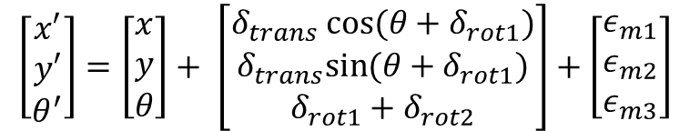

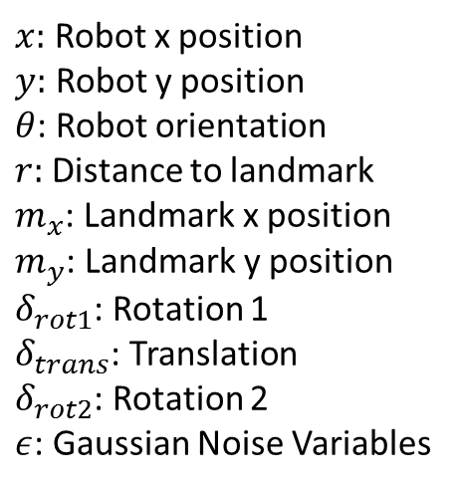
Evaluation: PR2 Robot
State and Control
$x_{t}={\left[x, y θ\right]}^{T}$ u = ${\left[δ_{rot1},δ_{trans},δ_{trans}\right]}^{T}$
Odometry Motion Model
Sensor Model
$x:$ Robot x position
$y:$ Robot y position
$θ$: Robot orientation
$r:$ Distance to landmark
$m_{x}$: Landmark x position
$m_{y}$: Landmark y position
$δ_{rot1}$: Rotation 1
$δ_{trans}$: Translation
$δ_{rot2}$: Rotation 2
$ε$: Gaussian Noise Variables
$$\left[\begin{aligned}x′ \\ y′ \\ θ^{′}\end{aligned}\right]=\left[\begin{aligned}x \\ y \\ θ\end{aligned}\right]+ \left[\begin{aligned}δ_{trans} cos⁡(θ+δ_{rot1}) \\ δ_{trans}sin⁡(θ+δ_{rot1}) \\ δ_{rot1}+δ_{rot2}\end{aligned}\right]+\left[\begin{aligned}ε_{m1} \\ ε_{m2} \\ ε_{m3}\end{aligned}\right]$$
$r=\sqrt{{\left(m_{x}−x\right)}^{2}+{\left(m_{y}−y\right)}^{2}}+ε_{Q}$
Thrun et al., Probabilistic Robotics, Chapter 5,6
Notes:
Odometry Motion Model as described by Thrun

Slide 18
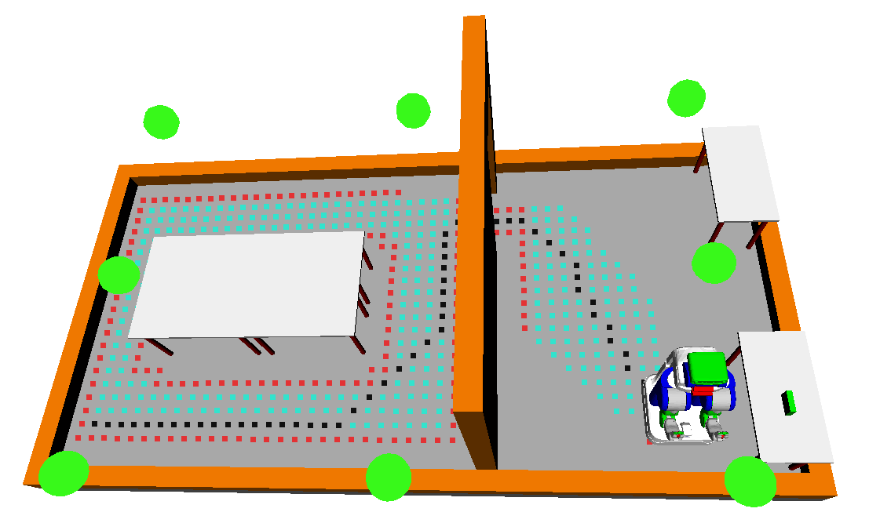
Experiment Setup
Implementation Details
Nominal plan computed using A* Algorithm in OpenRave
C++ implementation on 4-core Intel 2.20GHz i5 PC
Green Dots: Beacons for localization
Black Dots: Nominal motion plan

Slide 19
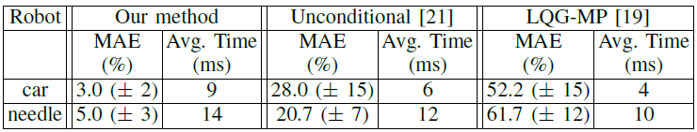
Experimental Results
Monte Carlo Simulation to
One million Monte Carlo simulations used as ground truth

Slide 20
Conclusion and Future Work
Presented a method to compute probability of collision, which
considers conditional dependence of collisions
does not require linear constraints to represents obstacles
handles non-point robots given collision-checker
Next Steps
Mixture of Gaussians
Test Other environments
Test different motion plans
Potential Future Work
Incorporate distance to obstacles as a metric to weigh Gaussians
More deterministic sampling via scaled unscented transform
Notes:
Method is applicable to wide variety of m planning under uncertainty methods

Slide 21
End

Slide 22
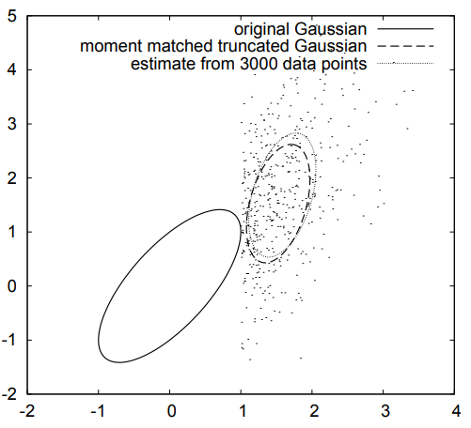
Prior Work: Gaussian Distribution Truncation
Optimal state estimation with state constraints (Johnson et al., ‘94)
Does not consider motion uncertainty
Analytical method to compute probability of collision without sensing uncertainty (Greytak, ’09)
Expectation-propagation framework for Bayesian inference (Toussaint, NIPS ‘09)
Problem: Truncation result depends on processing order of constraints, leading to no convergence guarantee
(Toussaint, NIPS ‘09)
Notes:
This paper presents a method to truncate Gaussians without caring about order of constraints. Also considers both motion and sensing uncertainty

Slide 23
Overview of Approach
Cycle of propagation and truncation
Propagation of estimated robot state distribution (Gaussian)
Truncation of estimated robot state distribution based on obstacles
Notes:
Grey ellipses yield an appropriate estimate. See Fig 1 in paper

Slide 24
Appendix: Formulation Elements
Gaussian Motion and Sensor Uncertainty
Linearization about Nominal Motion Plan
Kalman Filter State Estimator
Linear Feedback Controller to follow Nominal Motion Plan
Convex Feasible Region containing Robot State

Slide 25
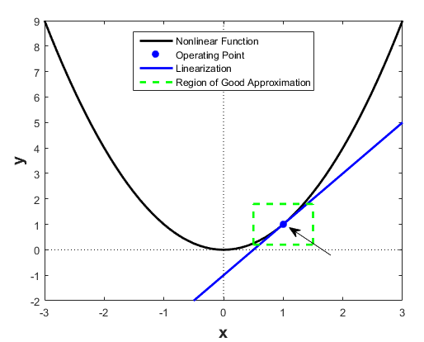

Appendix: Model Linearization
Linearize motion and sensor models about nominal plan
Express models in terms of deviations from
Nominal state $x_{t}^{∗}$
Nominal control input $u_{t}^{∗}$
Actual sensor measurement, $z_{t}^{∗}$
Notes:
https://www.mathworks.com/help/slcontrol/ug/linearizing-nonlinear-models.html

Slide 26
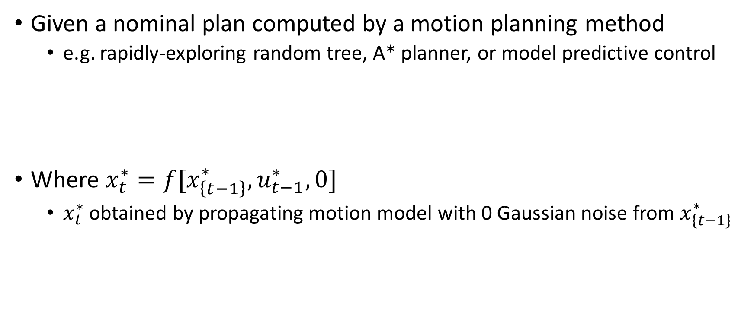

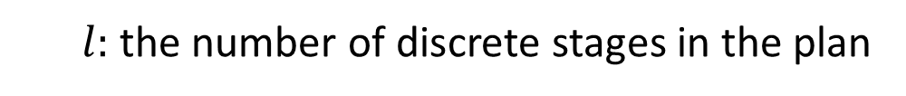

Appendix: Nominal Motion Plan
Given a nominal plan computed by a motion planning method
e.g. rapidly-exploring random tree, A* planner, or model predictive control
Where $x_{t}^{∗}=f[x_{\left\{t−1\right\}}^{∗}, u_{t−1}^{∗},0]$
$x_{t}^{∗}$ obtained by propagating motion model with 0 Gaussian noise from $x_{\left\{t−1\right\}}^{∗}$
$$[x_{0}^{∗}, u_{0}^{∗},…,x_{l}^{∗}, u_{l}^{∗}]$$
$l:$ the number of discrete stages in the plan
$$0≤t≤l$$
Notes:
Opporunity for an image. Draw out a sequence of states. Don’t bore people with too much text.
Clarify the 0 for Gaussian noise.
Skeptical, arbitrary robots. F function could be messy. Expect a question. Look into paper

Slide 27
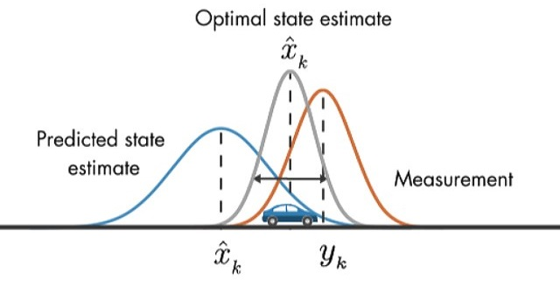

Appendix: Kalman Filter State Estimation
Use Kalman Filter to estimate $\hat{x_{t}}=E[\overline{x_{t}}]$
State Deviation Evolution
Where, $K_{t}$ is the Kalman Gain matrix
${\overline{x}}_{t}:$ true deviation from the true state $x_{t}$, assuming linearized motion model
${\hat{x}}_{t}$: the Kalman Filter estimator of $\overline{x_{t}}$, using sensor and motion models

Slide 28

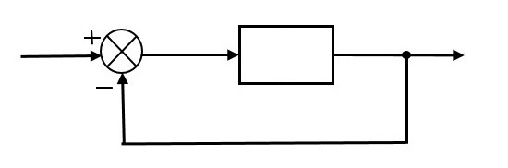
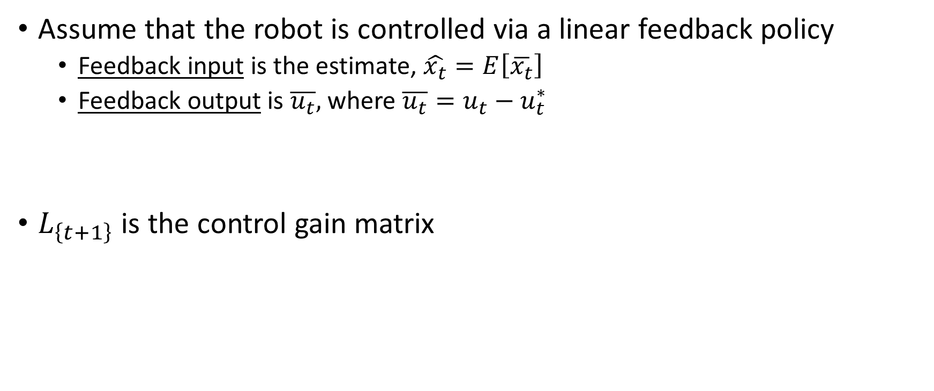
Appendix: Linear Feedback Control
Assume that the robot is controlled via a linear feedback policy
Feedback input is the estimate, $\hat{x_{t}}=E\left[\overline{x_{t}}\right]$
Feedback output is $\overline{u_{t}},$ where $\overline{u_{t}}=u_{t}−u_{t}^{∗}$
$L_{\left\{t+1\right\}}$ is the control gain matrix
Notes:
Put in the picture from the first page and keep referring back to it
Assumption: Linear feedback controller. Possible question.
Fails with nonlinear control laws. Optimization-based control, nonlinear functions. Fails in that case. Avoid huge claims. See arbitrary robot claim.
Feedback input is the estimate, $\hat{x_{t}}=E\left[\overline{x_{t}}\right]$
Feedback output is $\overline{u_{t}},$ the expected deviation of true control input from the nominal control input ($\overline{u_{t}}=u_{t}−u_{t}^{∗})$

Slide 29
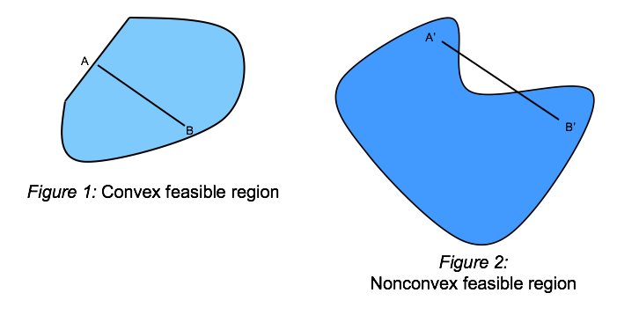

Appendix: Obstacle Constraints
$∀t∈[0,l]$ the feasible region containing $x_{t}$ is assumed convex
$$X_{\left\{F,t\right\}}=\left\{x∈Χ | \bigcap_{i=0}^{k}{a_{i}x≤b_{i}}\right\}$$
Notes:
https://ibmdecisionoptimization.github.io/tutorials/html/Beyond_Linear_Programming.html

Slide 30


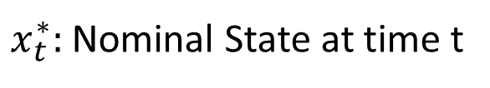
Appendix: Gaussian Propagation
Given ${\hat{y}}_{t}=E[{ y}_{t} ]$, and variance $R_{t}=Var\left[ y_{t} \right]$, we can specify the unconditional a priori state distribution of $x_{t}$ following the propagation of ${\hat{y}}_{t}$:
$$x_{t }\sim N[x_{t}^{∗}+Λ \hat{y_{t}}, ΛR_{t}Λ^{T}]$$
Where $Λ=[I 0]$
$x_{t}^{∗}:$ Nominal State at time t
$$y_{t}=\left[ \begin{matrix}{\overline{x}}_{t} \\ {\hat{x}}_{t}\end{matrix} \right]$$
${\overline{x}}_{t}:$ true deviation from the true state $x_{t}$, assuming linearized motion model
${\hat{x}}_{t}$: the Kalman Filter estimator of $\overline{x_{t}}$, using sensor and motion models

Slide 31
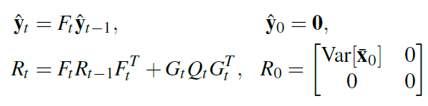
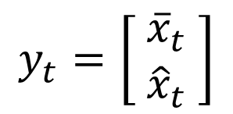
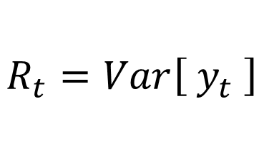

Appendix: Gaussian Propagation
$${\hat{y}}_{t}=E\left[{ y}_{t} \right]$$
$$y_{t}=\left[ \begin{matrix}{\overline{x}}_{t} \\ {\hat{x}}_{t}\end{matrix} \right]$$
$$R_{t}=Var\left[ y_{t} \right]$$

Slide 32
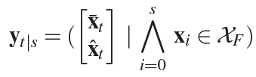
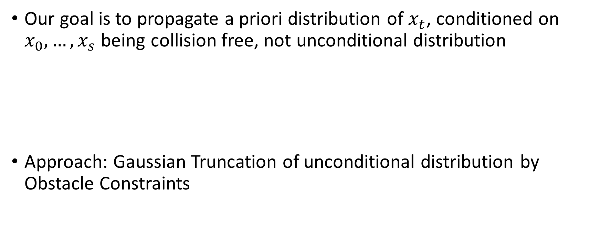
Appendix: Gaussian Truncation
Our goal is to propagate a priori distribution of $x_{t}$, conditioned on $x_{0},…, x_{s}$ being collision free, not unconditional distribution
Approach: Gaussian Truncation of unconditional distribution by Obstacle Constraints

Slide 33
Outline
Prior Work
Proposed Method
Formulation
Approach
Gaussian Propagation
Gaussian Truncation
Method Evaluation and Results
Car-like robot with second order dynamics
Nonholonomic bevel-tip flexible needle

Slide 34
Formulation: Gaussian Uncertainty
Robot operating in uncertain environment with obstacles
Motion Model
Sensor Model
$x_{t}$: Robot State
$m_{t}:$ Gaussian random noise variable with variance $M_{t}$
$u_{t}:$ Control input
$n_{t}:$ Gaussian random noise variable with variance $N_{t}$
$z_{t}:$ Sensor measurement

Slide 35
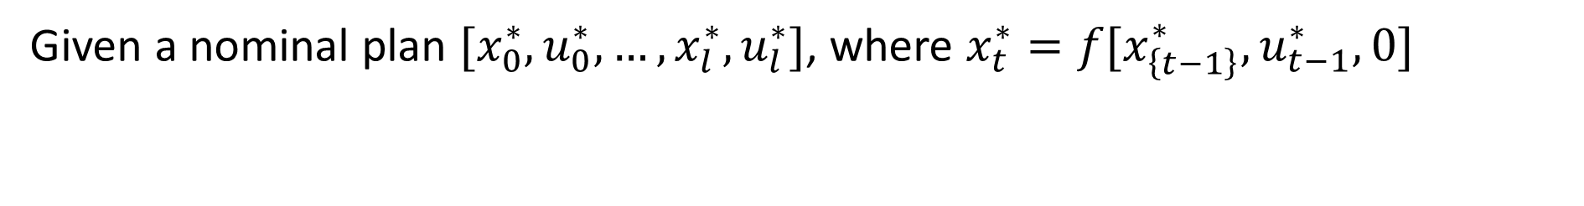
Formulation: Nominal Motion Plan
Given a nominal plan $[x_{0}^{∗}, u_{0}^{∗},…,x_{l}^{∗}, u_{l}^{∗}]$, where $x_{t}^{∗}=f[x_{\left\{t−1\right\}}^{∗}, u_{t−1}^{∗},0]$

Slide 36
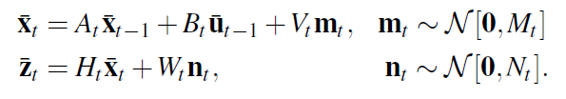

Formulation: Model Linearization
Where $\overline{x_{t}}=x_{t}−x_{t}^{∗}$, $\overline{z_{t}}=z_{t}−z_{t}^{∗}$, and $\overline{u_{t}}=u_{t}−u_{t}^{∗}$
Linearization via
appropriate Jacobians, A, B, V, H, W
Notes:
Emphasize Deviations!!!
Does an arbitrary f work? Will the linearization always work? States could be far apart. Terrible

Slide 37




Formulation: Kalman Filter State Estimation
$$\hat{x_{t}}=E[\overline{x_{t}}]$$
$$x_{t}$$
$$\hat{x_{t}}$$
$$x_{t}^{∗}$$
${\overline{x}}_{t}:$ true deviation from the true state $x_{t}$, assuming linearized motion model
${\hat{x}}_{t}$: the Kalman Filter estimate of $\overline{x_{t}}$, using linearized sensor and motion models

Slide 38

Formulation: Linear Feedback Control
$L_{\left\{t+1\right\}}$: Control gain matrix
$$x_{t}$$
$$\hat{x_{t}}$$
$$x_{t}^{∗}$$
Compute ${\overline{u}}_{t}$, deviation from nominal control $u_{t}^{∗}.$ $\overline{u_{t}}+u_{t}^{∗}$ is new control

Slide 39

Formulation: Obstacle Constraints
$$x_{t}$$
$∀t∈[0,l]$ the feasible region containing $x_{t}$ is assumed convex

Slide 40
Outline
Prior Work
Proposed Method
Formulation
Approach
Gaussian Propagation
Gaussian Truncation
Method Evaluation and Results
Car-like robot with second order dynamics
Nonholonomic bevel-tip flexible needle

Slide 41



Approach: Gaussian Propagation
The true (linearized) state deviation ${\overline{x}}_{t}$, and its estimator ${\hat{x}}_{t}$ evolve as
This is pretty messy, here’s the shorthand:
Notes:
2nd element is KF and state uncertainty
Don’t use word true, assumes nonlinear. It’s actually the linear approximation of true state deviaton.
Appropriate definitions provided for $y_{t}, q_{t}, F_{t}, G_{t}, Q_{t}$

Slide 42


Approach: Gaussian Propagation (Cont.)
Define the mean ${\hat{y}}_{t}=E[{ y}_{t} ]$, and variance $R_{t}=Var\left[ y_{t} \right]$
Propagate $\hat{y_{t}}$ and $R_{t}$ as follows:
$$y_{t}=\left[ \begin{matrix}{\overline{x}}_{t} \\ {\hat{x}}_{t}\end{matrix} \right]$$
${\overline{x}}_{t}:$ true deviation from the true state $x_{t}$, assuming linearized motion model
${\hat{x}}_{t}$: the Kalman Filter estimator of $\overline{x_{t}}$, using sensor and motion models
Notes:
Note that x hat_t is a Kalman filter estimator that uses both the motion and sensor models

Slide 43






Approach: Gaussian Propagation (Cont.)
$$x_{t }\sim N[x_{t}^{∗}+Λ \hat{y_{t}}, ΛR_{t}Λ^{T}]$$
$x_{t}^{∗}:$ Nominal State at time t
$$x_{t}$$
$$\hat{x_{t}}$$
$$x_{t}^{∗}$$
$$y_{t}=\left[ \begin{matrix}{\overline{x}}_{t} \\ {\hat{x}}_{t}\end{matrix} \right]$$
$${\hat{y}}_{t}=E\left[{ y}_{t} \right]$$
$$R_{t}=Var\left[ y_{t} \right]$$
Grey Ellipses: Unconditional a priori $x_{t}$distributions
$$Λ=[I 0]$$
Notes:
We can define x_t distribution at any point on the plan by propogating R_t and yhat_t

Slide 44

Approach: Gaussian Propagation (Cont.)
$$x_{t}$$
$$\hat{x_{t}}$$
$$x_{t}^{∗}$$
$$y_{t}=\left[ \begin{matrix}{\overline{x}}_{t} \\ {\hat{x}}_{t}\end{matrix} \right]$$
$${\hat{y}}_{t}=E\left[{ y}_{t} \right]$$
$$R_{t}=Var\left[ y_{t} \right]$$
Grey Ellipses: Unconditional a priori $x_{t}$distributions
$$Λ=[I 0]$$

Slide 45
Outline
Prior Work
Proposed Method
Formulation
Approach
Gaussian Propagation
Gaussian Truncation
Method Evaluation and Results
Car-like robot with second order dynamics
Nonholonomic bevel-tip flexible needle

Slide 46
Approach: Gaussian Truncation (Cont.)
Black Ellipses: Obstacle Truncated Gaussian Distributions

Slide 47


Approach: Gaussian Truncation (Cont.)
Compute shift in mean and variance for each constraint

Slide 48


Approach: Gaussian Truncation (Cont.)
Step 1: For each constraint, affine transform to 1D Gaussian
Current Constraint
Notes:
Affine transformation to 1D Gaussian along axis normal to the constraint

Slide 49
Approach: Gaussian Truncation (Cont.)
Step 2: Truncate 1D Gaussian by constraint (well-known problem)
Current Constraint
2
1
Notes:
Truncate 1D Gaussian at specified ub given by constraint

Slide 50

Approach: Gaussian Truncation (Cont.)
Step 3: Get shifts in $μ$ and $Σ$ of original Gaussian, $∆y_{t}^{i}$ and $ΔR_{t}^{i}$
Current Constraint
Notes:
Truncate 1D Gaussian at specified ub given by constraint

Slide 51




Approach: Gaussian Truncation (Cont.)
Truncated 1D-Gaussian
1 – cdf($α_{i}$):
Area under 1D Gaussian violating constraint

Slide 52

Approach: Gaussian Truncation (Cont.)
Unconditional priori distribution shift in $μ$, $Δy_{t}^{i},$ and shift in $Σ$, $ΔR_{t}^{i}$

Slide 53


Final Probability of No Collisions
Claim: Boole’s Inequality conservatively estimates collision-free probability
Final Expression

Slide 54


Local Convexification Attempt
$Σ_{t}=U_{t}U_{t}^{T}$ is Cholesky decomposition
Notes:
Convert distribution of robot position to a unit sphere via Cholesky Decomposition. Sphere simplifies task of finding a conservative convex region of free space around robot. Assumes only robot position relevant for collision detection.
Greedy algorithm. Part of distribution beyond the convex region is minimal

Slide 55
Outline
Prior Work
Proposed Method
Formulation
Approach
Gaussian Propagation
Gaussian Truncation
Method Evaluation and Results
Car-like robot with second order dynamics
Nonholonomic bevel-tip flexible needle

Slide 56




Evaluation: Car-like Robot with Second Order Dynamics
State and Control
$x_{t}={\left[x, y θ, v\right]}^{T}$ u = ${\left[a,φ\right]}^{T}$
Motion Model
Sensor Model
$d:$ Length of car
$τ:$ Time step
$x:$ x position
$y:$ y position
$θ$: orientation
$φ:$ Steering angle
$a:$ Acceleration
m: Motion noise
n: Sensor noise
$x_{1}$: Beacon 1
$x_{2}:$ Beacon 2
Notes:
2 beacons

Slide 57






Evaluation: Nonholonomic Bevel-tip Flexible Needle
State and Control Input
Motion Model
Sensor Model
$p:$ Needle Position
R: Needle Orientation
$v:$ Insertion speed
$w:$ Rotation speed
$κ:$ Curvature
U: Instantaneous twist
$\tilde{U}$: Noisy Instantaneous twist
n: Position noise
Notes:
2 beacons

Slide 58
Experimental Results
Implementation Details
Nominal plan computed using an RRT Planner
C++ implementation on a 3.33 GHz Intel i7 PC
One million Monte Carlo simulations used as ground truth

Slide 59
Experimental Results
Implementation Details
Nominal plan computed using an RRT Planner
C++ implementation on a 3.33 GHz Intel i7 PC
One million Monte Carlo simulations used as ground truth

Slide 60

Experimental Results: Car
$2000$ MC simulations to arrive within method’s accuracy bound

Slide 61

Experimental Results: Needle
$3000$ MC simulations to arrive within method’s accuracy bound

Slide 62
Conclusion and Future Work
Presented a method to compute probability of collision, which
considers conditional distributions
truncates Gaussians independent of order of constraints
Future Work
Real-world problems with complex dynamics and uncertainty e.g. medical needle steering and autonomous quadcopters
Non-point robots
Non-Gaussian feasible state distributions
Notes:
Method is applicable to wide variety of m planning under uncertainty methods

