Slide 1
Final Project Workshop
Ajaay Chandrasekaran
Inspired from work by Patil, van den Berg, and Alterovitz
April 4, 2018
Notes:
Published in 2012 IEEE International Conference on Robotics and Automation

Slide 2
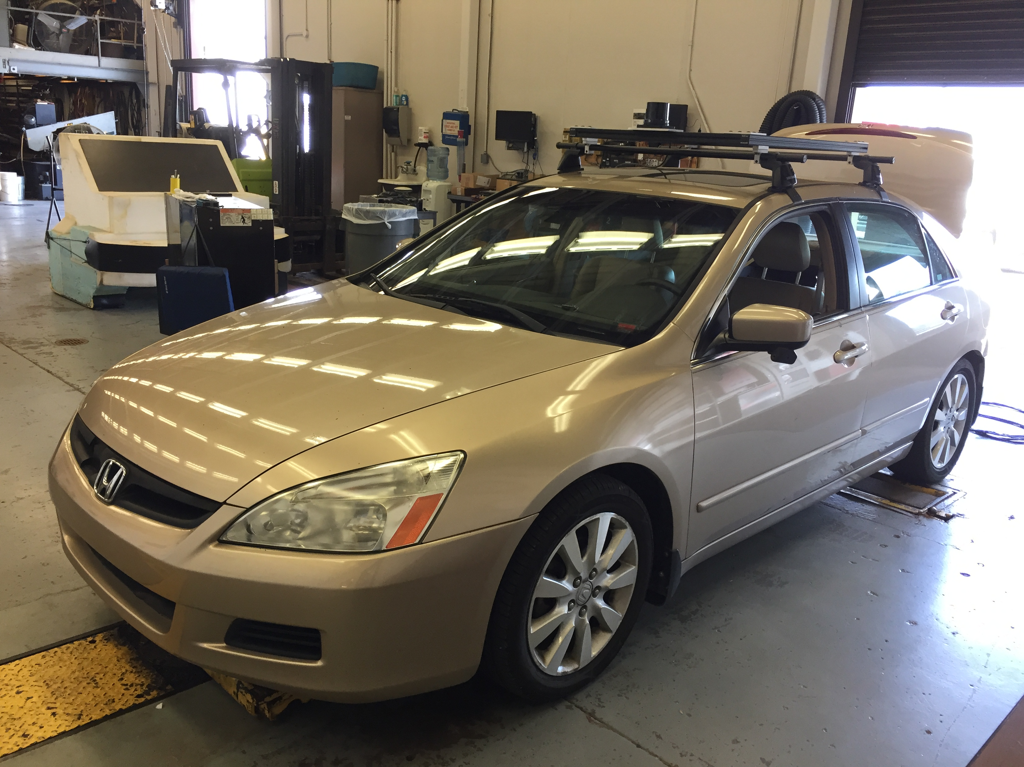
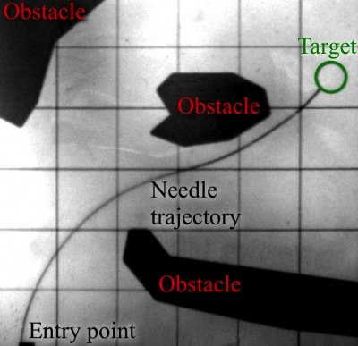
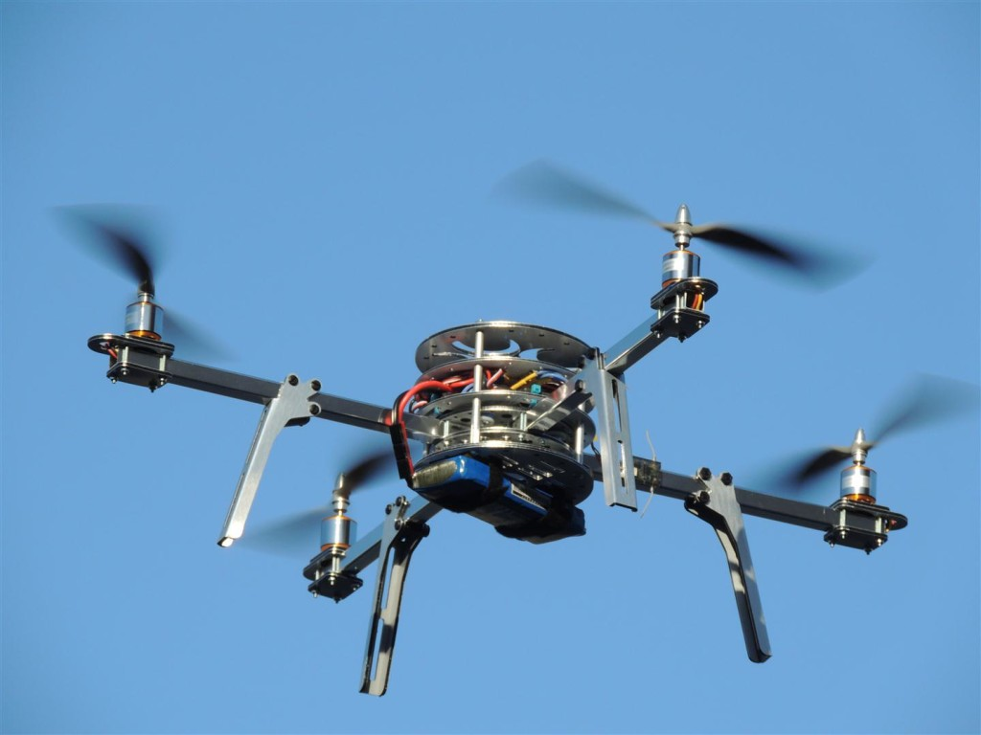
Research Motivation
Wish to quantify the safety of a motion plan before execution
Applications range from autonomous vehicles to steerable medical needles
Many planners compensate for the possibility of a collision
Safety is difficult to guarantee and quantify due to real world uncertainty
Notes:
Can be used inside a planner as a metric.
Emphasize safety in the context of obstacles
Safety is difficult to guarantee due to real world noise
https://oscarliang.com/build-a-quadcopter-beginners-tutorial-1/

Slide 3
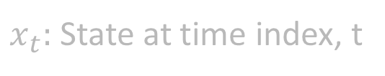
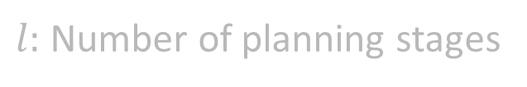
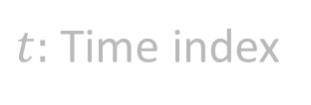


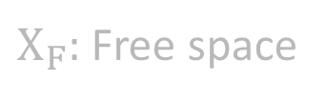


Goal
Given a motion plan, conservatively estimate the probability of no collisions in presence of sensor and motion uncertainty
$$p\left(\bigwedge_{t=0}^{l}{x_{t}∈Χ_{F}}\right)$$
$$∀t∈[0,l],x_{t}∈Χ$$
$Χ:$ State space
$Χ_{F}:$ Free space
$$Χ_{F}⊂Χ$$
$t:$ Time index
$x_{t}:$ State at time index, t
$l:$ Number of planning stages
Notes:
Conservative: If we are too conservative, planner will fail. If not conservative, then we expect more safety than there is.
Quickly: Must be efficient so that planner can run real time.

Slide 4
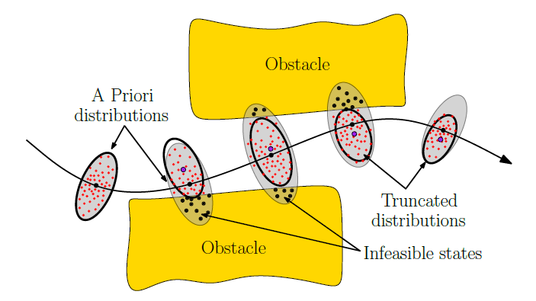
Problems
Real world uncertainty in
Robot motion
Sensor information
Naïve Monte-Carlo simulation is a no-go
Requires many simulations of many particles
No guarantee of conservative estimate
Notes:
Monte carlo simulation: millions is too high
Execute a controller that simulates individual particles. Too expensive. One simulation = generate a million particles, then you have to simulate the million particles with noise. See what proportion of particles had a collision = p of collision for that simulation. Then, average all of the p’s of collision
Conservative: Underestimate of the probability
Can’t tree collision probabilities as independent events, otherwise you’ll highly overestimate the probability of collision with general analytical approaches that try to multiply proportions of particles colliding in individual particle distributions. Monte-Carlo would be more accurate in this case

Slide 5
Questions so far?

Slide 6
Formulation
Based on Estimating Probability of Collision for Safe Planning under Gaussian Motion and Sensing Uncertainty (Patil, van den Berg, Alterovitz 2012)

Slide 7


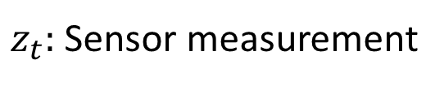
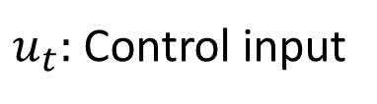
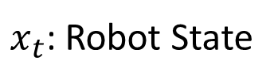
Formulation: Gaussian Uncertainty
Robot operating in uncertain environment with obstacles
Motion Model
Sensor Model
$x_{t}$: Robot State
$m_{t}:$ Gaussian random noise variable with variance $M_{t}$
$u_{t}:$ Control input
$n_{t}:$ Gaussian random noise variable with variance $N_{t}$
$z_{t}:$ Sensor measurement

Slide 8
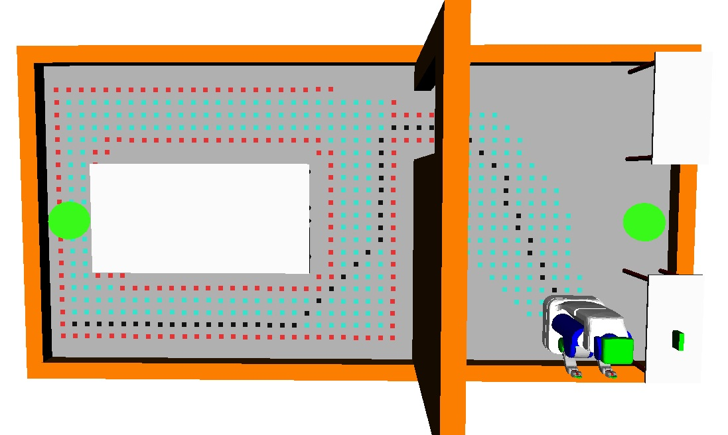
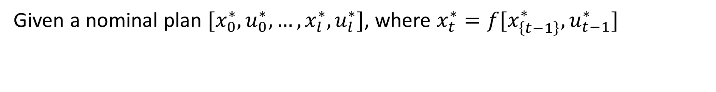
Formulation: Nominal Motion Plan
Green dots:
Beacons for localization
Given a nominal plan $[x_{0}^{∗}, u_{0}^{∗},…,x_{l}^{∗}, u_{l}^{∗}]$, where $x_{t}^{∗}=f[x_{\left\{t−1\right\}}^{∗}, u_{t−1}^{∗}]$

Slide 9
Formulation: Accepted Assumptions
Kalman Filter State Estimator
Linearization of Models about Nominal Motion Plan
Linear Feedback Controller to follow Nominal Motion Plan

Slide 10
Overview of Approach
Cycle of propagation and truncation
Propagation of estimated robot state distribution (Gaussian)
Truncation of estimated robot state distribution based on obstacles
Notes:
Grey ellipses yield an appropriate estimate. See Fig 1 in paper

Slide 11



Approach: Gaussian Propagation
$$x_{t}$$
$$\hat{x_{t}}$$
$$x_{t}^{∗}$$
Grey Ellipses: Unconditional a priori $x_{t}$distributions
Notes:
We can define x_t distribution at any point on the plan by propogating R_t and yhat_t

Slide 12
Approach: Gaussian Propagation (Cont.)
$$x_{t}$$
$$\hat{x_{t}}$$
$$x_{t}^{∗}$$
Grey Ellipses: Unconditional a priori $x_{t}$distributions

Slide 13
Approach: Gaussian Truncation
1
2
Black Ellipses: Obstacle Truncated Gaussian Distributions

Slide 14
Questions so far?

Slide 15
Formulation: Questionable Assumptions
Convex Feasible Region containing Robot State
Bounded by linear constraints
Point Robot?

Slide 16
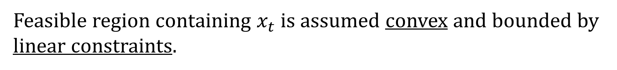

Assumption 1: Convex Feasible Region
$$x_{t}$$
Feasible region containing $x_{t}$ is assumed convex and bounded by linear constraints.

Slide 17
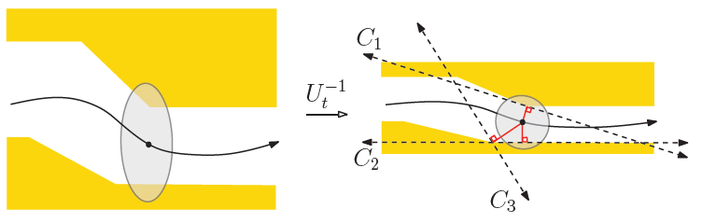
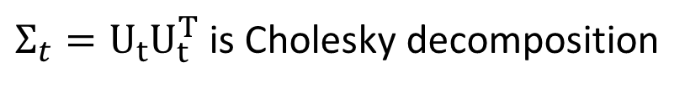
Proposed Local Convexification Attempt
$Σ_{t}=U_{t}U_{t}^{T}$ is Cholesky decomposition
Notes:
Convert distribution of robot position to a unit sphere via Cholesky Decomposition. Sphere simplifies task of finding a conservative convex region of free space around robot. Assumes only robot position relevant for collision detection.
Greedy algorithm. Part of distribution beyond the convex region is minimal

Slide 18
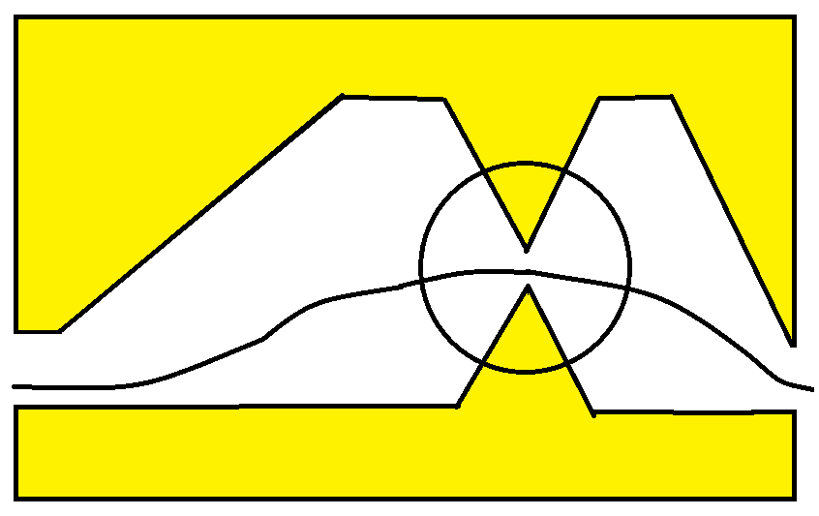

Question 1: Convexification
Problem!
$$x_{t}$$
Can we convexify the region more conservatively?
Notes:
Heuristics to decide best way to convexify space?

Slide 19
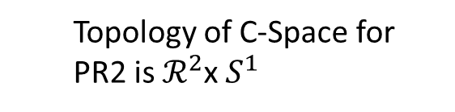
Question 2: Non-Point Robot?
Assume Gaussians truncated with respect to obstacle constraints formulated in the work space. Good for point robots
What about truncation in the C-Space?
Convert linear obstacle constraints in workspace as a C-Space constraint?
Computation of C-Space is a bad idea
Topology of C-Space for PR2 is $ℛ^{2}$x $S^{1}$

Slide 20
End

Slide 21
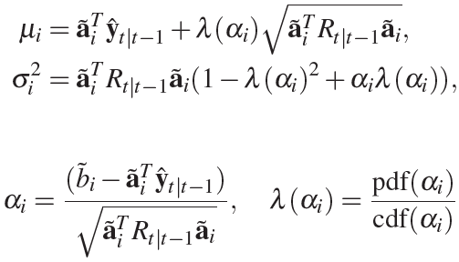
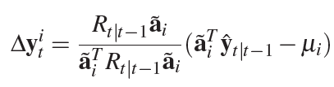

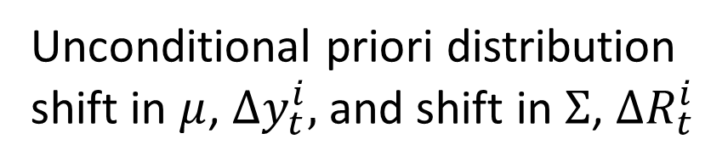
Approach: Gaussian Truncation (Cont.)
Unconditional priori distribution shift in $μ$, $Δy_{t}^{i},$ and shift in $Σ$, $ΔR_{t}^{i}$

Slide 22
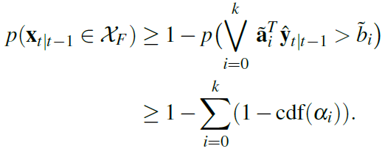
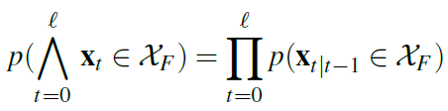
Final Probability of No Collisions
Claim: Boole’s Inequality conservatively estimates collision-free probability
Final Expression

Slide 23
Appendix: Formulation Elements
Gaussian Motion and Sensor Uncertainty
Linearization about Nominal Motion Plan
Kalman Filter State Estimator
Linear Feedback Controller to follow Nominal Motion Plan
Convex Feasible Region containing Robot State

Slide 24
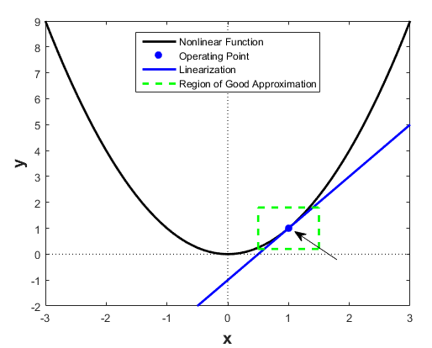

Appendix: Model Linearization
Linearize motion and sensor models about nominal plan
Express models in terms of deviations from
Nominal state $x_{t}^{∗}$
Nominal control input $u_{t}^{∗}$
Actual sensor measurement, $z_{t}^{∗}$
Notes:
https://www.mathworks.com/help/slcontrol/ug/linearizing-nonlinear-models.html

Slide 25
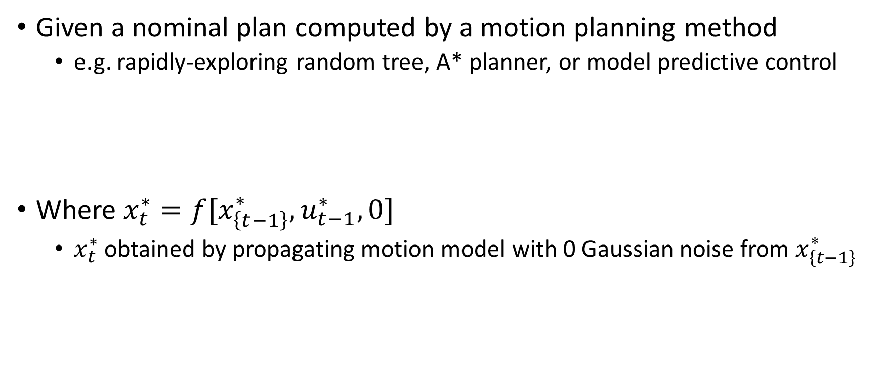

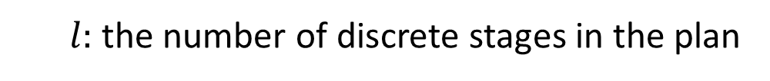

Appendix: Nominal Motion Plan
Given a nominal plan computed by a motion planning method
e.g. rapidly-exploring random tree, A* planner, or model predictive control
Where $x_{t}^{∗}=f[x_{\left\{t−1\right\}}^{∗}, u_{t−1}^{∗},0]$
$x_{t}^{∗}$ obtained by propagating motion model with 0 Gaussian noise from $x_{\left\{t−1\right\}}^{∗}$
$$[x_{0}^{∗}, u_{0}^{∗},…,x_{l}^{∗}, u_{l}^{∗}]$$
$l:$ the number of discrete stages in the plan
$$0≤t≤l$$
Notes:
Opporunity for an image. Draw out a sequence of states. Don’t bore people with too much text.
Clarify the 0 for Gaussian noise.
Skeptical, arbitrary robots. F function could be messy. Expect a question. Look into paper

Slide 26
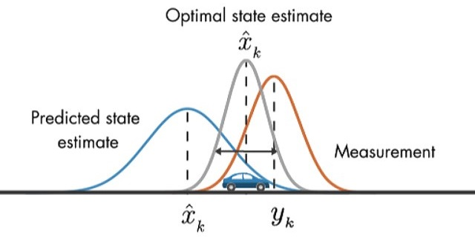

Appendix: Kalman Filter State Estimation
Use Kalman Filter to estimate $\hat{x_{t}}=E[\overline{x_{t}}]$
State Deviation Evolution
Where, $K_{t}$ is the Kalman Gain matrix
${\overline{x}}_{t}:$ true deviation from the true state $x_{t}$, assuming linearized motion model
${\hat{x}}_{t}$: the Kalman Filter estimator of $\overline{x_{t}}$, using sensor and motion models

Slide 27

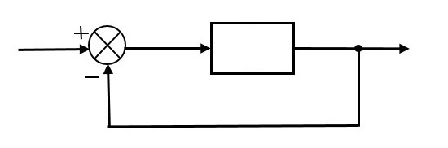
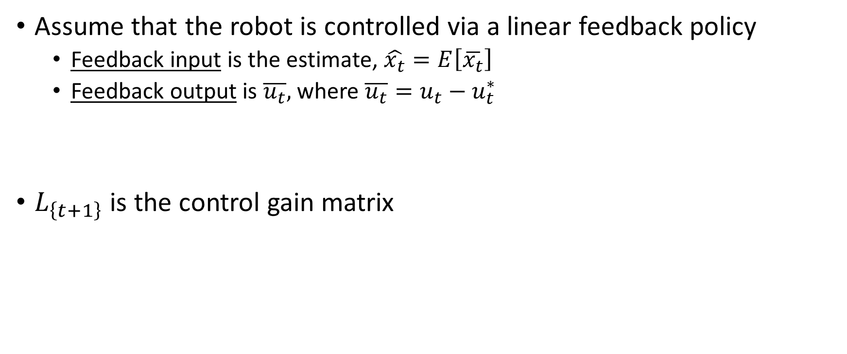
Appendix: Linear Feedback Control
Assume that the robot is controlled via a linear feedback policy
Feedback input is the estimate, $\hat{x_{t}}=E\left[\overline{x_{t}}\right]$
Feedback output is $\overline{u_{t}},$ where $\overline{u_{t}}=u_{t}−u_{t}^{∗}$
$L_{\left\{t+1\right\}}$ is the control gain matrix
Notes:
Put in the picture from the first page and keep referring back to it
Assumption: Linear feedback controller. Possible question.
Fails with nonlinear control laws. Optimization-based control, nonlinear functions. Fails in that case. Avoid huge claims. See arbitrary robot claim.
Feedback input is the estimate, $\hat{x_{t}}=E\left[\overline{x_{t}}\right]$
Feedback output is $\overline{u_{t}},$ the expected deviation of true control input from the nominal control input ($\overline{u_{t}}=u_{t}−u_{t}^{∗})$

Slide 28
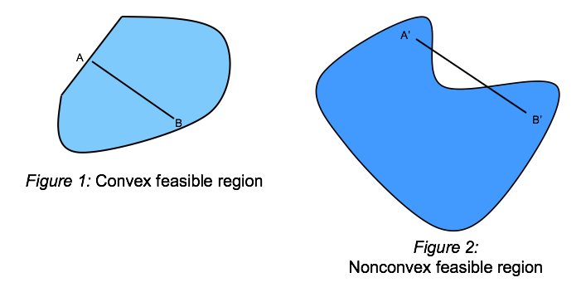

Appendix: Obstacle Constraints
$∀t∈[0,l]$ the feasible region containing $x_{t}$ is assumed convex
$$X_{\left\{F,t\right\}}=\left\{x∈Χ | \bigcap_{i=0}^{k}{a_{i}x≤b_{i}}\right\}$$
Notes:
https://ibmdecisionoptimization.github.io/tutorials/html/Beyond_Linear_Programming.html

Slide 29


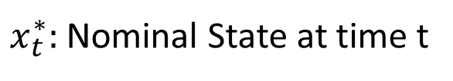
Appendix: Gaussian Propagation
Given ${\hat{y}}_{t}=E[{ y}_{t} ]$, and variance $R_{t}=Var\left[ y_{t} \right]$, we can specify the unconditional a priori state distribution of $x_{t}$ following the propagation of ${\hat{y}}_{t}$:
$$x_{t }\sim N[x_{t}^{∗}+Λ \hat{y_{t}}, ΛR_{t}Λ^{T}]$$
Where $Λ=[I 0]$
$x_{t}^{∗}:$ Nominal State at time t
$$y_{t}=\left[ \begin{matrix}{\overline{x}}_{t} \\ {\hat{x}}_{t}\end{matrix} \right]$$
${\overline{x}}_{t}:$ true deviation from the true state $x_{t}$, assuming linearized motion model
${\hat{x}}_{t}$: the Kalman Filter estimator of $\overline{x_{t}}$, using sensor and motion models

Slide 30
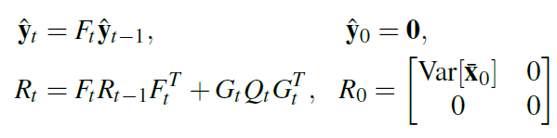
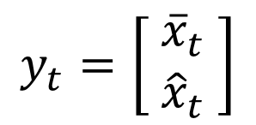
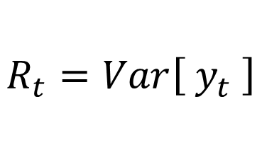

Appendix: Gaussian Propagation
$${\hat{y}}_{t}=E\left[{ y}_{t} \right]$$
$$y_{t}=\left[ \begin{matrix}{\overline{x}}_{t} \\ {\hat{x}}_{t}\end{matrix} \right]$$
$$R_{t}=Var\left[ y_{t} \right]$$

Slide 31
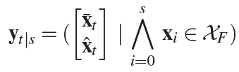
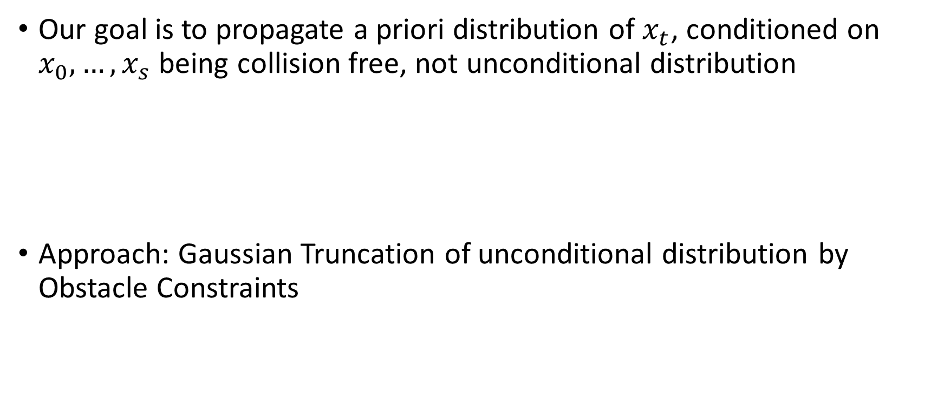
Appendix: Gaussian Truncation
Our goal is to propagate a priori distribution of $x_{t}$, conditioned on $x_{0},…, x_{s}$ being collision free, not unconditional distribution
Approach: Gaussian Truncation of unconditional distribution by Obstacle Constraints

Slide 32
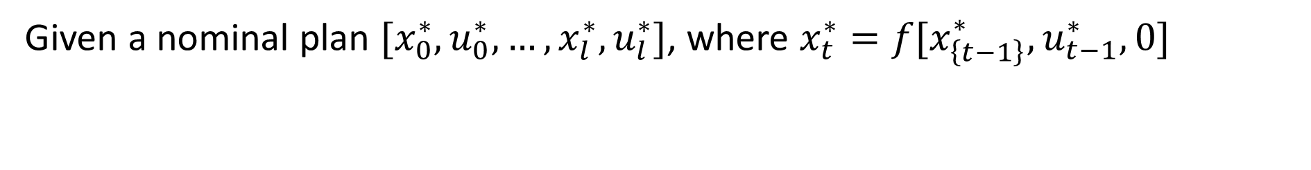
Formulation: Nominal Motion Plan
Given a nominal plan $[x_{0}^{∗}, u_{0}^{∗},…,x_{l}^{∗}, u_{l}^{∗}]$, where $x_{t}^{∗}=f[x_{\left\{t−1\right\}}^{∗}, u_{t−1}^{∗},0]$

Slide 33

Formulation: Kalman Filter State Estimation
$$\hat{x_{t}}=E[\overline{x_{t}}]$$
$$x_{t}$$
$$\hat{x_{t}}$$
$$x_{t}^{∗}$$
${\overline{x}}_{t}:$ true deviation from the true state $x_{t}$, assuming linearized motion model
${\hat{x}}_{t}$: the Kalman Filter estimate of $\overline{x_{t}}$, using linearized sensor and motion models

Slide 34
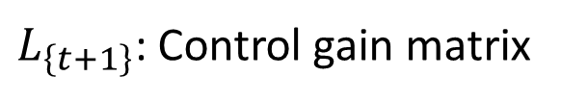
Formulation: Linear Feedback Control
$L_{\left\{t+1\right\}}$: Control gain matrix
$$x_{t}$$
$$\hat{x_{t}}$$
$$x_{t}^{∗}$$
Compute ${\overline{u}}_{t}$, deviation from nominal control $u_{t}^{∗}.$ $\overline{u_{t}}+u_{t}^{∗}$ is new control

Slide 35

Formulation: Obstacle Constraints
$$x_{t}$$
$∀t∈[0,l]$ the feasible region containing $x_{t}$ is assumed convex

Slide 36
Outline
Prior Work
Proposed Method
Formulation
Approach
Gaussian Propagation
Gaussian Truncation
Method Evaluation and Results
Car-like robot with second order dynamics
Nonholonomic bevel-tip flexible needle

Slide 37
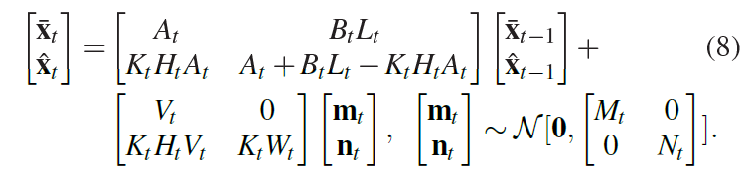


Approach: Gaussian Propagation
The true (linearized) state deviation ${\overline{x}}_{t}$, and its estimator ${\hat{x}}_{t}$ evolve as
This is pretty messy, here’s the shorthand:
Notes:
2nd element is KF and state uncertainty
Don’t use word true, assumes nonlinear. It’s actually the linear approximation of true state deviaton.
Appropriate definitions provided for $y_{t}, q_{t}, F_{t}, G_{t}, Q_{t}$

Slide 38


Approach: Gaussian Propagation (Cont.)
Define the mean ${\hat{y}}_{t}=E[{ y}_{t} ]$, and variance $R_{t}=Var\left[ y_{t} \right]$
Propagate $\hat{y_{t}}$ and $R_{t}$ as follows:
$$y_{t}=\left[ \begin{matrix}{\overline{x}}_{t} \\ {\hat{x}}_{t}\end{matrix} \right]$$
${\overline{x}}_{t}:$ true deviation from the true state $x_{t}$, assuming linearized motion model
${\hat{x}}_{t}$: the Kalman Filter estimator of $\overline{x_{t}}$, using sensor and motion models
Notes:
Note that x hat_t is a Kalman filter estimator that uses both the motion and sensor models

Slide 39
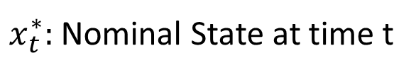





Approach: Gaussian Propagation (Cont.)
$$x_{t }\sim N[x_{t}^{∗}+Λ \hat{y_{t}}, ΛR_{t}Λ^{T}]$$
$x_{t}^{∗}:$ Nominal State at time t
$$x_{t}$$
$$\hat{x_{t}}$$
$$x_{t}^{∗}$$
$$y_{t}=\left[ \begin{matrix}{\overline{x}}_{t} \\ {\hat{x}}_{t}\end{matrix} \right]$$
$${\hat{y}}_{t}=E\left[{ y}_{t} \right]$$
$$R_{t}=Var\left[ y_{t} \right]$$
Grey Ellipses: Unconditional a priori $x_{t}$distributions
$$Λ=[I 0]$$
Notes:
We can define x_t distribution at any point on the plan by propogating R_t and yhat_t

Slide 40

Approach: Gaussian Propagation (Cont.)
$$x_{t}$$
$$\hat{x_{t}}$$
$$x_{t}^{∗}$$
$$y_{t}=\left[ \begin{matrix}{\overline{x}}_{t} \\ {\hat{x}}_{t}\end{matrix} \right]$$
$${\hat{y}}_{t}=E\left[{ y}_{t} \right]$$
$$R_{t}=Var\left[ y_{t} \right]$$
Grey Ellipses: Unconditional a priori $x_{t}$distributions
$$Λ=[I 0]$$

Slide 41
Outline
Prior Work
Proposed Method
Formulation
Approach
Gaussian Propagation
Gaussian Truncation
Method Evaluation and Results
Car-like robot with second order dynamics
Nonholonomic bevel-tip flexible needle

Slide 42
Approach: Gaussian Truncation (Cont.)
Black Ellipses: Obstacle Truncated Gaussian Distributions

Slide 43


Approach: Gaussian Truncation (Cont.)
Compute shift in mean and variance for each constraint

Slide 44


Approach: Gaussian Truncation (Cont.)
Step 1: For each constraint, affine transform to 1D Gaussian
Current Constraint
Notes:
Affine transformation to 1D Gaussian along axis normal to the constraint

Slide 45
Approach: Gaussian Truncation (Cont.)
Step 2: Truncate 1D Gaussian by constraint (well-known problem)
Current Constraint
2
1
Notes:
Truncate 1D Gaussian at specified ub given by constraint

Slide 46

Approach: Gaussian Truncation (Cont.)
Step 3: Get shifts in $μ$ and $Σ$ of original Gaussian, $∆y_{t}^{i}$ and $ΔR_{t}^{i}$
Current Constraint
Notes:
Truncate 1D Gaussian at specified ub given by constraint

Slide 47

Approach: Gaussian Truncation (Cont.)
Truncated 1D-Gaussian
1 – cdf($α_{i}$):
Area under 1D Gaussian violating constraint

Slide 48
Local Convexification Attempt
$Σ_{t}=U_{t}U_{t}^{T}$ is Cholesky decomposition
Notes:
Convert distribution of robot position to a unit sphere via Cholesky Decomposition. Sphere simplifies task of finding a conservative convex region of free space around robot. Assumes only robot position relevant for collision detection.
Greedy algorithm. Part of distribution beyond the convex region is minimal

