Slide 1
Business analysis in maryland for Emporium
BY ANGELO JACKSON
Capstone 1 · Data Analytics Project
SQL analysis of Maryland online and in-store sales, 12/31/2021 – 12/30/2025

Slide 2
What is covered?
Total revenue for Maryland?
Overall Maryland sales for the full data period, 12/31/2021 – 12/30/2025.
Revenue by year?
Maryland revenue for 2022 – 2025 and how it changed year over year.
Comparison from Region and State?
Maryland's revenue against the Northeast region, and its share of it.
Transaction per month and average transaction amount by product?
Transaction counts across the six product categories.
Ranking of in-store sales
Average sale amount per Maryland store, lowest first.

Slide 3
Total Revenue
=68,004,827.05
SELECT SUM(SalesTotal) AS total_revenue, MIN(Date), MAX(Date)
FROM Management,Online_Sales
WHERE Region = 'Northeast'
AND State = 'Maryland'
Total_Revenue | MIN_DATE | MAX_DATE
68,004,827.05 | 12/31/2021 | 12/30/2025
What this shows
Adds up SalesTotal for Maryland (Northeast region) across the whole data period.
MIN and MAX of Date confirm the span: 12/31/2021 to 12/30/2025.
$68,004,827.05 is the baseline for the comparisons that follow.

Slide 4
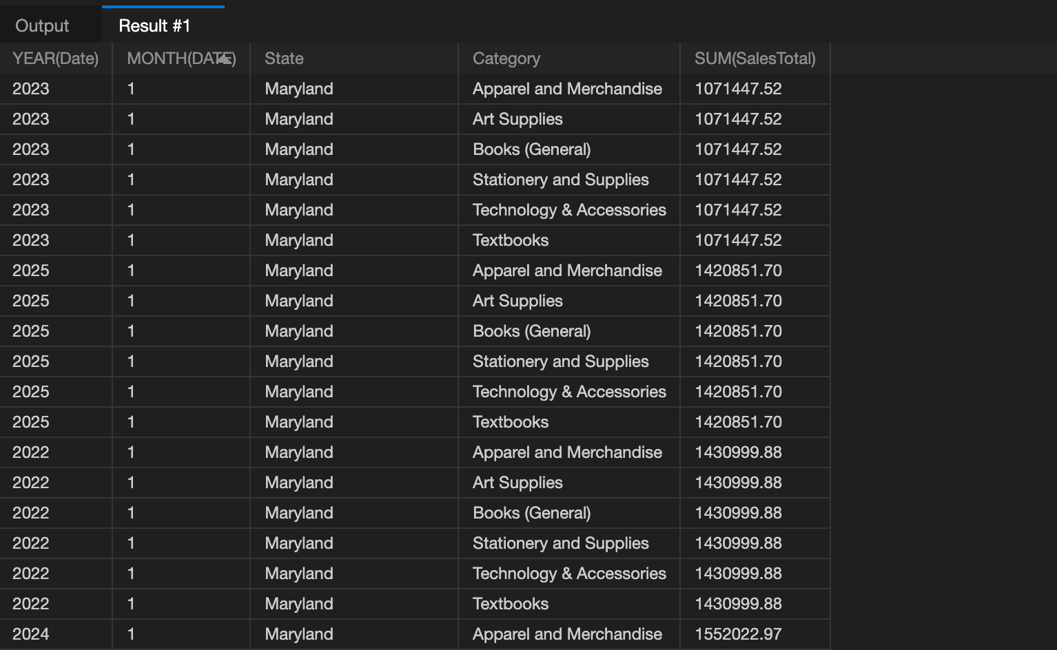
REVENUE BY YEAR
SELECT YEAR(Date), MONTH(DATE),State,Category, SUM(SalesTotal)
FROM Online_Sales,Management, Inventory_Categories
WHERE State = 'Maryland'
GROUP BY YEAR(Date), MONTH(DATE),State, Category
ORDER BY SUM(SalesTotal), YEAR(Date)
Revenue by year
2022: $1,238,988.38
2023: $1,298,037.18 (+4.8%)
2024: $1,552,022.97 (+19.6%)
2025: $1,660,093.78 (+7.0%)
Revenue rose every year, up 34.0% from 2022 to 2025. The biggest jump was 2023 to 2024.

Slide 5
Region VS. State
State Revenue
SELECT State, SUM(SalesTotal)
FROM Management, Online_Sales
WHERE State = 'Maryland'
State (Maryland): $68,004,827.05
Region (Northeast): $272,019,308.20
Rest of the Northeast: $204,014,481.15
Maryland counts for 25% (¼) of the region's sales, so one state brings in a quarter of the Northeast total.
Region Revenue
SELECT SUM(SalesTotal)
FROM Management, Online_Sales
WHERE Region = 'Northeast'

Slide 6
Transaction per month & average Transaction amount
1,000 transactions across 6 product categories, split almost evenly: 167 each for Stationery and Supplies, Apparel and Merchandise, Art Supplies and Books (General); 166 each for Textbooks and Technology & Accessories.
SELECT Category, Date , AVG(SalesTotal), COUNT(*)
FROM Inventory_Categories JOIN Management JOIN Online_Sales
WHERE State = 'Maryland'
GROUP BY Category, Date
ORDER BY AVG(SalesTotal), Category
Row Labels | Count of # Category
Stationery and Supplies' | 167
Apparel and Merchandise' | 167
Art Supplies' | 167
Books (General)' | 167
Textbooks' | 166
Technology & Accessories' | 166
Grand Total | 1000

Slide 7
IN-STORE SALES PERFORMANCE
SELECT DISTINCT Transaction_Date, Store_ID,StoreLocation,State, AVG(Sale_Amount)
FROM Store_Locations JOIN Store_Sales
WHERE State = 'Maryland'
GROUP BY Transaction_Date, Store_ID, StoreLocation
ORDER BY AVG(Sale_Amount) ASC
Row Labels | Count of Transactions
Ridgely' | 112
Annapolis' | 111
Parkville' | 111
North Harford' | 111
Baltimore' | 111
Back River' | 111
Queen Anne's County' | 111
Germantown' | 111
Howard' | 110
Grand Total | 1000
What this shows
1,000 transactions across 9 Maryland stores, 110 to 112 each (Ridgely highest at 112, Howard lowest at 110).
Sorted by average sale amount, lowest first, to find the weakest stores.

Slide 8
RECOMMENDATIONS
Recommendation: pilot sales training
1. Add sales training at store 903, which has the lowest average sales in Maryland.
2. Include stores 836, 850 and 816 to assess whether training increases sales for these stores as a controlled group.
3. If the pilot succeeds, implement developmental training at all stores.
Also consider the supply chain the location serves
“How often do we receive items to stock?”
“What are the most profitable products?”
“What are the least profitable products?”
“How can we raise sales for the least profitable products?”
These questions should be considered while assessing the shortage problem.

Slide 9
Thank you!
Key findings
$68,004,827.05 in Maryland revenue, 12/31/2021 – 12/30/2025
Yearly revenue grew from $1.24M in 2022 to $1.66M in 2025
Maryland is 25% of the Northeast region's sales
Six categories and nine stores have near-equal transaction counts; store 903 has the lowest average sale

