Slide 1







Codify Catalyst

Slide 2

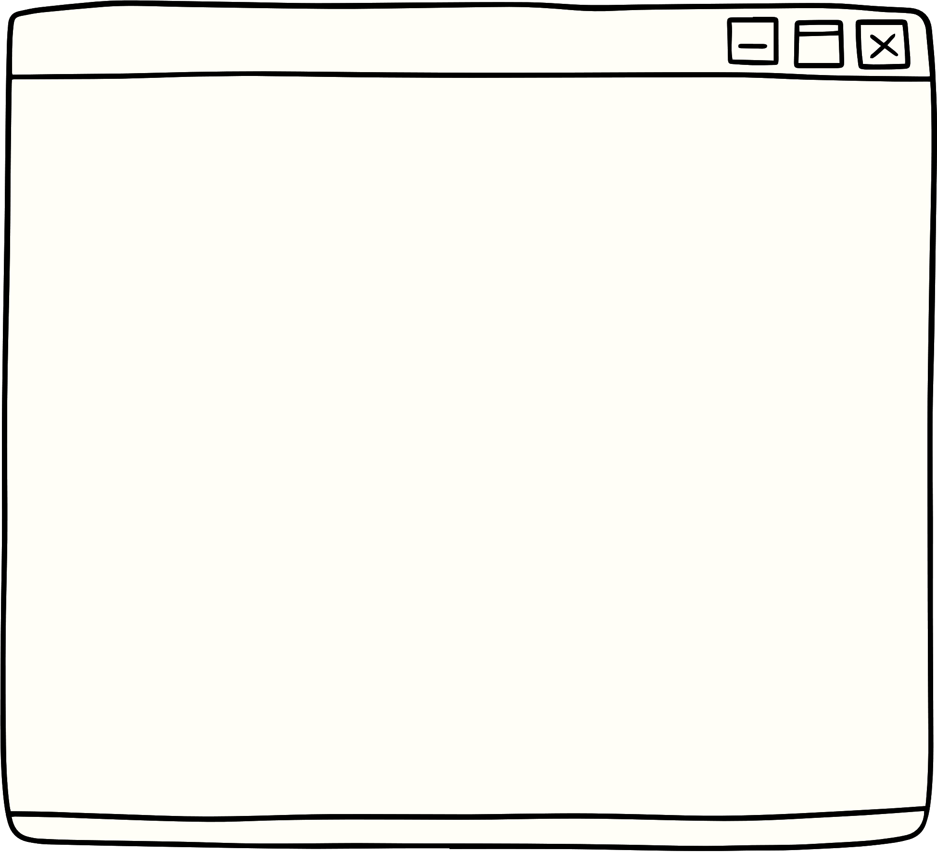



Problem
•Millions of students worldwide struggle to find high-quality, accessible educational resources.
•Scattered across the internet, these resources are often difficult to locate, requiring time-consuming searches and potentially leading to unreliable or irrelevant materials.
•This lack of a centralized platform for free educational resources creates a significant barrier to learning, especially for students facing financial constraints.

Slide 3




Solutions
Aggregating educational resources from various trusted sources like YouTube channels, educational institutions, and open-source repositories.
Providing a user-friendly search and discovery system that allows students to find relevant materials based on their specific needs, learning styles, and subjects.
Eliminating the distraction of scattered information that fosters a focused and personalized learning environment.

Slide 4
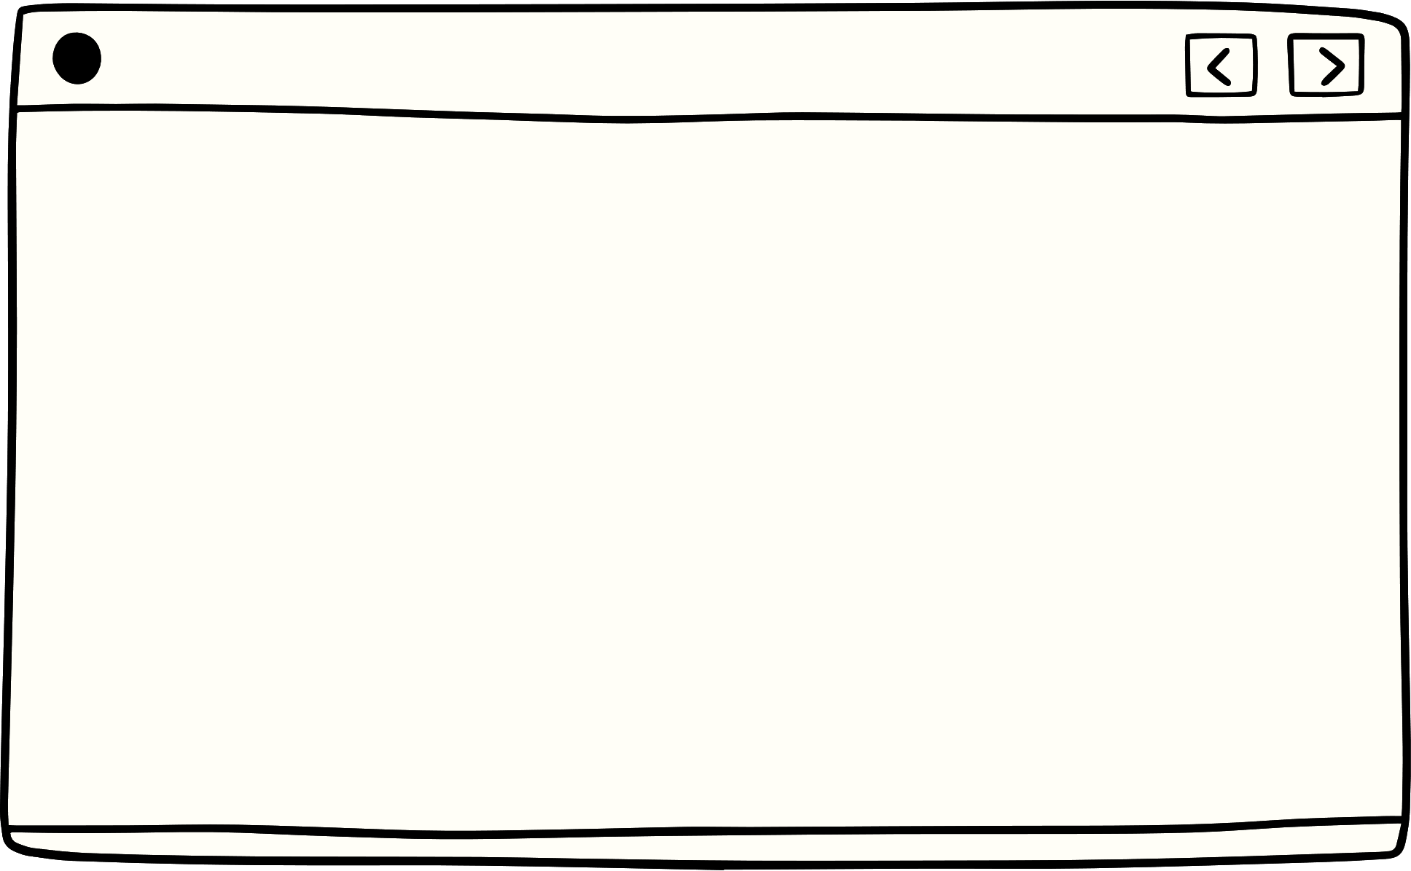
Our mission is to empower students by providing them with high-quality educational resources.
We go beyond static content by offering interactive tools that encourage active participation.
Aim
By being first to market, we can establish ourselves as the go-to destination for student learning.
We incentivize content creators to develop high-quality educational materials.
Olivia Wilson
Many existing educational technology platforms are struggling financially. Our platform can help by making their resources more discoverable and useful to students.

Slide 5




The market for educational resources is growing at a compound annual growth rate (CAGR) of 12.72%.
There is a gap in the market for a centralized platform that organizes educational resources.
The unorganized educational resource market is estimated to be worth 40 billion USD, presenting a significant opportunity.
Our platform will be monetized through advertising and promotional partnerships.
The platform is not focused on just India, the people from all over the world can benefit from it.
Market Scope

Slide 6



Front-End Technology
•User Interface (UI) Framework: React is a great choices.
•Responsive Design: Ensure the platform looks good and works on all devices.
•JavaScript Libraries: Utilize libraries like jQuery or Bootstrap for common functionalities and user experience.
Website & YouTube API Integration
Technical
Requirements
•Website API: Integrate with the website's API to allow features like user login/registration, accessing saved resources, and potentially interacting with the forum.
•YouTube Data API: Utilize the YouTube Data API v3 to search for educational content based on keywords, categories, or channels.
Back-End Technology
•Programming Language: Python, Javascript are all well-suited.
•Web Framework: Node.js can streamline development.
•Database: Choose a scalable database like MySQL, PostgreSQL, or MongoDB to store user data and information about the retrieved content.

Slide 7
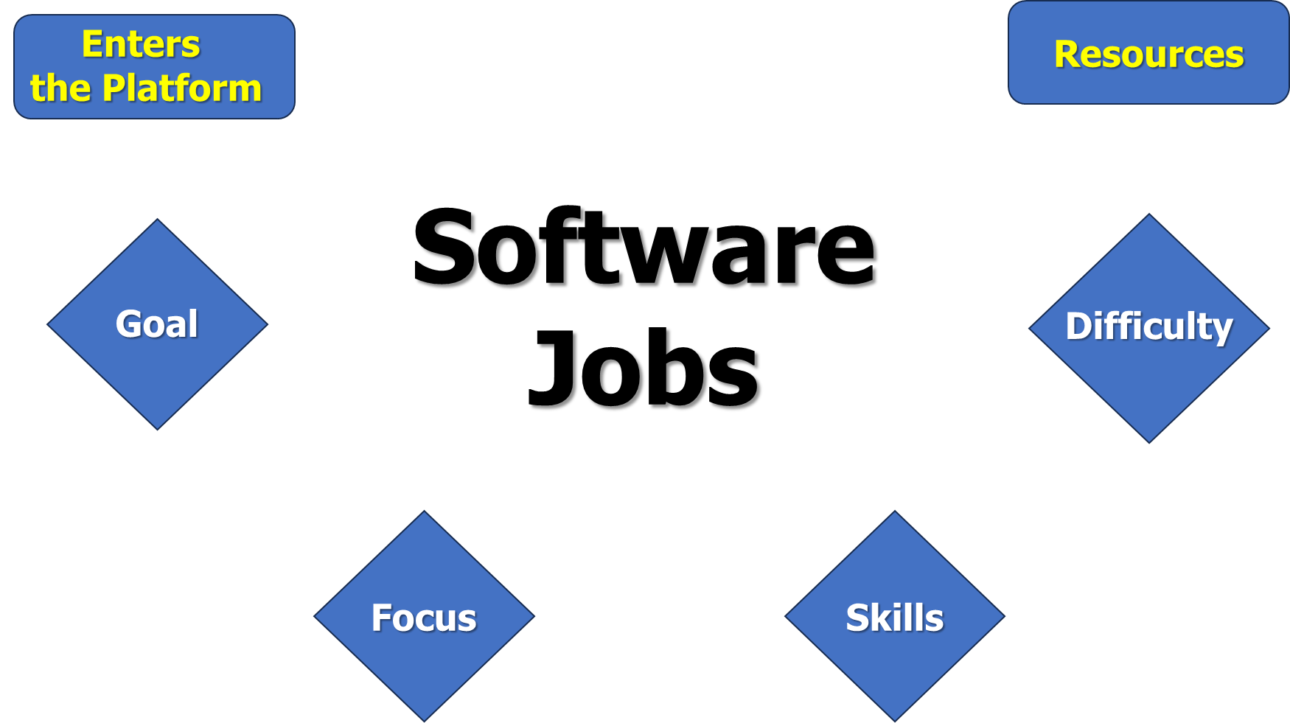

Slide 8
Rating System
Open Forum
Let users curate the content they see by implementing a rating system to influence rankings and suggestions.
Foster a collaborative learning environment by creating an open forum where users can interact, ask questions, and connect with like-minded people.
Partnerships with NGOs
Collaboration
Future Scope
Explore cutting-edge education tools and connect with exciting job opportunities from leading EdTech startups - all on our platform.
Collaborate with NGOs and educational institutions to provide students in developing countries with access to your platform and its learning resources.
Reward System
Language Accessibility
Motivate users to complete courses by offering a reward system with coupons or discounts
We plan to make our content available in multiple languages. To achieve this, we will create servers that cater to specific languages.

Slide 9


Thank you

