Slide 1

SKILL BASED EVALUATION REVIEW
Code-Mixed (Tanglish/Hinglish) Text: Language Identification, Normalization and N-gram/LSTM Language Modelling
25AI2008 Multilingual AI
Team Members
Division of Artificial Intelligence and Machine Learning
School of Computer Science and Technology
October 2026
Angel Sweety P (5051) | Shally S (5078)
K Kokila Dharshini (5037) | Selvarani S (5088)
Course Faculty
<<Faculty Name, Designation>>

Slide 2

Problem Statement & Objectives
Problem Statement
Objectives
What: Tanglish (Tamil-English) and Hinglish (Hindi-English) are typed in Roman letters with English words mixed in. NLP tools built for one language and one script fail on this text.
Why it is hard: no standard spelling (iruku / irukku, hai / haiii), ambiguous words and language boundaries, names and acronyms, very few gold-annotated corpora and many unseen word combinations.
Who benefits: search, moderation, keyboard / chat prediction and analytics for users of Romanized Indian languages.
1
Token-level language identification
Success: word accuracy and macro-F1 on held-out gold data; char n-gram + LogReg vs BiLSTM
2
Consistent code-mixed normalization
Success: WER vs three human references (Hinglish); spelling only, no translation
3
Statistical vs neural language modelling
Success: perplexity and top-1 / top-5 next-word accuracy, same corpus and test positions
25AI2008 | Multilingual AI | Skill Based Evaluation
2

Slide 3
Literature Survey
Ref | Authors & Year | Method / Model | Gap / Limitation
[1] | Sheth, Beniwal & Singh, 2025 Findings of EMNLP 2025 | COMI-LINGUA: expert-annotated Hindi-English code-mixed dataset (3 annotators per instance); 5 tasks incl. token-level LID and benchmarks with fine-tuned LLMs | Hindi-English only: no Tamil-English counterpart; no lightweight from-scratch baselines
[2] | Barman, Das, Wagner & Foster, 2014 CALCS workshop, pp. 13-23 | Word-level language identification on Bengali-English-Hindi Facebook comments; preliminary experiments | Work in progress; no Tamil; LID only (no normalization or language model)
[3] | Han & Baldwin, 2011 ACL 2011, pp. 368-378 | Lexical normalisation of ill-formed out-of-vocabulary words in Twitter / SMS text (dictionary lookup combined with other methods) | Targets English short text; not designed for Romanized Tamil / Hindi mixed with English
[4] | Pratapa et al., 2018 ACL 2018, pp. 1543-1553 | RNN language model for code-mixing trained with synthetic data from Equivalence Constraint Theory | Focus on synthetic-data curriculum for perplexity; no LID or normalization of noisy Romanized text
Research gap: The surveyed work handles one task or one language pair at a time. This project covers Tanglish and Hinglish in one pipeline (language ID, normalization, language models) and compares N-gram vs LSTM under one protocol, with explicit gold / silver label provenance.
25AI2008 | Multilingual AI | Skill Based Evaluation
3

Slide 4
Proposed Methodology
1
2
3
4
5
Data Collection
Preprocessing
Tokenization &
Embeddings
Model Training
Evaluation
COMI-LINGUA (Hinglish) and Tanglish-Corpus-185k, both CC-BY-4.0
NFKC clean-up, typed tokenizer, de-duplication, split by source
Char n-grams + TF-IDF; word and char-CNN embeddings; LM vocabulary
LogReg and BiLSTM taggers; KN trigram; LSTM LM, all from scratch
Accuracy / macro-F1, WER, perplexity, top-1 / top-5 on held-out data
Workflow Summary
Romanized Tanglish / Hinglish sentence → typed tokenizer → token-level language ID (rules for numbers, punctuation, URLs, emoji + char n-gram LogReg or BiLSTM) → normalizer (rules + language-aware dictionaries) → LM tokens → trigram-KN and LSTM next-word suggestions and perplexity.
One pipeline class serves the Streamlit app, CLI and evaluation. Module owners: <<to be filled by the team>>
25AI2008 | Multilingual AI | Skill Based Evaluation
4

Slide 5
Dataset & Languages
2
213,892
76 / 14 / 10
Languages covered: Tanglish (Tamil-English) and Hinglish (Hindi-English)
Sentences in the LM corpora: 185,601 Tanglish + 28,291 Hinglish
Train / Val / Test (%), Tanglish LM corpus. Hinglish LM corpus: 74 / 8 / 17
Source & Preparation
Hinglish: COMI-LINGUA (LingoIITGN, CC-BY-4.0, huggingface.co/datasets/LingoIITGN/COMI-LINGUA); Roman-script sentences only; 3 annotators per sentence give token tags and normalized references. LID: 7,191 / 799 / 750 sentences.
Tanglish: Tanglish-Corpus-185k (vishnu-n, CC-BY-4.0): 185,973 sentences from YouTube, Reddit and DravidianCodeMix; 185,670 after de-duplication; split by source (video / subreddit).
Labels: Hinglish tokens are GOLD (3-annotator majority). Tanglish tokens are SILVER (lexicon rules, not human); evaluated on 120 hand-reviewed sentences, not independently validated.
Conventions: TA / HI, EN, OTHER (names, acronyms, handles, noise); NUM and PUNCT by rules; numbers → <num>; native-script sentences removed.
25AI2008 | Multilingual AI | Skill Based Evaluation
5

Slide 6
Model Architecture
1 LANGUAGE IDENTIFICATION (per word)
Key Components
Tokens
(rules label NUM, PUNCT, URL, emoji)
Char n-grams
+ TF-IDF
Logistic
Regression
TA / HI · EN · OTHER
(Model A or Model B)
LID: char n-gram TF-IDF + LogReg (context-free) vs word + char-CNN + BiLSTM (sentence context)
Normalization: rules + learned (Hinglish) / curated (Tanglish) dictionaries
LM: KN trigram (NumPy) vs embedding → LSTM → linear → tied softmax
No transformers, no pretrained weights
Word emb. +
char-CNN
BiLSTM
tagger
2 NORMALIZATION (rule- and dictionary-based)
Tagged
tokens
Unicode clean-up · punctuation runs · elongation
slang expansion · language-aware dictionaries
Normalized text
(not translation)
3 LANGUAGE MODELLING (same corpus, vocabulary, test positions)
Normalized
LM tokens +
shared
vocabulary
Trigram counts +
continuation counts
Interpolated
Kneser-Ney
Perplexity
top-1 / top-5
next word
Hyperparameters
N-gram (statistical)
BiLSTM tagger: word emb 64, char-CNN 32-d (k = 3, 5), 128 hidden x 2, dropout 0.3, Adam 2e-3, 10 epochs
LSTM LM: Tanglish 256 / 512, dropout 0.3, 10 epochs; Hinglish 200 / 400, dropout 0.4, early stop at epoch 25; Adam 2e-3, clip 1.0
KN trigram: discount D = 0.9 (tuned on validation)
Embedding
LSTM
Linear
Softmax
LSTM (neural, PyTorch)
The BiLSTM tagger (lane 1) and the LSTM language model (lane 3) are different models for different tasks. Everything is trained from scratch; no pretrained or transformer model is used.
25AI2008 | Multilingual AI | Skill Based Evaluation
6

Slide 7
Implementation
1
Language & Libraries
2
Models & Frameworks
Python 3.14.3 · PyTorch 2.14.0 · scikit-learn 1.9.1 · NumPy 2.4.0 · pandas 3.0.3 · wordfreq · joblib. KN trigram model, tokenizer and metrics written from scratch (no NLTK).
No pretrained models: all models trained from scratch. Char n-gram + LogReg, BiLSTM tagger, KN trigram, LSTM LM (tied softmax). Streamlit 1.62.0 dashboard (Analyze, Batch, Evaluation, About); pytest: 25 tests passed.
3
Environment & Hardware
4
Modules Developed
Local development on an Apple M4 laptop, 16 GB, macOS; PyTorch MPS (Apple GPU) backend. Data, models and results stored locally. LSTM training: 233 s (Hinglish), 1,206 s (Tanglish).
M1 language ID · M2 normalization · M3 trigram LM · M4 LSTM LM · pipeline.py + Streamlit app.py · evaluation.py
Owner per module: <<to be filled by the team>>
25AI2008 | Multilingual AI | Skill Based Evaluation
7

Slide 8
Results & Evaluation
Observations
LID: char n-gram ≈ BiLSTM (95.8 vs 96.3 Hinglish; 95.3 vs 95.1 Tanglish gold), so sentence context adds little.
LSTM top-5 is +2.1 / +2.2 pts (Hi / Ta); top-1 only +1.2 / +1.3.
Normalization WER 13.6% → 10.1%; the 3 annotators differ by 16.2%, so scoring is subjective.
Metrics: accuracy, macro-F1, WER, perplexity, top-1 / top-5.
Limits: Tanglish gold = 120 sentences, not independently validated; 99% silver score is inflated; names / acronyms recall about 46%; Tanglish normalization 97% uses 68 self-authored pairs.
Takeaway: the LSTM lowers perplexity most (Hinglish 193 → 142, Tanglish 416 → 259); the two language-ID models score about the same. Tanglish language ID uses the 120-sentence hand-reviewed gold set.
25AI2008 | Multilingual AI | Skill Based Evaluation
8

Slide 9
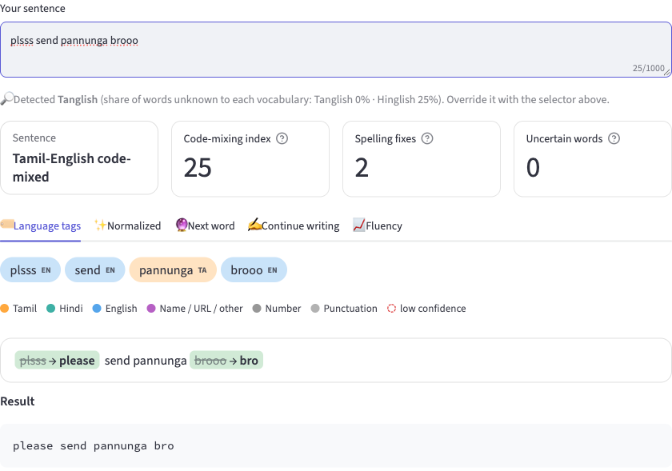
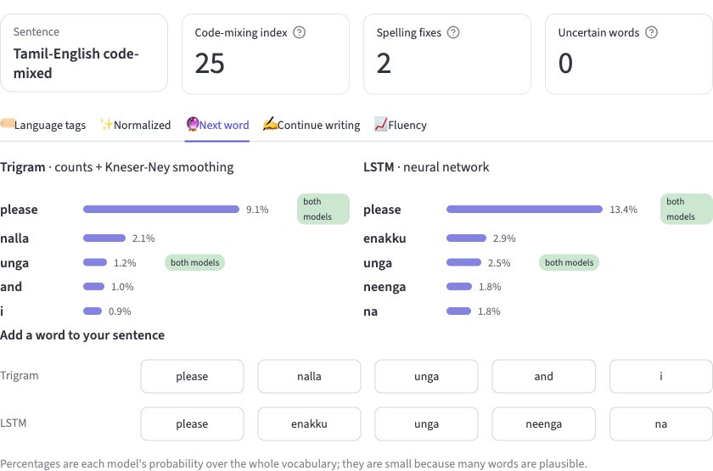
Demo & Output Screenshots
Input: “plsss send pannunga brooo” → token-level language ID (plsss[EN] send[EN] pannunga[TA] brooo[EN]) → normalized output “please send pannunga bro”
Next-word top-5, side by side: trigram (Kneser-Ney) vs LSTM; both models rank “please” first (9.1% vs 13.4%)
Genuine screenshots of the project's Streamlit dashboard (project results/ folder and captures from the running app); cropped to the relevant panels, not edited.
25AI2008 | Multilingual AI | Skill Based Evaluation
9

Slide 10
Conclusion & Future Work
1
Conclusion
2
Future Work
Built language ID, normalization and two language models (KN trigram, LSTM) from scratch in one tested pipeline and dashboard.
Key numbers: LID 95.8% / 96.3% (Hinglish), 95.3% / 95.1% (Tanglish gold); WER 13.6% → 10.1%; perplexity 193 → 142 and 416 → 259.
LSTM beats the trigram on every LM metric, mainly in perplexity.
Limitations: Tanglish labels are weak (silver); 120-sentence gold set not independently validated; vocabulary capped at 20k; no cross-variant transfer; one-command rebuild (run_all) not verified end to end.
Native-speaker validation and a larger Tanglish gold set
Independent Tanglish normalization benchmark
Better handling of names and acronyms
Larger vocabulary and more robust GPU training
Cross-language generalization; more Indic languages
Context-aware, language-aware normalization; verify the full rebuild
25AI2008 | Multilingual AI | Skill Based Evaluation
10

Slide 11
Thank You
Questions & Discussion
25AI2008 Multilingual AI | Division of Artificial Intelligence and Machine Learning

