Slide 1

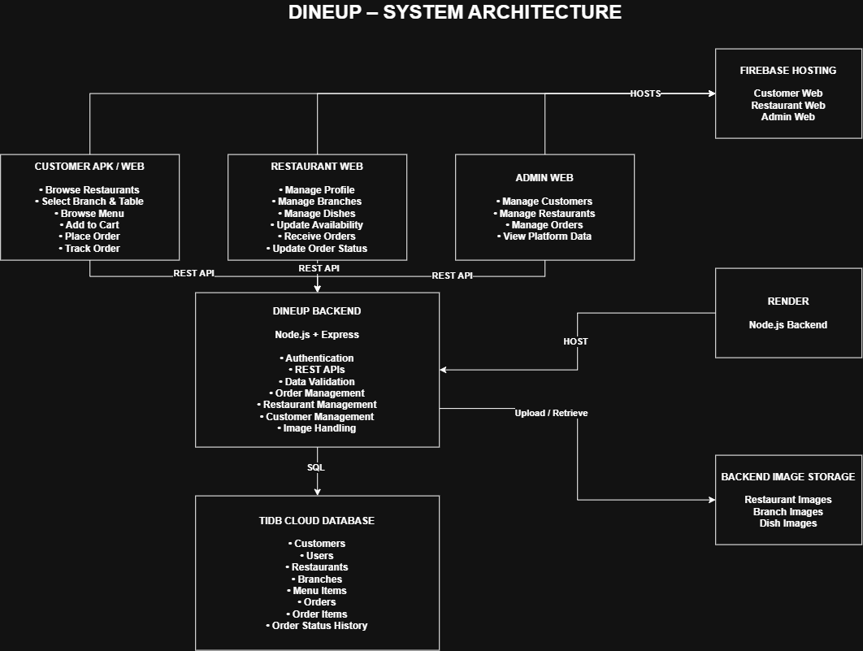
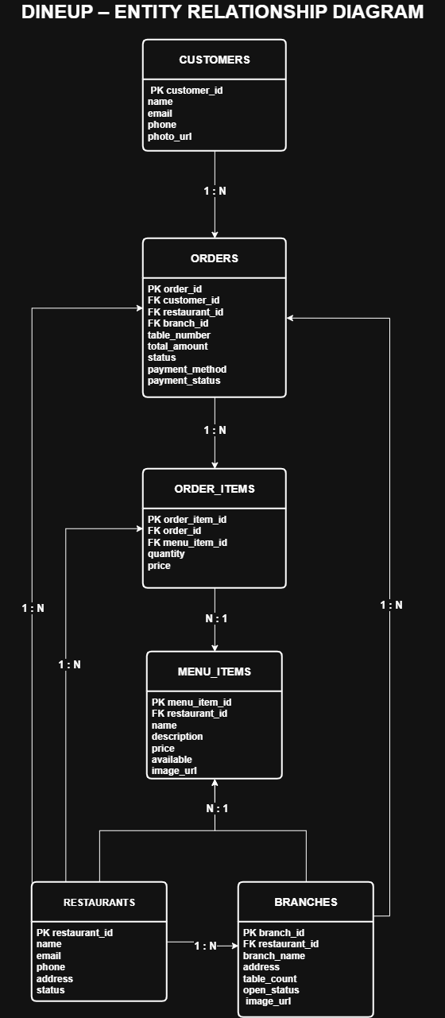
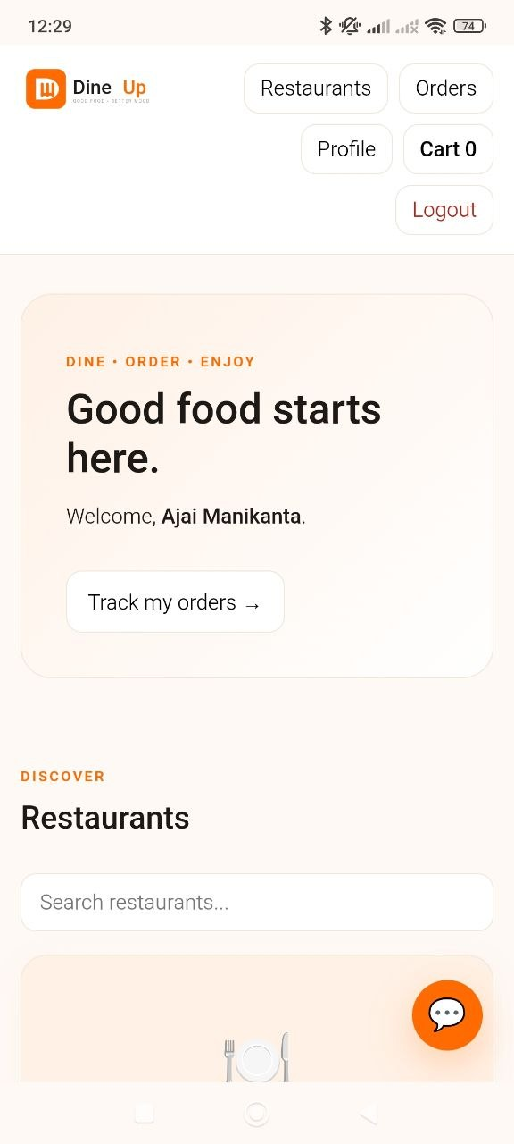
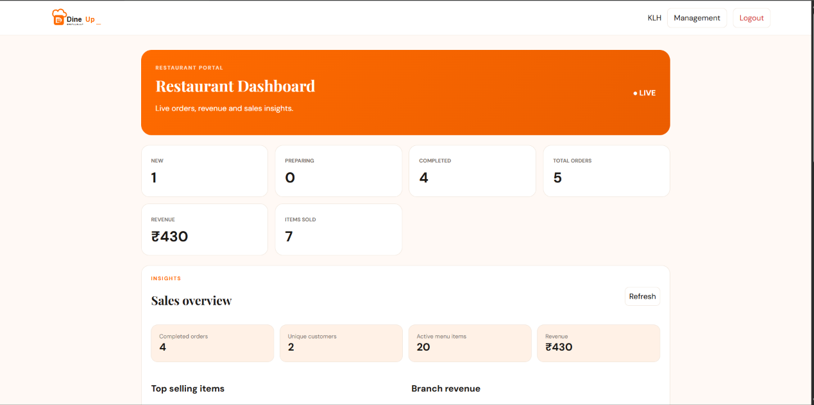
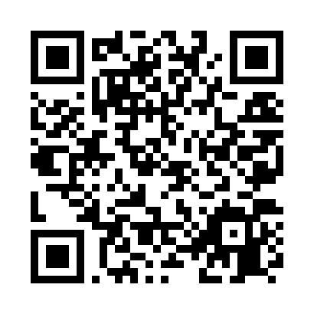
FOOD AND BEVERAGE MOBILE APP FOR DINER SELF-SERVICE
Team ID: 21 | Section: 7 | Members: Ajai Manikanta – 2520030320, Akshith – 2520030041, Teja – 2520030569 | Guide: Dr. Spandana
Database Systems Engineering and Distributed Backend Development (25CS1302E) | KLH Bachupally Campus, CSE | PBL 2026–27
Abstract
Tools & Technologies
DineUp is a self-service food and beverage platform connecting diners, restaurants and administrators through a web-based system, with a planned Customer Android APK. Diners can browse restaurants, branches and menus, select a table, place orders and track status. Restaurants manage branches, dishes, availability and incoming orders, while Admin manages platform data and accounts.
The system uses REST APIs, Node.js/Express and a MySQL-compatible cloud database for centralized order management.
Front-End: HTML5, CSS3, JavaScript; Customer Android APK planned
Back-End: Node.js + Express + REST APIs
Database: TiDB Cloud (MySQL-compatible)
Authentication: Google sign-in / JWT-based authentication
Hosting: Firebase Hosting + Render
Tools: Git & GitHub, VS Code, Android Studio, Postman
Development: CRUD, validation, image uploads and order-status workflow
Problem Statement & Objectives
System Architecture & ER Diagram
Problem: Traditional table ordering can involve waiting for staff, manual order entry and limited visibility of order status.
Objective 1: Provide fast self-service ordering from a customer's table.
Objective 2: Give restaurants centralized menu, branch and order management.
Objective 3: Synchronize customer, restaurant and order data through REST APIs.
Scope: Customer ordering, restaurant management, admin control, menu/branch management and order tracking.
Existing vs Proposed System
Implementation Screenshots
Feature | Existing System | Proposed System
Ordering | Waiter/manual ordering | Diner self-service
Menu | Physical/menu-dependent | Live digital menu
Order status | Limited visibility | Status tracking
Management | Manual/separate records | Centralized REST + DB
Key gap | Slow coordination | Connected workflow
Customer
Restaurant / Admin
Feasibility Study
Customer app
Restaurants
Select branch + table
Browse dishes & cart
Place order
Track status
Restaurant / Admin
Manage branches
Add & edit dishes
Set availability
Receive orders
Update order status
Technical: HTML/CSS/JavaScript, Node.js/Express, REST APIs, MySQL-compatible cloud database, Firebase Hosting and Render.
Economic: Open-source software and student-friendly/free-tier cloud services reduce development cost.
Operational: Simple customer flow and dedicated restaurant/admin interfaces support easy adoption and maintenance.
Schedule: Modular development and testing fit the semester PBL timeline.
Results & Testing
Conclusion
Future Scope
REST APIs tested for authentication, restaurants, branches, menus and orders.
CRUD workflows implemented.
Server-side validation used for order/menu data.
Restaurant-uploaded images served through the backend.
Customer, Restaurant and Admin interfaces connect to the cloud backend.
DineUp demonstrates a connected diner self-service workflow from digital menu discovery to order placement and status tracking.
The centralized REST backend and cloud database connect Customer, Restaurant and Admin modules and improve order visibility.
Release Customer Android APK.
Add richer real-time notifications.
Expand analytics and reporting.
Scale backend/database for more restaurants.
Add production payment integration when required.
References: [1] Node.js & Express Documentation [2] Firebase Hosting Documentation [3] TiDB Cloud Documentation [4] GitHub – DineUp Backend

