Slide 1

HousePy Analysis of Houston’s Housing Market (2015-2019)
Group 5.
Iretemi Adelaja
Aline Jaimes
Sanjar Rasuly
Elizabeth Shaw
Date: September 11, 2019 Data Analytics Bootcamp, Rice University

Slide 2
Project Summary
Goal: Exploratory analysis of the Houston's hosing market from September 1, 2015-August 31 2019
Questions:
1. Which subdivisions are appreciating/depreciating and undergoing gentrification?
2. What areas are considered affordable for average income families?
3. Which market areas have properties with more/less days in the market? and what are the implications of it?
4. Does school district impact market price?
Data Source: Private database site of matrix.mls at Har.com. Contains record of every realtor-assisted transaction for single-family homes in Harris County.
Area of interest: Harris county, Cities: {Houston, Spring Valley, Hedwig Village, Hillshire Village, Bunker Hill Village, Piney Point Village, Hunter’s Creek Village, Bellaire, Southside Place, West University Place}

Slide 3
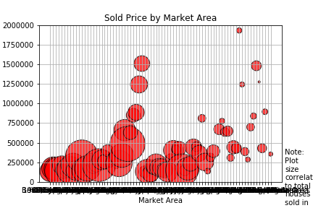
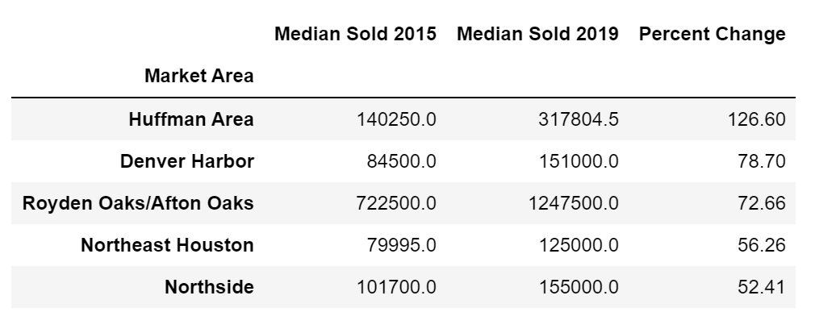
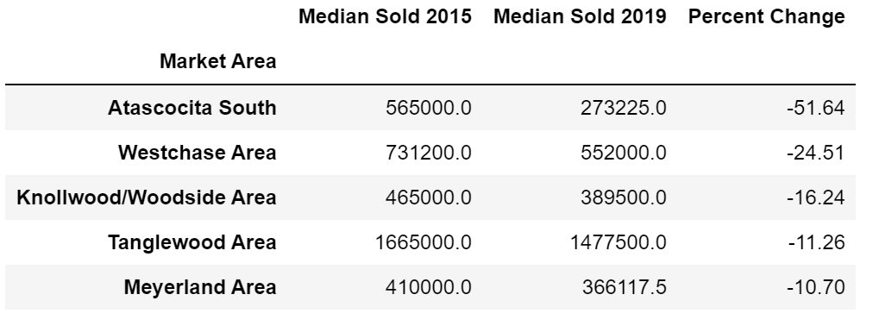
Data Analysis: 1 . Which market areas are appreciating/depreciating?

Slide 4
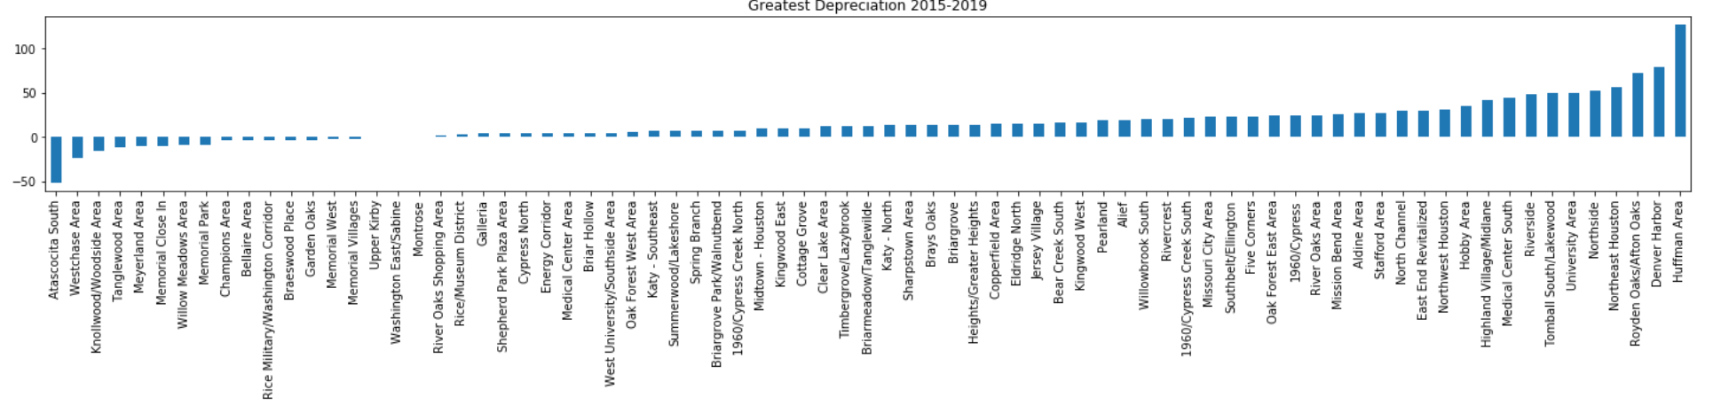
Data Analysis: Which market areas are appreciating/depreciating?
Above. The percent change in median home sold price from 2015 to 2019.

Slide 5
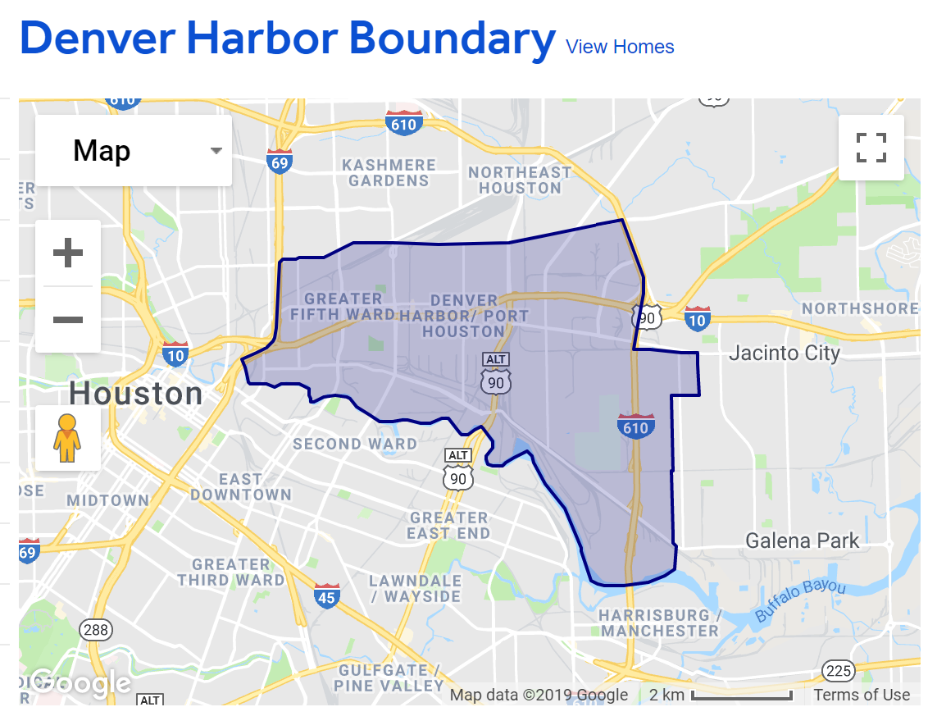
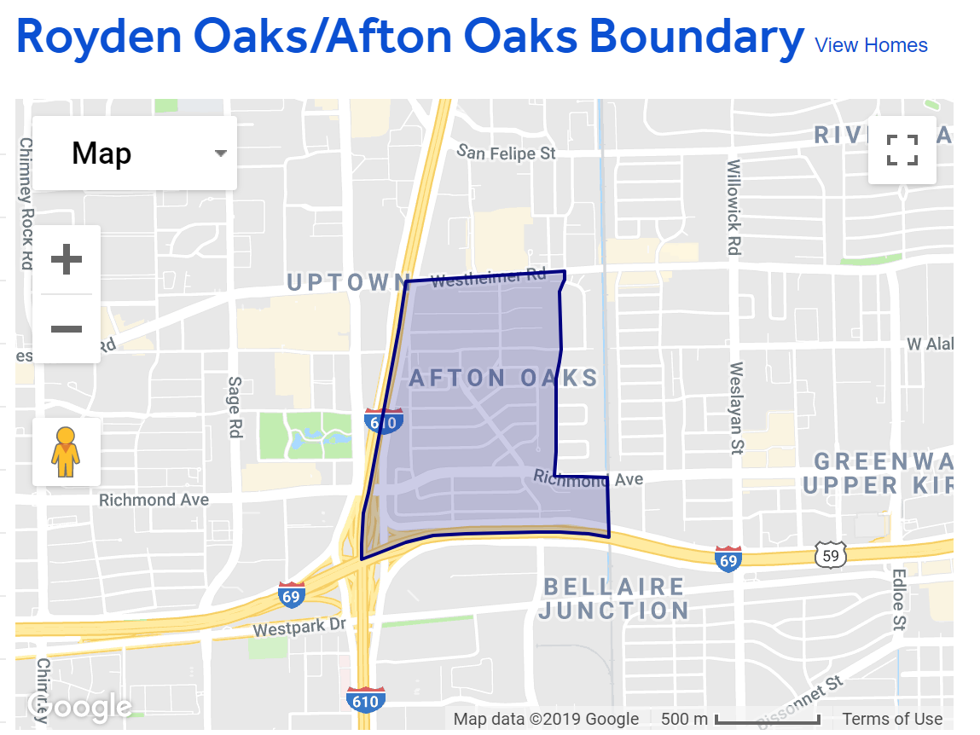
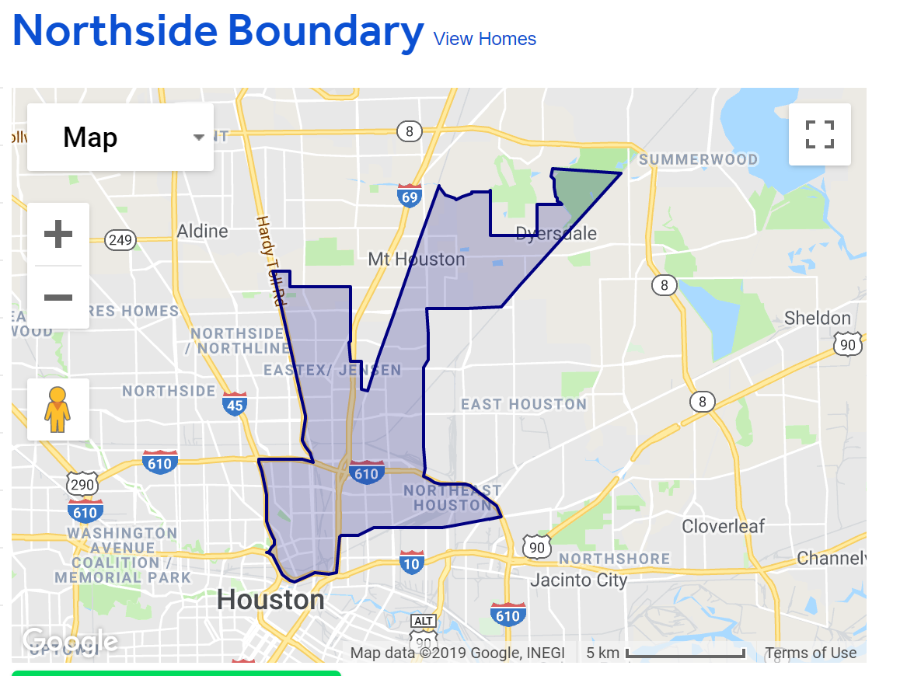
Data Analysis: Which market areas are gentrifying?
According to Zillow gentrifying is:
Homes are built over 50 years ago.
Bordered by two neighborhoods that are at least double median price.
Transportation access.
Not too many vacant lots.

Slide 6
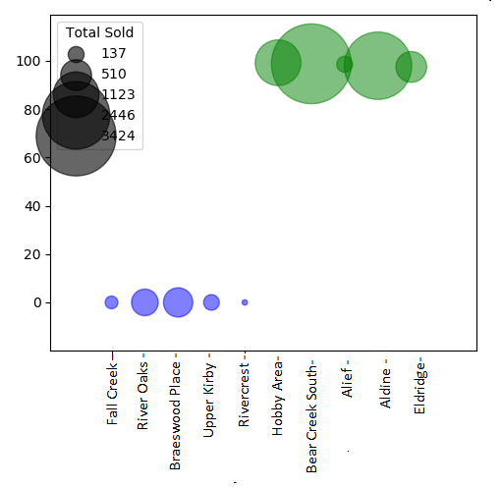
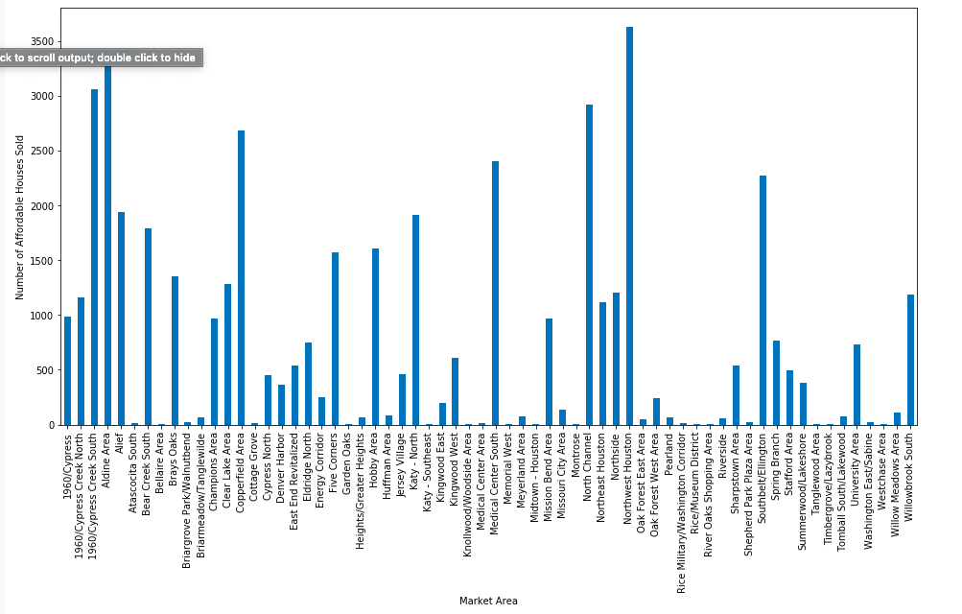
Data Analysis. What market areas are considered affordable?
Affordable Housing =median income x4.12 (Source: Zillow )
The Median income of Harris County is $57,791.00 (Source: According to census.gov)
Above. Top 5 areas with highest (green) and lowest (blue) percentage of affordability. Percentage of affordability calculated as number of sold homes with sold prices below the 4.12 *median income.

Slide 7
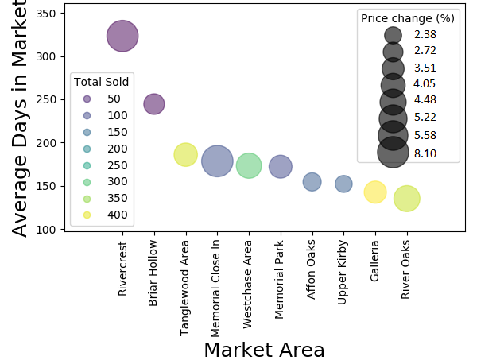
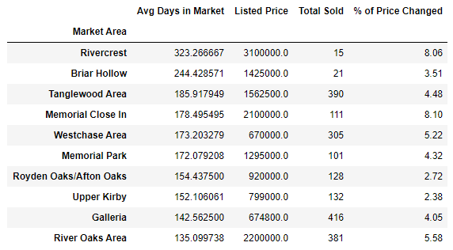
Data Analysis: Which market areas have properties with more/less days in the market?
Highlights
Market areas with properties that remain in the market longer, reduce the total number of homes sold.
The longer a property remains in the market, the largest percentage of price change from listed to sold.
Table. Summary of the top ten areas with lowest average number of days in the market.
Above. Top ten areas with highest average number of days in the market.

Slide 8
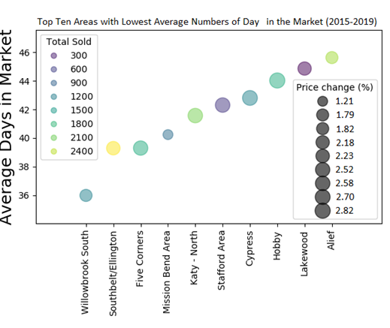
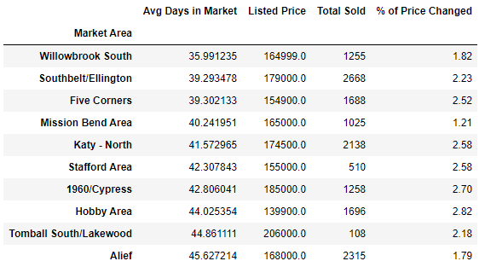
Data Analysis: Which market areas have properties with more/less days in the market?
Highlights
Market areas with properties that sell quickly significantly increase the total number of homes sold.
The percentage of price change does not change largely.
Table. Summary of the top ten areas with lowest average number of days in the market.
Above. Top ten areas with lowest average number of days in the market.

Slide 9
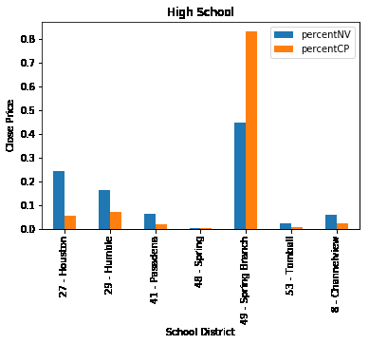
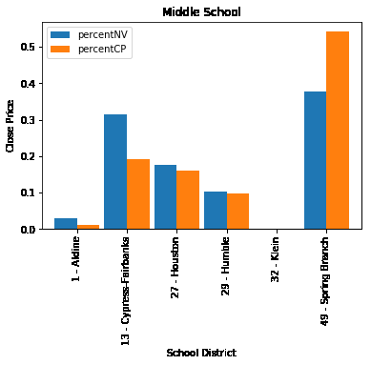
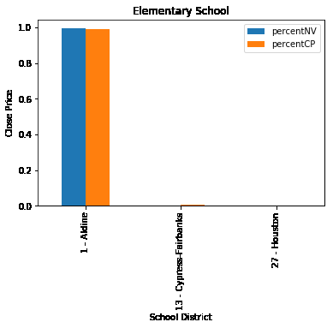
Data Analysis: 4. Does school district impact market price?
High School
Middle School
Elementary School
Above. Percent of homes sold in Harris County from 2015 to 2019. Based on percent of “Numerical Value” and percent of “Close Price”

Slide 10
Conclusions
Summary of Market Areas that are:
Fastest Sell, Less lost of value
Willow brook South
Ellington
Harrison Bend Area
Katy-North
Appreciating
Huffman Area
Denver Harbor
Royden Oaks/Afton Oaks
Affordable
Hobby Area
Bear Creek South
Alief
Aldine
Eldrige

Slide 11
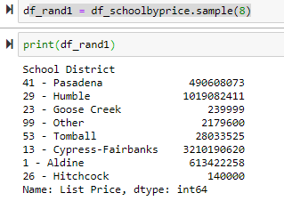
Data Cleanup & Exploration
Dropped columns and datatypes were changed from object to integer by removing punctuation characters.
New columns were created to calculate sales over time.
When applying functions it was determined about 25% of pre-defined Market Areas by HAR had less than 10 sales for the four year data period. These Market Areas were dropped from the data as outliers.
Subset data frame
Identify/Convert data types
Exploratory plots
group the data by “School District” to identify top performing school
Created three random sample from the school districts
#f_rand1 = df_schoolbyprice.sample
Using the merge method, combined “Top school” with “Housepy”
#df_Elementary_School_D_join = pd.merge(df_Elementary_rating, housepy_df,on="School Elementary")
Performed the analysis using matplotlib

