Slide 1
MODE GLOBAL · SUNTECK TMS
QA AI POC — Mode
Playwright Agentic Test Automation — Handover & Deliverables
Hybrid rule-based + LLM multi-agent pipeline · Claude-powered generation tiers · Self-healing validation · Cursor-governed guardrails
28
24
4
5
Scripts Delivered
Billing Toggle
DFB
Agents + AI Writer
R Systems International | Prepared for Mode Global | July 2026

Slide 2
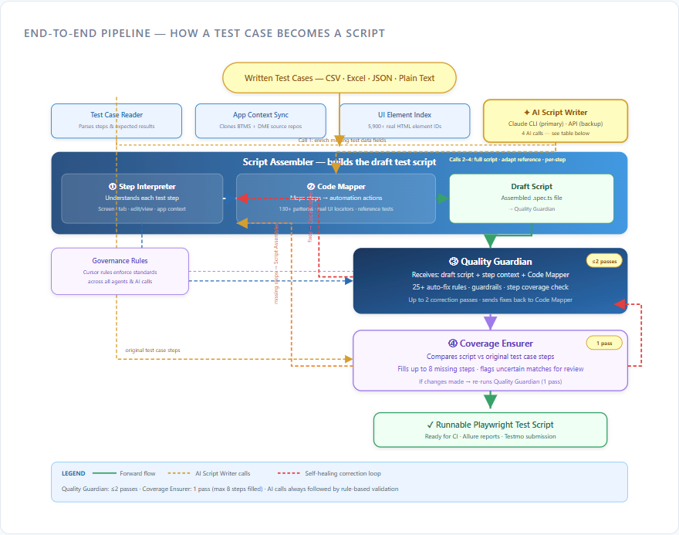
Agentic Architecture — How a Test Case Becomes a Script
Pipeline Flow
Input: CSV · Excel · JSON · plain text test cases
Prep: Test Case Reader · App Context Sync · UI Element Index
Script Assembler → Draft .spec.ts
③ Quality Guardian (≤2 passes) → ④ Coverage Ensurer (1 pass)
Output: Runnable Playwright test script
What Each Agent Does
✦ AI Script Writer — 4 Claude calls: Data Enricher · Full Script Writer · Smart Adapter · Step Writer
① Step Interpreter — screen, tab, edit/view, app context (BTMS/DME/TNX)
② Code Mapper — 130+ patterns · 5,900+ UI IDs from app source
③ Quality Guardian — 25+ auto-fix rules · guardrails · step coverage
④ Coverage Ensurer — fills up to 8 missing steps · re-runs Guardian if changed
Generation order: Call 2 → Call 3 → Rule-based (Step Interpreter + Code Mapper) → Call 4. Claude CLI + Anthropic API · All AI output passes Quality Guardian & Coverage Ensurer before save. POC delivered: 24 billing toggle + 4 DFB scripts.

Slide 3
POC Deliverables — For Mode Global & QA Teams
What You Receive
How QA Teams Use the Agent Going Forward
Playwright Agent repository — framework, page objects, agent pipeline
src/tests/AIAgent/ — 28 generated .spec.ts scripts (billing toggle + DFB)
src/data/<category>/ — runtime test data CSVs per product module
src/agent/examples/sample-testcases.csv — testcase step catalog
Agent CLI — generate scripts from detailed test cases
Reference specs + Cursor governance rules
Handover document + technical deck (agentic-system-slides.html)
Run tests: npx playwright test src/tests/AIAgent/
Interactive generation: npm run agent:cli
From file (CSV/Excel/JSON): npm run agent:file -- <path>
Batch: npm run agent:batch -- <folder>
Preview only: npm run agent:preview
Prepare Testmo cases with full steps + expected results (3–5 hrs/case)
Reports: npm run test:allure · npm run submit:testmo
Handover Complete
The agentic pipeline is built, validated, and ready for Mode Global QA. Run existing scripts today; generate new automation from detailed test cases via the Agent CLI. See QA-AI-Agent-Handover.docx for full setup, architecture, and step-by-step usage.

