Slide 1
MODE GLOBAL · SUNTECK TMS · QA AI AGENT
Playwright Agentic Test Automation — Current State & Gaps
Hybrid rule-based + LLM multi-agent pipeline for SunTeck TMS — Claude-powered generation tiers, self-healing validation, structured test inputs, and Cursor-governed guardrails.
4
4
28
130+
3
Specialized Agents
AI Generation Calls
Scripts Generated
Automation Patterns
Apps Covered
Prepared By: R Systems International | Prepared For: Mode Global | Platform: SunTeck TMS (BTMS · DME · TNX) | Date: June 29, 2026

Slide 2
Contents
1 What We Built — The Agent Pipeline
2 Upstream Gaps & Next Steps

Slide 3
1
What We Built — The Agent Pipeline
Outcome: Written test cases flow through a four-agent pipeline and emerge as validated, runnable Playwright scripts. Delivered: 24 billing toggle and 4 DFB test scripts successfully generated through this architecture.
The pipeline combines deterministic automation rules (proven patterns, real UI locators) with Claude AI calls at four strategic points. Every script is reviewed by the Quality Guardian and Coverage Ensurer before it is saved.

Slide 4
Specialized Agents
✦ AI Script Writer
① Step Interpreter
Claude · 4 generation calls
Agent 1 · StepProcessor
Writes and adapts test scripts. Claude CLI primary; Anthropic API backup.
Understands each step — screen, tab, edit vs view, app context.
② Code Mapper
③ Quality Guardian
Agent 2 · POMMethodMatcher
Agent 3 · SpecValidator
Maps steps to automation using 130+ patterns and 5,900+ UI element IDs.
Validates scripts, auto-fixes violations, up to 2 correction passes.
④ Coverage Ensurer
Agent 4 · SpecFeedbackLoop · 1 pass · up to 8 steps
Compares script vs test case; fills missing steps; re-runs Quality Guardian if changed.

Slide 5
Key Metrics
24
4
5,900+
25+
Billing toggle scripts generated
DFB scripts generated
UI elements indexed
Auto-fix quality rules

Slide 6
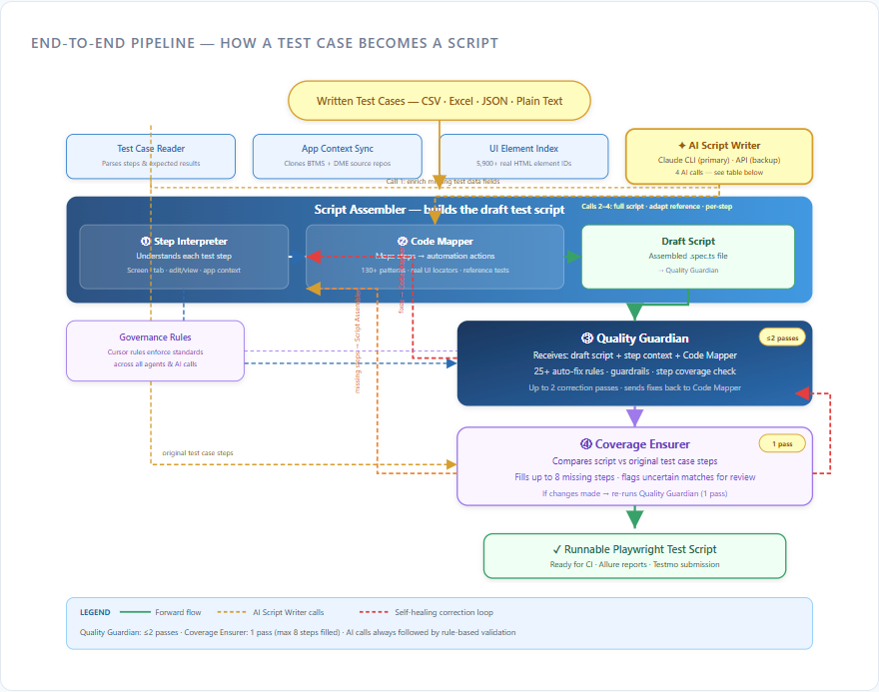
End-to-End Pipeline — How a Test Case Becomes a Script

Slide 7
✦ AI Script Writer — Four Claude Calls
Call | Name | What It Does | When | If Fails
1 | Data Enricher | Fills missing test data fields | Before generation when data incomplete | Continues with partial data
2 | Full Script Writer | Writes entire script using reference template | First attempt (≤40 steps, reference exists) | Falls back to Call 3 or rules
3 | Smart Adapter | Clones reference; rewrites differing steps | When ≥70% similar to existing test | Keeps reference or Call 4
4 | Step Writer | Writes code for unmatched individual steps | Last resort after rules fail | Placeholder for manual completion

Slide 8
Agent Roster — Business Names & Responsibilities
Business Name | Component | Role | Output / Loops
AI Script Writer | LLMService | 4 Claude calls for data & script generation | Code → Script Assembler
Step Interpreter | Agent 1 | Understands each written step | Context → Code Mapper + Guardian
Code Mapper | Agent 2 | Maps steps to proven actions | Draft script; receives fixes from 3 & 4
Quality Guardian | Agent 3 | Validates & auto-fixes scripts | ≤2 passes; loops to Code Mapper
Coverage Ensurer | Agent 4 | Ensures every step in final script | 1 pass; max 8 steps; re-runs Guardian

Slide 9
Inputs & Outputs
What Goes In
What Comes Out
Written test cases — CSV, Excel, JSON, or plain text
Step-by-step actions and expected results
Runtime test data per category
Application source (BTMS + DME repos) for UI locators
Playwright .spec.ts scripts — 24 billing toggle & 4 DFB generated
Organized by product category
Traceable to original test case step numbers
Parsed data saved to dedicated module data files

Slide 10
Governance & Evidence — How Quality Is Enforced
Artifact | What It Ensures | Type
Cursor governance rules | Architecture standards, guardrails, POM protection | Always on
130+ automation patterns | Proven step-to-code mappings | Rule-based
5,900+ indexed UI elements | Real locators from app source | App source
Reference test catalog | Clone when ≥70% similar | Pattern reuse
25+ auto-fix rules | Quality Guardian corrects before review | Self-healing

Slide 11
2
Upstream Gaps & Next Steps
The pipeline is built and working — but its effectiveness depends on the quality of inputs.
Thin test cases, undocumented business rules, or restricted application access will limit what the agents and AI Script Writer can produce.

Slide 12
① Test Cases Lack Sufficient Detail
② Tribal Knowledge — Scenarios Without Steps
Testmo cases need full steps and expected outcomes
Manual QA spends 3–5 hours per test case — largest upstream effort
Without detail, spec generation is inaccurate
Scenarios exist in JIRA — the what is documented
Agent-ready step detail is often missing — the how is not
Precondition paths cannot be automated reliably
③ Limited Application Source Access
④ Execution Time — Monolithic Scripts
UI Element Index syncs BTMS and DME repos only
Code Mapper cannot discover new UI IDs without source
Broader repo sync needed for full coverage
Large cases become single long-running scripts
No shared preconditions or phased build-up
Multi-app flows multiply wall-clock time per run

Slide 13
Recommended Next Steps
Enrich test cases with explicit expected results per step
Add agent-ready step detail to JIRA scenarios
Approve additional application repo sync
Decompose large cases into phased specs or shared fixtures
Grow the reference test catalog per category
Cap step count per script with continuation links

Slide 14
R Systems International | Confidential — Prepared for Mode Global
Agentic Test Automation Pipeline · SunTeck TMS · June 2026

