Slide 1
A Black-Box Approach to Energy-Aware
Scheduling on Integrated CPU-GPU Systems[1]
Rajkishore Barik, Naila Farooqui, Brian T. Lewis, Chunling Hu, Tatiana Shpeisman
By
Ashish Jain (MT18052)
Sarosh Hasan (MT18084)

Slide 2
Background
Integrated CPU-GPU processors combine a CPU and a GPU compute device with different power performance characteristics.
Hardware vendors such as Intel and AMD do not provide user-level DVFS control for the GPU.
Dynamic voltage and frequency scaling (DVFS) is the adjustment of power and speed settings on computing devices to optimize resource allotment for tasks and maximize power saving when those resources are not needed.
Instead Use automatic hardware power management techniques to achieve good performance and reduced energy consumption within a thermal budget like Intel’s TurboBoost and AMD’s TurboCORE.
The performance and energy consumption of integrated CPU-GPU processors depend on many factors such as -
Workload Distribution on CPU and GPU.
The processor package control unit (PCU)- adjusts CPU and GPU frequencies .
Vary from one specific SKU (Stock Keeping Unit) to another.

Slide 3
Background
Energy-Related Metrics for different computer system.
For mobile device - The users of mobile devices want to optimize the energy-delay product. The energy-delay product is defined as E*T, where E is energy and T is time. This metric is used to calculate that how long the system takes to execute an application.
For data-center and HPC applications - Here the execution time is so important that another energy metric is used, the energy delay-squared product (ED2) is defined as E*T*T , where E is energy and T is time. It depends on the best workload distribution.

Slide 4
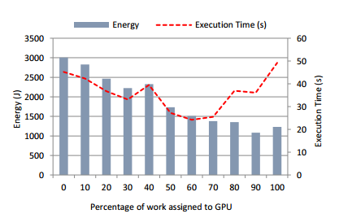
Problem statement
The problem is to optimize the energy efficiency on integrated CPU-GPU processors.
Improving energy efficiency has become an important concern for all computing systems. In mobile devices helps in improving battery life and in large scale computing centres helps in reducing power consumption.
The energy efficiency can be achieved by proper workload distribution on CPU-GPU computing devices.
Since most integrated processors don’t allow the user to control DVFS, so use a scheduling runtime that automatically distributes work between the CPU and GPU to optimize the energy metric.
Figure 1: Energy use and performance for the Connected Components application on an Intel Haswell desktop with varying percentage of work assigned to GPU.

Slide 5
Contributions in the paper
The contributions to optimize an energy-related objective using a black-box approach on an integrated CPU-GPU platform are as follows -
Distributing application work between the CPU and GPU using information about the processor’s power use characteristics and the workload’s runtime behavior.
Presents an Energy-Aware Scheduler (EAS) that partitions data-parallel work between a CPU and GPU to optimize for any user-defined energy-related metric that can be expressed as a function of power consumption and program execution time.
Presents an experimental evaluation of EAS technique on two platforms, a high-end desktop system and a low power tablet. Evaluation uses a set of twelve widely-varying benchmarks that include both regular and irregular workloads.
On average, EAS algorithm yields an energy-delay product that is 96% and 93% of the nearideal Oracle energy-delay product on the desktop and tablet, respectively

Slide 6
Motivation
Energy efficiency is the most important concern for all computing systems, from fitness trackers and tablets, where it affects battery life, to cloud computing centers, where it directly impacts operational cost, maintainability, and environmental impact.
The computing systems today include accelerators such as GPUs that, in addition to providing significant gains in performance, provide substantial energy savings for data-parallel, throughput-oriented workloads.
For the integrated CPU-GPU processors, hardware vendors implement automatic power management policies that are typically not exposed to the end-user.
Propose a new black-box scheduling technique to reduce energy use by effectively partitioning work across the CPU and GPU cores of integrated CPU-GPU processors.

Slide 7
Insights
While GPU execution is usually beneficial for energy and performance, the lowest energy use or best performance may require both the CPU and GPU, performance and energy use also depend on how the work is distributed between the CPU and GPU.
The GPU offloading factor is dependent on the processor and may vary accordingly with different processor.
The value of GPU offloading factor needs to be computed once using multiple iterations to find the best performance factor.

Slide 8
Implementation
Used Concord[2] to perform fine-grained work distribution for energy efficiency and implement automatic partitioning of work across CPU and GPU cores.
Concord provides a data parallel_for loop construct.
The loop iterations are independent of each other and can be executed in arbitrary order on either the CPU or the GPU.
Then the runtime implements work-stealing on the CPU, with one CPU worker thread (the GPU proxy thread) offloading work to the GPU.
The GPU then offload fraction α that minimizes the target energy metric is computed after profiling by the GPU proxy thread.
Which then distributes the remaining parallel iterations among the CPU and GPU cores.

Slide 9
Experimental Methodology
Present an evaluation of our energy-aware scheduling algorithm on two platforms -
A desktop computer with a 3:4GHz Intel 4th Generation Core i7-4770 Processor with four CPU cores .The integrated GPU, an Intel HD Graphics 4600, has 20 execution units (EUs), each with 716-wide SIMD hardware threads.The system has 8GB memory and is running 64-bit Windows 7.
A tablet with a 1:33GHz Intel Atom CPU Z3740 Processor with four CPU cores. The integrated GPU has 4 execution units (EUs), each with seven 16-wide SIMD hardware threads.The system has 2GB memory and is running 32-bit Windows 8.1.
Classify workloads as irregular if they exhibit input-dependent control flow, e.g.,graph algorithms.
Classified workloads as Short/Long based on their execution. If the estimated execution time for the remaining iterations (Nrem in EAS Algorithm) after profiling is less than 100 ms, we classify the workload as Short, else as Long.
Classify a workload as memory-bound if its ratio of L3 cache misses to total
load/store instructions retired is greater than 0.33.The Intel Performance Counter Monitor tool is used to measure L3 cache misses and total instructions retired during profiling.

Slide 10
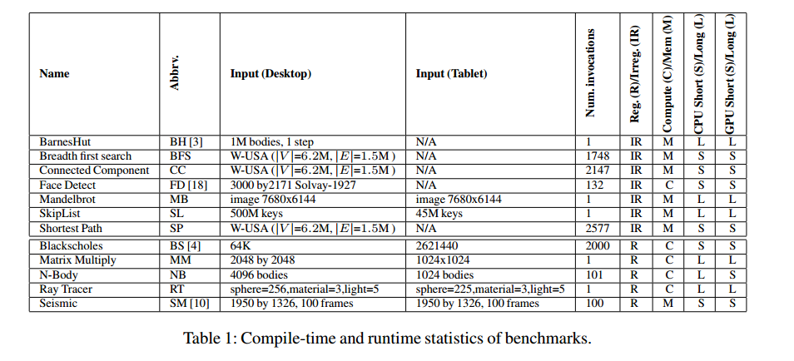
Experimental Methodology

Slide 11
Experimental Methodology
Comparison schemes: Compare the following energy aware scheduling strategies to distribute the parallel iterations between the CPU and GPU:
CPU: Multi-core CPU execution based on Intel Thread Building Blocks (TBB).
GPU: GPU-alone execution using the vendor OpenCL driver.
Oracle: The best energy metric (either energy-use or energy-delay product) we found through exhaustive search of possible GPU offload ratios α in the range [0;1] with 0:1 increment. This is the baseline in evaluation.
PERF: The best-performance strategy corresponds to the workload distribution which yields the best execution time by using both CPU and GPU simultaneously.
EAS: Our energy-aware scheduling algorithm using the analytical power modeling and online profiling.

Slide 12
Results
GPU-alone execution may not be the best strategy for energy optimization on all platforms.
PERF(Performance-aware work partitioning) is not the best strategy for energy optimization on either platform. In particular, it does not perform well on the desktop when energy-use is the metric.
EAS (Energy Aware Algorithm) is the best strategy for both the energy-use and energy-delay product metrics. It results in an energy delay product that is 96.2% and 93.2% on the desktop and tablet, respectively.
Given the complexities of modern processor hardware power management, the results demonstrate that a black-box, user-level approach to optimizing energy efficiency can be surprisingly effective.

Slide 13
Conclusion
In this paper, we investigated the problem of improving the energy efficiency of processors with integrated GPUs by finding an appropriate distribution of work between the CPU and GPU.
The paper presented a methodology for characterizing the integrated CPU-GPU processor power behavior by relating it to the workload distribution between the CPU and GPU components.
Use this power use characterization to optimize the energy use of applications as well as results from lightweight online profiling, to determine the work distribution for an application that optimizes a user-specified energy-related metric such as the energy-delay product or total energy-use.
The paper presented an experimental evaluation of our scheduling technique on two widely-different platforms, a high-end desktop system and a low power tablet, each executing a diverse set of twelve benchmarks that contain a mix of regular and irregular code.
The benefits of the EAS algorithm are primarily due to its use of offline platform power characterization combined with online profile-based workload characterization.

Slide 14
Our Plan
How are we going to use cotton runtime with our project?
We are going to keep a GPU proxy thread (CPU worker thread) for computing of α on the basis of CPU and GPU execution (Energy / Time) profiling and then place the task in their respective deques for optimal execution.
The computation of α is done in a manner that it minimizes the finish time of tasks being executed on both the GPU and CPU and minimizes the overall energy consumed.
If the GPU finishes the task earlier then increase the value of α by a fraction of ~ 0.01 (value of α lies between[0,1]).
The offloading of tasks from CPU to GPU will be done using OpenCL APIs.
The stealing operation’s across GPU and CPU will depend upon the value of α computed by the GPU proxy thread. This profiling is done only once using multiple iterations.

Slide 15
References
Rajkishore Barik, Naila Farooqui, Brian T. Lewis, Chunling Hu, and Tatiana Shpeisman. 2016. A Black-box Approach to Energy-aware Scheduling on Integrated CPU-GPU Systems. In CGO. ACM, New York, NY, USA, 70ś81.
R. Barik, R. Kaleem, D. Majeti, B. Lewis, T. Shpeisman, C. Hu, Y. Ni, and A.-R. Adl-Tabatabai. Efficient mapping of irregular C++ applications to integrated GPUs. In IEEE/ACM International Symposium on Code Generation and Optimization (CGO), 2014

Slide 16
Thank You

