Slide 1

An Exploratory Data Analysis on The Aspiring Mind Employment Outcomes (AMEO) 2015 Study From AMCAT
-submited by
Ajai Raaj (IN9240802)

Slide 2
About me
I am Ajai Raaj. I hold a Bachelor of Technology (B.Tech) degree in Information Technology . My undergraduate education provided me with a strong foundation in computer science principles, including programming, algorithms, and data structures.
I am passionate about leveraging data-driven insights to solve complex problems and make informed decisions.
The field of data science offers exciting opportunities to extract valuable insights from large datasets, apply
machine learning algorithms to predict trends, and derive actionable recommendations for businesses and
organizations. By learning data science, I aim to enhance my analytical skills and contribute to innovative projects that harness the power of data.
While I do not have formal work experience in the field of data science, I have completed relevant coursework and personal projects to develop my skills in data analysis, machine learning, and statistical modeling. Additionally, I actively seek opportunities to participate in data science competitions and collaborative projects to gain practical experience and expand my knowledge in this domain.
LinkedIn profile: https://www.linkedin.com/in/ajairaajvinayak/
GitHub profile: https://github.com/ajairaajvinayak

Slide 3
Introduction
Brief Overview:
The project involves conducting Exploratory Data Analysis (EDA) on a salary dataset to extract valuable insights.
Objective:
Uncover patterns, outliers, and relationships within the data.

Slide 4
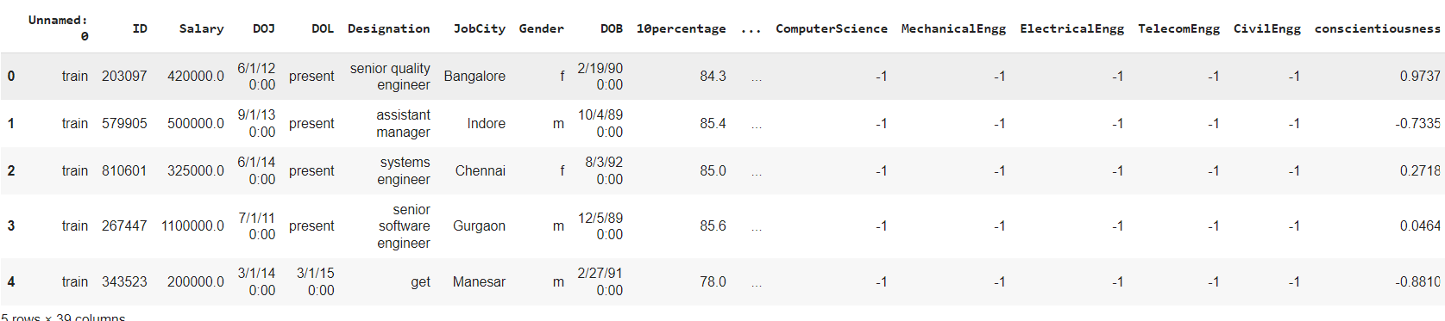
Dataset Overview
The dataset consists of 3998 entries and 39 columns.
Columns include information such as ID, Salary, Date of Joining (DOJ), Date of Leaving (DOL), Designation, JobCity, Gender, Date of Birth (DOB), 10th and 12th percentage, and many more.
Head of the Dataset:
Shape:
Rows: 3998, Columns: 40
Description:
The dataset provides a comprehensive overview of candidates' educational backgrounds, professional experiences, and personality traits.
Various data types include float64, int64, and object.

Slide 5
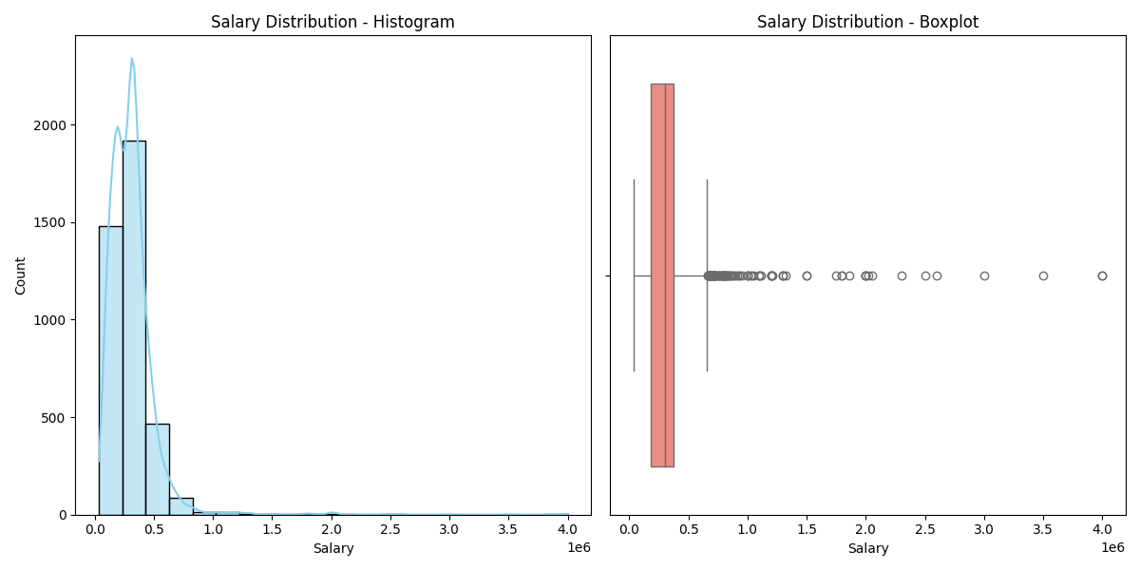
Univariate Analysis - Salary Distribution
The Salary distribution exhibits positive skewness with a value of 6.45, indicating that the majority of salaries are concentrated on the lower end, while a few instances have exceptionally high salaries.
A total of 109 outliers were identified, with salaries significantly exceeding the general trend. Noteworthy examples include salaries of 1,100,000, 800,000, and 1,500,000.
The histogram and boxplot visually represent the skewed nature of the distribution and the presence of outliers. Further investigation into the context of these high salaries is recommended to determine whether they are valid data points or anomalies.
This analysis serves as a foundation for understanding the distribution of salaries in the dataset.

Slide 6
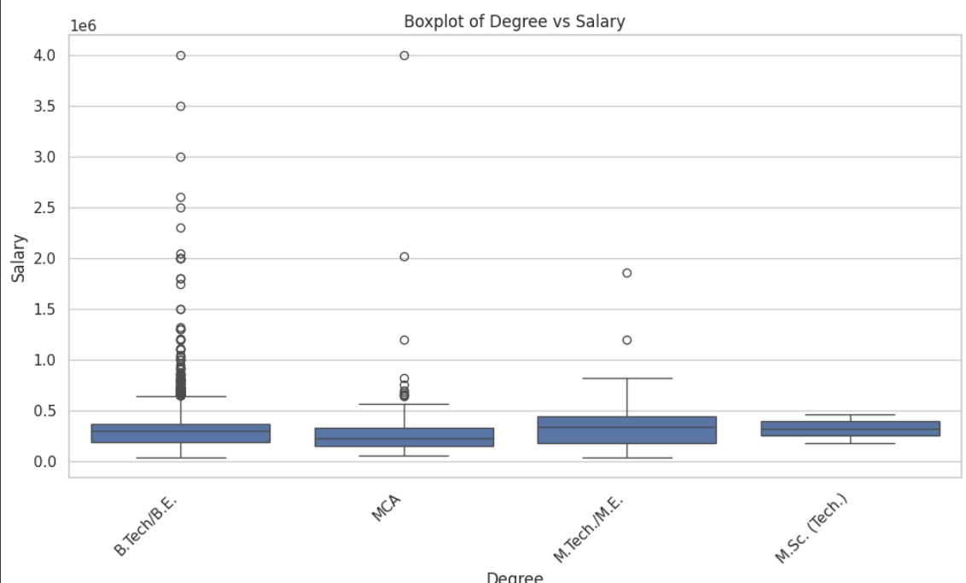
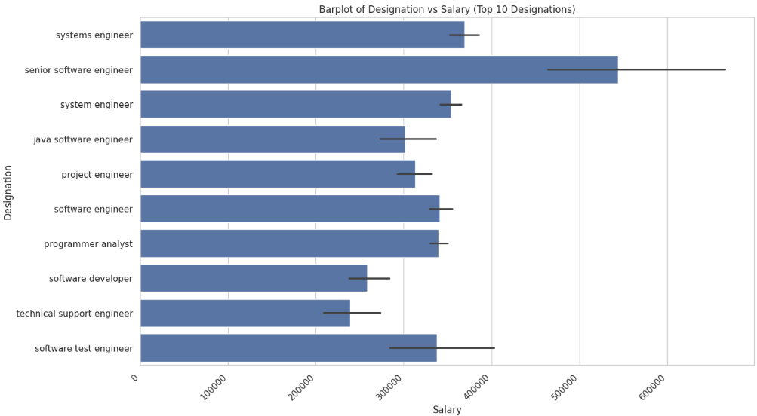
Bivariate Analysis
In bar plot of Degree vs Salary , the M.Tech/M.E. Degree has slightly High salary compare to others.
There certainly more outliers for B.Tech/B.E. Degree which tells it has chances of getting more higher salary in exceptional cases
In Bar plot , It can be seen that senior software engineer having usually more salary compared to other designations
Technical support engineer having least salary among top 10 highest paid designations

Slide 7
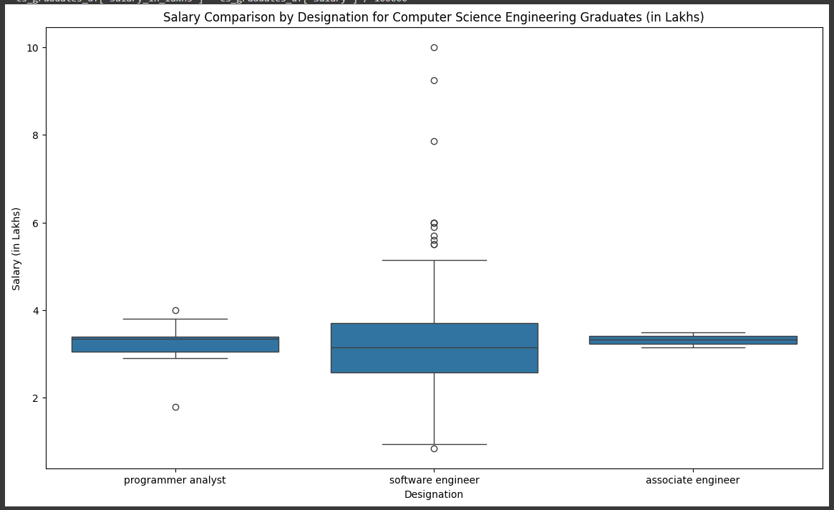
Research Questions
Times of India article dated Jan 18, 2019 states that “After doing your Computer Science Engineering if you take up jobs as a Programming Analyst, Software Engineer, Hardware Engineer and Associate Engineer you can earn up to 2.5-3 lakhs as a fresh graduate.”
Conclusion:
Yes, after doing Computer Science Engineering if you take up jobs as a Programming Analyst, Software Engineer and Associate Engineer you can earn up to 2.5-3 lakhs as a fresh graduate
However ,there was no data present to support the fact that after Computer Science Engineering if you take up jobs as a Hardware Engineer you can earn up to 2.5-3 lakhs as a fresh graduate

Slide 8
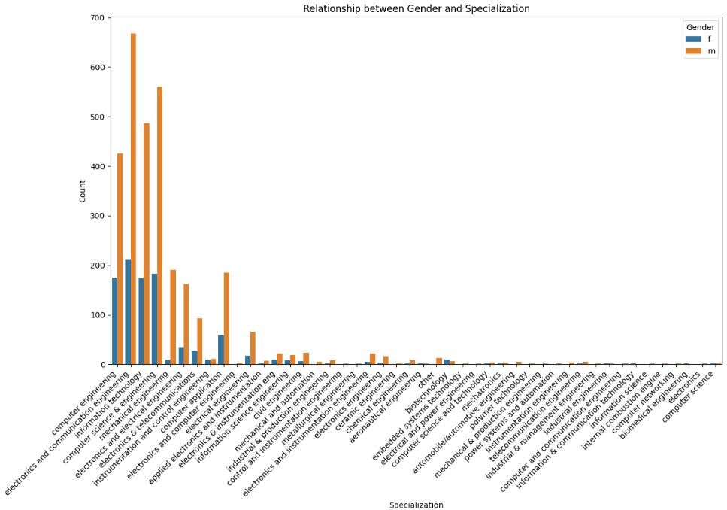
Is there a relationship between gender and specialization? (i.e. Does the preference of Specialisation depend on the Gender?)
By looking at plot we can see males are doing more specialization than females
Females are preferring less specialization, in some cases it is less than half the number of males

Slide 9
Conclusions
In conclusion, our exploratory data analysis (EDA) sheds light on several key aspects of the dataset related to salary and various features. Here are the main takeaways:
Salary Distribution:
The distribution of salaries exhibits some degree of skewness, indicating variations in compensation levels among individuals.
Through histogram and boxplot visualizations, we identified outliers that require further investigation.
Correlation Analysis:
Bivariate analysis revealed correlations between salary and specific features such as 'Quant,' 'Logical,' 'English,' '10percentage,' and '12percentage.'
Certain features, like 'Computer Science,' 'ID,' and 'CollegeTier,' show negative correlations with salary.
Research Questions:
The Times of India's claim about salary expectations for fresh graduates in the field of Computer Science Engineering was tested against the dataset.
Additionally, we explored the relationship between gender and specialization preferences.

Slide 10

THANK YOU

