Slide 1
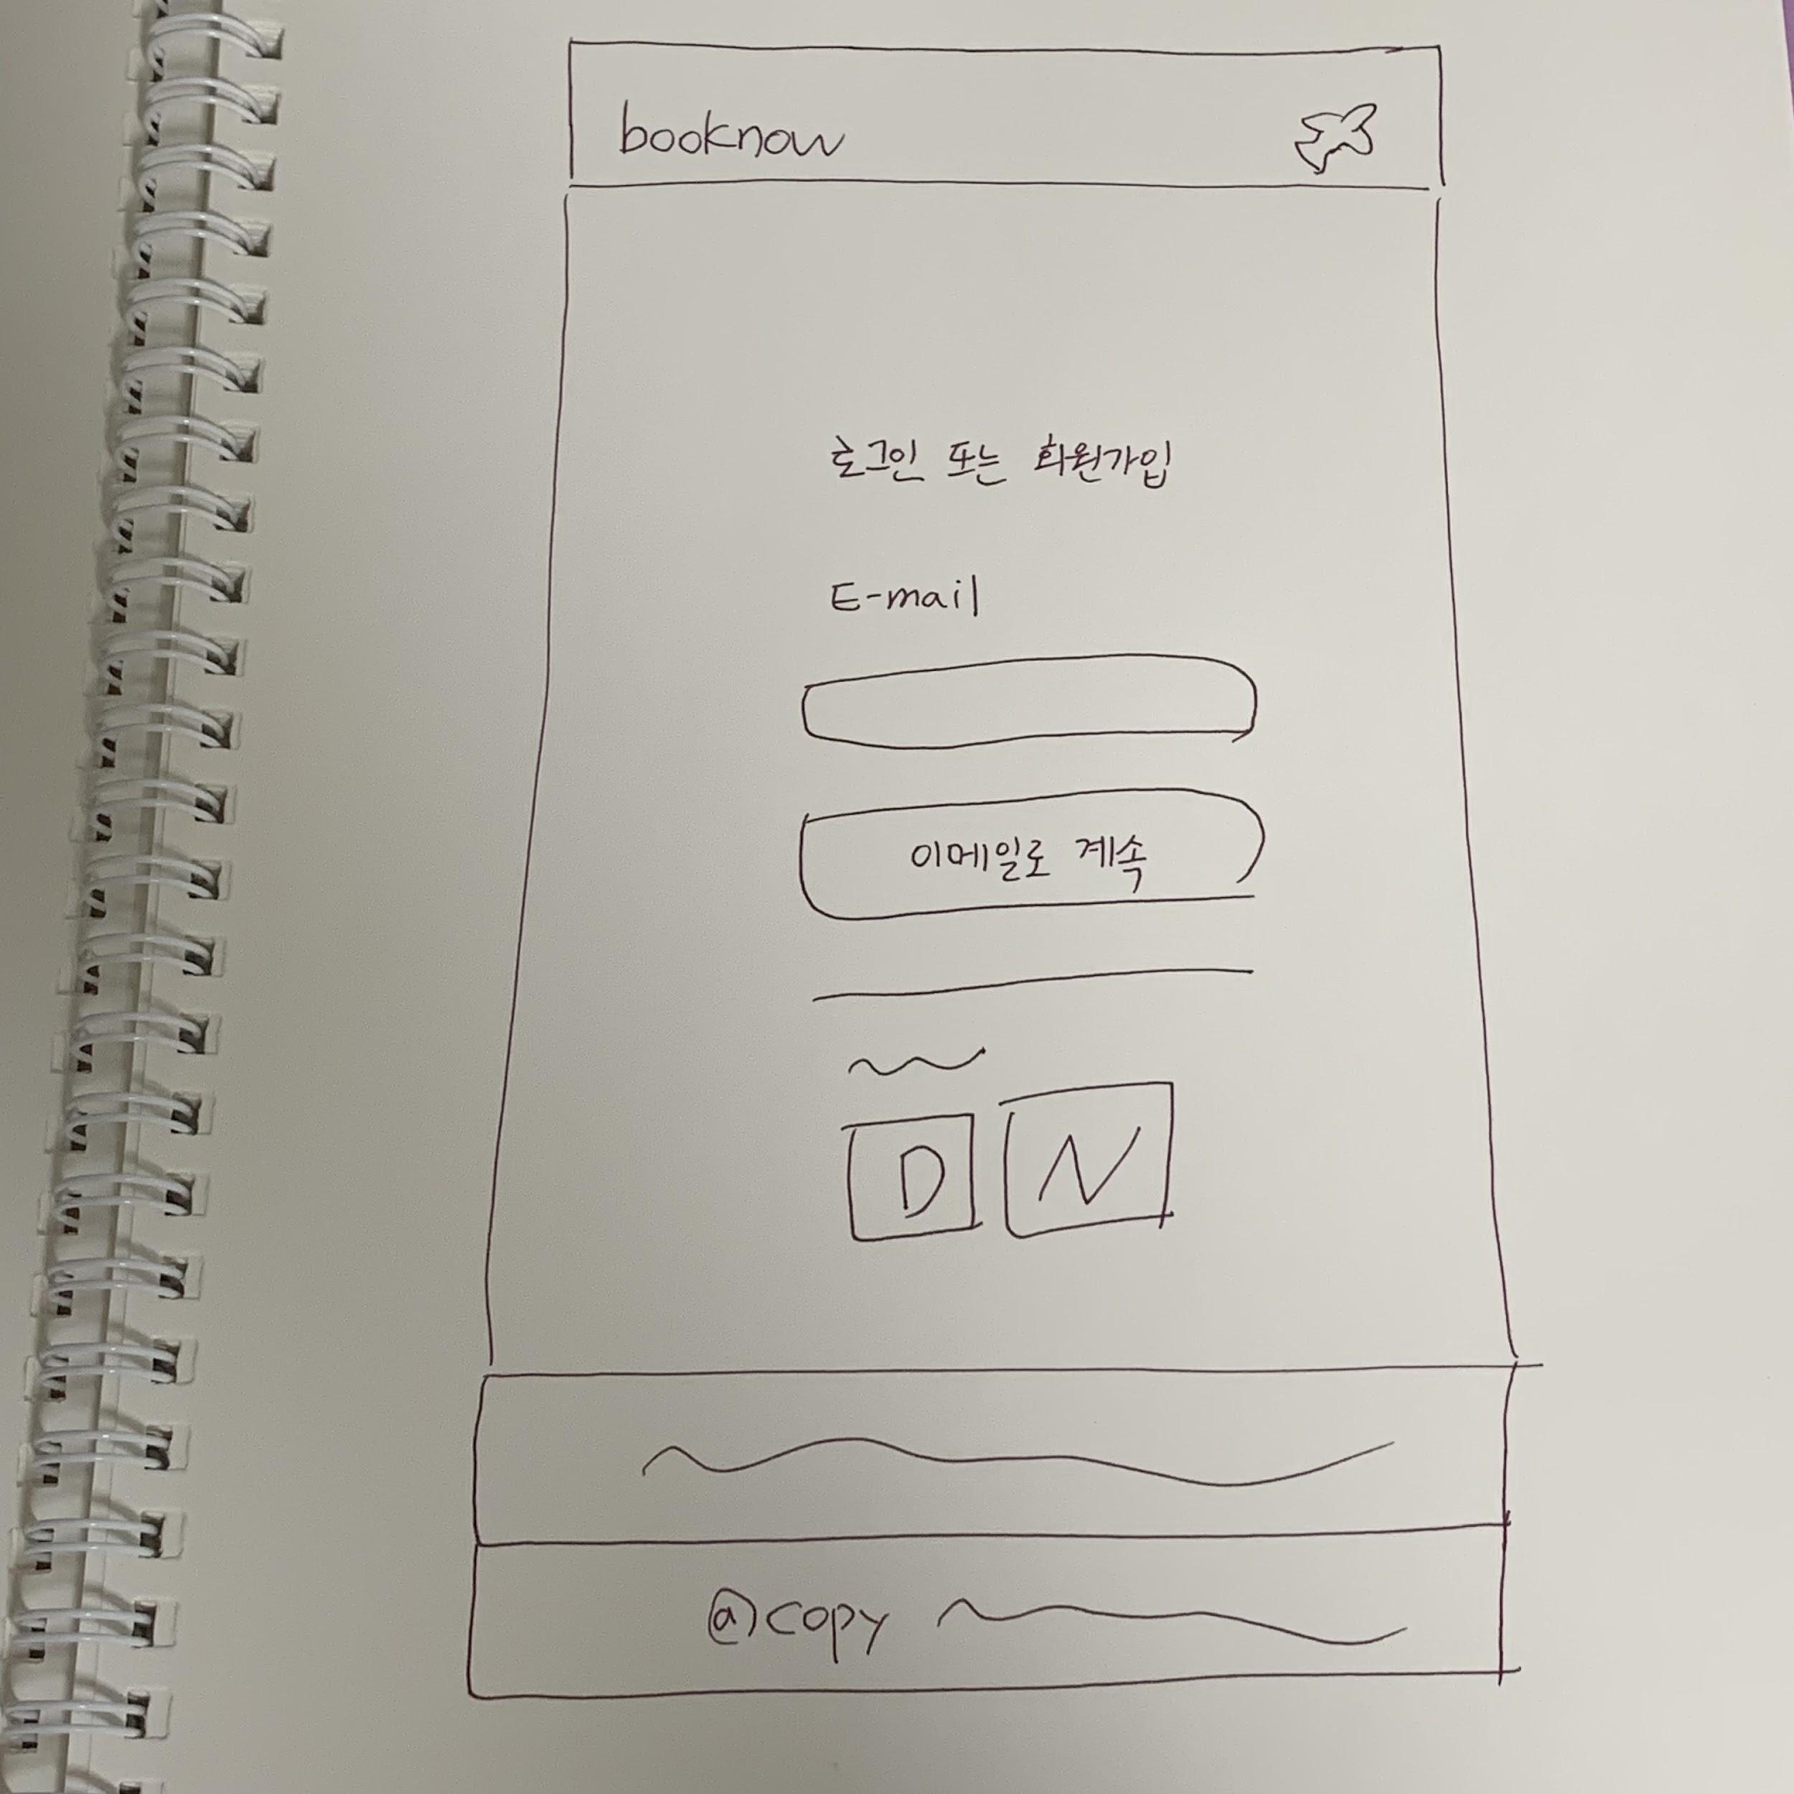


스케치-login
header
.header-inner
p a
i.class
.section-login
.inner-login
h1
input
p
footer

Slide 2
1300px
Wireframes
Head
Contents
Contents
Footer-1
Footer-2

Slide 3
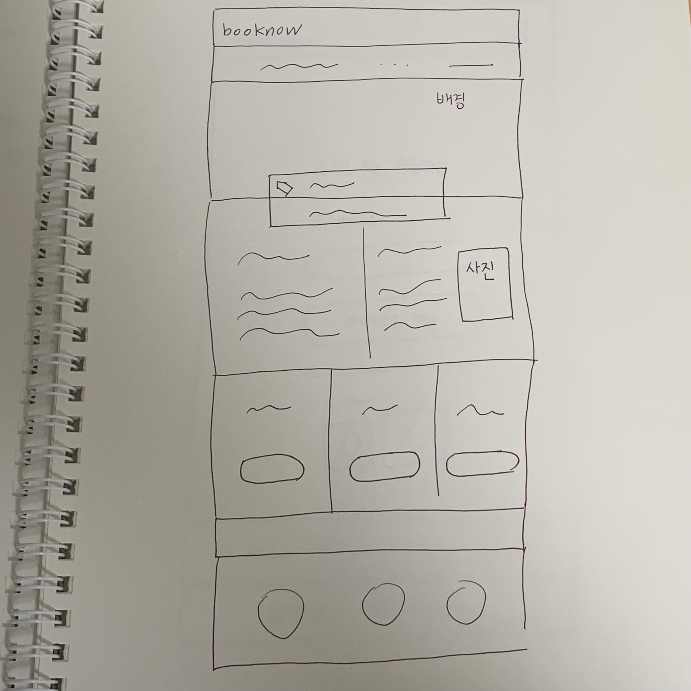
스케치-할인페이지
header
.head-inner
a
.head-corona
.corona-content
p > a
.section
.top-contents
.bottom-section
footer

Slide 4

1300px
Wireframes
Head
SubHead
Background-image
Center-box
Text-contet
Text-contet
bottom-contens
bottom-contens
bottom-contens
Footer

