Slide 1



Wireless Heart rate Monitor

Slide 2
Content
Objective and Abstract
Functional block diagram
Heart
Structure of Heart
Heartbeat
Electrocardiogram
Conventional Measurement of Pulse Rate
Pulse sensor
Principle of working
Schematic
Interfacing with an Arduino Uno
Bluetooth Module HC-05
Interfacing with Arduino Uno
Android Application
Android Studio
Classes used - BluetoothAdapter and BluetoothSocket
Results
References

Slide 3
Objective
The objective of the current project is to create a method to measure and monitor the heart rate of a subject in order to facilitate remote diagnosis and monitoring. There are multitude of solutions which can achieve the objective. The disadvantage of these readymade solutions are that they are either too bulky or too expensive to be viable for regular use by the common person.
We aim to reduce the size of the device to make it more portable. We also aim to make it more user-friendly and accessible to all the users by providing a mobile application that will interface with the device via Bluetooth and reduce the costs

Slide 4
Abstract
We plan to make a portable wireless heart rate monitor by using an Arduino UNO as the brain due to its low power consumption, cost, and rich feature set. A PulseSensor from World Famous Electronics llc. Is selected to be the sensing element due to its low cost and small form factor. The data collected by the sensor will be collected and processed by the Arduino UNO and transmitted to a mobile application via Bluetooth. The Bluetooth transmission is made possible by the use of a Bluetooth transceiver module HC-05. The data will then be received and displayed using a custom app that has been developed in-house

Slide 5
Functional Block Diagram
Transmitter:
PulseSensor
ADC
Arduino UNO
UART Transmission
Bluetooth Module
HC-05
Receiver
Smartphone
Monitoring Application

Slide 6
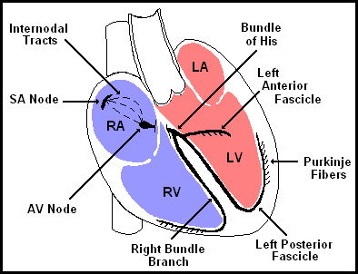
Structure of A Heart

Slide 7
What Is A Heartbeat?
A person’s heartbeat is the sound of the valves in his/her heart contracting or expanding as they force blood from one region to another. The number of times the heart beats per minute (BPM), is the heartbeat rate and the beat of the heart that can be felt in any artery that lies close to the skin is the pulse.

Slide 8
Nominal Heart Rate Values
The heart rate gets progressively slower as a person moves through childhood toward adolescence.
The normal resting heart rate for adults over the age of 10 years, including older adults, is between 60 and 100 beats per minute (bpm).
Highly trained athletes may have a resting heart rate below 60 bpm, sometimes reaching 40 bpm.

Slide 9
Electrocardiography
Electrocardiography is the process of producing a recording – a graph of voltage versus time – of the electrical activity of the heart using electrodes placed on the skin. These electrodes detect the small electrical changes that are a consequence of cardiac muscle depolarization followed by repolarization during each cardiac cycle

Slide 10
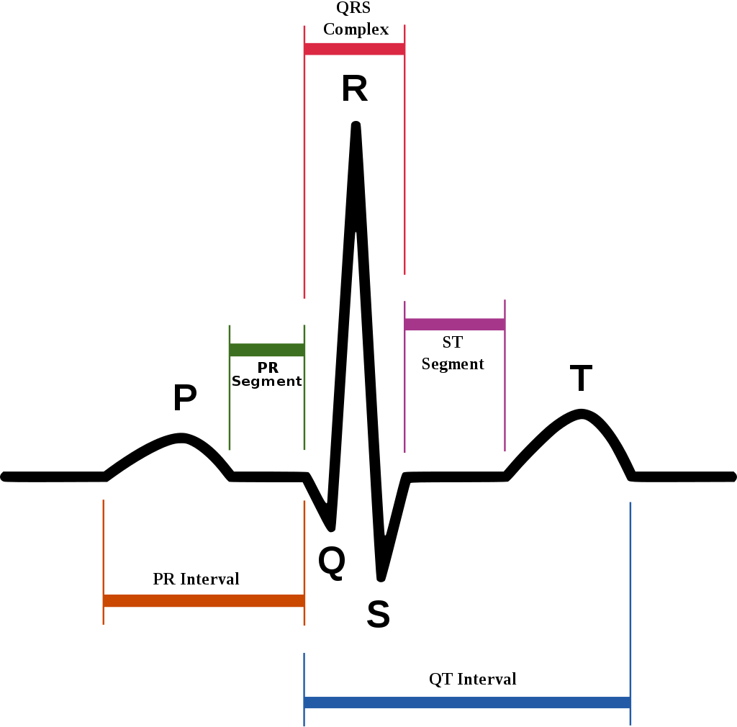
Typical ECG Waveform

Slide 11
Measurement of Pulse rate
Conventional Method
Using a Pulse Sensor

Slide 12
Conventional Method
Heartbeat can be checked manually by checking one’s pulses at two locations- wrist (the radial pulse) and the neck (carotid pulse). The procedure is to place the two fingers (index and middle finger) on the wrist (or neck below the windpipe) and count the number of pulses for 30 seconds and then multiplying that number by 2 to get the heartbeat rate. However pressure should be applied minimum and fingers should be moved up and down till the pulse is felt.

Slide 13
Using a Pulse Sensor
Heartbeat can be measured based on optical absorption variation as light is scattered or absorbed during its path through the blood as the heartbeat changes

Slide 14
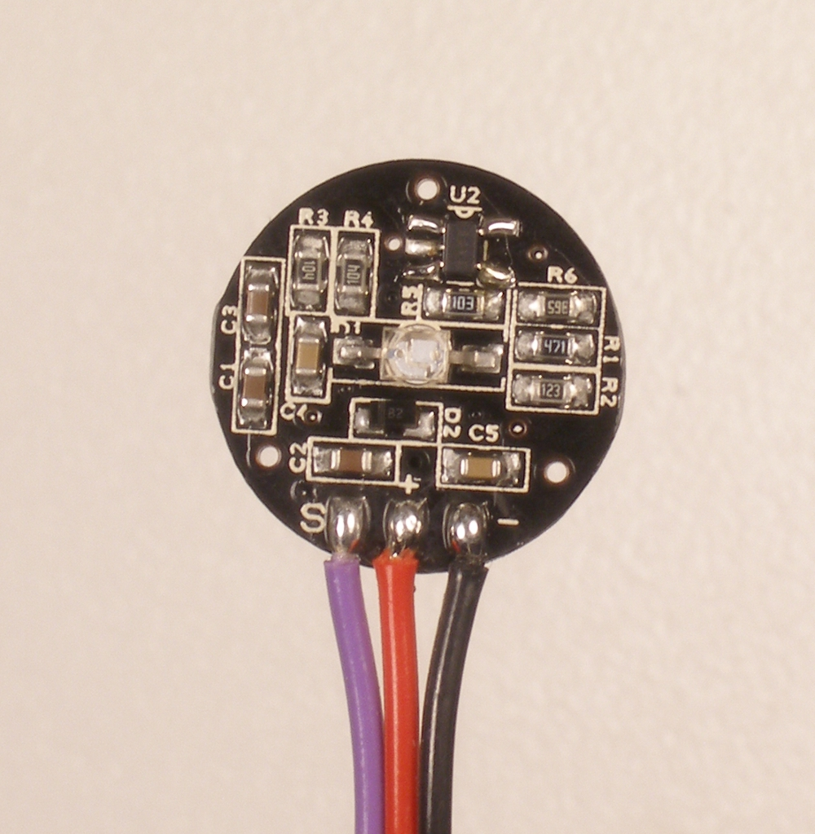
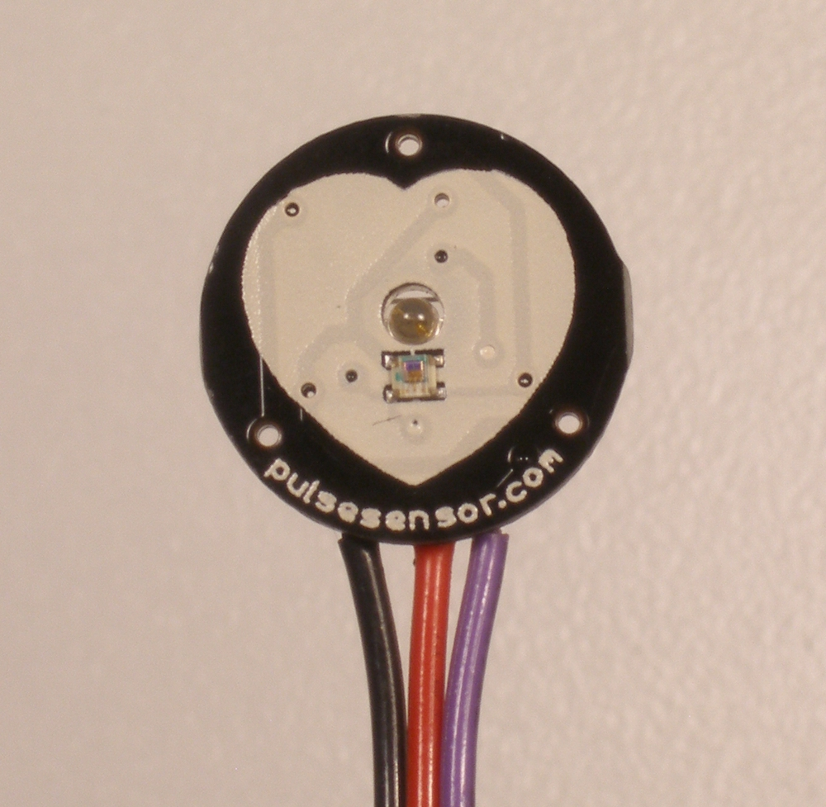
PulseSensor
The PulseSensor is an opensource hardware project by World Famous Electronics llc.
They aim to make the process of using the pulse rate of a subject easier for other applications such as remote monitoring, integration with the next level gaming consoles, etc.
The module has the signal conditioning part built into it to enable easy use of the data

Slide 15
Principle of Operation of PulseSensor
The pulse sensor is based on the principle of photo plethysmography. It measures the change in volume of blood through any organ of the body which causes a change in the light intensity through that organ (a vascular region). In case of applications where heart pulse rate is to be monitored, the timing of the pulses is more important. The flow of blood volume is decided by the rate of heart pulses and since light is absorbed by blood, the signal pulses are equivalent to the heartbeat pulses.

Slide 16
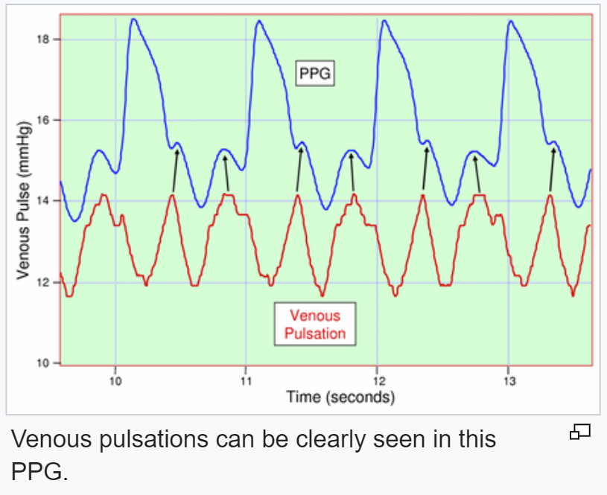
Photoplethysmography
With each cardiac cycle the heart pumps blood to the periphery. Even though this pressure pulse is somewhat damped by the time it reaches the skin, it is enough to distend the arteries and arterioles in the subcutaneous tissue. If the pulse oximeter is attached without compressing the skin, a pressure pulse can also be seen from the venous plexus, as a small secondary peak.
The change in volume caused by the pressure pulse is detected by illuminating the skin with the light from a light-emitting diode (LED) and then measuring the amount of light either transmitted or reflected to a photodiode. Each cardiac cycle appears as a peak, as seen in the figure. Because blood flow to the skin can be modulated by multiple other physiological systems, the PPG can also be used to monitor breathing, hypovolemia, and other circulatory conditions. Additionally, the shape of the PPG waveform differs from subject to subject and varies with the location and way the pulse oximeter is attached.

Slide 17
Types of Photoplethysmography
Transmission: Light emitted from the light emitting device is transmitted through any vascular region of the body like earlobe and received by the detector.
Reflection: Light emitted from the light emitting device is reflected by the regions.

Slide 18
Working of PulseSensor
The non-invasive type of optical heart rate sensor consists of an electronic circuit that monitors heartbeat by clipping onto a finger tip. It does this by shining light into (or through) the finger and measuring how much light is reflected (or absorbed). This goes up and down as blood is pumped through the finger. Usually a clever combination of an infrared light sender and a light receiver is used for the operation.
In addition to the optical sensor assembly, an amplifying circuit is needed to ‘boost and shape’ the feeble signal coming off the optical sensor. Next figure shows the entire circuit diagram of our optical PulseSensor. Its output is in the range of 0.3-5 Volts

Slide 19
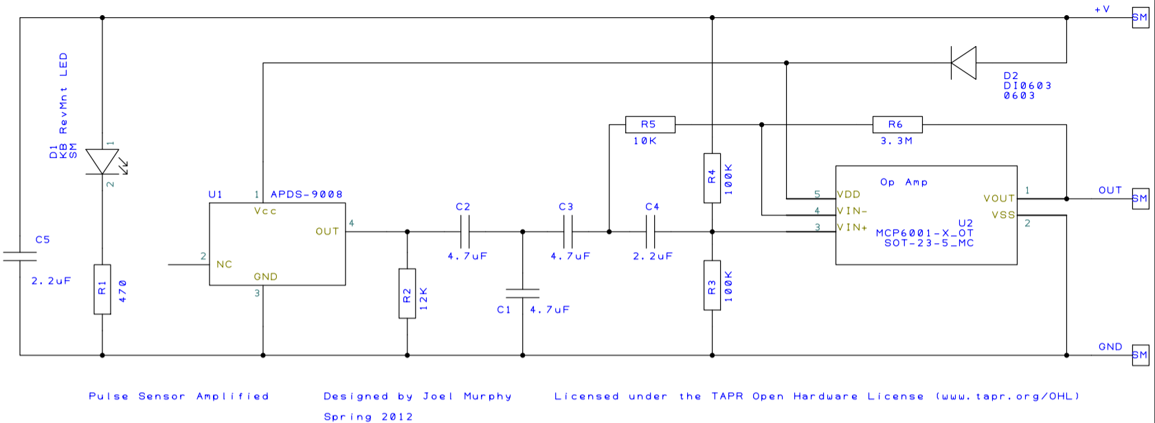
Schematic

Slide 20
Interfacing with an Arduino UNO
The Pulse Sensor comes with a collection of code and projects made just for the PulseSensor and Arduino
This collection of code is called the PulseSensorPlayground library
This library empowers us with the tools required to acquire and analyze the raw data from the PulseSensor
The raw analog data is converted to a digital value by using the built in Analog to Digital Converter of the Arduino UNO (Pin A0).
This raw data of the output of the Optical sensor is then used to calculate the Beats per Minute pulse rate and Heart rate variability by measuring the R-R time for each cycle

Slide 21
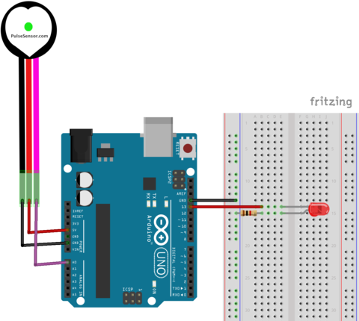
Hardware Connection
The Pulse sensor is powered using the 5V and GND pins of the Arduino UNO.
The analog input of the sensor is connected to the A0 pin for the ADC functionality
We also connect an LED to PIN 13 to enable us to monitor the pulse rate

Slide 22
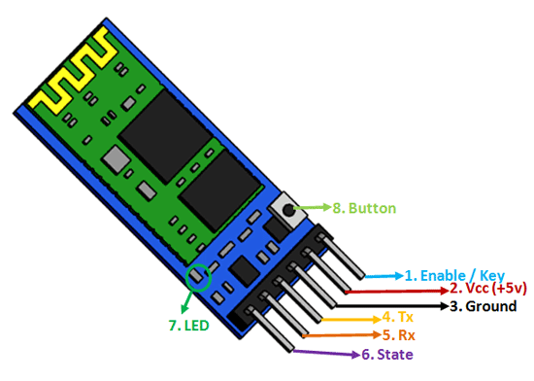
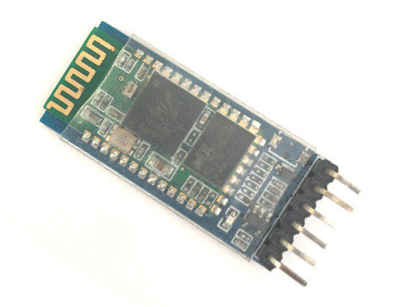
Bluetooth Module HC-05
The HC-05 is a Bluetooth transceiver module which enables two-way (full-duplex) wireless functionality to our projects. We can use this module to communicate between two microcontrollers like Arduino or communicate with any device with Bluetooth functionality like a Phone or Laptop.
The module communicates with the help of USART at 9600 baud rate hence it is easy to interface with any microcontroller that supports USART.
We can also configure the default values of the module by using the command mode and a terminal application.

Slide 23
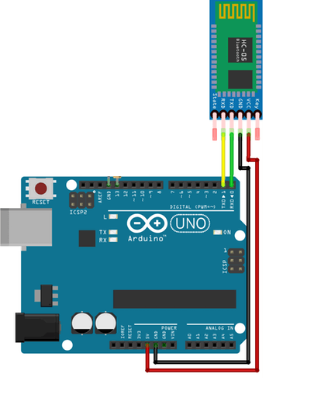
Interfacing HC-05 with Arduino UNO
We have a library SoftwareSerial that enables us to use the digital output pins of the Arduino UNO to act as Rx, Tx pins to provide UART functionality.
The HC-05 will receive the bpm value as an ASCII string serially at a baud rate of 9600
This data will then be transmitted to the Bluetooth receiver via the built-in antenna
The function write() enables us to do the above operation in a single line

Slide 24
Android Application
The data that is being transmitted by the Bluetooth module will be received by a mobile device that is connected to it via Bluetooth
To visualize and store this data we have developed an android application using the android studio IDE

Slide 25

Android Studio
Android Studio is an Integrated Development Environment (IDE) that provides us with to tool to develop, debug and test our android application
Android Studio is the official IDE for Google's Android operating system, built on JetBrains' IntelliJ IDEA software and designed specifically for Android development
Kotlin is Google’s preferred language for Android app development. Still, other programming languages are supported by Android Studio, such as Java and C++

Slide 26
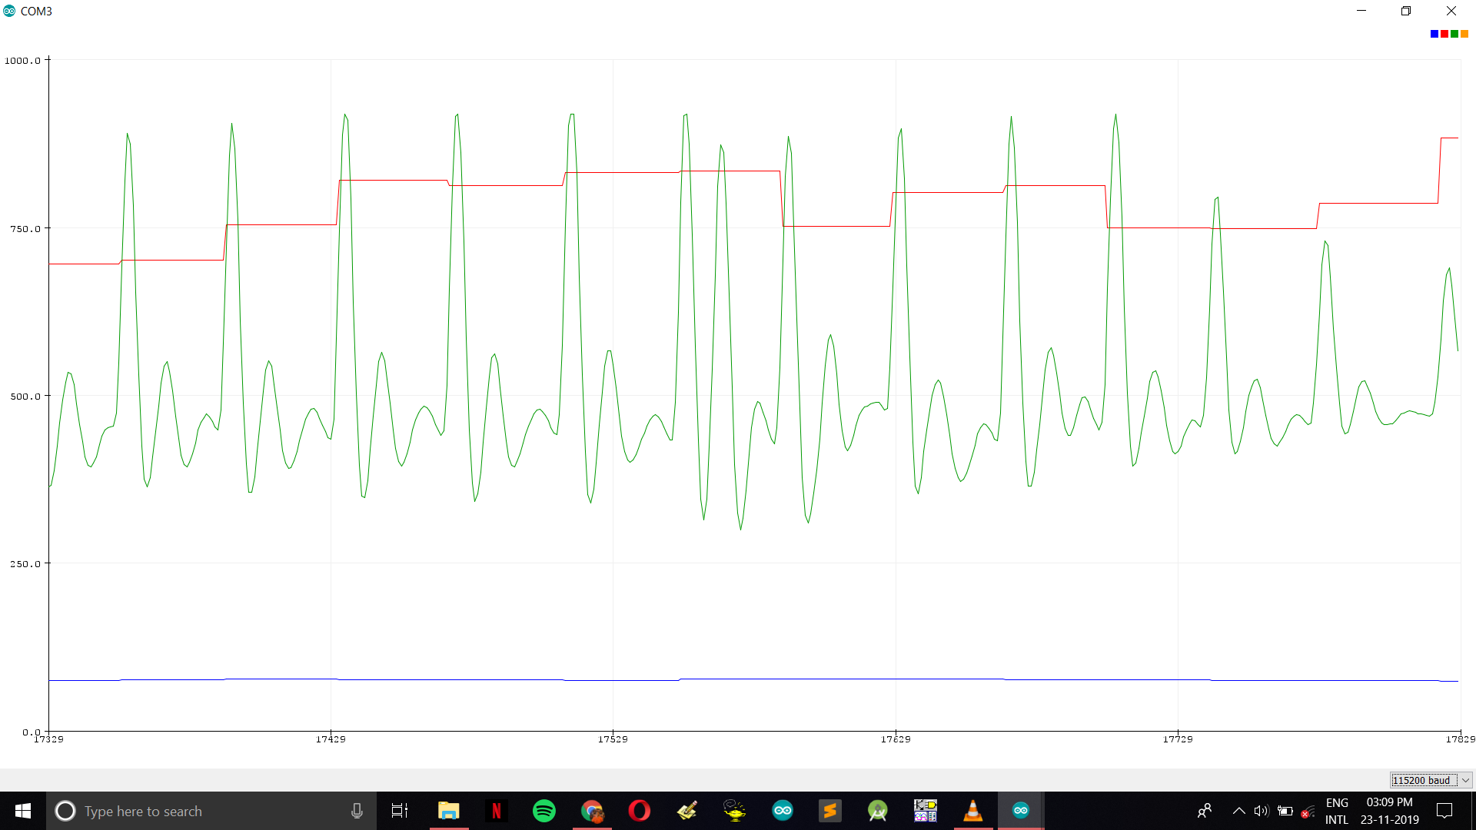
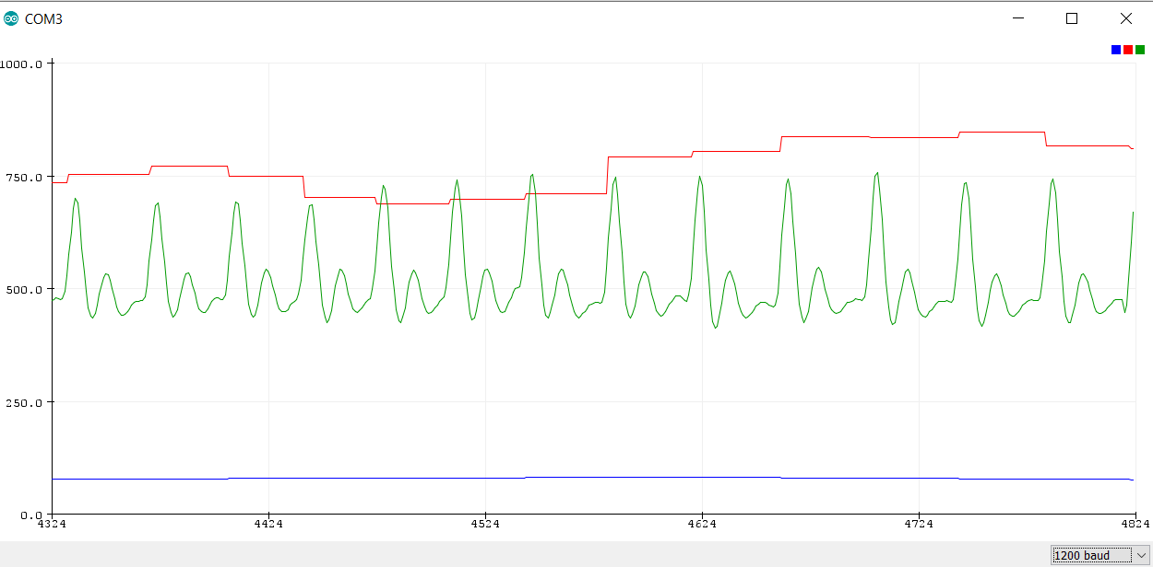
Results
Test 1
These graphs were the output that was received in the Arduino Serial Plotter
The green lines are the raw digital data
The blue lines are the bpm
The red lines are used to calculate the R-R time to monitor Heart Rate Variability
We can observe that in test 1 and 2 we get the bpm of the person to be about 90 bpm.
We can also observe that the amplitude of the raw data is different between test 1 and test 2. This is due to the ambient light difference
Test 2

Slide 27
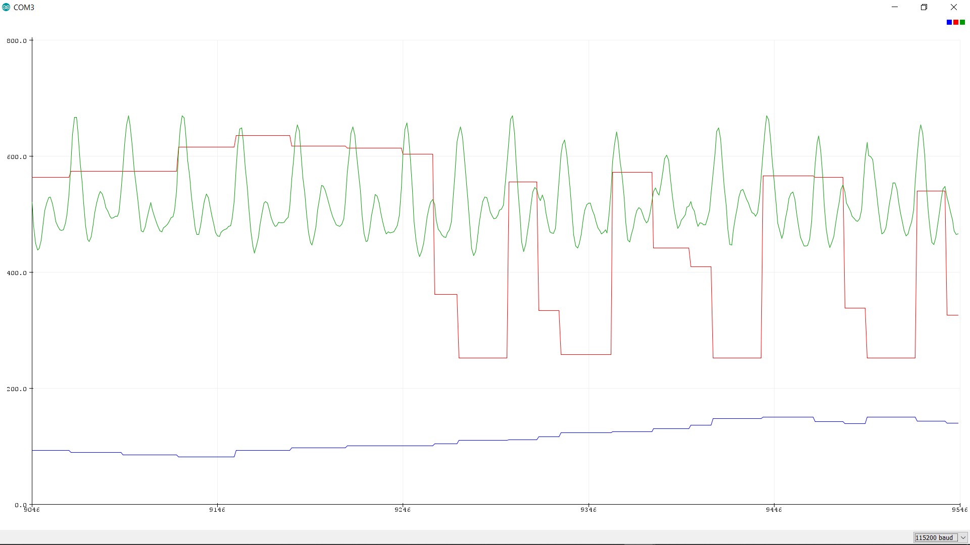
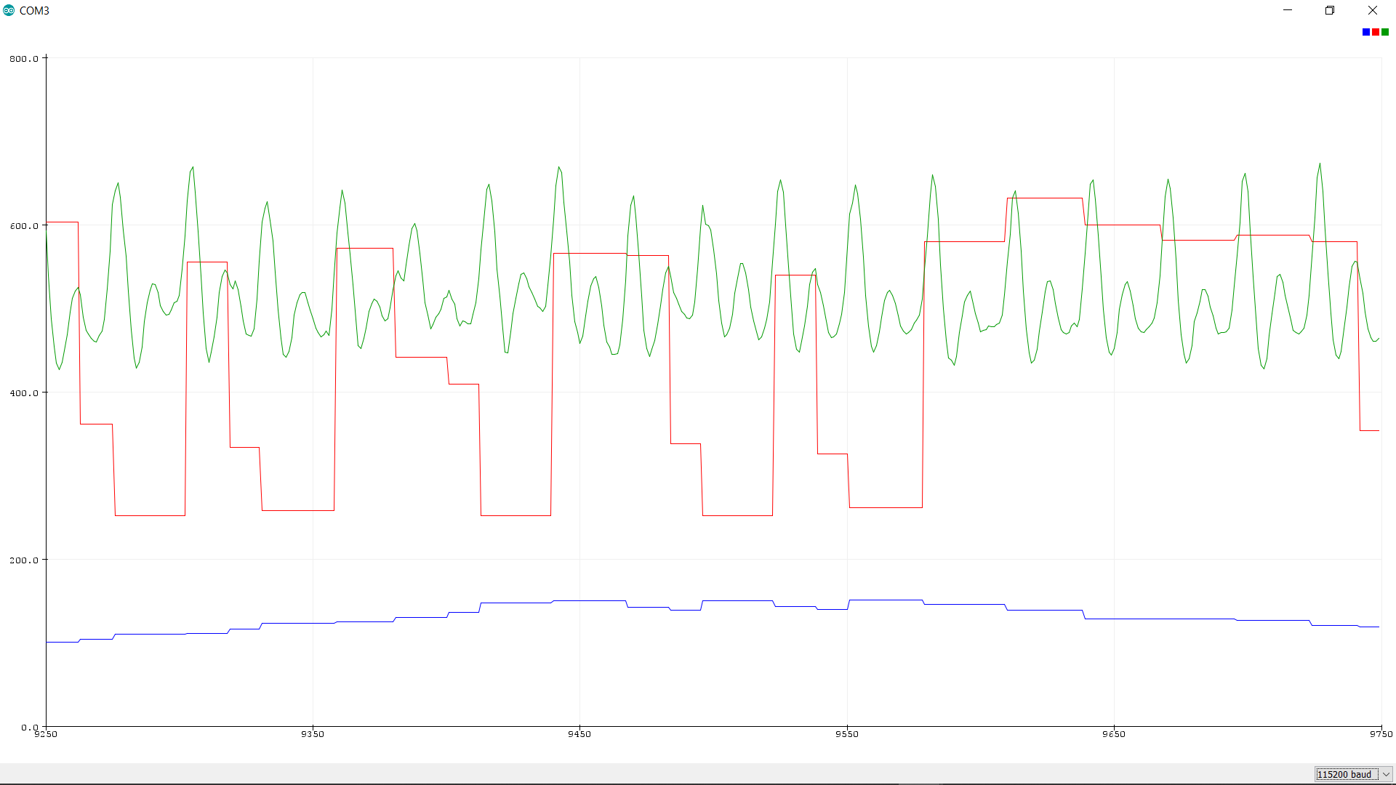
Results
Test 3
Here in both test 3 and test 4, we observe that the heartrate is extremely high, in the range of 150 – 200 bpm.
The subject was not under any stress during the testing process
So, this indicates that the sensor output is not always reliable
These erroneous results in test 4 were due to the motion that was introduced on purpose to see the effectiveness of the sensor in rejecting these artifacts
Test 4

Slide 28
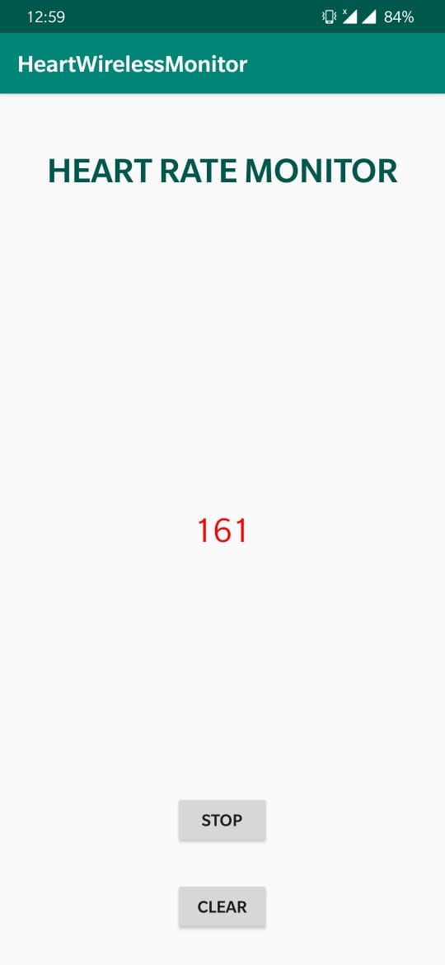
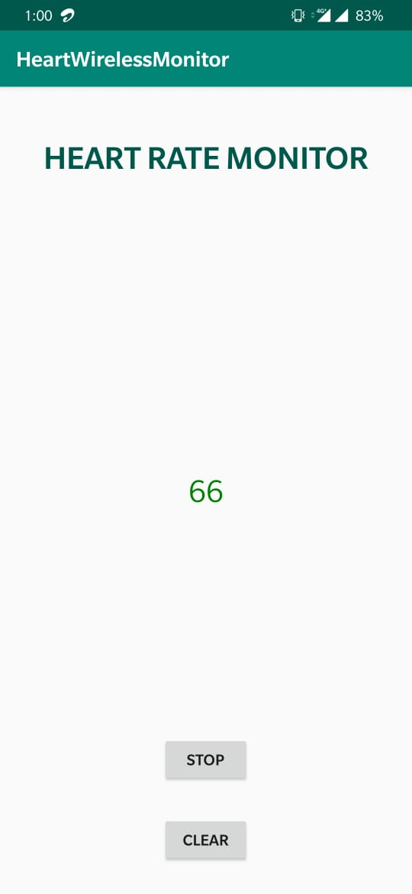
Results
These are the screenshots of the application that has been developed to receive the data
We can see that if the bpm exceeds the normal rates the number turns red to indicate that there is a problem

Slide 29
References
Nazmus Saquib, Md. Tarikul Islam Papon, Ishtiyaque Ahmad, and Ashikur Rahman Measurement of Heart Rate Using Photoplethysmography
Anatomy of The DIY Heart Rate Monitor
Photoplethysmogram
PulseSensor Hardware
PulseSensor Datasheet
Ambient Light Sensor Datasheet
Reverse mount LED Datasheet
Pulse Sensor Getting Started Guide
PulseSensorPlayground
The "GettingStartedProject“
Bluetooth Module HC-05 guide
Bluetooth Module HC-05 datasheet
Android Studio

