Slide 1
Amazon Sales Performance Analytics
Executive Business Intelligence Dashboard
Power BI | Corporate Analytics Presentation

Slide 2
Agenda
Business context and objectives
Dashboard overview
Key performance indicators
Sales trends analysis
Category and product insights
Business recommendations & conclusion

Slide 3
Business Context
Amazon operates across multiple product categories with high transaction volume
Understanding sales trends is critical for revenue optimisation
This dashboard supports management-level decision-making

Slide 4
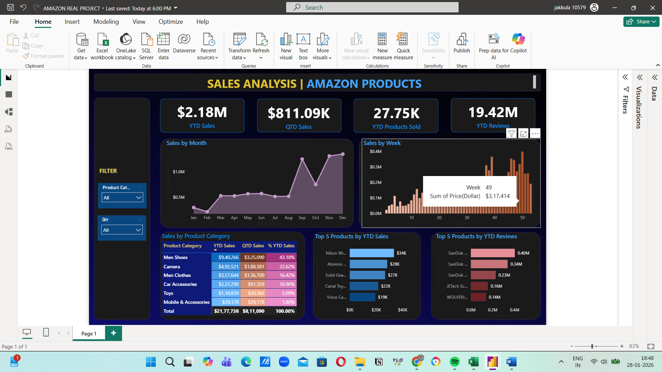
Power BI Dashboard Overview

Slide 5
Key Performance Indicators
YTD Sales – Overall revenue performance
QTD Sales – Quarterly momentum
YTD Products Sold – Demand measurement
YTD Reviews – Customer engagement indicator

Slide 6
Monthly Sales Trend Analysis
Sales increase gradually through the year
Clear seasonality observed during peak months
Indicates effectiveness of promotions and demand cycles

Slide 7
Weekly Sales Performance
Weekly data reveals short-term fluctuations
Sales spikes align with campaigns and discounts
Useful for operational and tactical decisions

Slide 8
Category Performance Insights
Few categories generate majority of revenue
Top categories act as primary revenue drivers
Lower categories show optimisation potential

Slide 9
Product-Level Insights
Top products contribute disproportionate revenue share
High-review products indicate strong customer interest
Opportunities for pricing and visibility optimisation

Slide 10
Key Business Insights
Sales performance is seasonal
Revenue concentration among top products
Customer engagement aligns with sales success
Weekly tracking enables agile response

Slide 11
Strategic Business Recommendations
Prioritise inventory for high-performing products
Plan promotions around seasonal trends
Improve conversion for highly reviewed products
Monitor weekly KPIs for rapid adjustments

Slide 12
Conclusion
Power BI dashboard delivers actionable insights
Supports strategic sales and marketing decisions
Demonstrates strong BI and analytical capability

